Slide 1
SEB CASE
Masud Pervez
2021-04-06

Slide 2
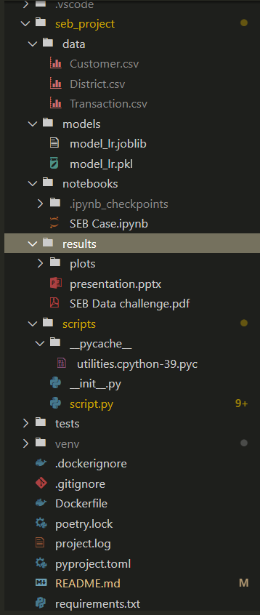
Set up environment & Structure of my project
Project structure
Create a Git Repository
Build a Project folder structure
Create a Virtual Environment
Notebooks
Poetry:
Install virtualenv
Install frameworks: python packages
source: https://python-poetry.org/
Reproduce the codes by running:
`poetry install`

Slide 3
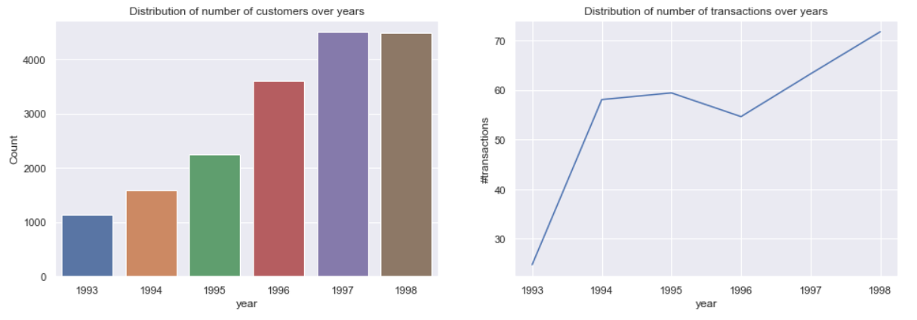
(A) Data exploration:
How many transactions did an average customer complete in the
period? (about 235 transactions)
How much did they spend? -spent 5924.15 amount/per transaction
Does it change over time?

Slide 4
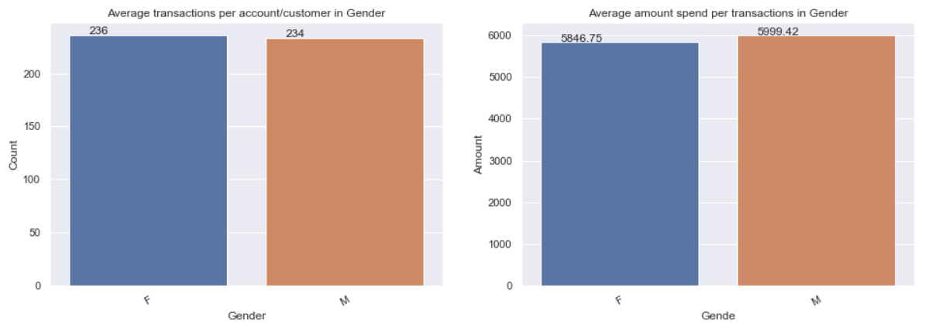
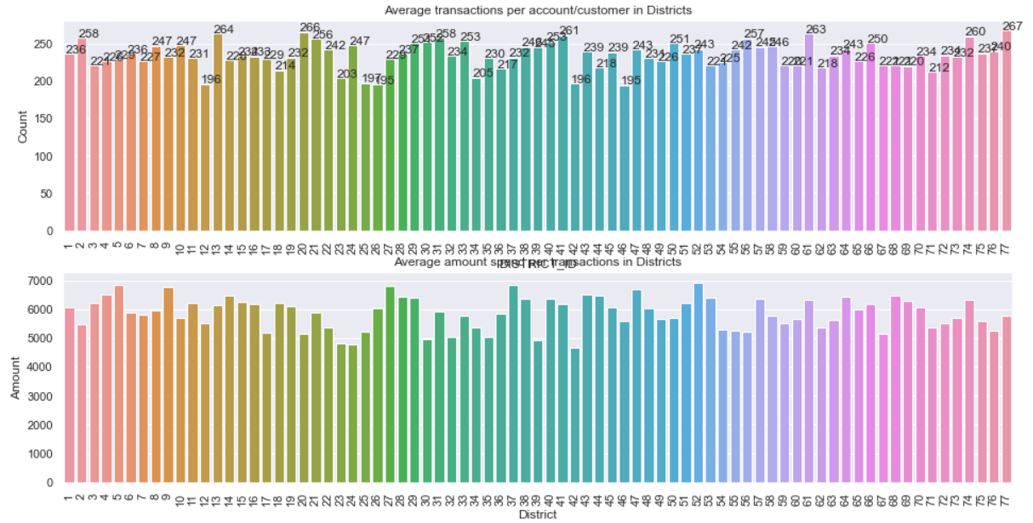
Do different customer profiles show different behavior?
Is the transaction pattern homogeneous across geographic regions?

Slide 5
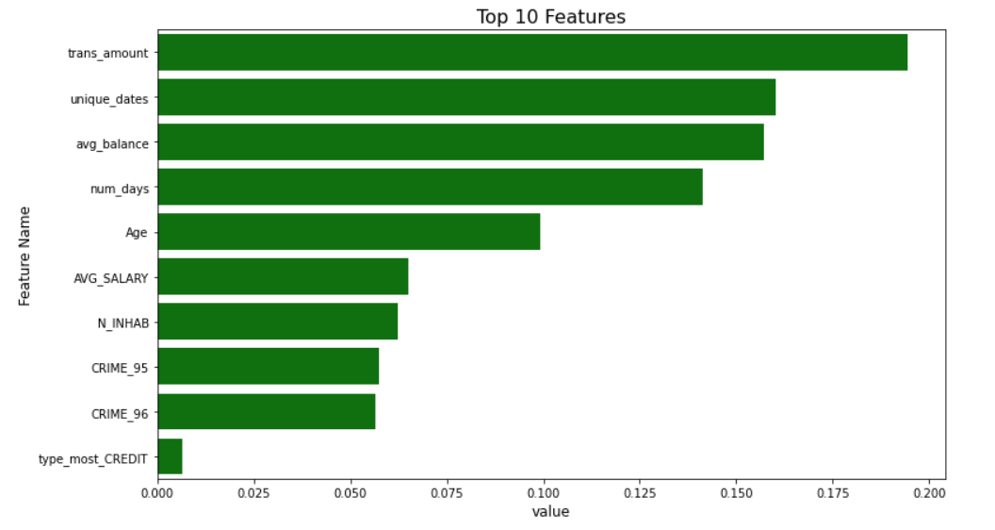
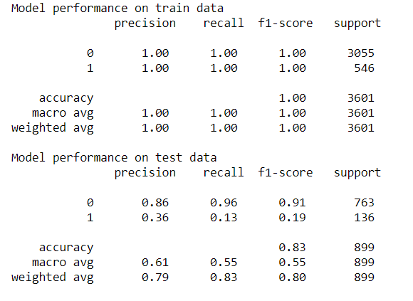
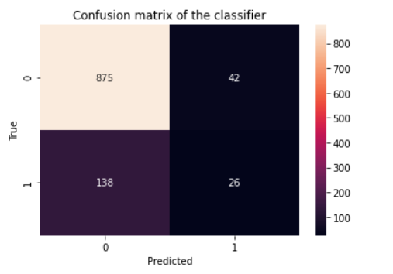
(B) Predictive model
What are the most important features in the model?
How does the model performance compare in the train and test
sets?
What would you do to improve the model if you had more time? - Apply Smote Synthetic Minority Over-sampling Technique, Bayesian Optimization algorithm, try with different algorithms, Feature engineering.

Slide 6
(C) A/B testing
How would you select which customers are in the email group or in
the mobile app group in the test?- Randomize way
How would you conclude which channel is optimal at the end of the
test? What is the minimum sample size?
z-test(proportion test): If p-value < 0.05 (at 5% level of significance), then we can conclude that the two groups are significantly differrent. Then, we then can perform a one sided test to see which group is overperfoming other.
Sample size:
n = (Zα/2+Zβ)^2 * (p1(1-p1)+p2(1-p2)) / (p1-p2)^2,
Where, Zα/2 is the critical value of the Normal distribution( Zα/2 = 1.96 for 95%),
Zβ is the critical value of the Normal distribution at β (e.g. for a power of 80%, β is 0.2 and the critical value is 0.84) and
p1 and p2 are the expected sample proportions of the two groups. (p₁=p₂=0.5)

