Slide 1
SEB CASE
Masud Pervez
2021-04-06

Slide 2
Set up your environment
Check Python installation
python -V
Check pip installation
Install virtualenv
Install frameworks

Slide 3
Poetry is a robust dependency management system and makes it easy to make Python libraries accessible in Jupyter notebooks.
Install poetry for windows
Create a project folder using: poetry new SEB_project
By default a new poetry project doesn’t any venv associated with it. To do that we use:
Poetry env use <path of the python.exe file>
Poetry manage env for projects.
-numpy, -pandas, scikit-learn, matplotlib, seaborn
poetry env info –path
Poetry install
Poetry shell
Run jupyter notebook

Slide 4
Where do I start? How do I structure my project? What do I do with project results once I’m done?
Creating a Git Repository
Building a Project folder structure
Creating a Virtual Environment
Notebooks
Module/Script Writing
Project directory (file tree) looks like this:

Slide 5
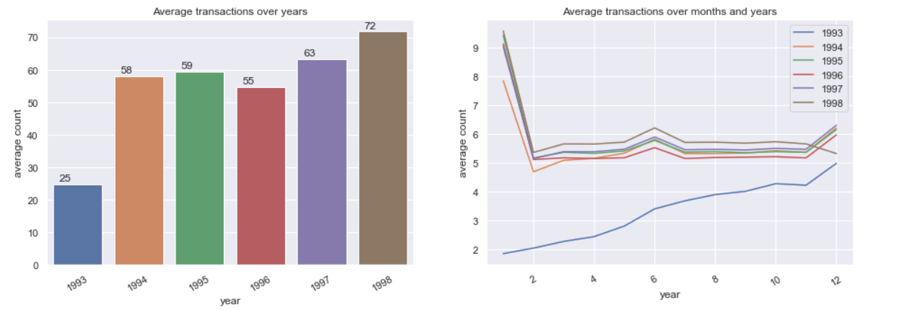
A
How many transactions did an average customer complete in the
period? (about 235 transactions)
How much did they spend? -spent 5924.15 amount/per transaction
Does it change over time?

Slide 6
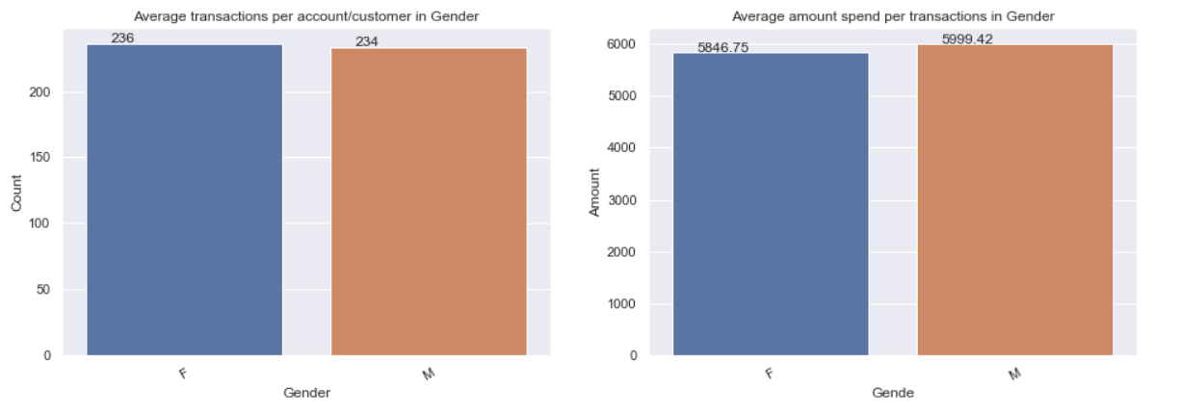
Do different customer profiles show different behavior?
Is the transaction pattern homogeneous across geographic regions?

Slide 7
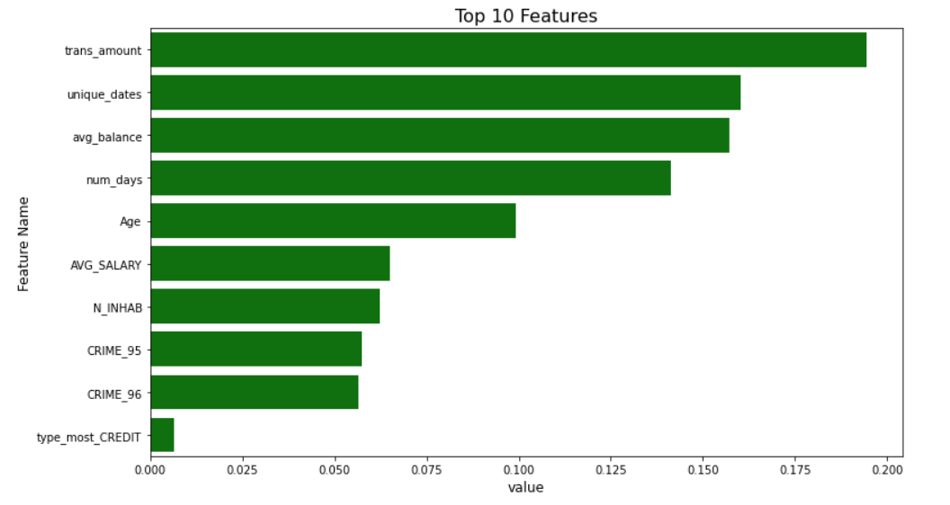
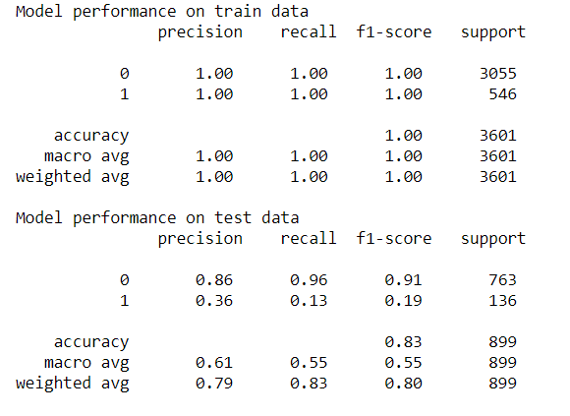
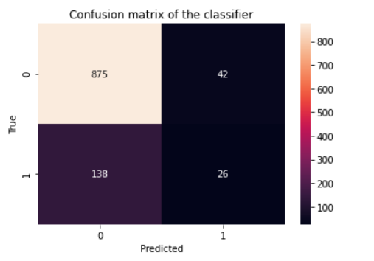
(B) Predictive model
What are the most important features in the model?
How does the model performance compare in the train and test
sets?
What would you do to improve the model if you had more time? - Apply Smote Synthetic Minority Over-sampling Technique, Bayesian Optimization algorithm, try with different algorithms, Feature engineering.

Slide 8
(C) A/B testing (optional bonus question)
How would you select which customers are in the email group or in
the mobile app group in the test?- randomly
How would you conclude which channel is optimal at the end of the
test? What is the minimum sample size?

