Slide 1

A Short Tour of Machine Learning
Michael Mathioudakis
Covve, Athens, 2017-08-02

Slide 2
today
part 1: machine-learning algorithms
basic concepts and the ML pipeline
algorithms
part 2: platforms and software
part 3: hands-on session

Slide 3
part 1: machine learning algorithms

Slide 4
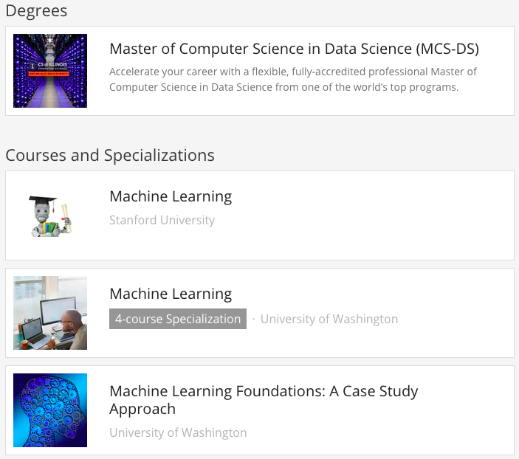
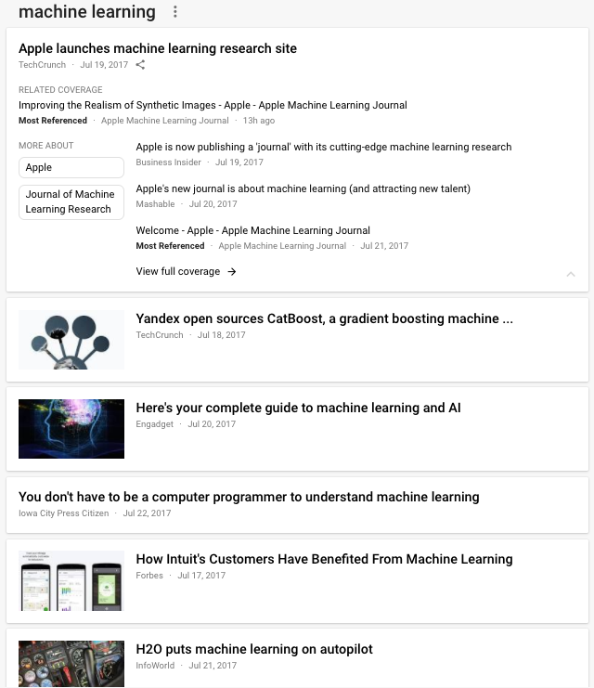
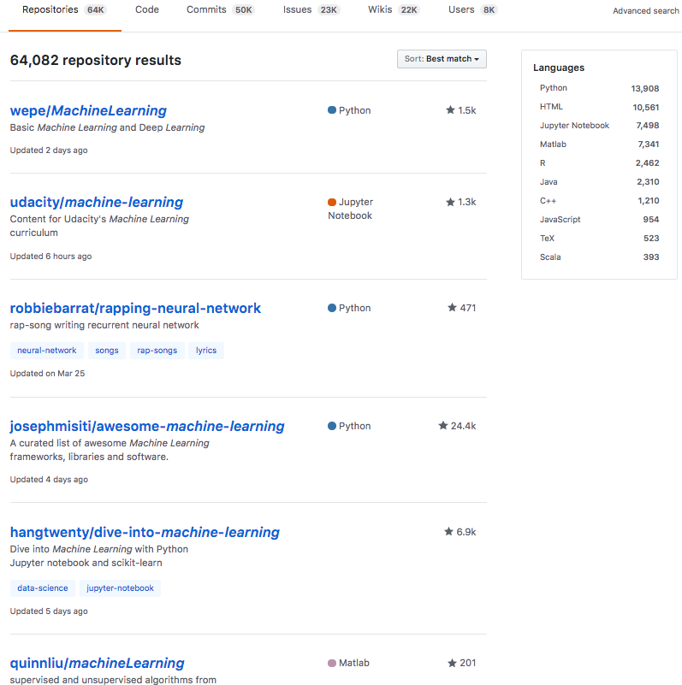
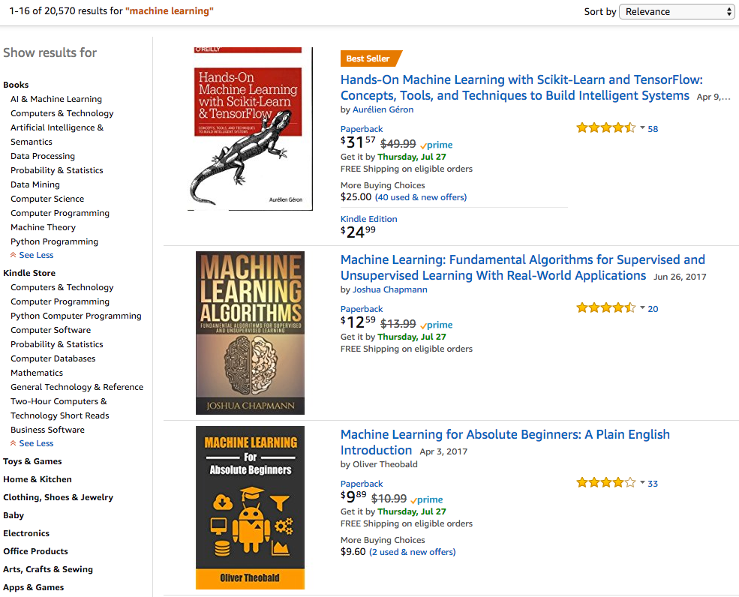
Notes:
Machine learning…
... in the news, amazon books, universities and online courses, software.

Slide 5
what is machine learning?

Slide 6
‘learning’
what do we learn?
a description of the data
a ‘model’ that tells us how the data are distributed
why?
to make predictions and decisions

Slide 7
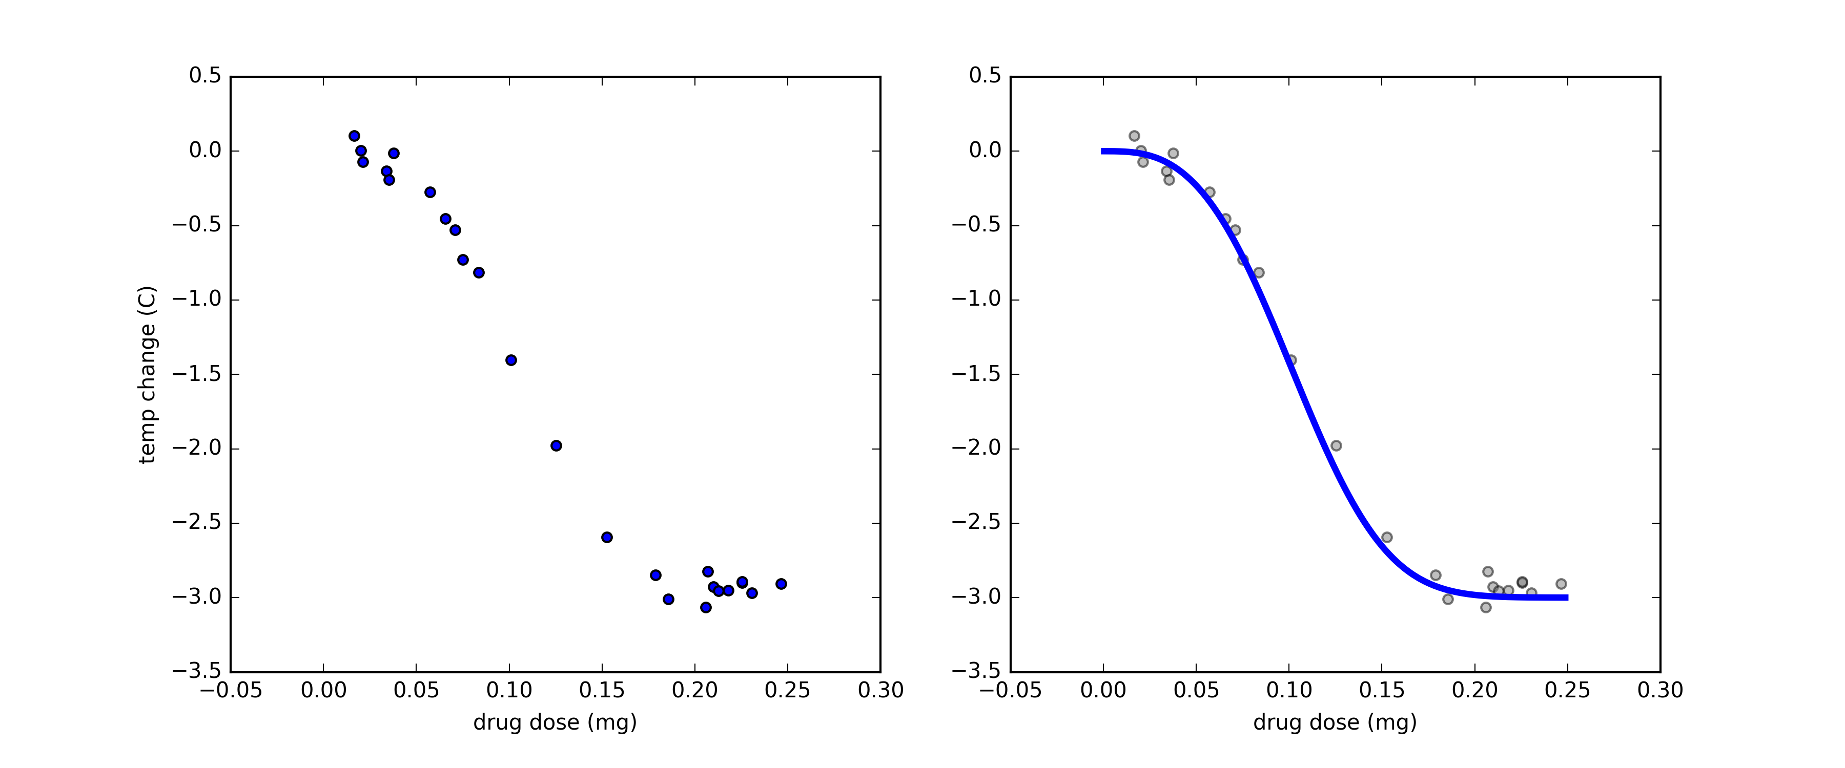
example
the patient’s temperature has just exceeded 40C
we supply a drug and observe their temperature change after 2 hours
learning
model
data
ok, we ‘learned’ - then what?
predict what happens to temperature if we supply 0.20mg?
decide minimum dose to achieve at least 2.5C temp drop?
can do with the model
without the data

Slide 8
example
classification

Slide 9
example
clustering / density estimation

Slide 10
‘machine’ learning
why do we need the machines?
for learning to be
automated
and
efficient
big data
complex models

Slide 11

example: language
task: complete the sentence
language is complex
basic rules (syntax and grammar)
do not suffice for good predictions
requires complex models
data
millions/billions of sentences/queries
user features
session attributes

Slide 12
ML pipeline
learning
inference / training / fitting
data
model
prediction
decision
model candidates
probability
how much we believe that something is true

Slide 13
outline
what is machine learning
examples of tasks: regression, classification, clustering
data, learning, prediction, decision; probability
probability
algorithms
regression
classification
clustering
wrap-up: ML pipeline
deep learning
software + hands-on session

Slide 14
probability
‘proposition’
how much we believe that something is true
GIVEN some information
VERY IMPORTANT!
0: impossible 1: certain

Slide 15
probability
intuitive explanation

Slide 16
ML pipeline
learning
data
model
prediction
decision
model candidates
probability
assign probabilities to various propositions

Slide 17
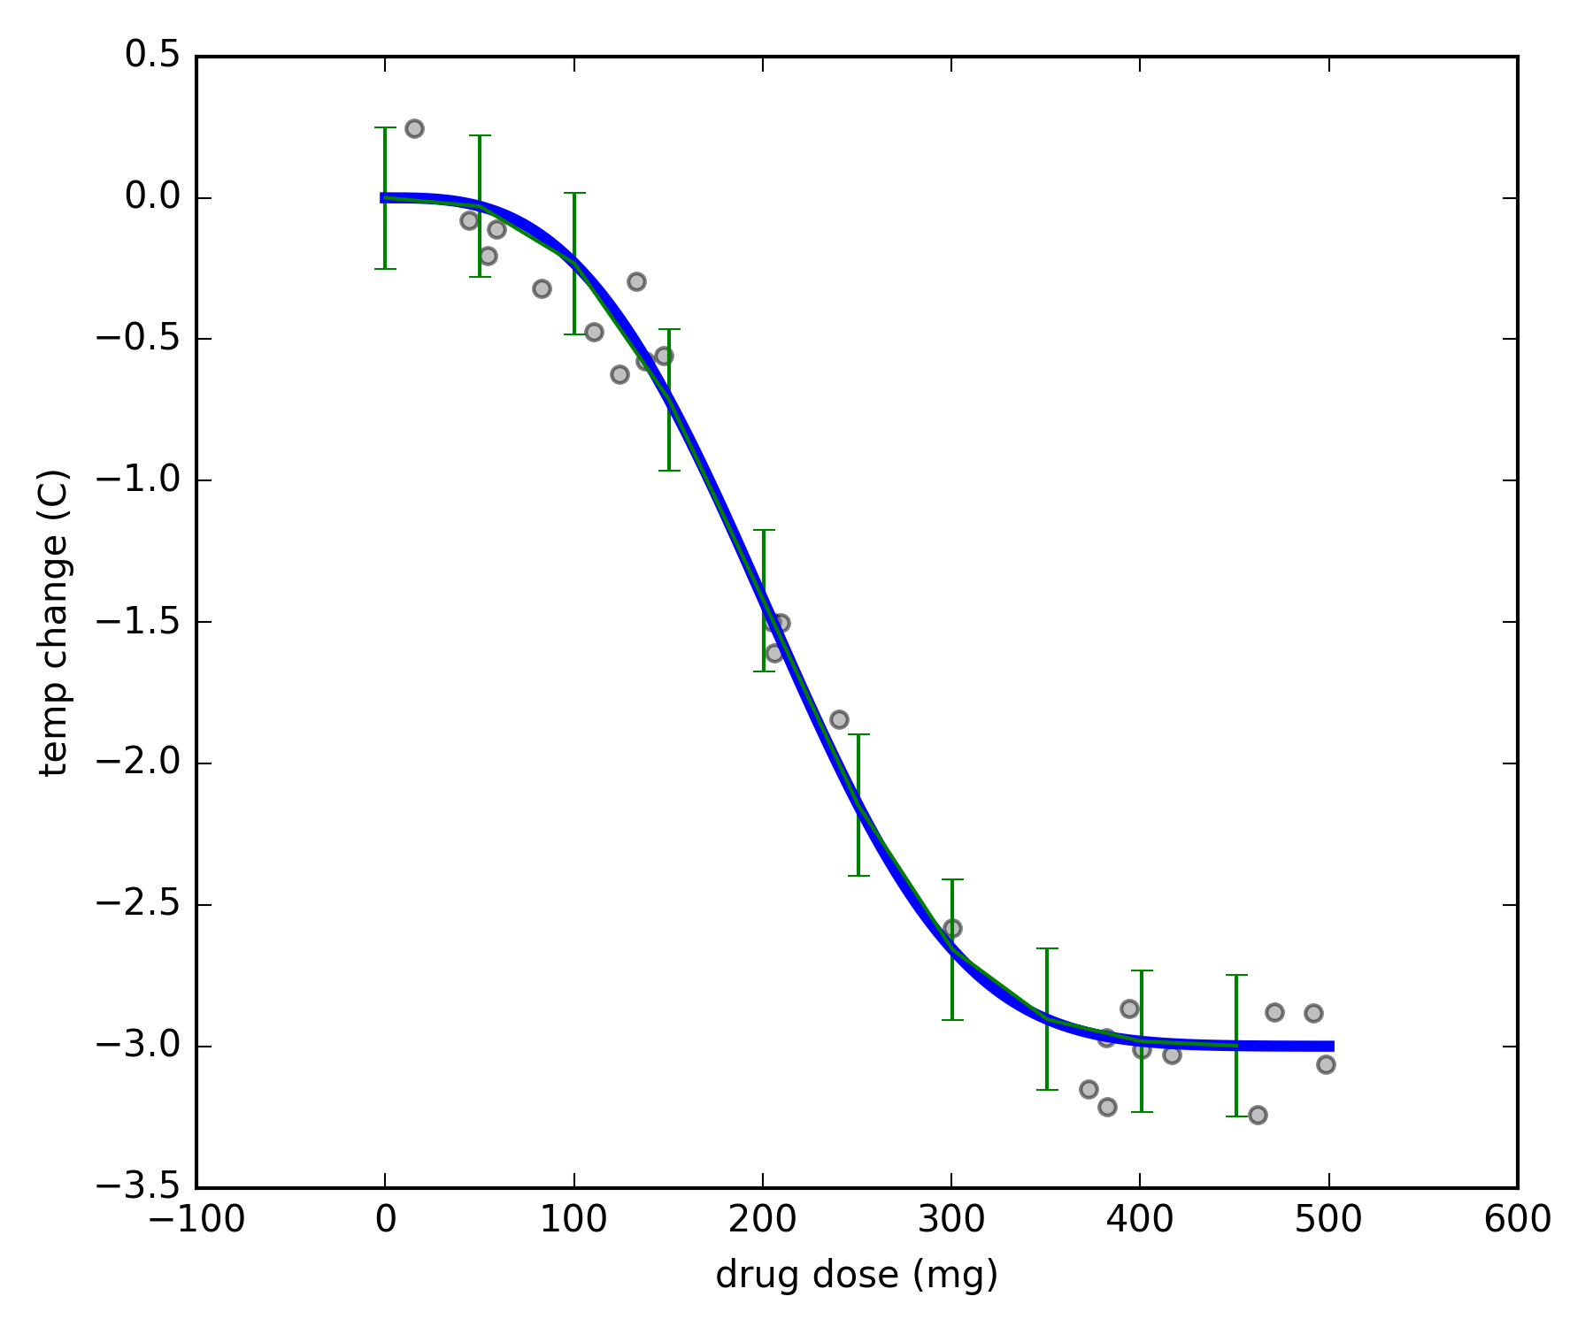
probability :: prediction
what is the probability that a dose of 300mg drops temperature more than 2C ?
probability of
temp. drop > 2C
given
dose = 300 mg and model (see figure)
proposition
P(temp. drop > 2C | dose = 300 mg ; model)
given information
the value for this probability is provided by the model!

Slide 18
ML pipeline
learning
data
model
prediction
decision
model candidates
probability
assign probabilities to various models

Slide 19
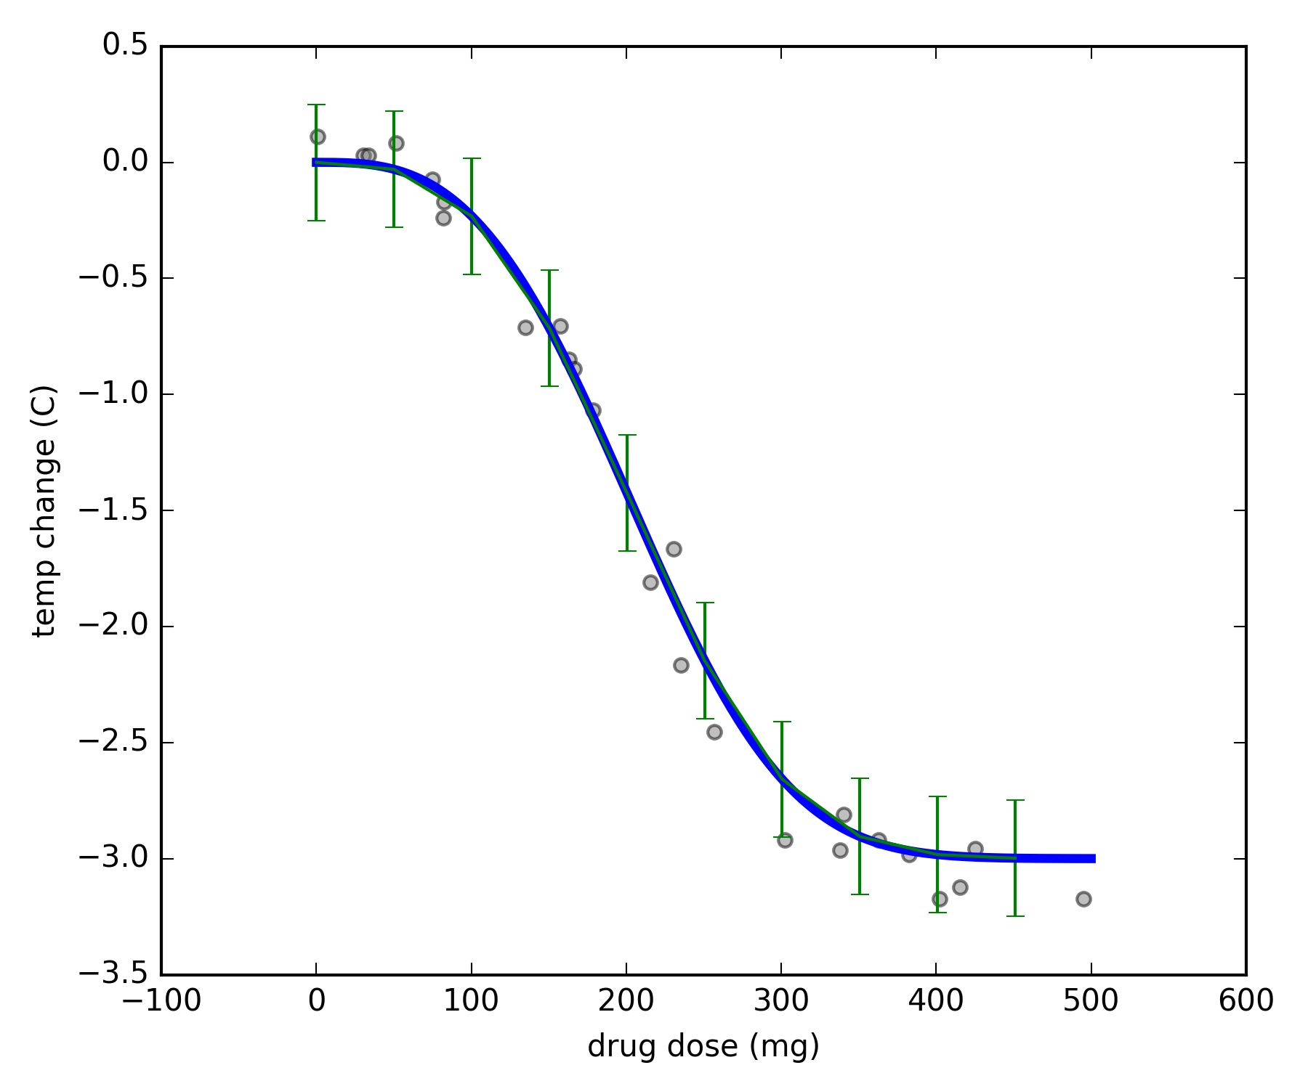
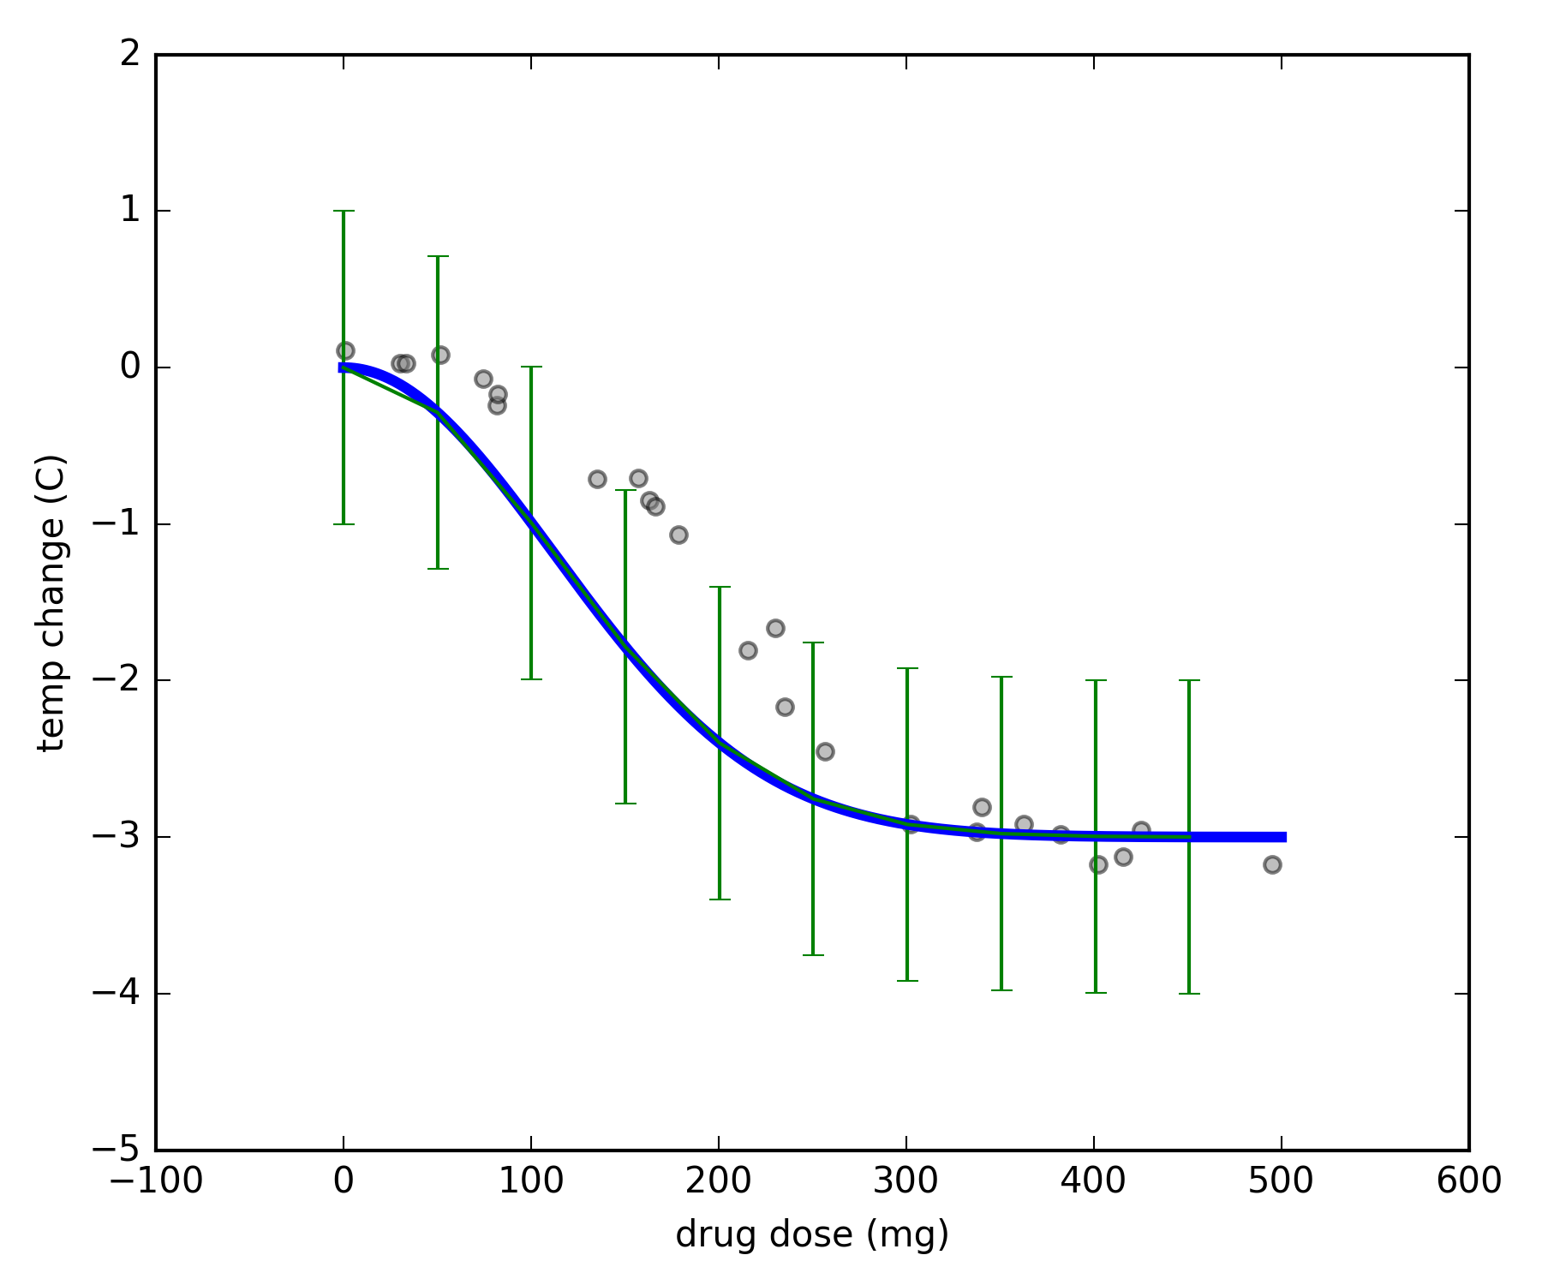
probability :: learning
consider models where temperature drops
exponentially with dose
drop : dose^{-k} and error up to ε
what is the probability that the right model is M1 / M2 / … ?
model M1
probability of
model (k, ε)
given
data
k from -5 to + 5 and ε from -2 to +2
model M2

Slide 20
probability :: learning
p ( model (k, ε) | data; k in [-5, + 5], ε in [-2, +2] )
p ( M | D ; I )
from Bayes’ Rule, this is proportional to
p(data | M ; I) x p(M | I)
model M1
likelihood
prior
we choose the model of maximum probability
(do we have to?)
model M2

Slide 21
ML pipeline
learning
data
model
prediction
decision
model candidates
probability

Slide 22
ML pipeline – the Bayesian way
learning
data
prediction
decision
model candidates
probability

Slide 23
in what follows…
learning
data
model
prediction
decision
model candidates

Slide 24
outline
what is machine learning
examples of tasks: regression, classification, clustering
data, learning, prediction, decision; probability
probability
algorithms
regression
classification
clustering
wrap-up: ML pipeline
deep learning
software + hands-on session

Slide 25
regression
build model that provides
p(Y = y | X = x; Model M)
for real-valued Y
regression methods differ in the set of model candidates
they consider
each method has corresponding algorithm(s)
to search for best model
Y
X

Slide 26
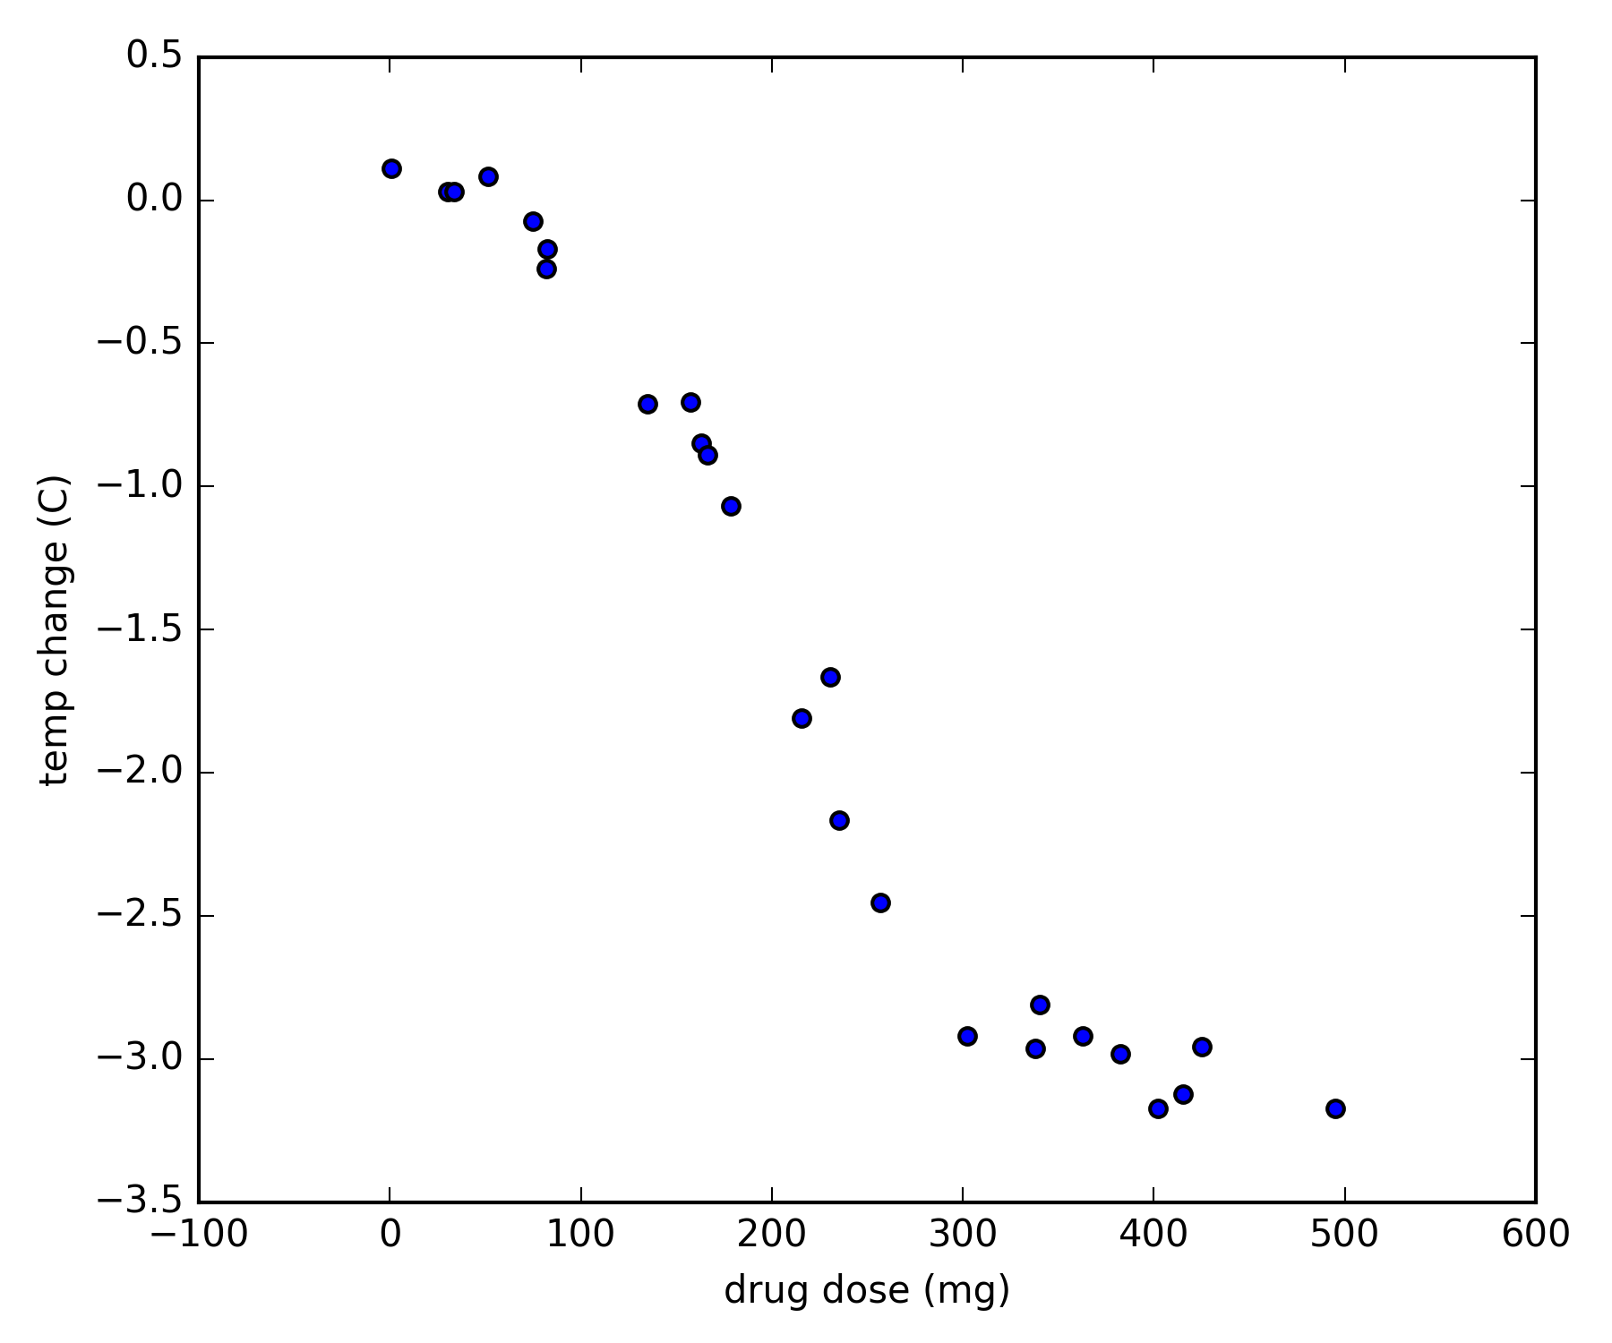
some regression methods
linear regression
line + error
segmented regression
k segments + errors
multinomial regression
curve + error
this is where methods differ
p ( M | data ; I ) ∝ p(data | M ; I) x p(M | I)
each model comes with its own

Slide 27
linear regression
(specifics)

Slide 28
regularized regression
ridge regression
lasso
the penalty expresses a prior

Slide 29
decision trees

Slide 30
random forests

Slide 31
neural networks

Slide 32
outline
what is machine learning
examples of tasks: regression, classification, clustering
data, learning, prediction, decision; probability
probability
algorithms
regression
classification
clustering
wrap-up: ML pipeline
deep learning
software + hands-on session

Slide 33
naïve-bayes
details

Slide 34
classification
build model that provides
p(Y = y | X = x; Model M)
for categorically-valued Y
classification methods differ in the set of model candidates
they consider
each method has corresponding algorithm(s)
to search for best model
Y
X

Slide 35
logistic regression

Slide 36
decision trees & random forests

Slide 37


neural networks
idea
apply a linear model on a non-linear transformation of the input

Slide 38
support-vector machines

Slide 39
outline
what is machine learning
examples of tasks: regression, classification, clustering
data, learning, prediction, decision; probability
probability
algorithms
regression
classification
clustering
wrap-up: ML pipeline
deep learning
software + hands-on session

Slide 40
supervised and unsupervised learning
the methods we saw for
regression and classification
are cases of ‘supervised’ learning
build model that provides
p(Y = y | X = x; Model M)
other data features
some data features
build model that provides
p(X = x, Y = y; Model M)
‘unsupervised’ learning

Slide 41
unsupervised learning
build model that provides
p(X = x, Y = y; Model M)
find structure in the data
Y
X

Slide 42
histogram

Slide 43
k-means clustering
(details)

Slide 44
PCA

Slide 45
outline
what is machine learning
examples of tasks: regression, classification, clustering
data, learning, prediction, decision; probability
probability
algorithms
regression
classification
clustering
wrap-up: ML pipeline
deep learning
software + hands-on session

Slide 46
deep learning
basically another name for ‘neural networks’
with many layers
and generalized structure
rebranded due to
efficiency and good results on difficult tasks
language (translation, sentence completion)
image recognition

Slide 47
recurrent neural networks

Slide 48
convolutional neural networks

Slide 49
part 2: platforms and software

Slide 50
outline
scikit-learn
apache spark
deep-learning libraries
ML on the cloud
amazon, azure, google
other products

Slide 51
scikit-learn

Slide 52
apache spark

Slide 53
deep learning :: tensorflow

Slide 54
deep learning :: torch

Slide 55
deep learning :: keras

Slide 56
cloud :: amazon
classification and regression
with logistic and linear regression
Notes:
http://docs.aws.amazon.com/machine-learning/latest/dg/types-of-ml-models.html

Slide 57

cloud :: google
Cloud ML Engine
basically offers the ML pipeline
with Deep Learning models
as implemented in Tensorflow
other services offer already trained models for other applications
speech, video or image tagging, translation
https://cloud.google.com/products/machine-learning/
pricing: about 0.5$ per hour
Notes:
https://cloud.google.com/ml-engine/
https://research.googleblog.com/2016/06/wide-deep-learning-better-together-with.html
https://cloud.google.com/speech/

Slide 58
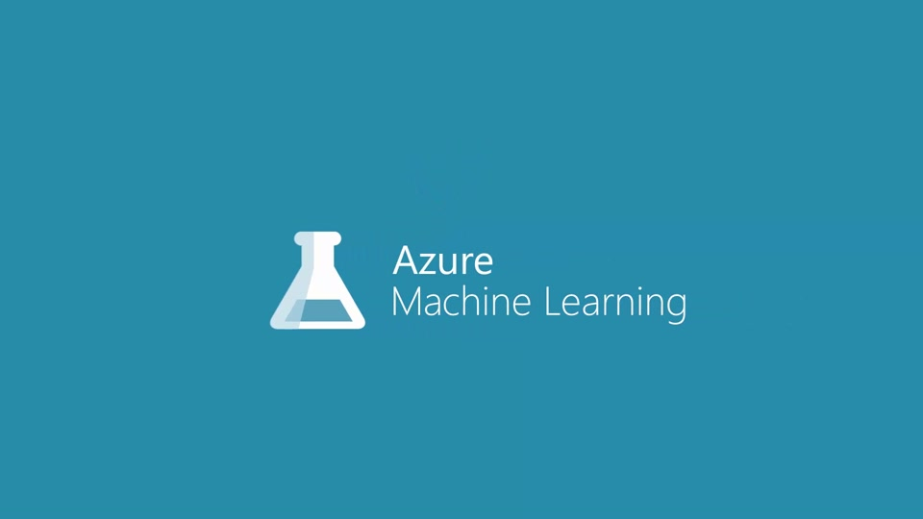
cloud :: azure
azure machine learning
cortana intelligence
Notes:
https://azure.microsoft.com/en-us/services/machine-learning/
https://docs.microsoft.com/en-us/azure/machine-learning/machine-learning-what-is-machine-learning

Slide 59
other

Slide 60
part 3: hands-on session

Slide 61
outline
simple examples with scikit-learn
image recognition with scikit-learn
tensorflow example

Slide 62
scikit-learn

Slide 63
the end… not!

