Slide 1
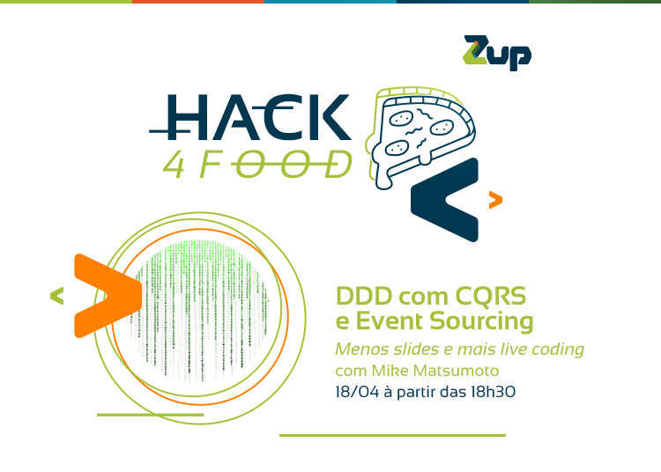

Slide 2
Agenda
DDD
Event / Event Sourcing
CQRS
Framework Axon 3.0.4

Slide 3
Domain Driven Design
Warning - Dogma Driven Design
Dogma is an established belief or doctrine of a religion, ideology or any type of organization, considered a fundamental and indisputable point of a belief.

Slide 4
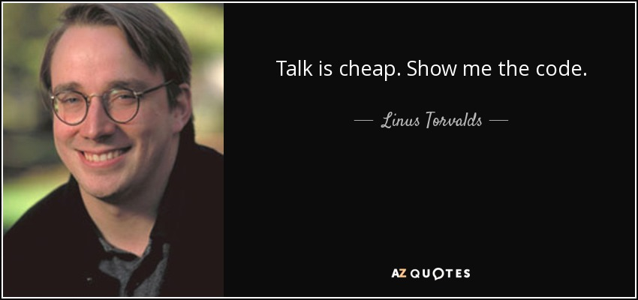
Domain Driven Design
Why DDD?

Slide 5
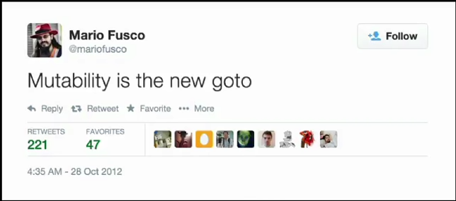
Domain Driven Design
Mutability EVERYWHERE!!!

Slide 6
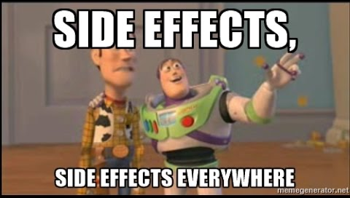
Domain Driven Design
No Type Save – Primite Obsession
Strings, Integers, Floats and more Strings
Invalids Objects / Wrong meaning

Slide 7
Domain Driven Design
Anemic Domain Model
...is the use of a software domain model where the domain objects contain little or no business logic (validations, calculations, business rules etc.).
getters / setters / builders

Slide 8
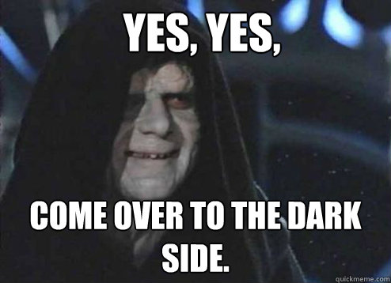
Domain Driven Design
Anemic Domain Model leads to ...
where Services and Commands Layers are OVER ABUSED!!!

Slide 9
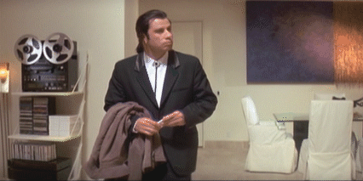
Domain Driven Design
Where‘s the OO?

Slide 10
Domain Driven Design
How did we get here?
Bad Frameworks and Technology
J2EE, EJB
Frameworks Javabeans
IDEs
Your best Seniors are focused on fix Technology problems and limitations.

Slide 11
Domain Driven Design
DDD Concepts:
No technology envolved
Ubiquitous Language
Express your Domain business actions in your code
avoid: save(…), update(…), execute(…)

Slide 12
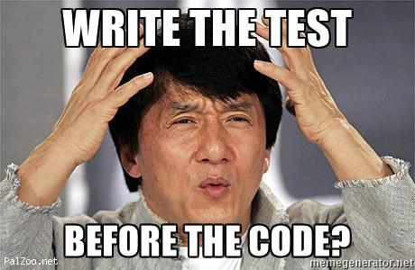
Domain Driven Design
DDD Concepts:
Focus on DOMAIN, not on Services
Come back to OO
Tests

Slide 13
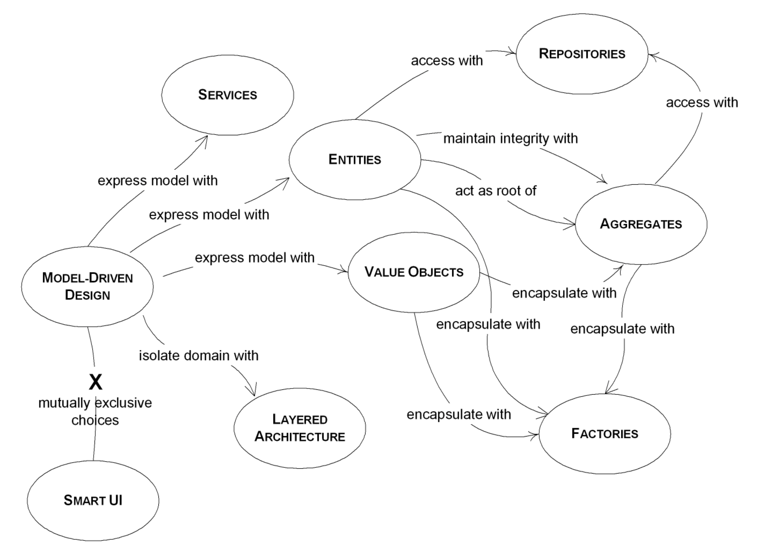
Domain Driven Design – by Eric Evans 2005

Slide 14
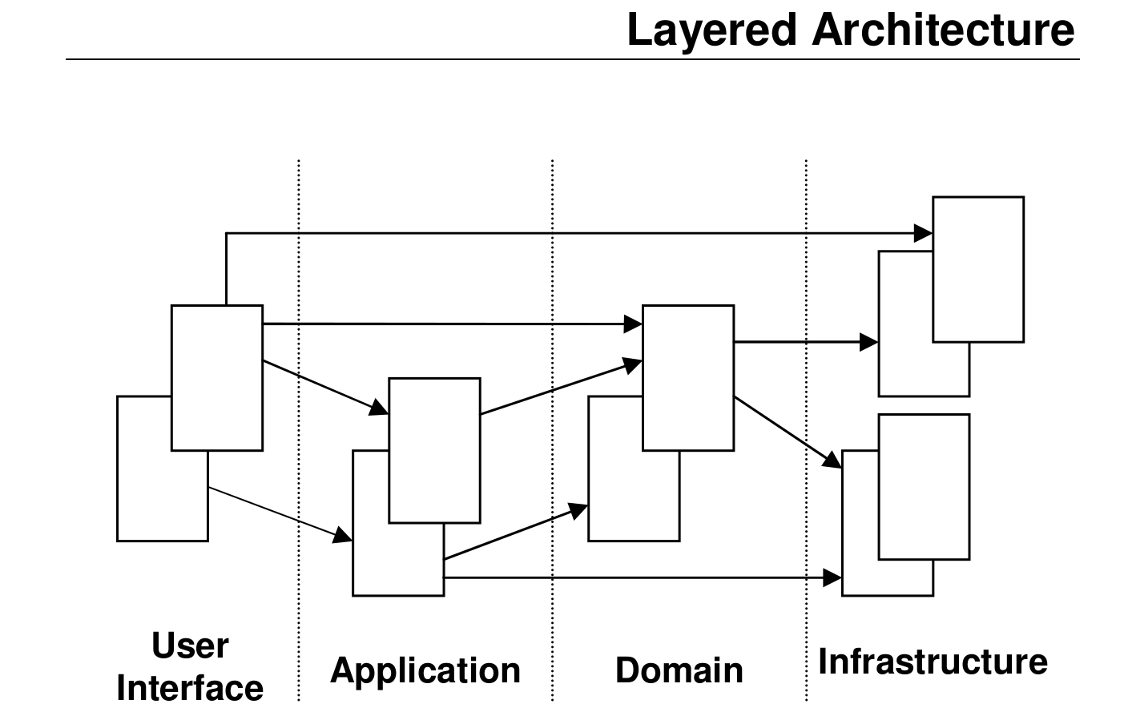
Domain Driven Design – by Eric Evans 2005

Slide 15
Domain Driven Design
Entity
If objects have different attribute values but same identity value they are equals
Mutable, Persistent ¨somehow¨
EqualsHashCode: Identifier

Slide 16
Domain Driven Design
Value Objects
Value Objects should represent concepts in your Ubiquitous Language, and a domain expert should be able to recognize it
Immutable
EqualsHashCode: ALL Attributes
Not just getters/setters. They can and probably will have business logic

Slide 17
Domain Driven Design
Aggregates and Aggregate Root
Aggregates draw a boundary around one or more Entities
is a cluster of domain objects that can be treated as a single unit
Any references from outside the aggregate should only go to the Aggregate Root
More than one Aggregate for the same Model

Slide 18
Domain Driven Design
Services
A Service should not replace the operation which normally belongs on domain objects
The operation performed refers to a domain concept which does not naturally belong to an Entity or Value Object
The operation performed refers to other objects in the domain
The operation is stateless
Application Service and Domain Service

Slide 19
Domain Driven Design
Repository
All data access must be performed though a Repository
Interfaces - aggregates only knows the Interface
Factories
helps encapsulate the process of complex object creation
GOF – Design Patterns – Abstract Factory e Factory Method

Slide 20
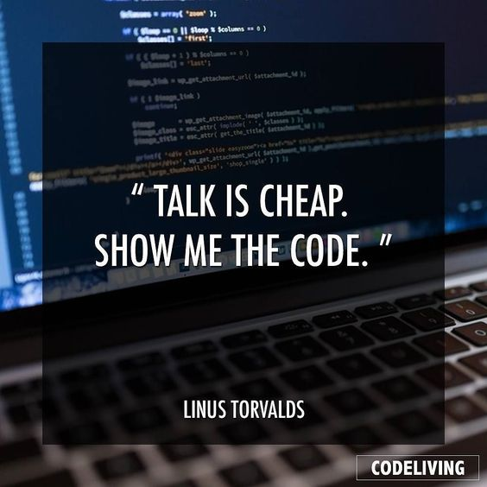
Domain Driven Design

Slide 21
Aggregates and Events
Monolithic Applications
Begin Transaction
aggregate1.doSomething1()
aggregate2.doSomething2()
aggregate3.doSomething3()
Commit/Rollback Transaction

Slide 22
Aggregates and Events
Aggregates concept creates clear boundaries
Loosely connected – Identifier only, not Object Reference
Modularity / Microservices
Order Service
Customer Service
Order
Customer
Product Service
Address
OrderLine
Item
Product

Slide 23
Aggregates and Events
One Command by Aggregate – keep the boundaries
CreateOrderCommand
AddItemCommand
CancelOrderCommand
Order Service
Order
Address
OrderLine
Item

Slide 24
Aggregates and Events
Event-driven architecture
Events are Immutable
Events stream is just a LeftFold concept in Functional Programming
CreateOrderCommand
Message Bus
OrderCreatedEvent
Order Service
Order
Stock Service
ProductReservedEvent
Product
OR
Address
OrderLine
Item
ReserveFailedEvent

Slide 25
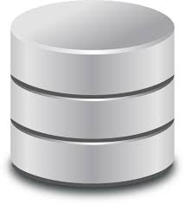
Event Sourcing
Event Sourcing is an architectural pattern in which the state of the application is being determined by a sequence of events
Event Store
Aggregate
APPLY
CreateCustomerCommand
1 - CreateCustomerEvent
HANDLER
Customer Service
DISPATCH
2 - UpdateCustomerAddressEvent
CustomerAddressUpdateCommand
3 - UpdateCustomerContactEvent
Other Service
CustomerContactUpdateCommand

Slide 26
Event Sourcing
Event Store
Audit Log / Immutable
Replays
New queries from the begin
Sagas
Event Snapshots
Storage cost?
AXON FRAMEWORK
Event Store
Aggregate
APPLY
CreateCustomerCommand
DISPATCH
1 - CreateCustomerEvent
HANDLER
2 - UpdateCustomerAddressEvent
Customer Service
CustomerAddressUpdateCommand
3 - UpdateCustomerContactEvent
CustomerContactUpdateCommand

Slide 27
CQRS - Command Query Responsibility Segregation
It's a pattern that I first heard described by Greg Young. At its heart is the notion that you can use a different model to update information than the model you use to read information. For some situations, this separation can be valuable, but beware that for most systems CQRS adds risky complexity.
Martin Fowler – 14 July 2011

Slide 28
CQRS - Command Query Responsibility Segregation
Can exist without Event Sourcing
CQRS is a Pattern and not a entire architecture
A method should either change state of an object, or return a result, but not both.
Commands: Change the state of a system but do not return a value
Queries: Return a result and do not change the observable state of the system (are free of side effects)

Slide 29
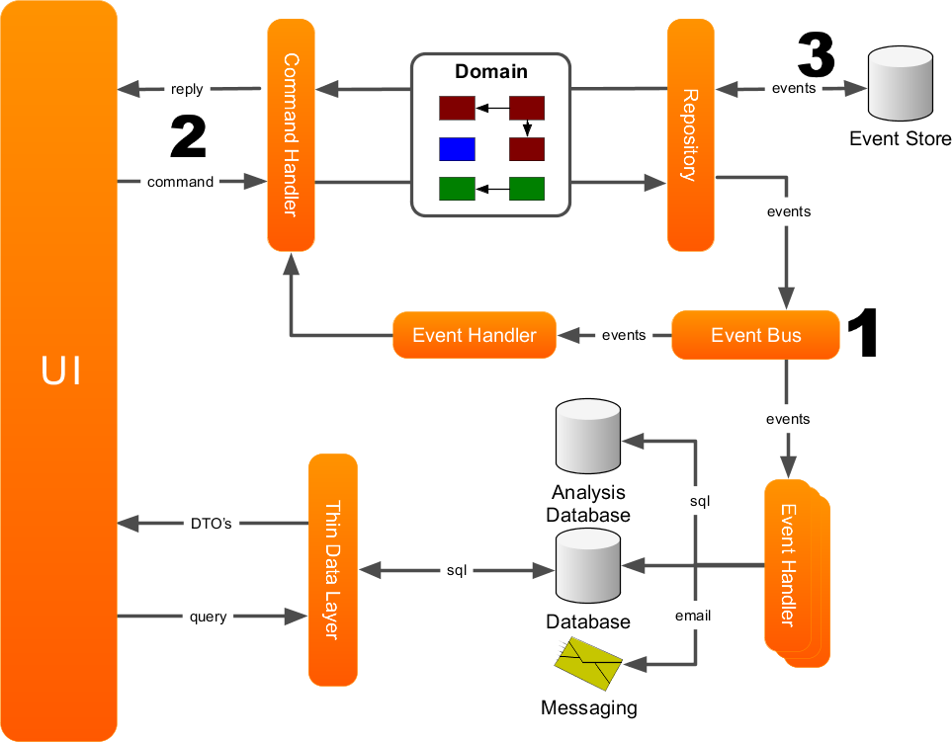
CQRS - Command Query Responsibility Segregation

Slide 30

CQRS - Axon, Springboot demo

