Slide 1

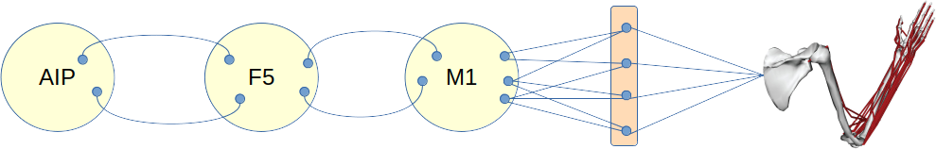
Review – the Michaels “modular RNN” model

Slide 2
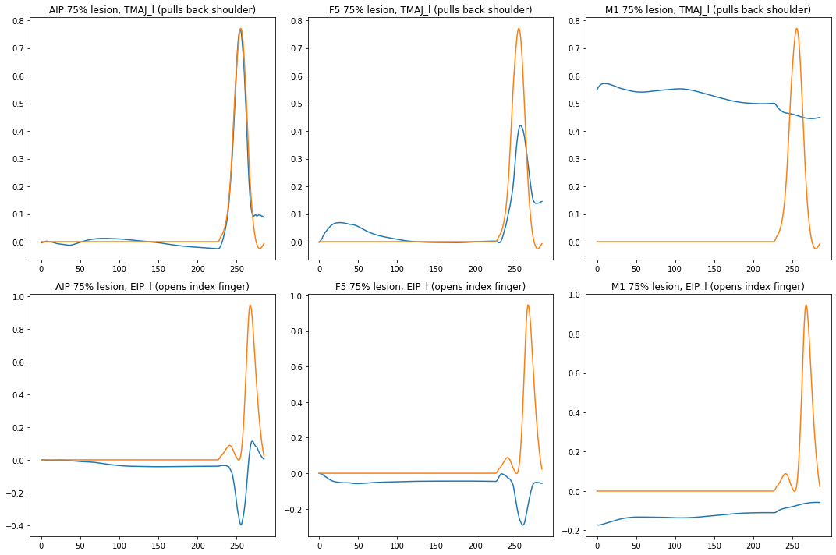
Effect of a lesion

Slide 3
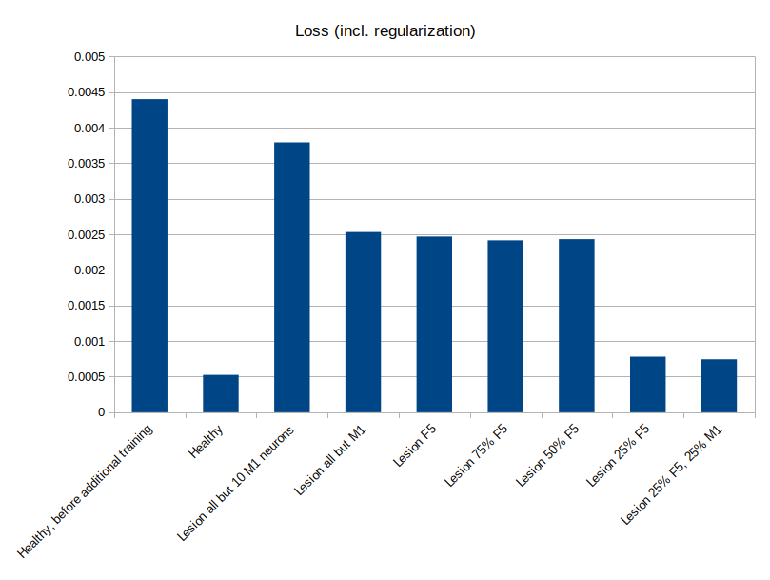
Simulating recovery before adding coproc?
Goal: simulate recovery after lesion
Co-processor will improve from there
Challenge: how do we train it?
  Learned solutions will be very different than original, unless care is taken
  Is this due to HFO vs. Adam? Stopping condition?
  Do we care?

Slide 4
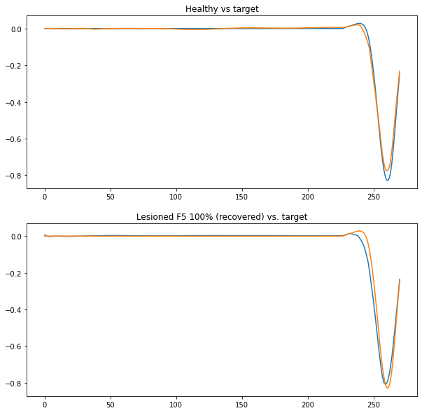
Simulating recovery?
Goal: simulate recovery after lesion
Co-processor will improve from there
Challenge: how do we train it?
  Learned solutions will be very different than original, unless care is taken
  Is this due to HFO vs. Adam? Stopping condition?
  Do we care?

Slide 5
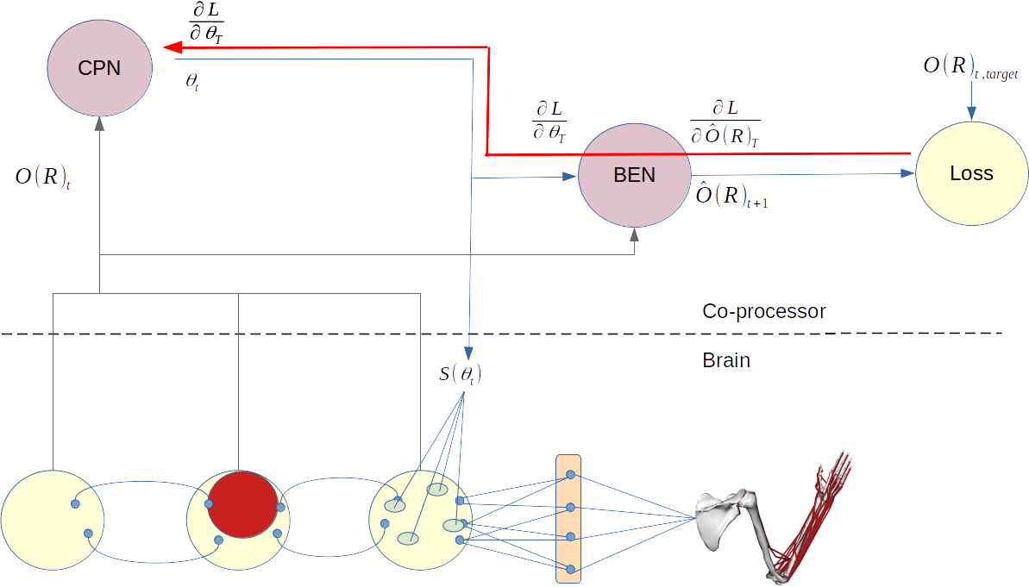
Driving towards target brain activity

Slide 6
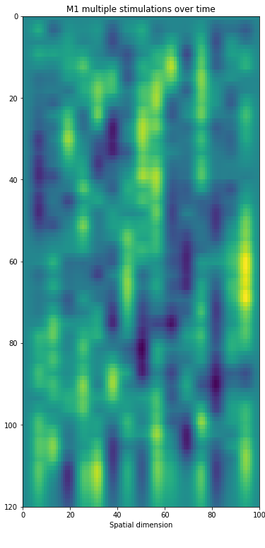
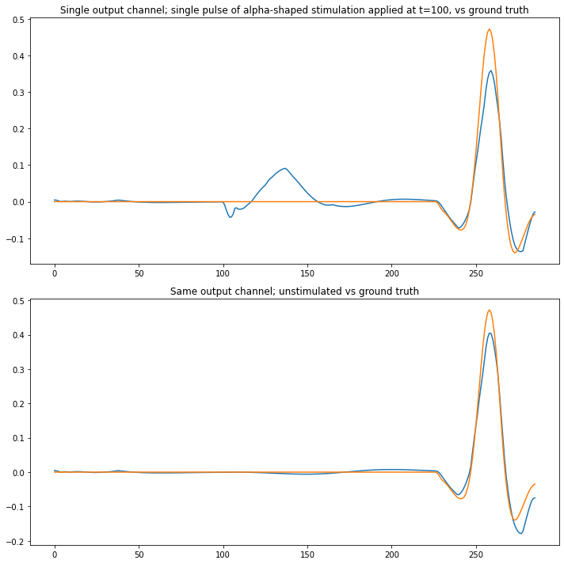
Stimulation function

Slide 7
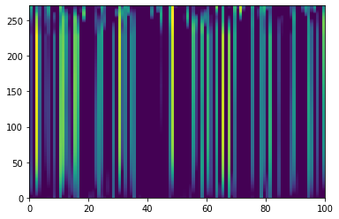
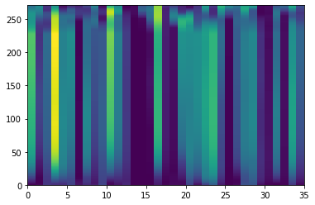
Observation function
Represents our inability to observe every neuron directly
Co-proc must operate on incomplete information
Examples: observe a subset of neurons, average “nearby” neurons
M1 activity
M1 activity, spatial (Gaussian) convolution

Slide 8
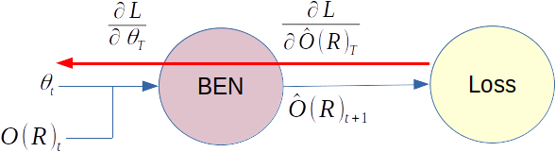
Brain emulator network (BEN)
A stimulation and brain dynamics model
  Similar in structure to Yang/Shanechi et al.
Trained independently, on random stimulations
Loss is backpropagated through BEN to train co-proc:
  Prediction loss – ignored; so BEN needs to generalize well and be low error at this point.
  Stimulation loss – trains co-proc

Slide 9
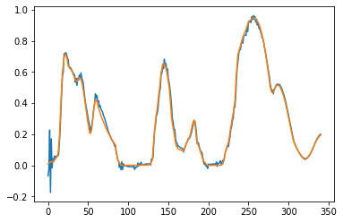
Brain emulator network (BEN)
A stimulation and brain dynamics model
  Similar in structure to Yang/Shanechi et al.
Trained independently, on random stimulations
Loss is backpropagated through BEN to train co-proc:
  Prediction loss – ignored; so BEN needs to generalize well and be low error at this point.
  Stimulation loss – trains co-proc

