Slide 1
IMPROVING RESTAURANTS BUSINESS - REVIEW ANALYSIS
By- Meghna Srivastav
Monica Mavoori
Niharika Salady
Shivpriya Tamboskar

Slide 2
BRIEF INTRODUCTION
PROBLEM:
It is becoming increasingly difficult to handle the large number of opinions posted on review platforms.
SOLUTION:
Provide this information in a useful way to business owners.
USE:
To understand in-detail customers perspective about their service.
Gives a better insight towards what customers expect, thus improve accordingly.

Slide 3
FACTORS CONSIDERED
Topic Distribution of
All Reviews irrelevant of its ratings
Reviews with 1-Star Ratings
Reviews with 5-Star Ratings
Reviews of top 1000 Users (users with more fans count)
Location where there are 5-Star Ratings Restaurants
There are considered to be locations popular locations to where people generally hangout
Check-in Timings
What are the popular timings where people visit a restaurant and prefer to write a review

Slide 4
IMPLEMENTATION
Topic Modelling Algorithm
Used Latent Dirichlet Allocation – Probabilistic Model
Python Packages:
NLTK
Genism
NumPy
Necessary Pre-Processing of Data is done.

Slide 5
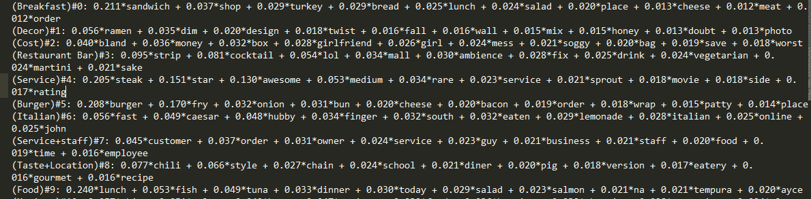
OUTCOME

Slide 6
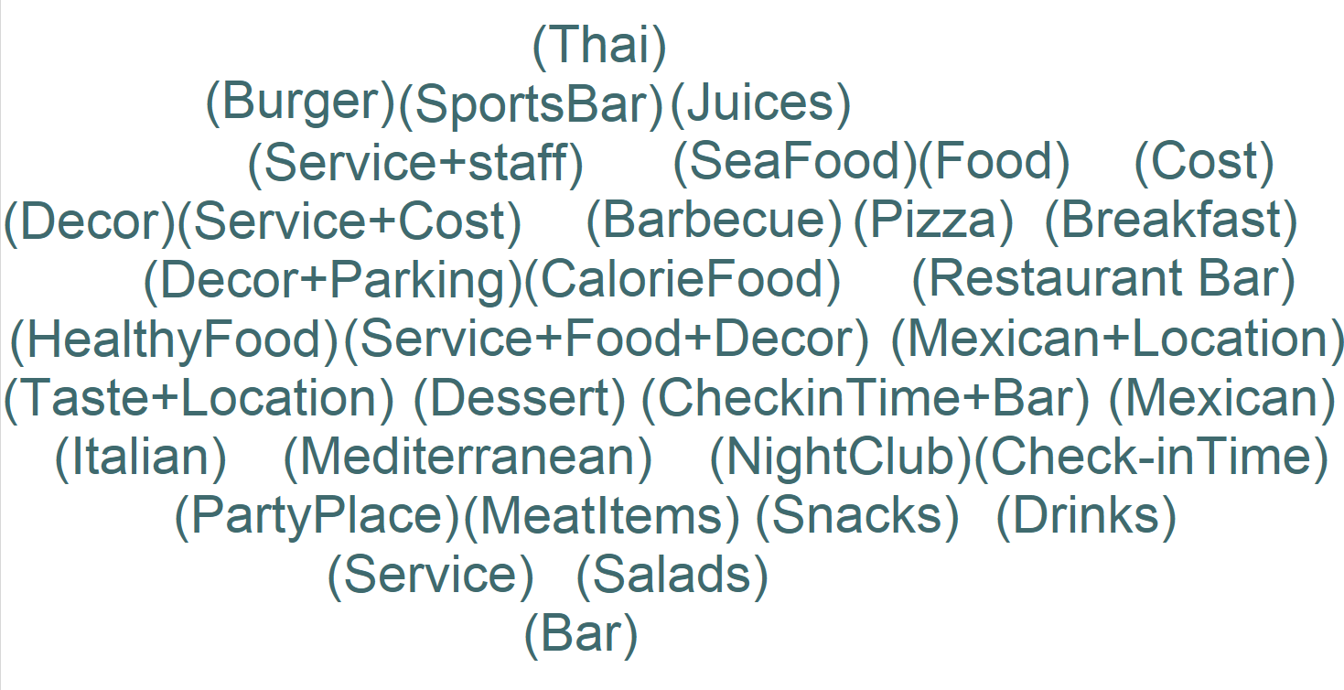
TOPIC DISTRIBUTION OF ALL REVIEWS

Slide 7
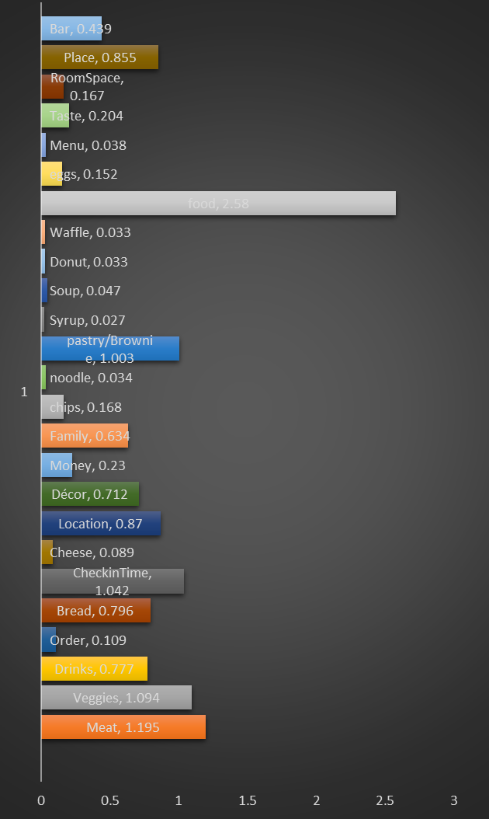

Slide 8
ANALYSIS OF EXAMPLE REVIEW
I have never been to this place but I am pretty sure this is aweful. Botto.. What kind of name is that.. badd... Bistro.. who calls their restaurant Bistro? Sounds like a big ball or water or authentic Italian..? what a farse. I am disappointed they do not seve kungPo chicken or chicken vindaloo.. How can they miss those? Also... no sushi.. Califinia's own food? Shame on them. I have never seen their waiters but pretty sure they are bad. I ask for food and they never bring it and will laugh at me., Ohh also they hate colored folks.. Altogether, never ever been to this restaurant because it sucks in Yelp reviews!
[(7, 0.173979336376367435), (8, 0.09344804518265865), (16, 0.22013217061090186), (14, 0.05372209472083155), (24, 0.01535985308065378), (31, 0.334829314265223476), (33, 0.046977300077683241), (34, 0.094438343698184689)]

Slide 9
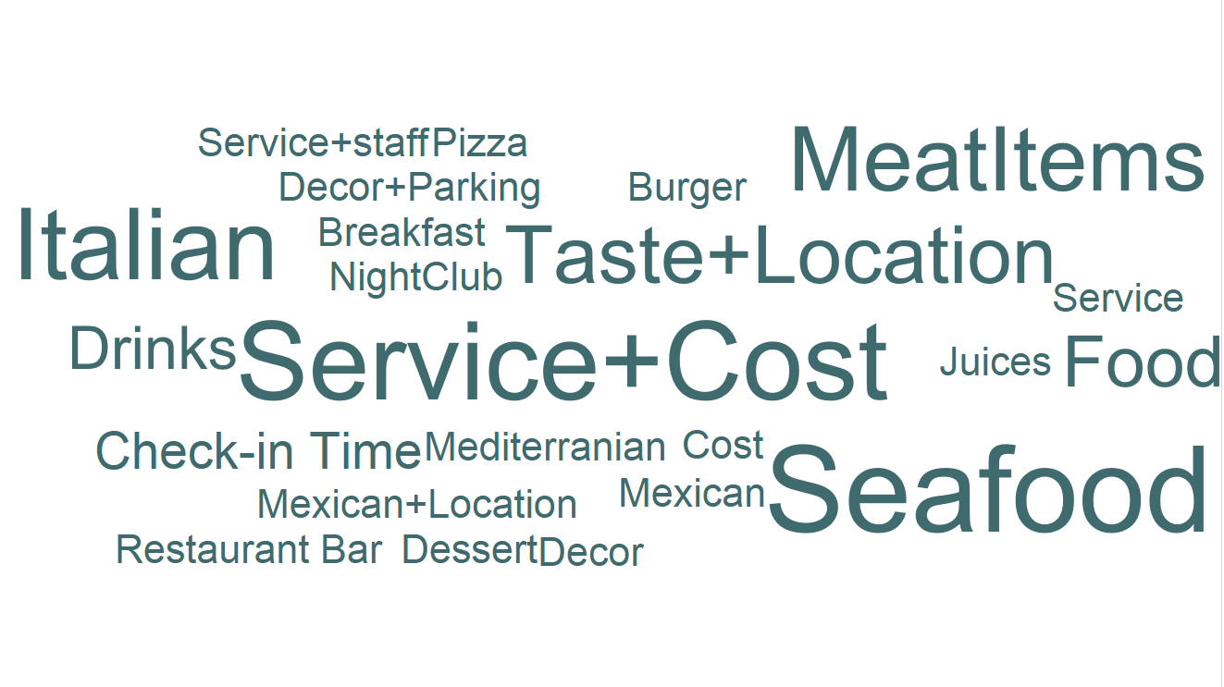
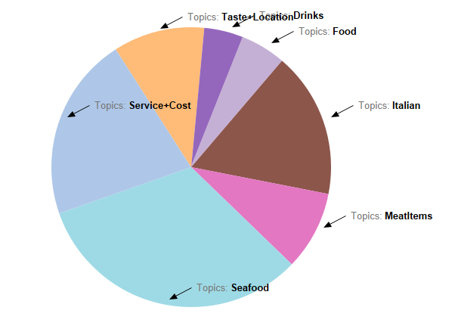
TOPIC DISTRIBUTION OF EXAMPLE REVIEW

Slide 10
DATA ANALYSIS
TOPIC DISTRIBUTION
Reviews with 1-Star Ratings
Reviews with 5-Star Ratings
Reviews of Users with more fans count.
Notes:
Now, I will explain about the major categories in the reviews that we have focussed on and applied our topic distribution model.

Slide 11
Notes:
Food, staff

Slide 13
COMPARING TOPICS
Topic Distribution of 1-Star Rating Reviews
Topic Distribution of 5-Star Rating Reviews
Food – No more varieties available, Tastes bad
Staff – Staff is not responding properly
Service – Service is not fast and appropriate
Place – Ambience is not good, Cockroaches
Family – Not a good place for family
Quality – Food is not freshly cooked
Food – Have good Taste and quality
Check-in Time – Mostly visit in busy hours
Family – Good place for whole family
Service – On time service
Meat – Varieties available
Location – Near by to office, home
Notes:
Now, we compare the topics from 1- star reviews and 5-star reviews and we can see that many of topics are same. However, food topic in the 1-start rating conveys that the taste of the food was not good and there were not much varieties available. Whereas, food topic in 5- star conveys that the taste and the quality was good.

Slide 15
COMPARING TOPICS
Topic Distribution from Reviews of All Ratings
Topic Distribution of Reviews of Top 1000 Users
Food
Location
Service
Desserts
Meat
Food
Place
Desserts
Drinks
Location
Conclusions:
Topic distribution is almost similar.
Instead of calculating Topic distribution on whole review corpus we can rely on reviews of users with more fans.

Slide 16
LOCATION SUGGESTION FOR RESTAURANTS
Every Restaurant wants to score top ratings
Collect data of the locations where there are high rating restaurants.
Choose a mid sized location among those
And concentrate on topics found from 5-Star ratings Reviews.
Choosing highest count locations may become a problem as it will be really challenging to compete
Notes:
The Next aim of our analysis was to suggest locations to people who are planning to start new restaurants,
We found out the locations where high rated restaurants are located, and we found out the topic distribution from the 5-star reviews of those restaurants.
So these topics can be used by a person to focus on when starting a new restaurant in order to achieve high ratings.
And, we can also suggest the person to choose a mid sized location to start with. Because choosing

Slide 17
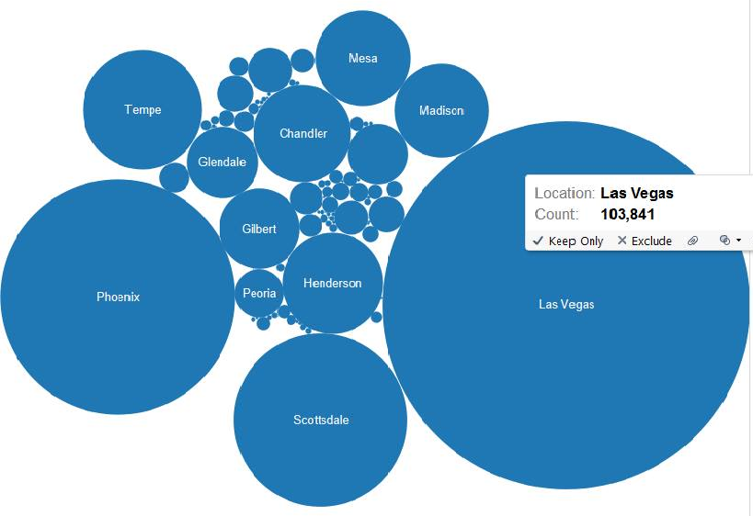
92 Cities with count of Top Star Restaurants

Slide 18
Top 5 Cities
Las Vegas
Phoenix
Scottsdale
Tempe
Henderson

Slide 19
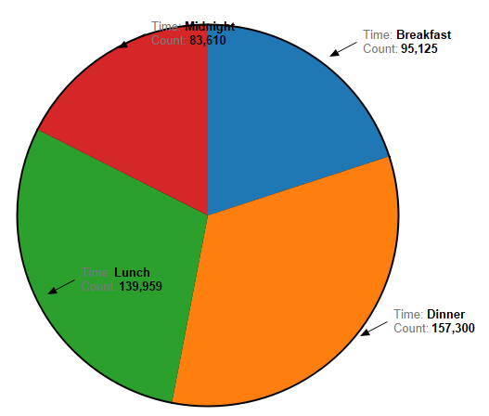
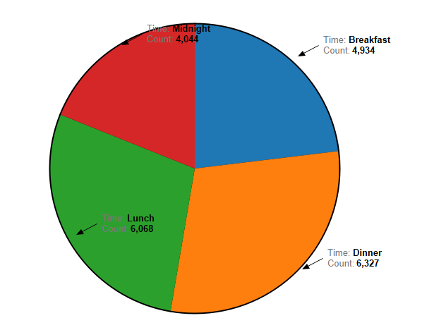
CHECK-IN TIME TRENDS
High Ratings Analysis
Low Ratings Analysis

Slide 20
OBSERVATIONS
Reviews Trend doesn’t differ much with Check-in timings
But, from the chart it shows that
Users generally Check-in Restaurant for Dinner and Lunch
Users prefer to write a review for Dinner and Lunch
SUGGESTION:
We Suggest Restaurants to be careful in the topics mentioned during there busy hours mainly for Dinner and Lunch and meet their customer expectations

Slide 21
CONCLUSIONS
In-detail analysis on the reviews helps
Users in choosing appropriate restaurant according to their needs
Owners in building a better business which is more likely towards customers taste.
We have been able to show what users care about most in their reviews of restaurants.
We have also found on what topics “Top Users” generally care when writing a review and how does it effect the overall rating of the Restaurant

Slide 22
FUTURE SCOPE
Semantic Analysis of the reviews can be done to say whether the text represents good/bad.
Study of reviews on group of businesses can be done based on their performance over past years.
Scalability of businesses is possible, by concentrating to improve all types of businesses not only Restaurants.

Slide 23

We Thank!!!
Dr. Sanjay Ranka
Dr. Daisy Wang
Clint P. George

