Slide 1
FrontDesk
An Enterprise class Web-based software system for programming assignment submission, feedback dissemination, and grading automation.
Student Mike Maxim
Professor Bill Scherlis

Slide 2
Motivation
In courses with complex programming assignments and large numbers of students, an efficient system of submission and grading is necessary.
Large classes typically provide less feedback and communication between course staff and students – can this be reversed?
FrontDesk attempts to address both of these problems.
  Provides support for automatic correctness grading across multiple servers and a centralized submission area for students. This helps alleviate the pains of grading the assignments of a large number of students.
  Provides a rich feedback system in order to keep the students and course staff on the same page. TAs can provide better subjective feedback when they have objective test data available.
    Students can use FrontDesk to get early objective feedback (unit testing) as they develop components of a large program.

Slide 3
History
Prototype of FrontDesk has been currently deployed in 15-211 for 5 semesters, about 1200 students with about 5000 assignments submitted.
There is extensive information on the strengths and weaknesses of the current design.
The FrontDesk project is a complete reengineering of the existing prototype.

Slide 4
Functionality
Construct a Web centered system to provide students with a centralized submission and grading feedback site and course staff with a centralized automatic grading and feedback distribution site.
Students
  Submission
    Archive (JAR, TAR, ZIP)
    CVS – Provide students with a way to submit a CVS module.
  Feedback
    Receive feedback upon submission for various sanity checks, e.g. submission compiles, submission performs basic tests correctly, etc.
    Receive feedback from the final grading pass. Get subjective and correctness feedback from course staff.
Course Staff (TAs and Instructors)
  Correctness Test Definition
    Provide a testing system allowing course staff to construct flexible tests.
  Objective Grading
    Support testing for large courses. Handle all failure modes of submissions. Multiple servers employed to help speed the task along.
  Subjective Grading
    Provide course staff with means to easily disseminate detailed subjective grading comments to students where students can easily view and understand such comments.
  Transparency
    Provide course staff with visibility into test setup and submission status.

Slide 5
Student Experience
Submission
  Archive (JAR, TAR, ZIP)
  CVS – Provide students with a way to submit a CVS module.
Feedback
  Receive feedback upon submission for various sanity checks, e.g. submission compiles, submission performs basic tests correctly, etc.
  Receive feedback from the final grading pass. Get subjective and correctness feedback from course staff.

Slide 6
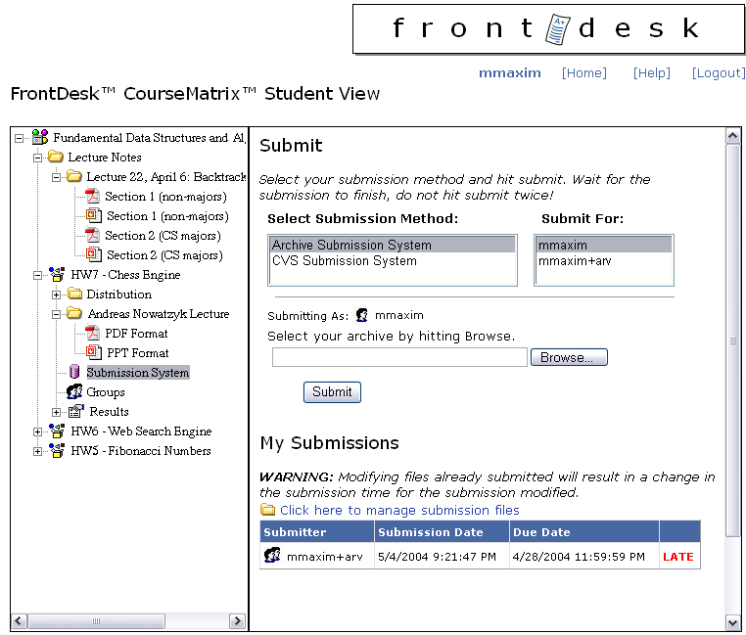

Slide 7
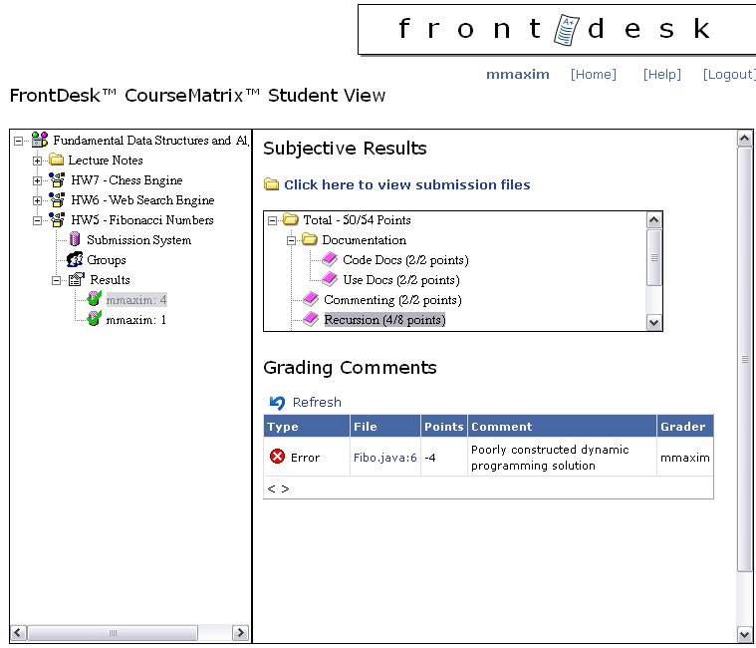

Slide 8
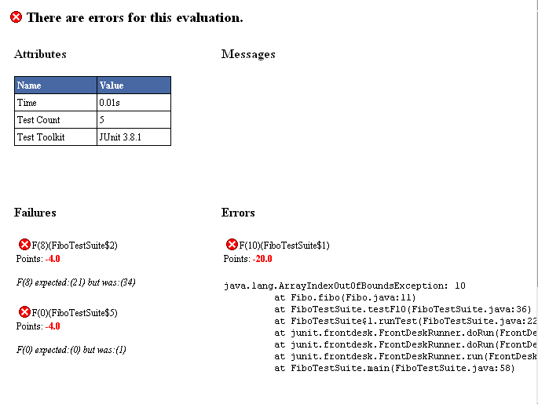

Slide 9
Course Staff Experience
Correctness Test Definition
  Provide a testing system allowing course staff to construct flexible tests.
Objective Grading
  Support testing for large courses. Handle all failure modes of submissions. Multiple servers employed to help speed the task along.
Subjective Grading
  Provide course staff with means to easily disseminate detailed subjective grading comments to students where students can easily view and understand such comments.
Transparency
  Provide course staff with visibility into test setup and submission status.

Slide 10
Objective Testing
Distributed system implemented to automate correctness testing.
  Many different computers can be employed to complete a grading job.
Each testing center equipped to run tests that conform to output standards.
  Tests can be written for any platform, however must output results in the format that the testing centers expect.
Unit testing toolkits can be used for test creation.
  JUnit API popular for testing Java programs. FrontDesk provides classes to glue together JUnit and the testing centers.

Slide 11
Subjective Feedback
FrontDesk provides central point for the creation of the assignment rubric.
  Objective automatic tests are entries in the rubric with specific point values.
  Subjective categories exist as well for human results dealing with student code.
Graders able to browse code to subjective asses submissions.
  Suggested remarks are available for each subjective rubric entry. This allows for course staff to maintain consistency across graders with respect to the comments given.
  Comments in code are linked to the assignment rubric, allowing students to seamlessly browse comments that stem from issues in code files.

Slide 12
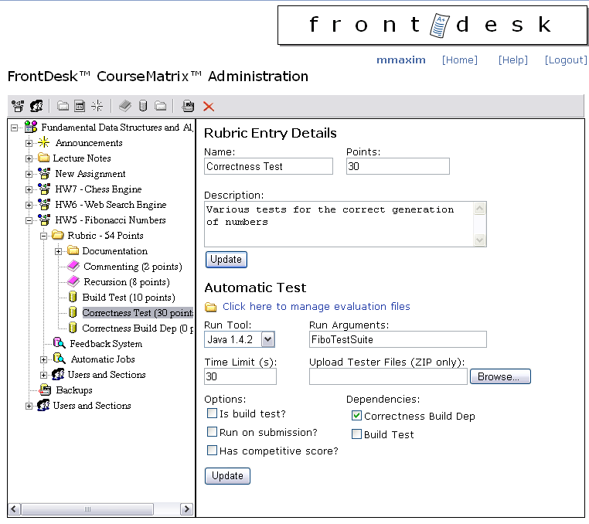

Slide 13
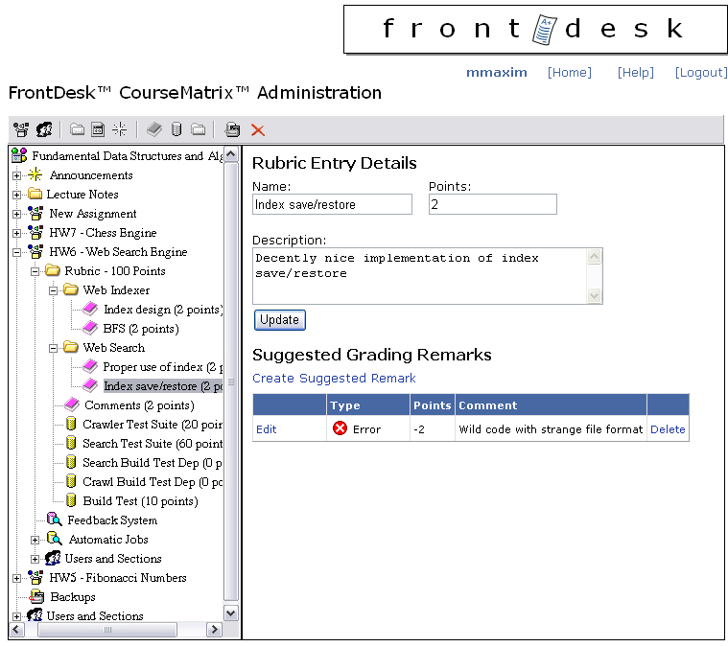

Slide 14
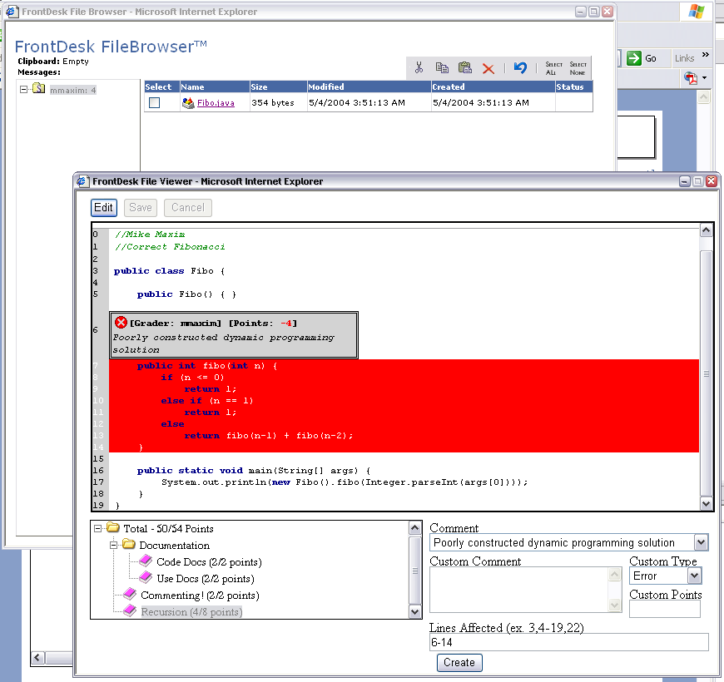

Slide 15
References
Stephen Edwards, Teaching software testing, automatic grading meets test-first coding. Addendum to the 2003 Proceedings of the Conference on Object-oriented Programming, Systems, Languages, and Applications, San Francisco, CA, 2003, 500-506.
J.B Hext, J.W. Winings, An automatic grading scheme for simple programming exercises, Communications of the ACM, 12(5), 1969, 272-275.
Kent Beck, Test Driven Development (Addison-Wesley, 2002).

