Slide 1
FrontDesk
A Web Application for Programming Assignment Submission and Interactive Grading Feedback
Mike Maxim
Advisor: Professor Bill Scherlis

Slide 2
Summary
Prototype of FrontDesk has been currently deployed in 15-211 for 5 semesters, about 1200 students with about 5000 assignments submitted.
There is extensive information on the strengths and weaknesses of the current design.
The FrontDesk project is a complete reengineering of the existing prototype.
The research focus of the project is the Web based architecture, and understanding what it takes to achieve a successful deployment in our user community.
We will also investigate the value added by implementing such a system compared with the various methods currently employed.

Slide 3

Web and Data Architecture
Presentation Layer
Pages
PresentationControls
Grid Display, File View, etc.
Submission Interface
Feedback Interface
Testing Interface
User and Course Management
DataComponents
Data abstraction layer
Data Layer
IFileSystemProvider
IDataProvider
Database
File System

Slide 4
Testing Architecture
Test request received
TestingServer
TestResult sent back
Run unit tests
UnitTester (JUnit)
TestResult
Fetch test files
TestZoneSynchonizer
TestZone
Data Layer
IFileSystemProvider
IDataProvider
Database
File System

Slide 5
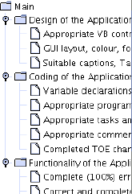
Feedback Enhancements
Students have centralized application to receive objective (automatic test results) and subjective (TA comments) results on their submissions.
Objective test results can be viewed by students so they can assess exactly where their program failed
Subjective results can be displayed in a variety of ways. Subjective hierarchies give detailed information and structure to TA comments.
FrontDesk markup allows TAs to mark comments in code, making it clearly visible to students. Students can then ask FrontDesk for a complete summarized view of all in-code comments and the point values associated with the comments.
Hierarchies
for subjective
comments

Slide 6
Submission Enhancements
Problems
  Submission made with no guarantee it was received properly.
  If the project is in source control, would like to just hand in the source control identifier.
  Groups are typically specified in unformatted text files that need to be manually inspected.
FrontDesk Solutions
  Preliminary tests run through the testing center and send student confirmation that the submission was received and functions properly.
  Allows for CVS integration. Instructors can set up CVS repositories on the FrontDesk server to allow students to simply update their source control area for submissions.
  FrontDesk coordinates group submissions, clearly indicating group memberships and delegating grading responsibility when groups bridge over TA sections.

Slide 7
Testing Enhancements
Problems
  Tests take a potentially long time to run. For a class of over 400 students, the amount of time to run 10 tests on all students could be on the order of days on a single computer.
  Writing tests is usually an ad hoc process. TAs find it hard to create tests that can handle large classes.
FrontDesk Solutions
  The Testing Center architecture allows for many Testing Centers to be running on multiple computers. The Testing Center main program can coordinate these distributed centers in order to run multiple tests at the same time. This greatly reduces testing time.
  FrontDesk incorporates a Test Development Kit based on the software engineering unit testing toolkit JUnit. JUnit provides an industry tested unit test creation framework that can be utilized within the FrontDesk system for a formal test creation process. This framework makes test creation a much simpler, structured process.

Slide 8

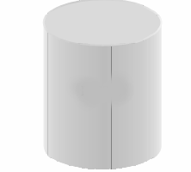
Use Diagram
Process Submission
Submit
Submission Feedback
Student
WWW Server
Automatic Test Request
Run Tests
Collect Results
Results
Subjectively Assess
Submission
Staff
WWW Server
Testing Service

Slide 9
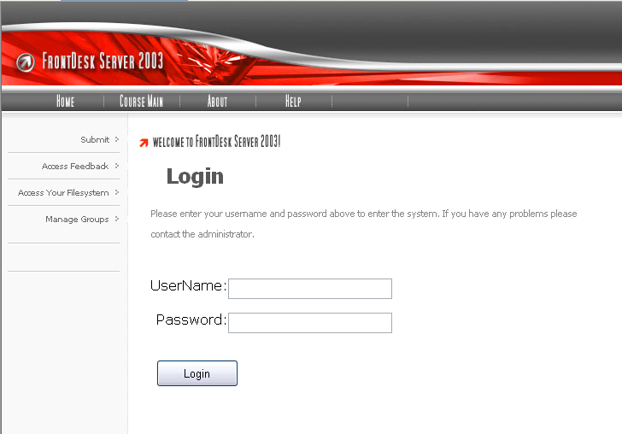
FrontDesk Login

