Slide 1
FrontDesk
A Web centered programming assignment submission and grading feedback system.
Student Mike Maxim
Professor Bill Scherlis

Slide 2
Testing
Distributed system implemented to automate correctness testing.
  Many different computers can be employed to complete a grading job.
Each testing center equipped to run tests that conform to output standards.
  Tests can be written for any platform, however must output results in the format that the testing centers expect.
Unit testing toolkits can be used for test creation.
  JUnit API popular for testing Java programs. FrontDesk provides classes to glue together JUnit and the testing centers.

Slide 3
Feedback
FrontDesk provides central point for the creation of assignment rubric.
  Automatic tests are entries in the rubric with specific point values.
  Subjective categories exist as well for human results.
Graders able to evaluate code by inserting comments that correspond to entries in the rubric.
  Canned responses available to grader with commenting.
  Comments in code are summarized in each category of the rubric automatically.

Slide 4
Effectiveness
The evaluation strategies address the main concerns of making a large grading process more efficient.
  Distributed automatic tests make objective testing faster and easier to define.
  Rubric-guided subjective testing is centralized and convenient for evaluating student code and other documents.

Slide 5
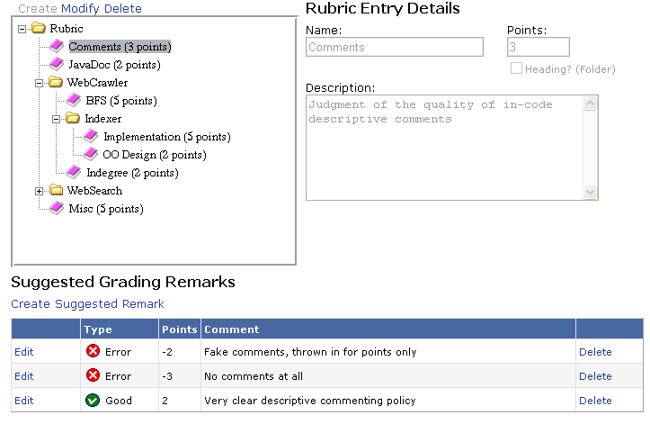

Slide 6
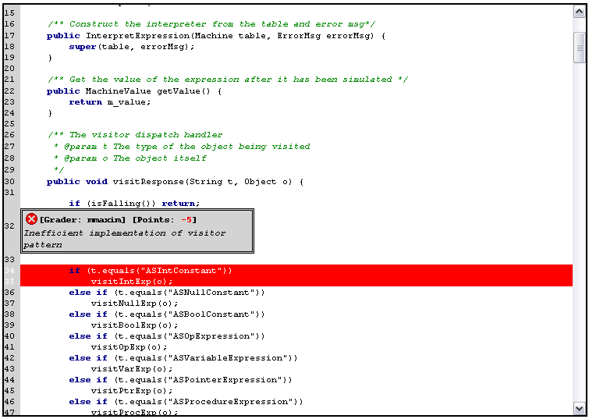

Slide 7
