Slide 1
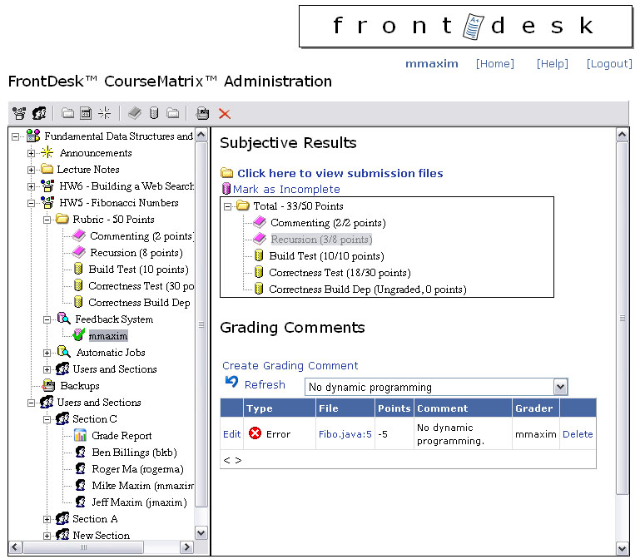
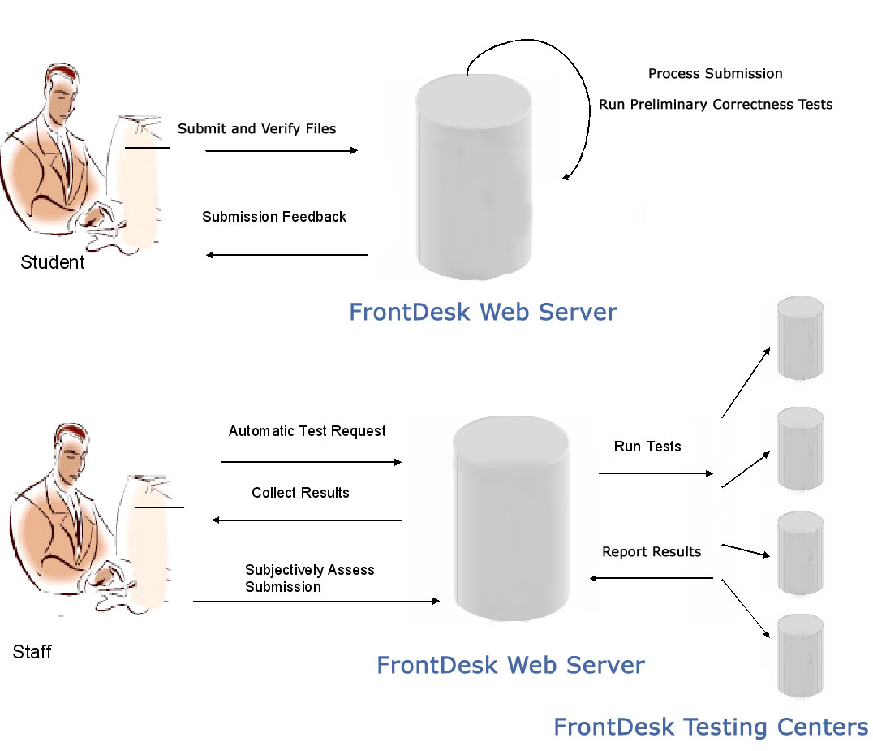
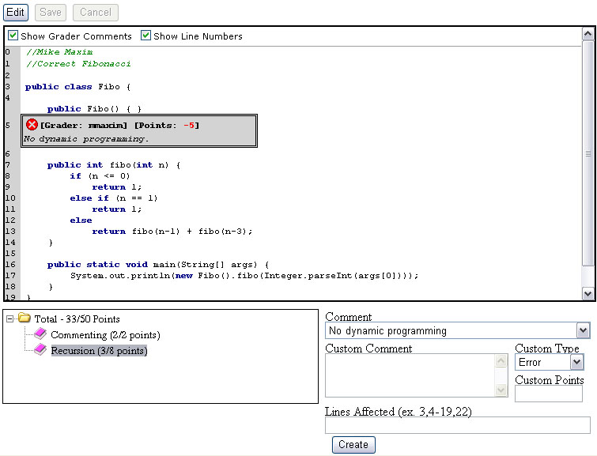
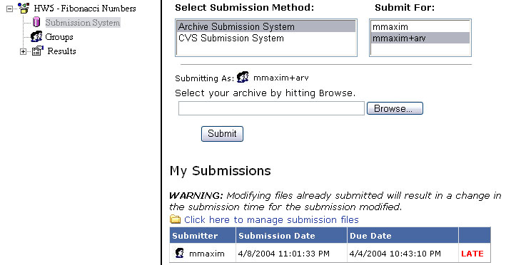

FrontDesk
Mike Maxim (mmaxim@cs)
Advisor: Bill Scherlis
An Enterprise Class Web-based Software System for Programming Assignment Submission, Feedback Dissemination, and Grading Automation.
Published in 2004 IEEE Conference on Advanced Learning Technologies
The Issues
FrontDesk Solutions
Subjective Feedback
  Students need and demand accurate and robust subjective feedback about submissions.
  Course staff need and demand tools enabling efficient, consistent and intuitive creation and dissemination of subjective feedback.
Automatic Testing
  Correctness testing utilizing automatic test suites must be rigorously controlled and defined. Execution of tests should happen over multiple workstations to improve grading time.
  In order for staff to produce automatic test suites in a timely manner, the test creation process must be a simple and efficient process.
Course Management
  Submission services through the Web or through IDE plug-ins. Students should be able to access their submission files through the Web interface.
  Group support to reflect group assignments directly on the grading system.
  Content management to provide assignment write-ups at the submission and grading site.
Feedback System
  Hierarchical grading schemas with suggested comments for each entry in the schema to maximize consistency across graders.
  In-code comments place subjective feedback directly in student submission files while being linked with grading schema.
  Efficient and intuitive interface for both course staff and students for processing subjective feedback.
Automatic Testing Centers
  Distributed system of testing centers to process automatic tests. This maximizes speed and efficiency improving grading time.
  Tests runs in a loosely coupled manner with the Testing Centers. Testing Centers read XML text output from tester suites enabling the testing of programs written in any language on any platform.
  Test APIs are available to simplify test creation, specifically for the JUnit API. This allows JUnit tests to be immediately usable from within FrontDesk.
Course Management
  Submission system supports group submissions and many different data sources (ZIP, and CVS based submission)
  Content management allows students to access write-up information directly from the submission and grading system.
  Section management allows course staff to assign groups of students to staff members to divide up the grading process.
  Grade reports are available for sections and the entire course, summarizing performance.
Enterprise Design
  Built upon a multi-layer architecture using the Microsoft .NET framework.
  All data is stored on a SQL Server 2000 database. Submission files are stored on the database server’s local disk.
  XML Web Services allow for easy integration with existing systems.
Subjective and automatic tests defined in the same grading schema
Summary view of all comments for the schema entry.
Make comments directly in student code under specific entries in the grading schema. Graders can make custom comments, or draw from the suggested set for the schema entry.
Some common use-case scenarios for both students and staff members
FrontDesk Architecture
Presentation Layer
ASP.NET Web Forms IDE Plug-ins
Data Access Layer
(.NET Components)
Service Layer
(XML Web Services)
Existing CMS
Flexible submission methods and the ability to submit impersonating a group identity.
FrontDesk Data Provider
FrontDesk File System Provider
SQL Server 2000
OS File System

