Slide 1
Maxwell DealFlow
Visual Guide v4
Every screen, email, and portal in the CRM
Maxwell Midodzi · eXp Realty

Slide 2
Contents
App Screens
12 screens — Dashboard through Approval Preview
Email Templates
17 templates — every email the system sends
Public Pages
4 portals — client / builder / stakeholder
Mobile
3 screens — phone layout + push notifications

Slide 3
App Screens

Slide 4
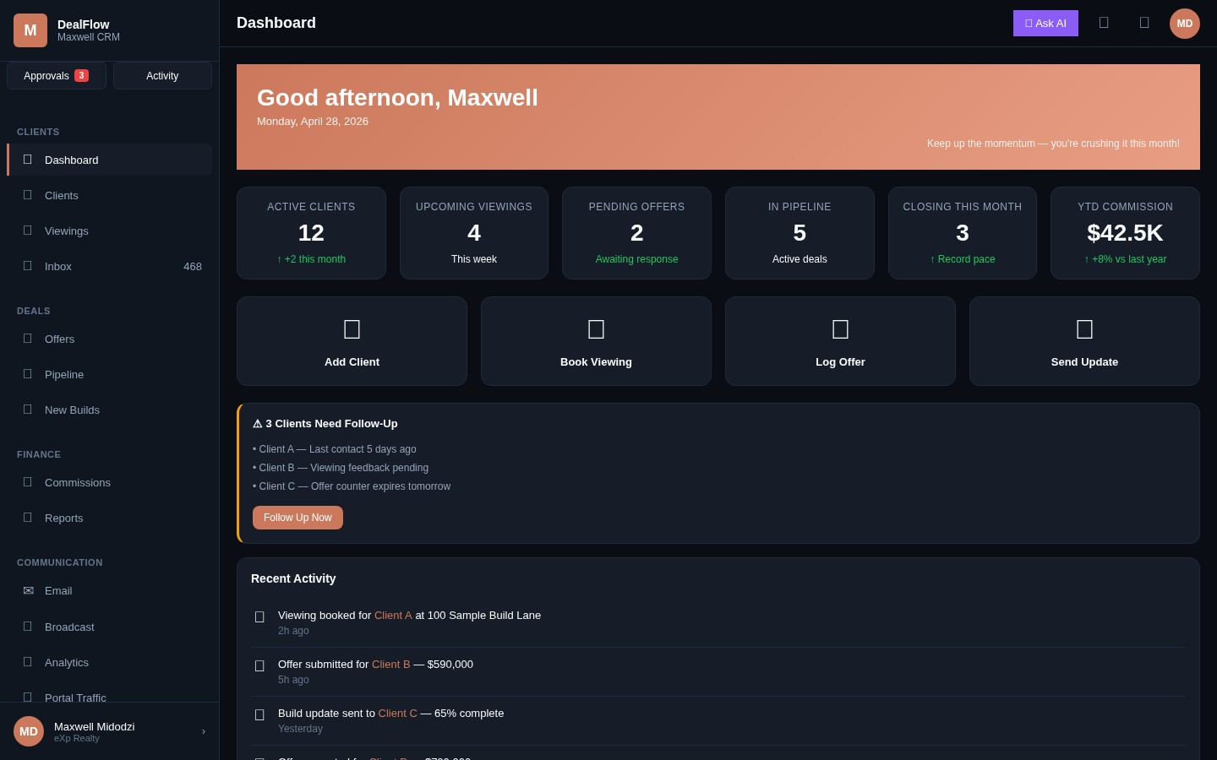
Dashboard
Daily home view
Maxwell DealFlow Visual Guide v4 · Slide 4

Slide 5
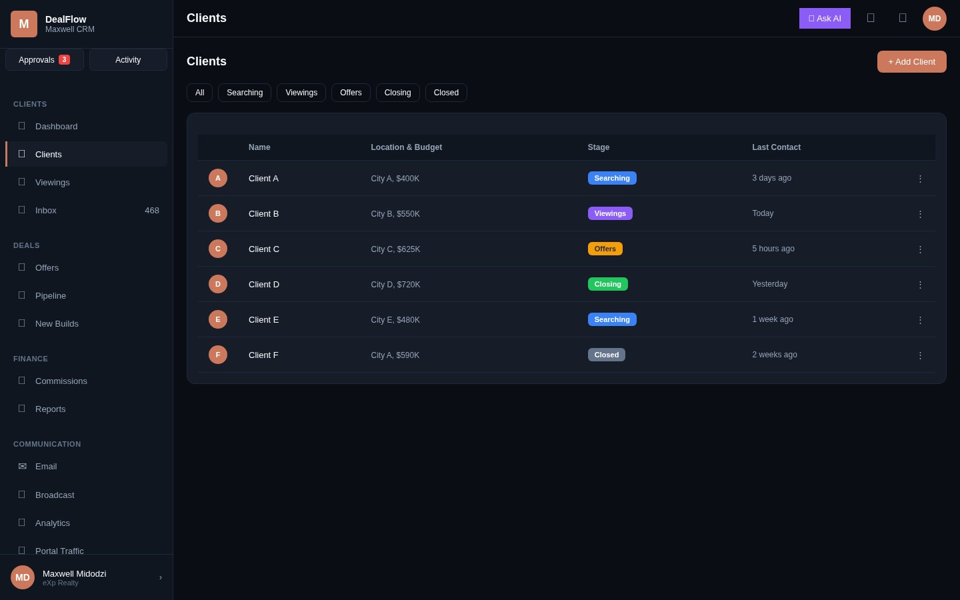
Clients List
All clients with stage filters
Maxwell DealFlow Visual Guide v4 · Slide 5

Slide 6
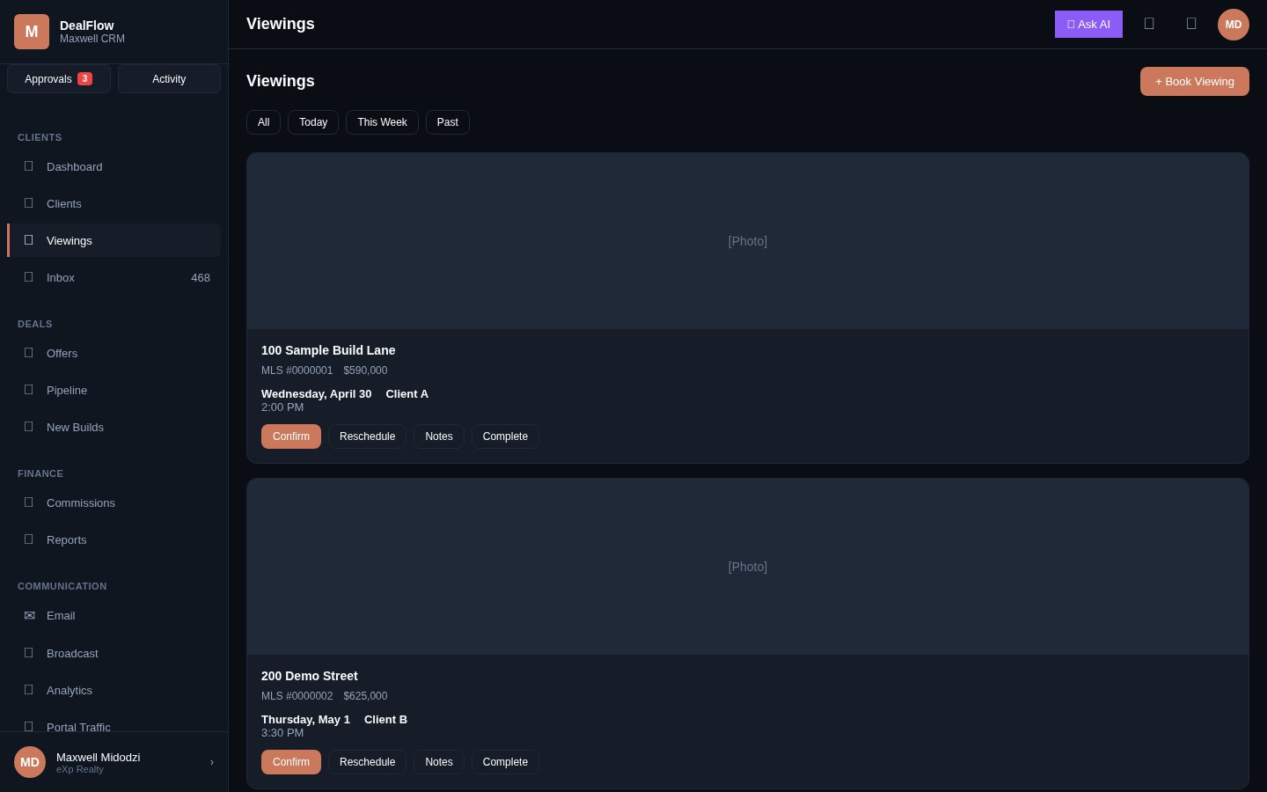
Viewings
Upcoming viewings tracker
Maxwell DealFlow Visual Guide v4 · Slide 6

Slide 7
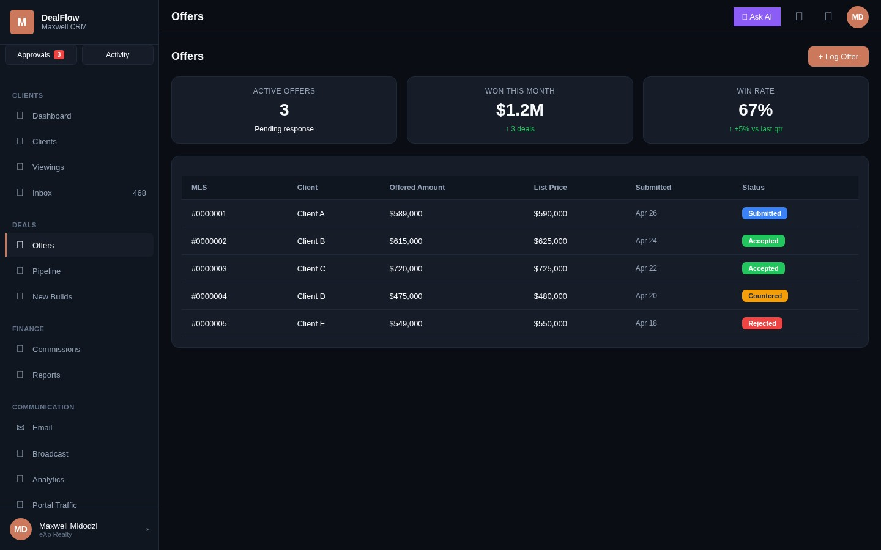
Offers
Active offers with KPIs
Maxwell DealFlow Visual Guide v4 · Slide 7

Slide 8
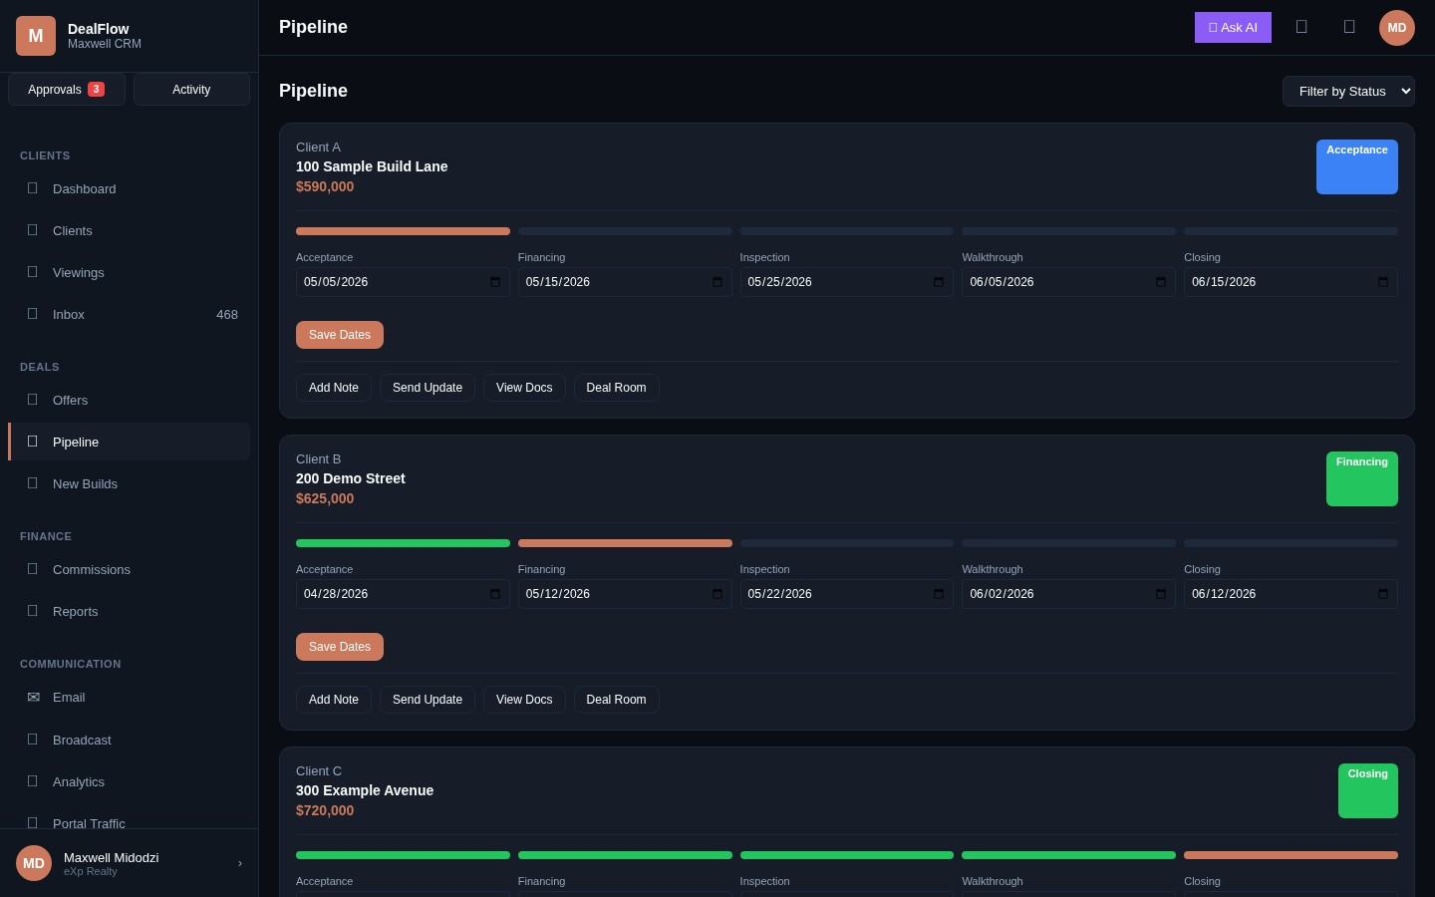
Pipeline
Vertical deal cards with milestone dates
Maxwell DealFlow Visual Guide v4 · Slide 8

Slide 9
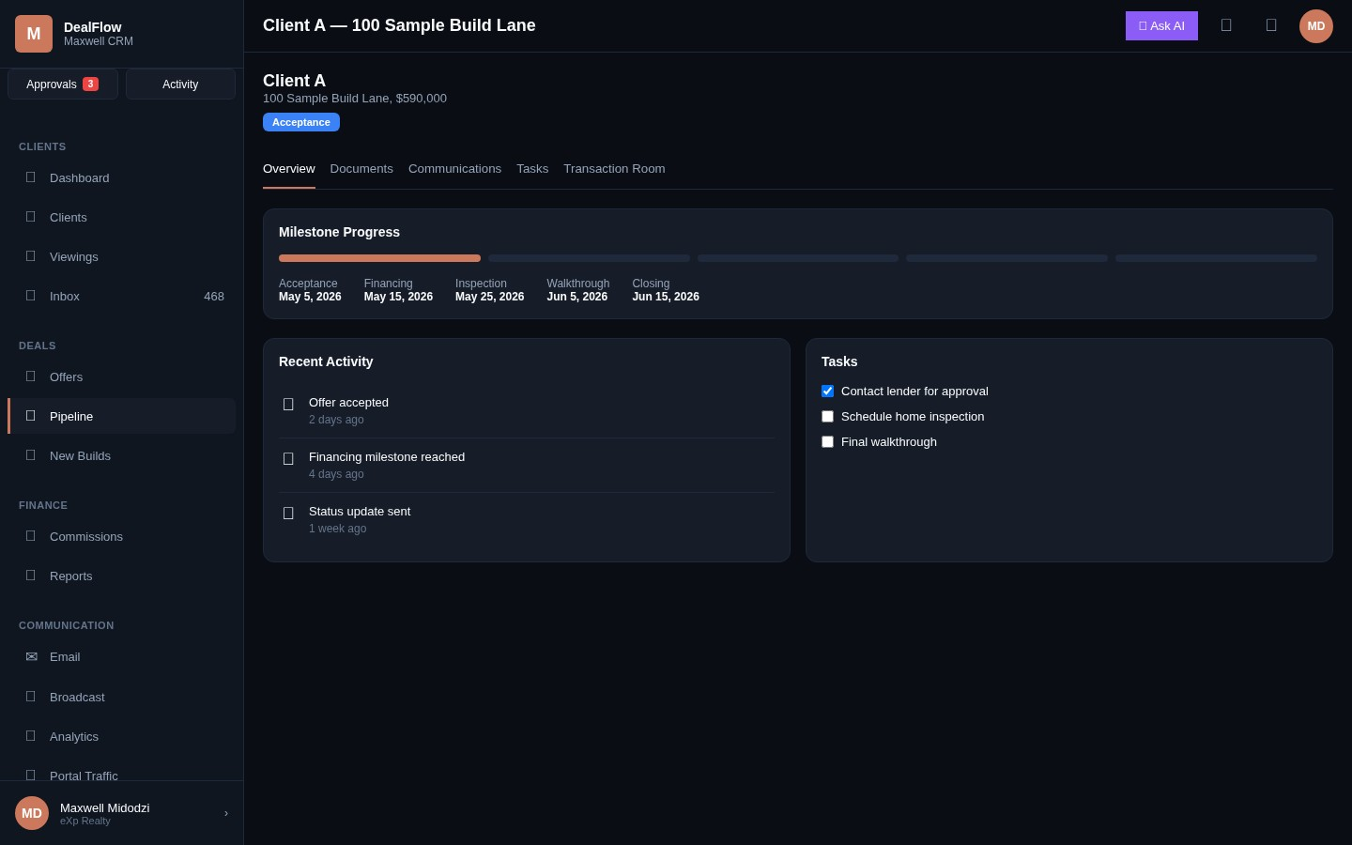
Pipeline Deal
Single deal interior with tabs
Maxwell DealFlow Visual Guide v4 · Slide 9

Slide 10
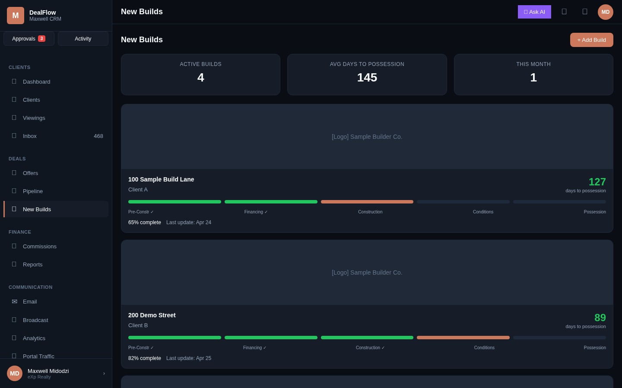
New Builds
Construction tracker with milestones
Maxwell DealFlow Visual Guide v4 · Slide 10

Slide 11
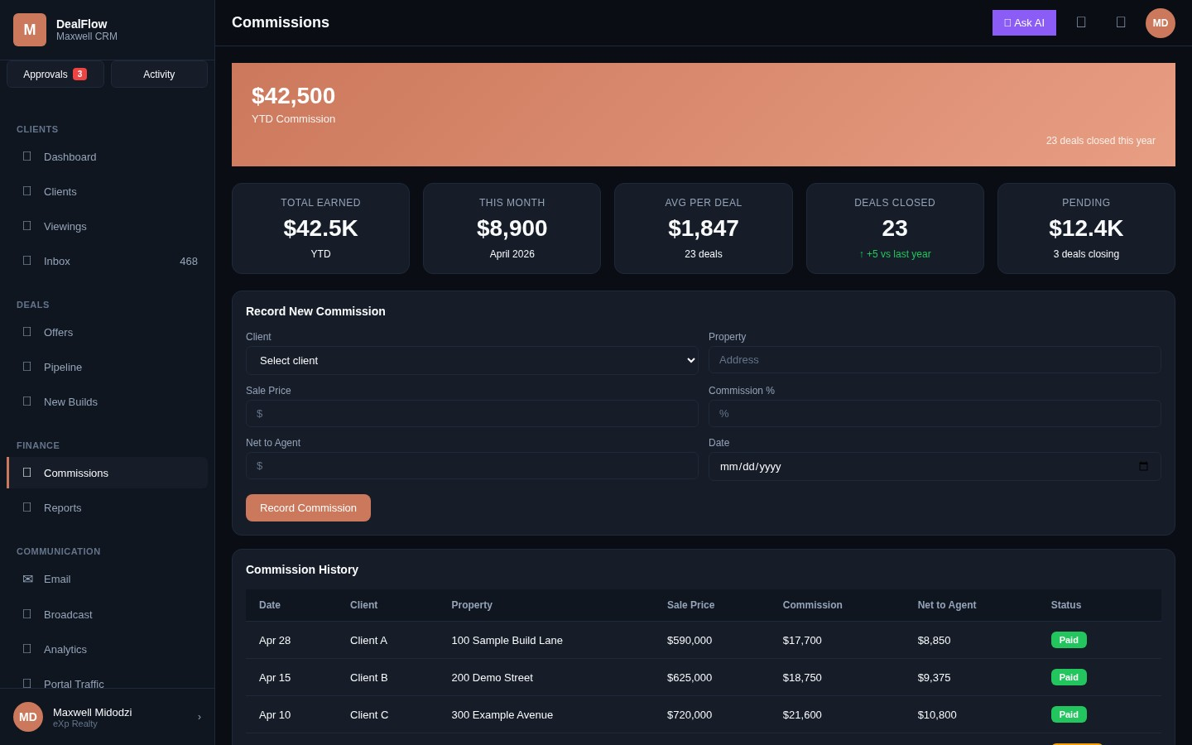
Commissions
YTD earnings + record new
Maxwell DealFlow Visual Guide v4 · Slide 11

Slide 12
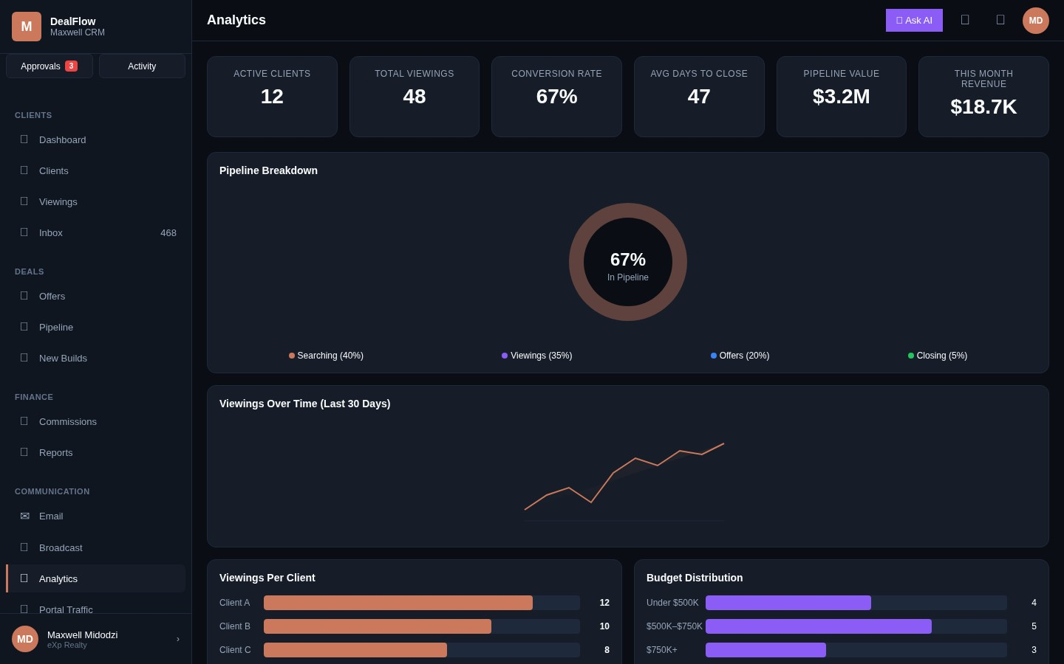
Analytics
KPIs and charts
Maxwell DealFlow Visual Guide v4 · Slide 12

Slide 13
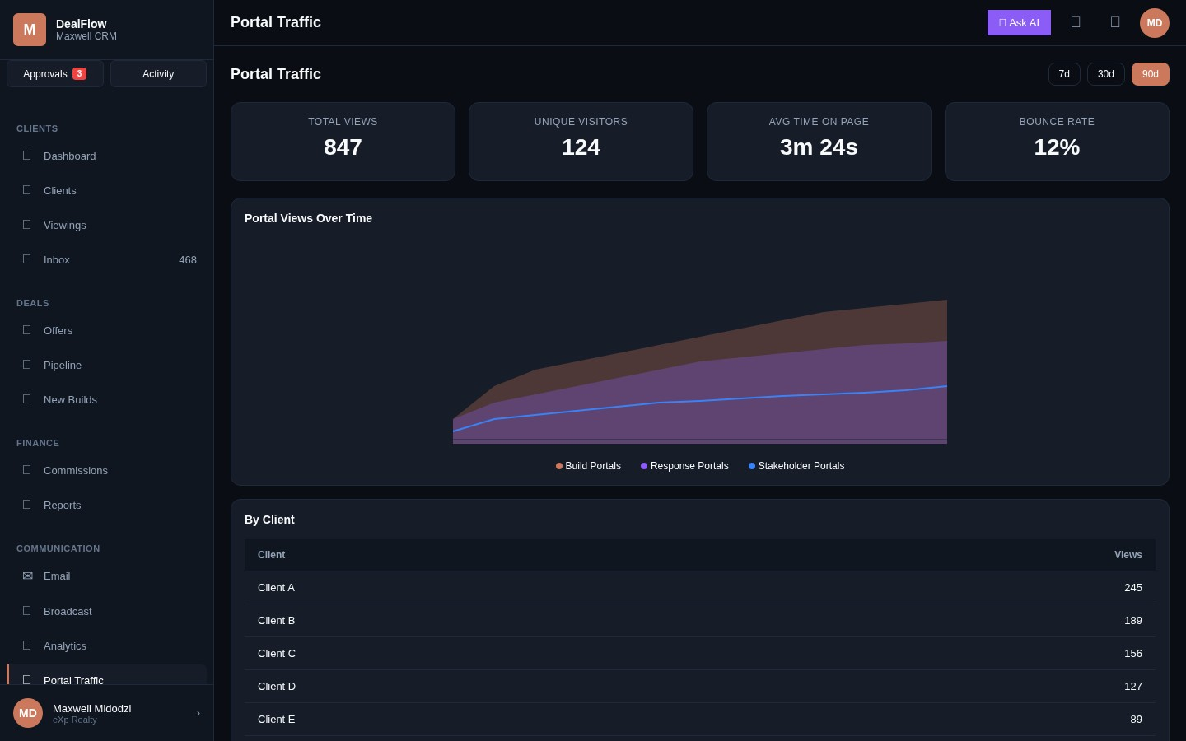
Portal Traffic
View analytics by source and client
Maxwell DealFlow Visual Guide v4 · Slide 13

Slide 14
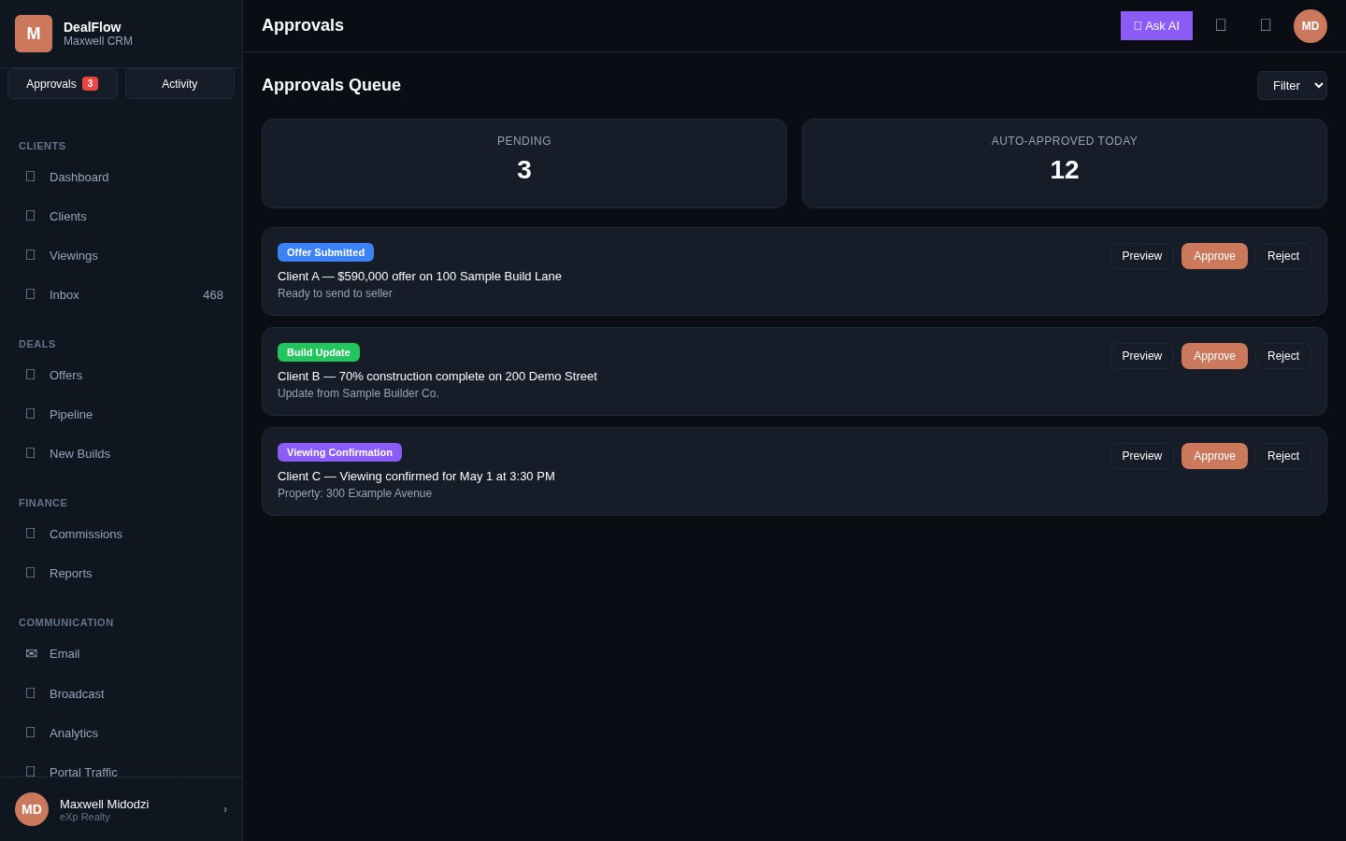
Approvals Queue
Notifications awaiting approval
Maxwell DealFlow Visual Guide v4 · Slide 14

Slide 15
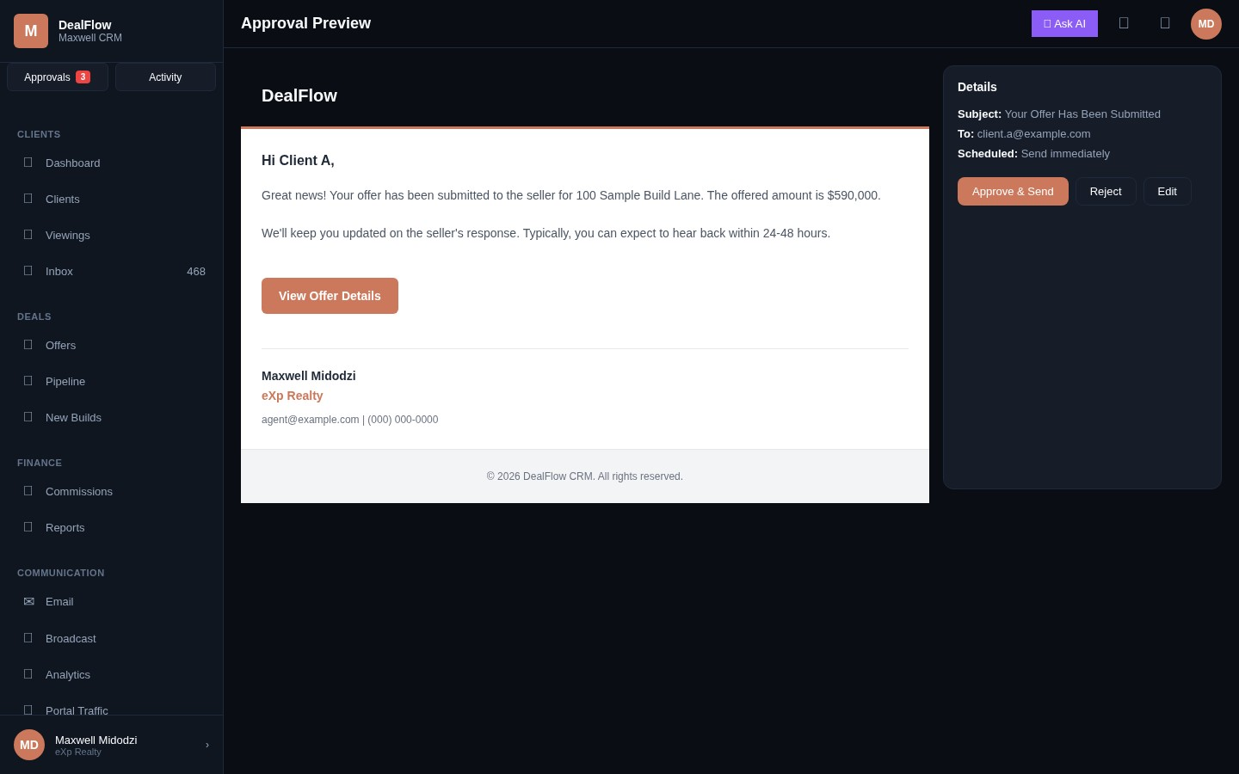
Approval Preview
Email preview before sending
Maxwell DealFlow Visual Guide v4 · Slide 15

Slide 16
Email Templates

Slide 17
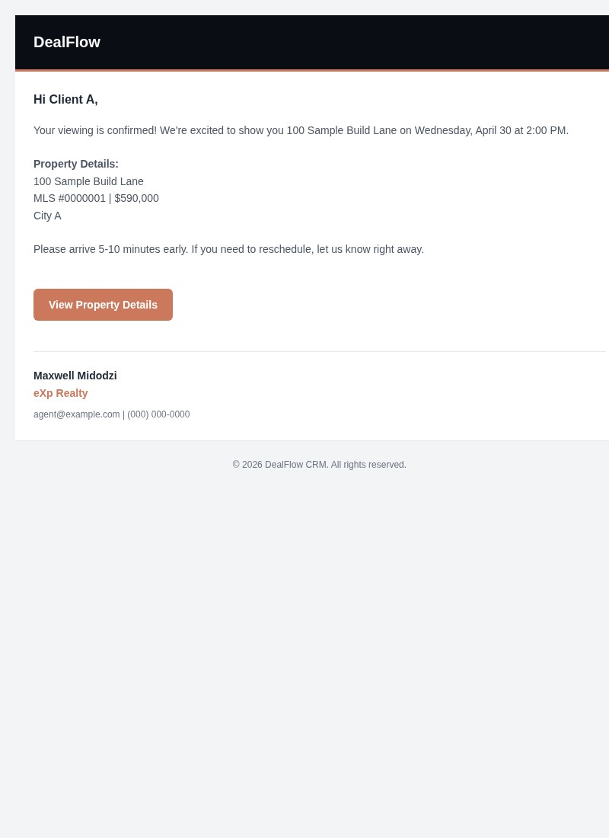
Email: Viewing Confirmed
When client books a viewing
Maxwell DealFlow Visual Guide v4 · Slide 17

Slide 18
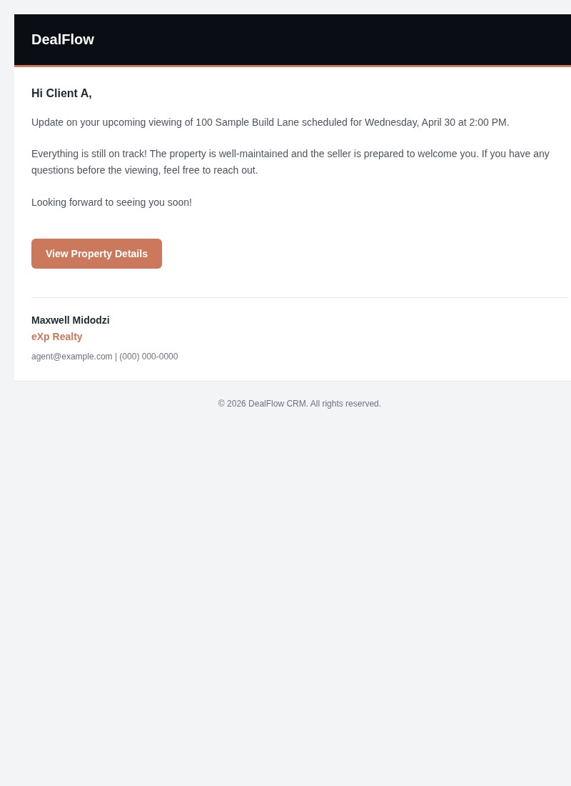
Email: Viewing Update
When viewing details change
Maxwell DealFlow Visual Guide v4 · Slide 18

Slide 19
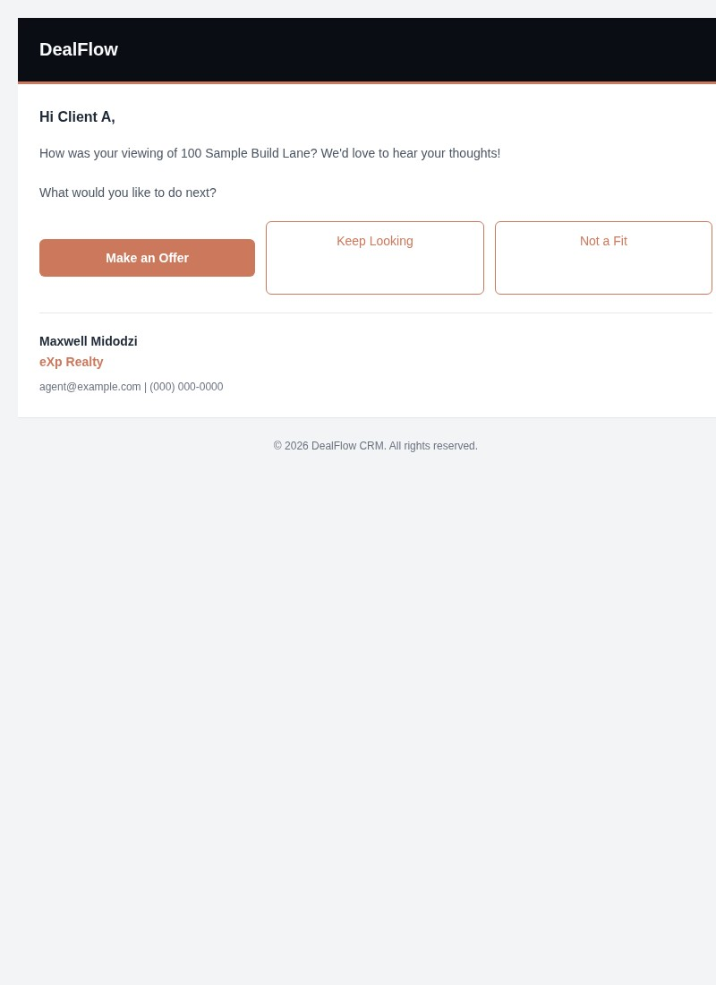
Email: Viewing Follow-Up
After viewing completed
Maxwell DealFlow Visual Guide v4 · Slide 19

Slide 20
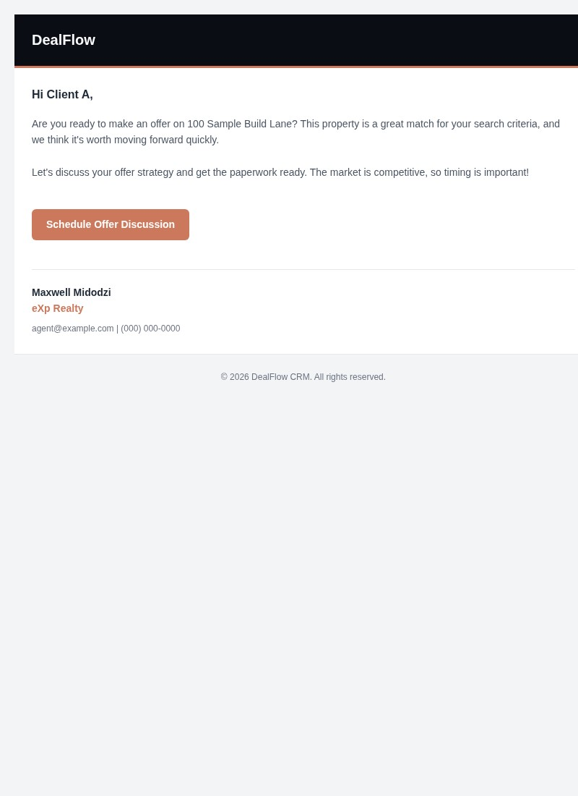
Email: Ready to Offer
Encouraging offer submission
Maxwell DealFlow Visual Guide v4 · Slide 20

Slide 21
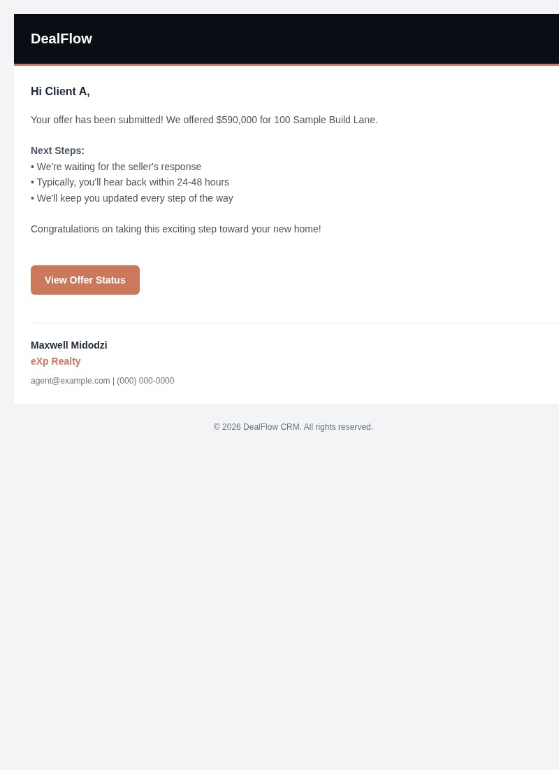
Email: Offer Submitted
Offer sent to seller
Maxwell DealFlow Visual Guide v4 · Slide 21

Slide 22
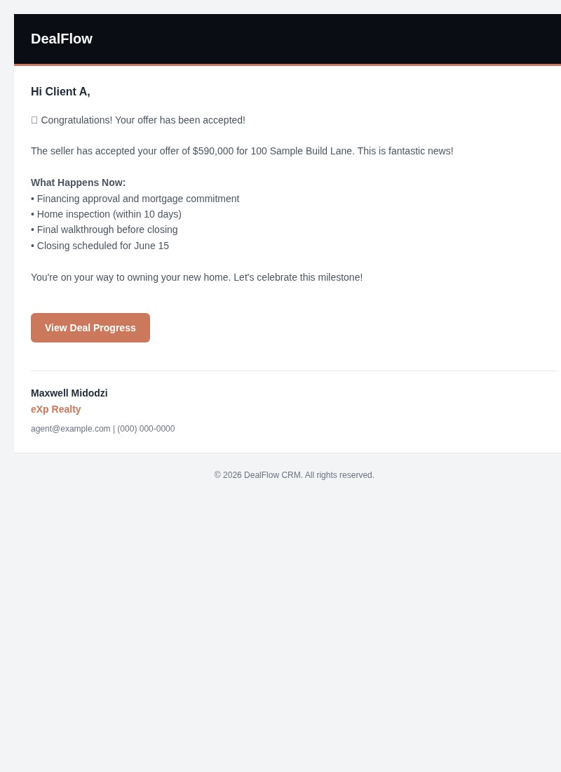
Email: Offer Accepted
Offer is accepted
Maxwell DealFlow Visual Guide v4 · Slide 22

Slide 23
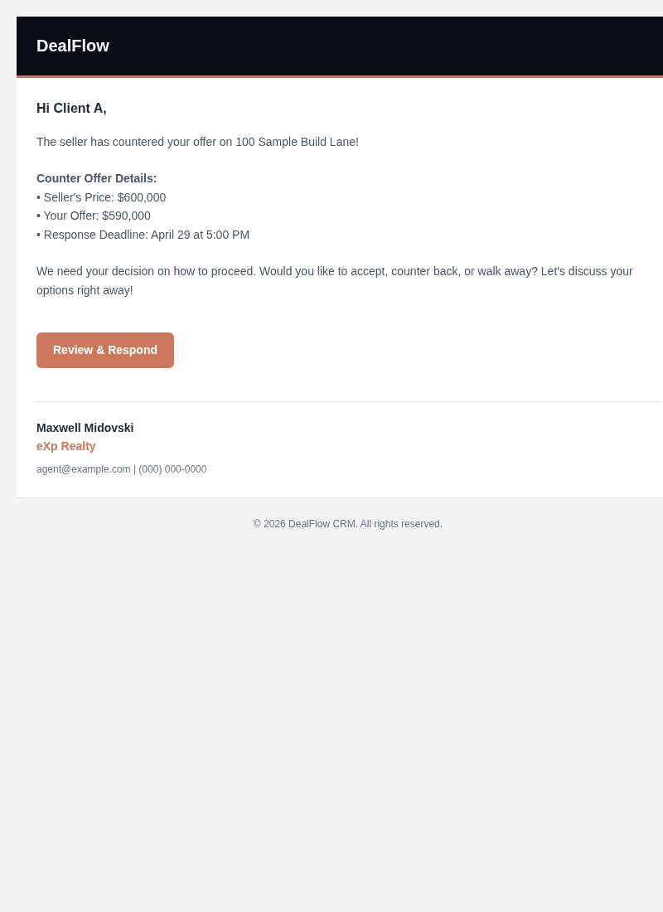
Email: Offer Countered
Seller counters offer
Maxwell DealFlow Visual Guide v4 · Slide 23

Slide 24
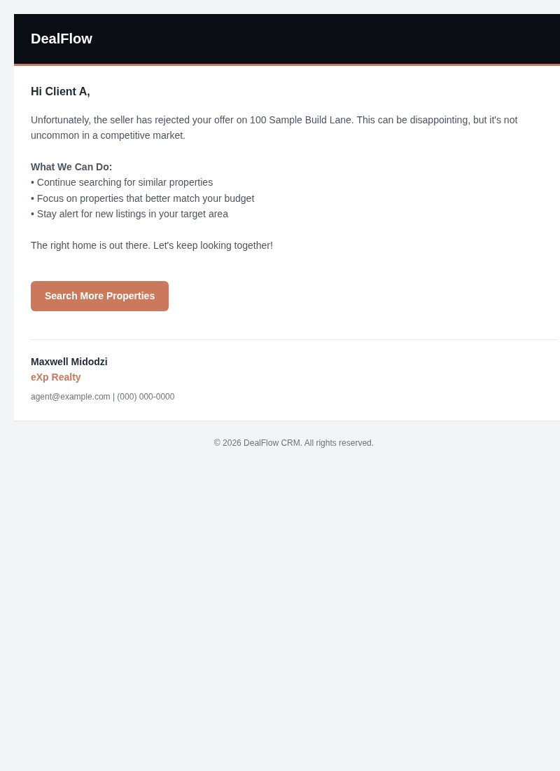
Email: Offer Rejected
Offer is rejected
Maxwell DealFlow Visual Guide v4 · Slide 24

Slide 25
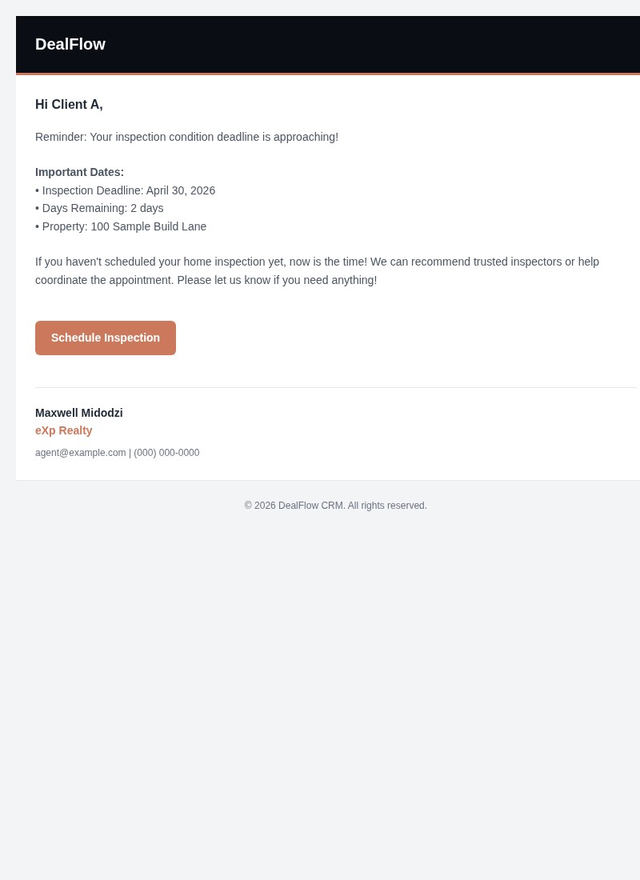
Email: Condition Reminder
Condition deadline approaching
Maxwell DealFlow Visual Guide v4 · Slide 25

Slide 26
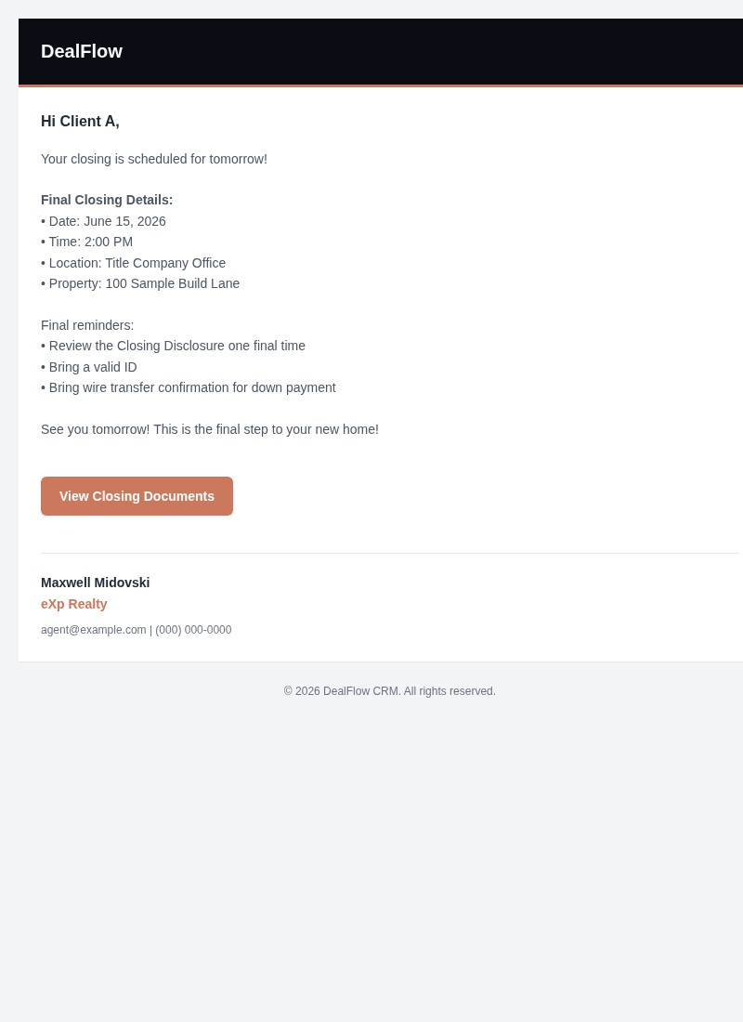
Email: Closing Day
Closing is imminent
Maxwell DealFlow Visual Guide v4 · Slide 26

Slide 27
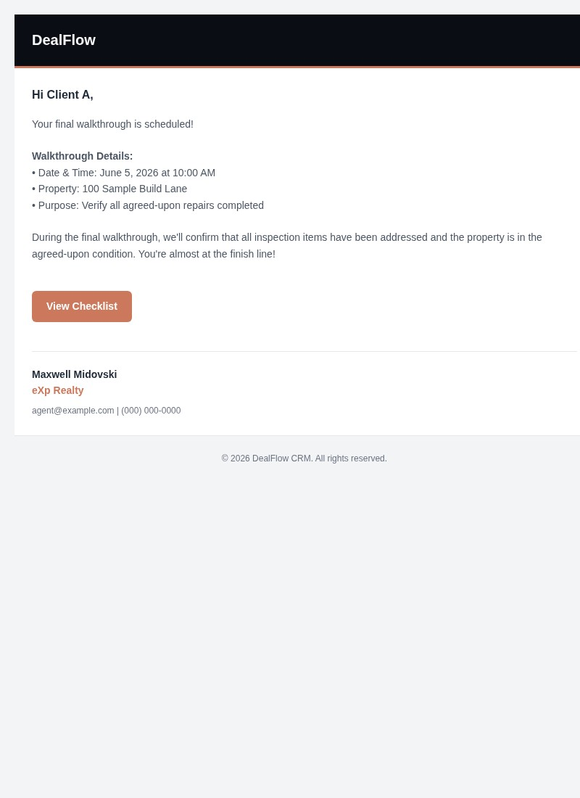
Email: Final Walkthrough
Final walkthrough scheduled
Maxwell DealFlow Visual Guide v4 · Slide 27

Slide 28
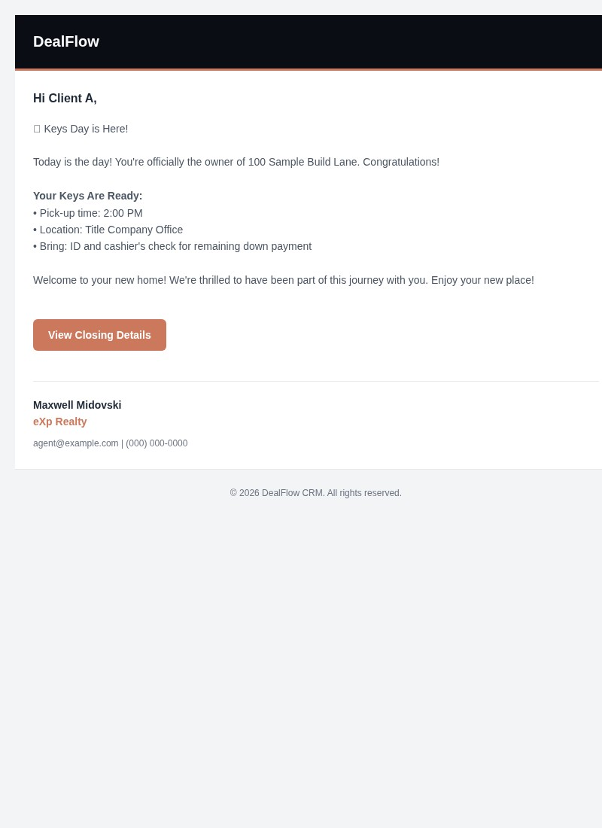
Email: Keys Day
Closing complete
Maxwell DealFlow Visual Guide v4 · Slide 28

Slide 29
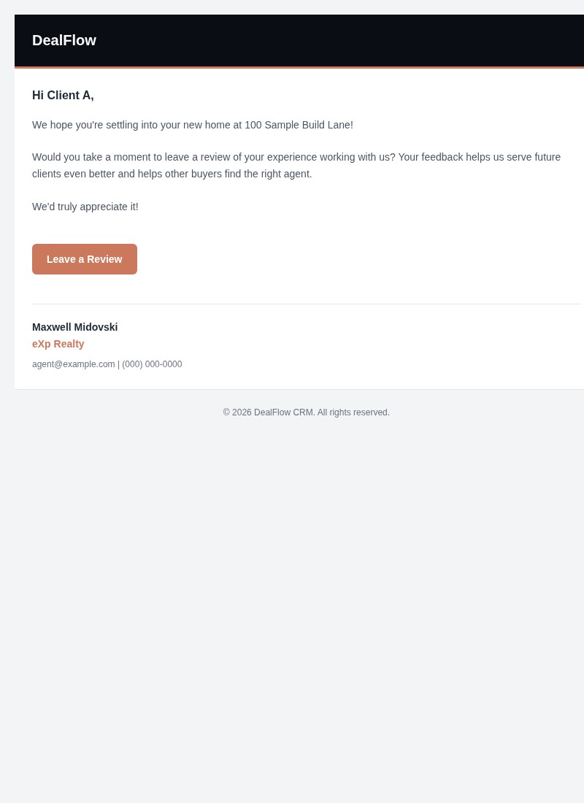
Email: Review Request
Post-closing follow-up
Maxwell DealFlow Visual Guide v4 · Slide 29

Slide 30
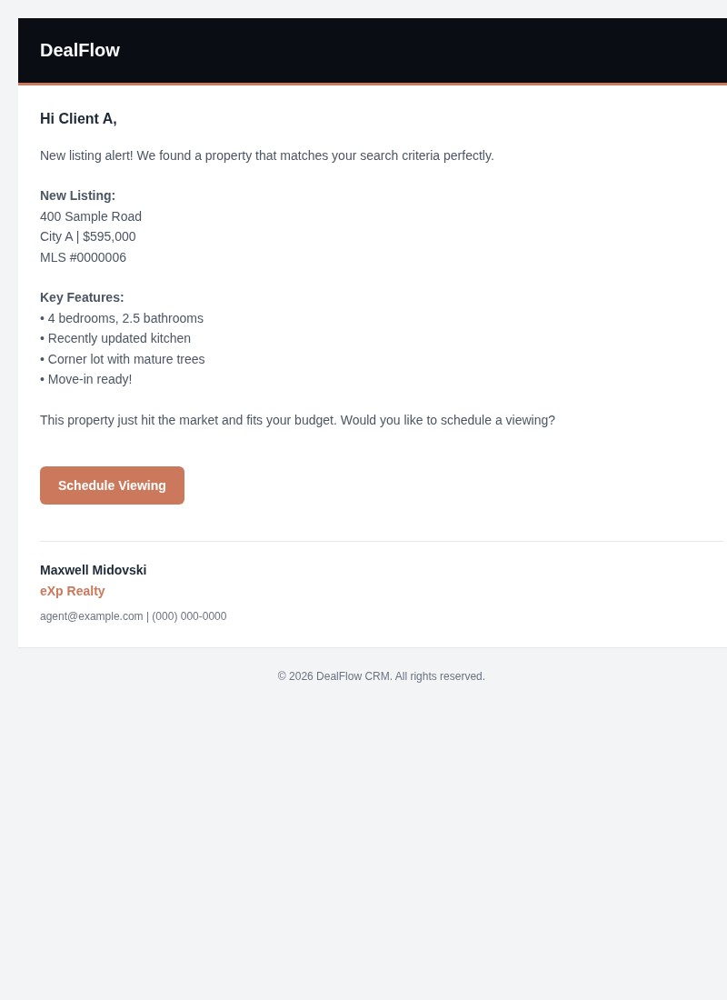
Email: New Listing Match
Property matches saved search
Maxwell DealFlow Visual Guide v4 · Slide 30

Slide 31
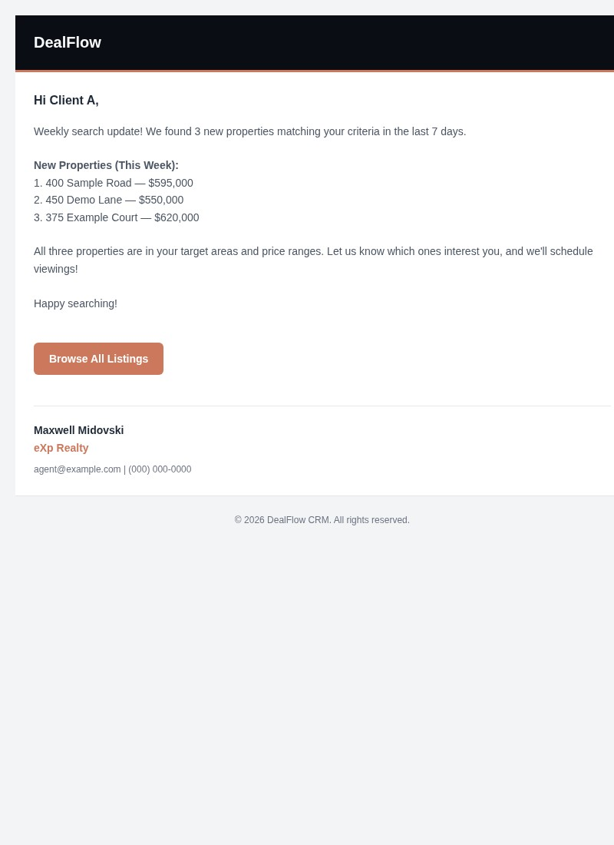
Email: Search Update
Market update sent
Maxwell DealFlow Visual Guide v4 · Slide 31

Slide 32
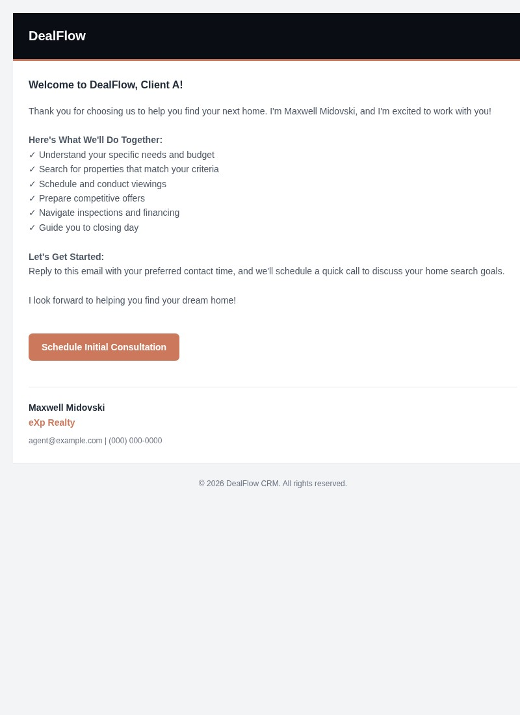
Email: Welcome
New client onboarded
Maxwell DealFlow Visual Guide v4 · Slide 32

Slide 33
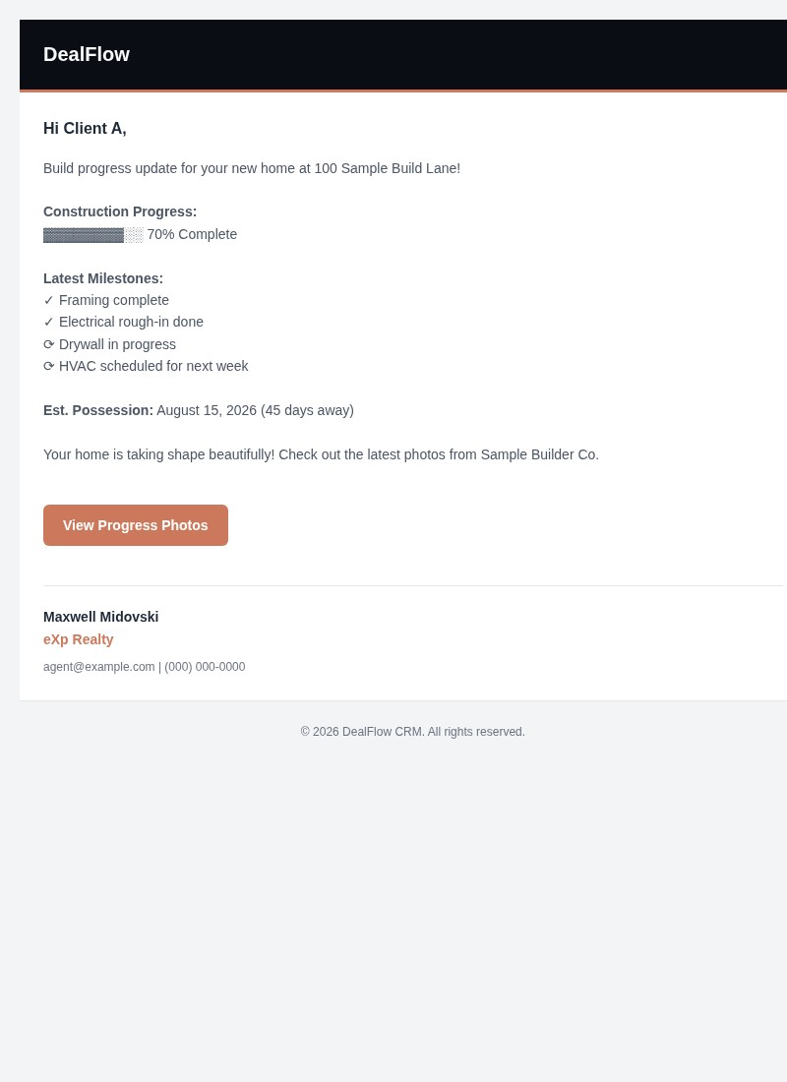
Email: Build Update
New build reaches milestone
Maxwell DealFlow Visual Guide v4 · Slide 33

Slide 34
Public Pages

Slide 35
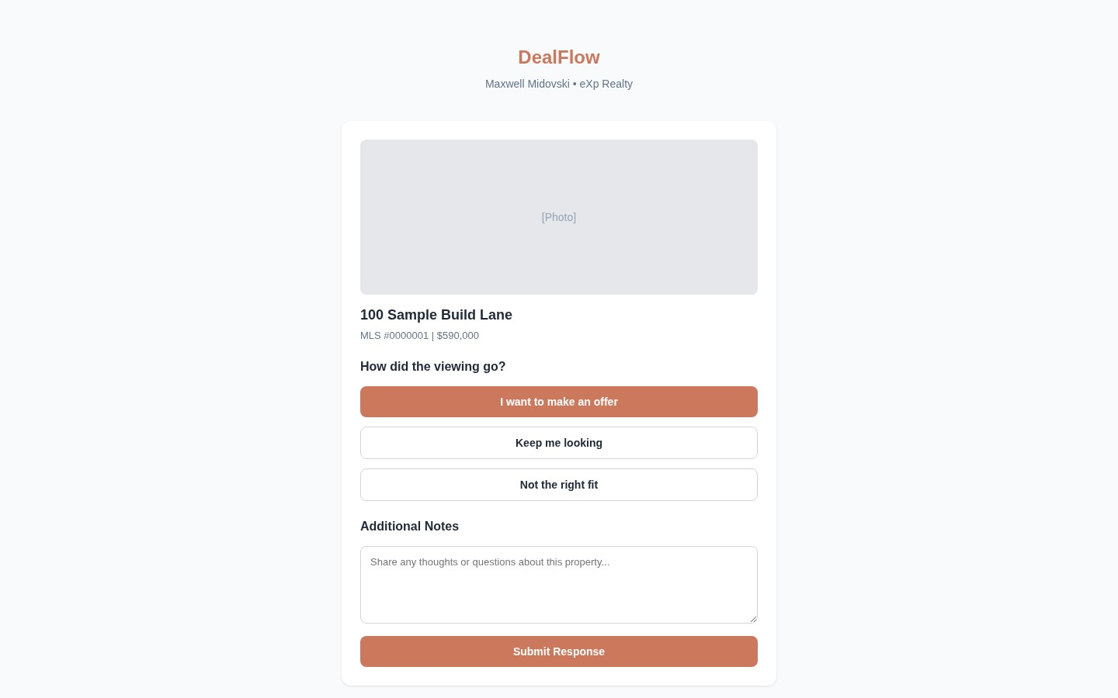
Viewing Response Page
Client-facing feedback form
Maxwell DealFlow Visual Guide v4 · Slide 35

Slide 36
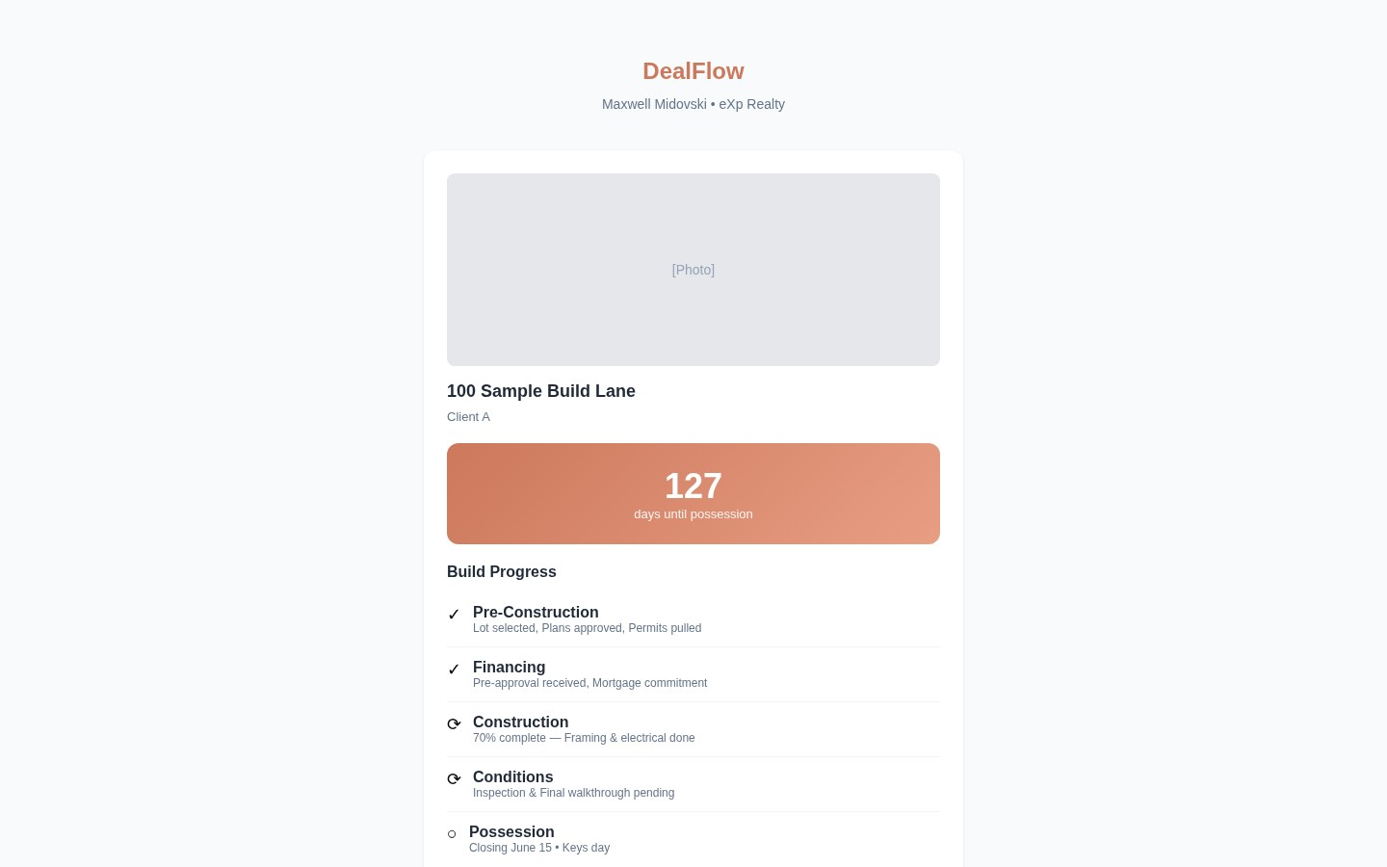
Build Portal (Client)
Public new build tracker
Maxwell DealFlow Visual Guide v4 · Slide 36

Slide 37
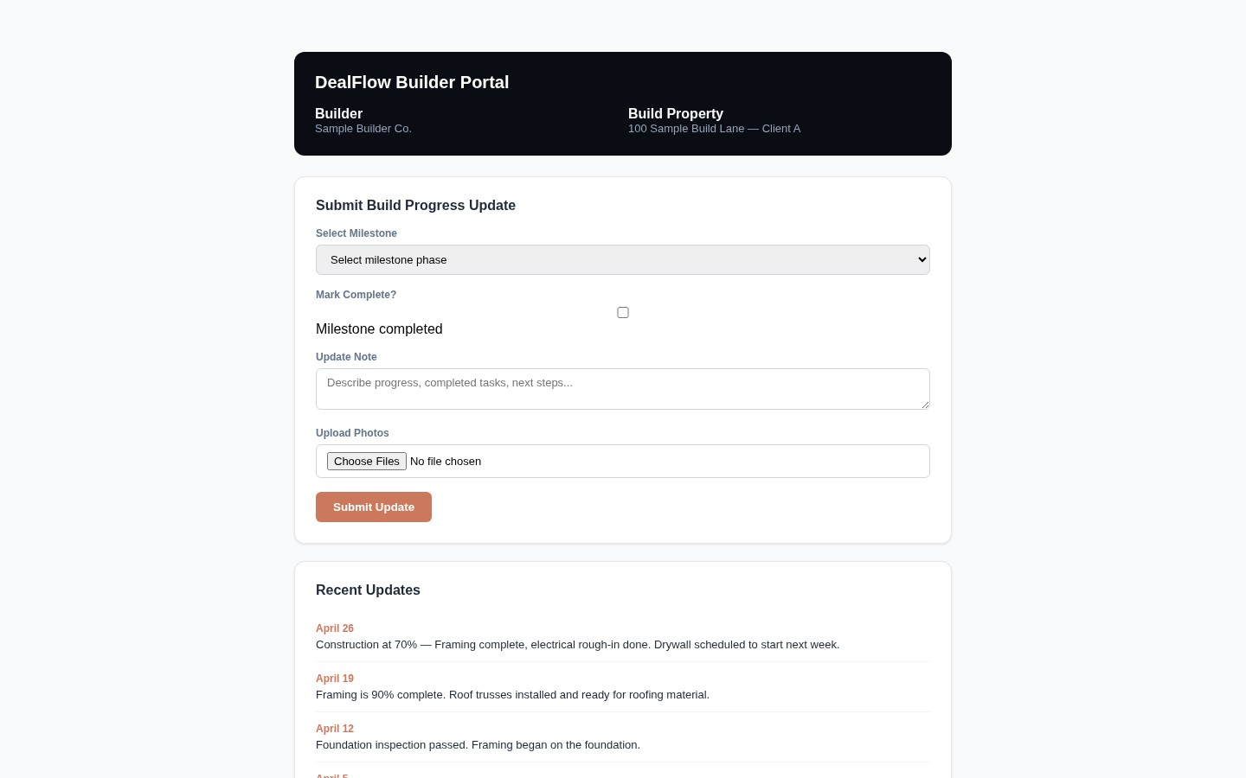
Builder Portal
Builder-facing progress updates
Maxwell DealFlow Visual Guide v4 · Slide 37

Slide 38
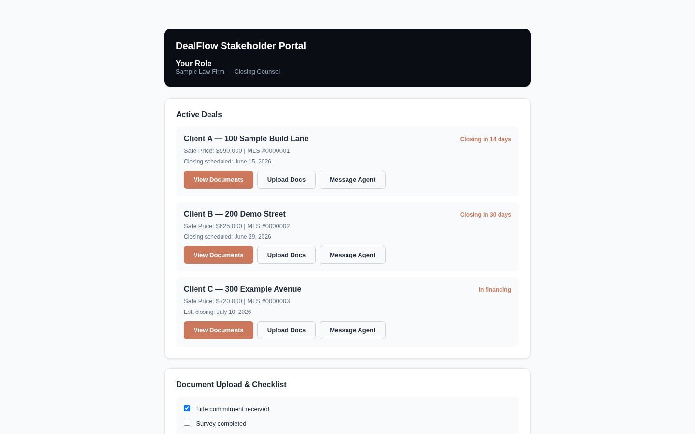
Stakeholder Portal
Lawyer/lender view of deal
Maxwell DealFlow Visual Guide v4 · Slide 38

Slide 39
Mobile

Slide 40
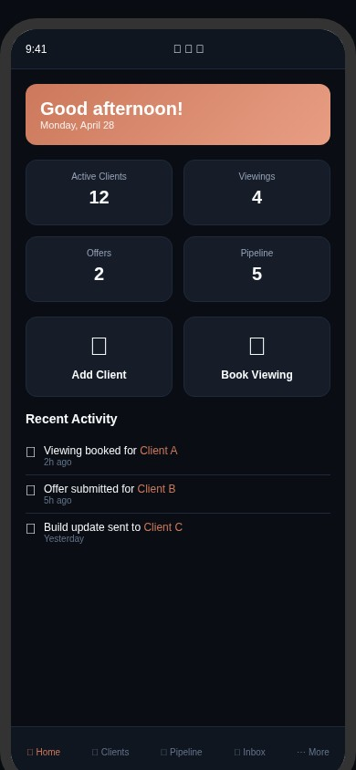
Mobile Dashboard
390x844 mobile layout
Maxwell DealFlow Visual Guide v4 · Slide 40

Slide 41
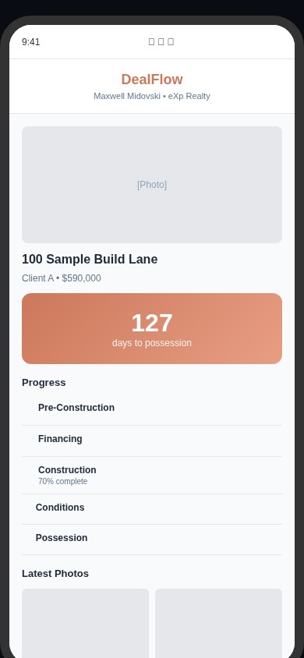
Mobile Build Portal
Build tracker on phone
Maxwell DealFlow Visual Guide v4 · Slide 41

Slide 42

Mobile Push Notification
iPhone lock screen alert
Maxwell DealFlow Visual Guide v4 · Slide 42

Slide 43
End of Visual Guide
Maxwell DealFlow CRM · eXp Realty
Sample data only — all client names and addresses are fictional.

