Slide 1
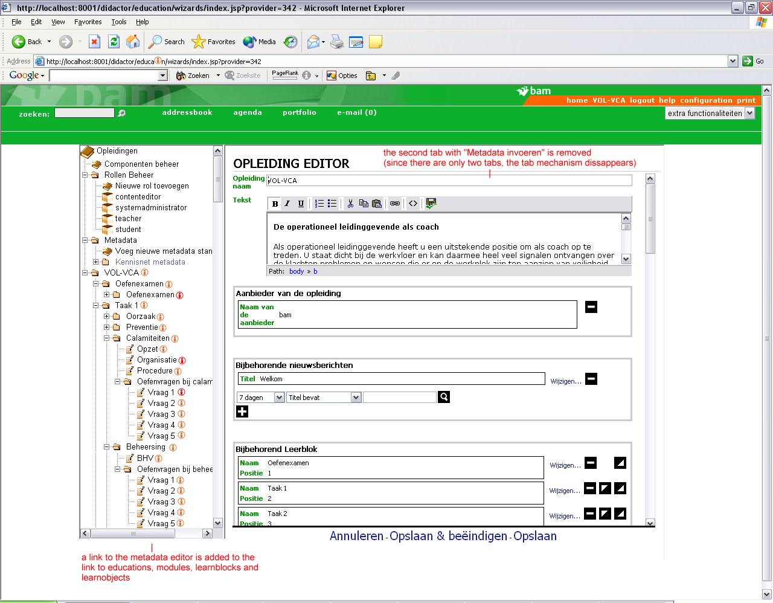
MetaFormButton

Slide 2
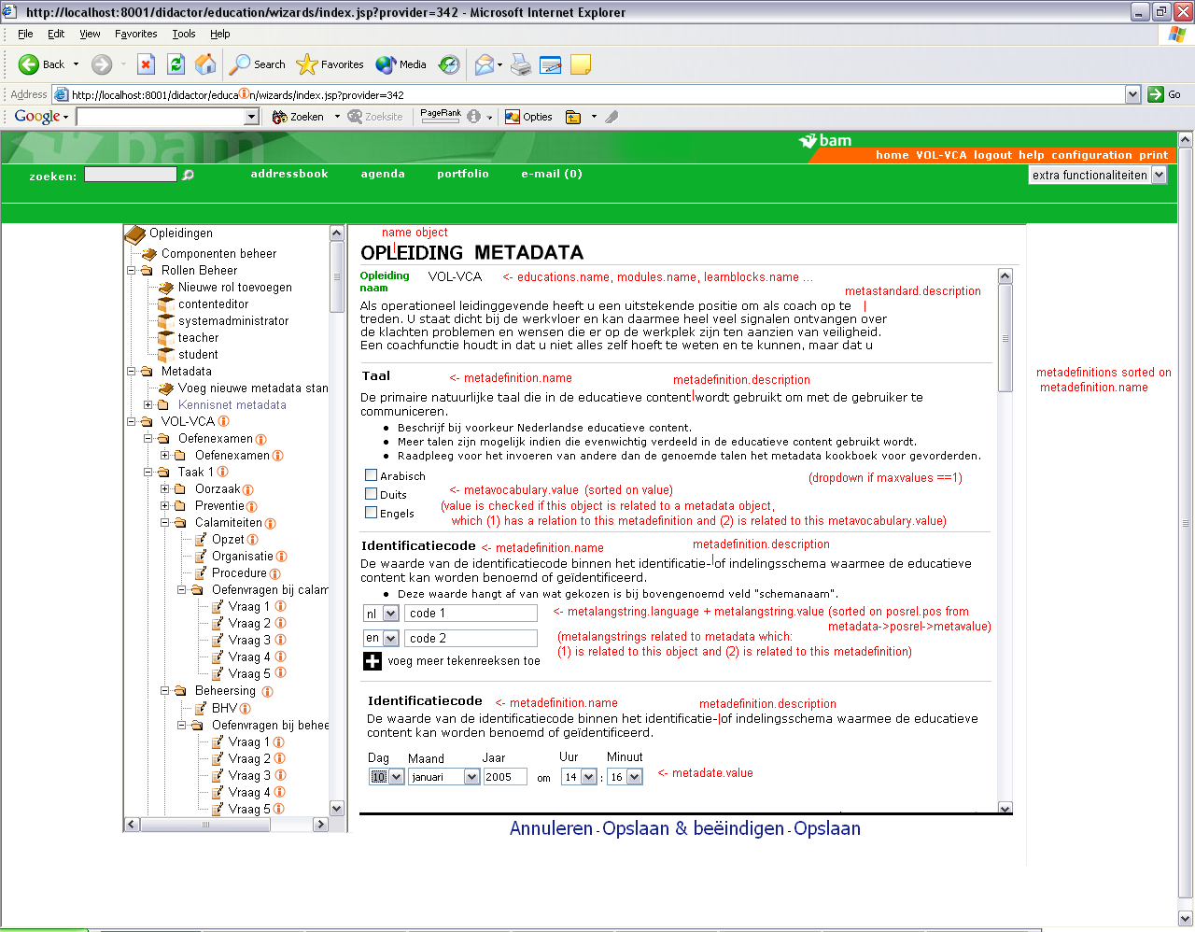
MetaForm1

Slide 3
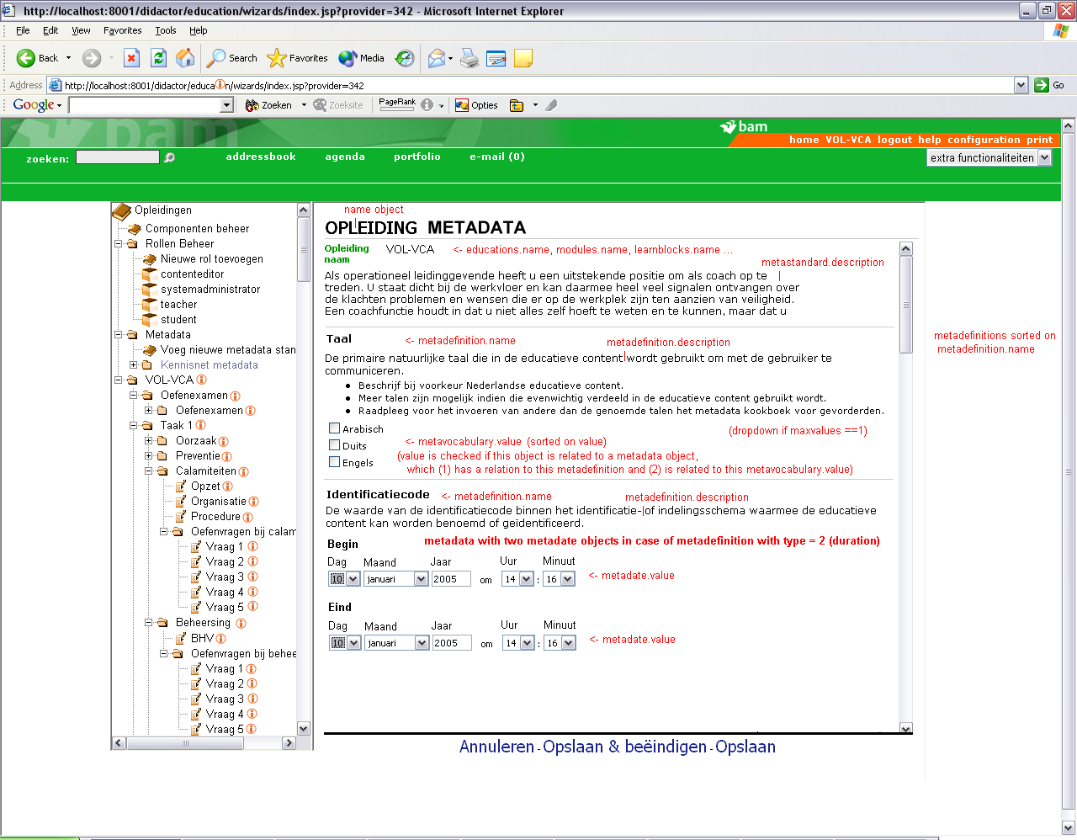
MetaForm2 (with duration)

Slide 4
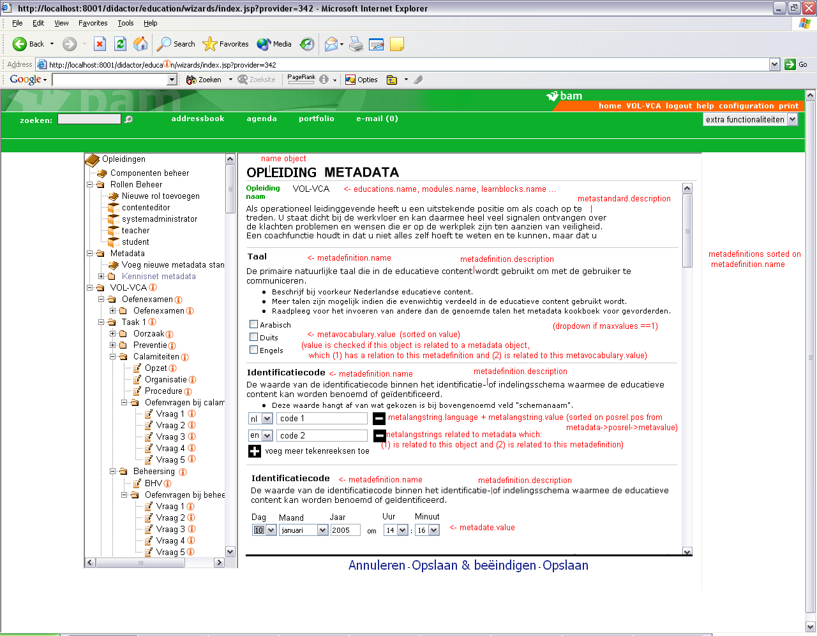
MetaForm3 (deleting lang strings)

Slide 5
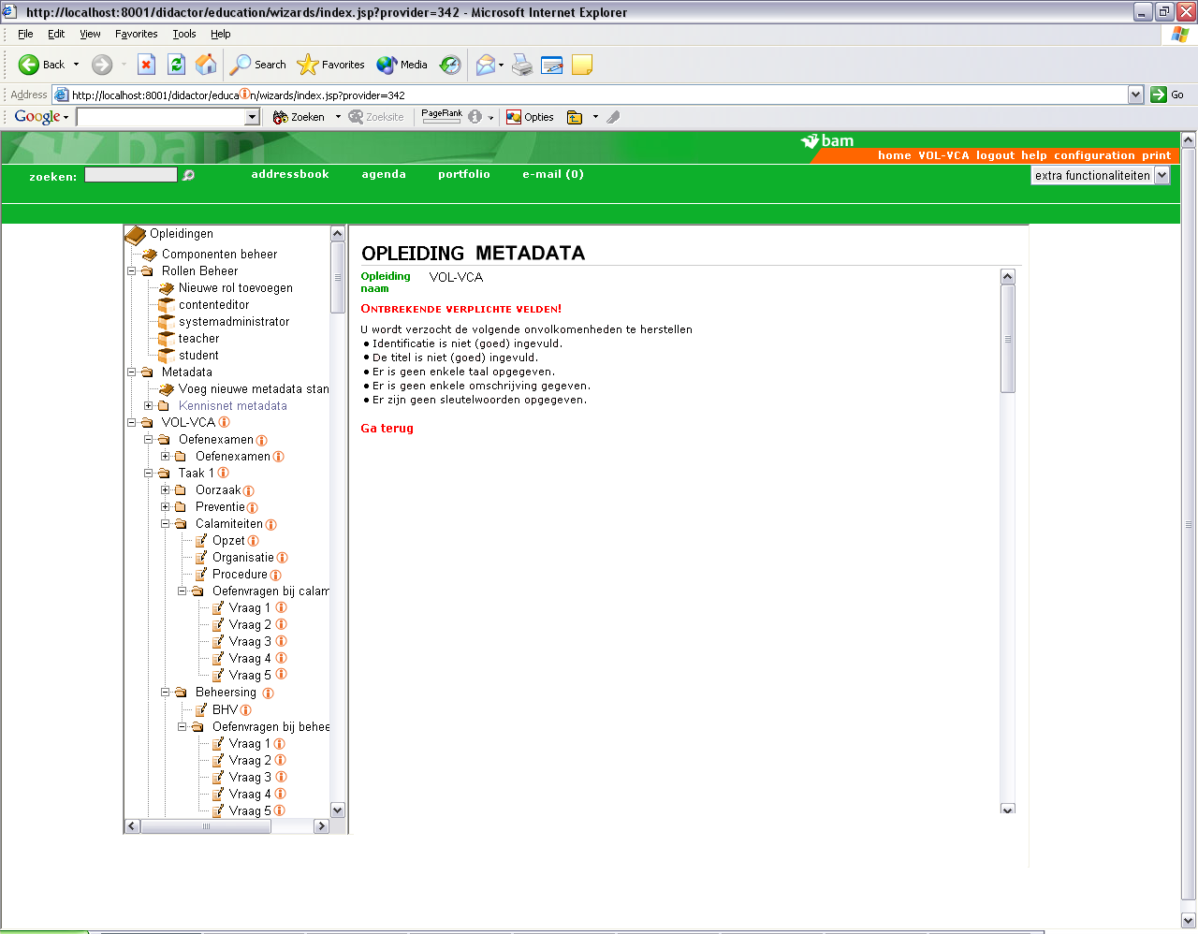
MetaWarning

Slide 6
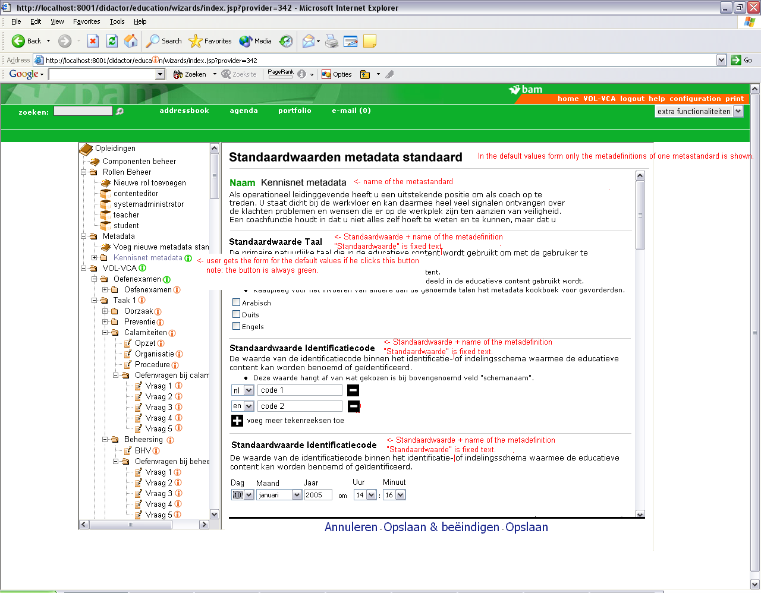
SettingDefaults

Slide 7
MetaFormButton

