Slide 1
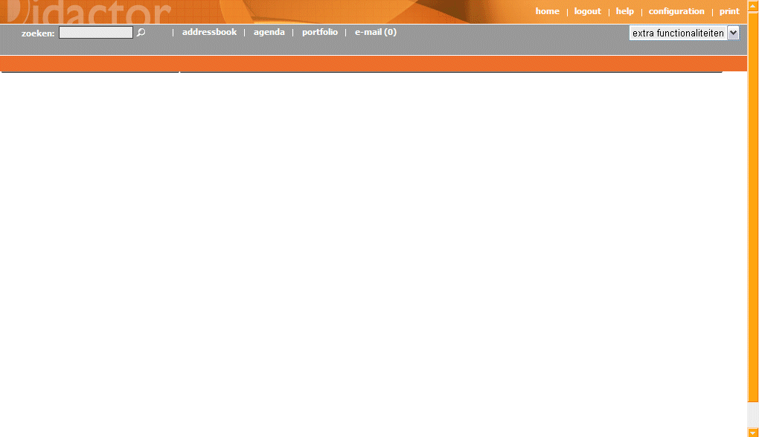
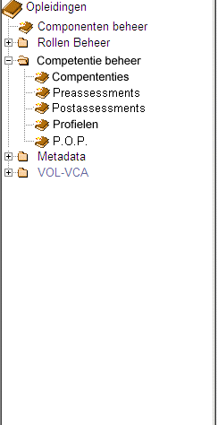
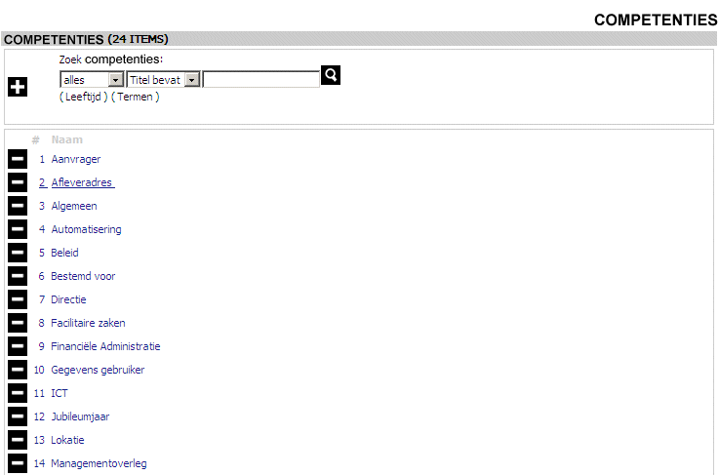
PROJECT | COMPETENCE MANAGEMENT
SCREEN | CompetenciesEdit1
DESCRIPTION | Competencies in the “Competentie beheer” is a link to the editwizard for competencies.

Slide 2
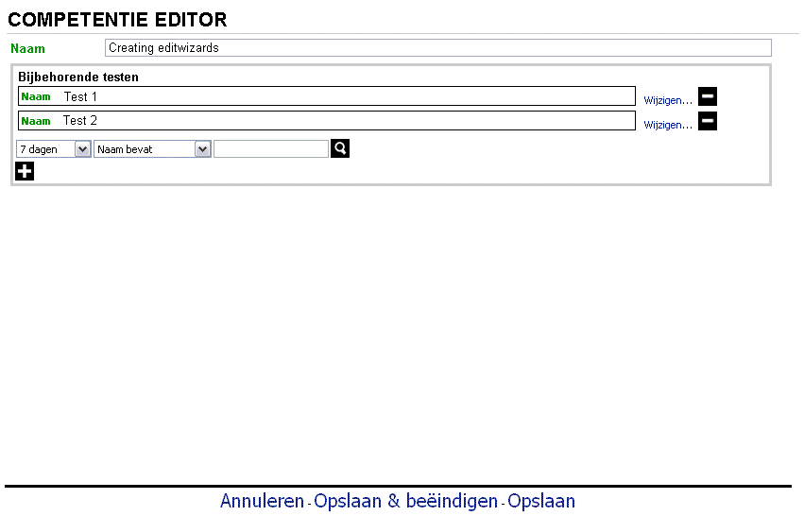
PROJECT | COMPETENCE MANAGEMENT
SCREEN | CompetenciesEdit2
DESCRIPTION | The competency editwizard contains the name of the competency and tests related to the competency.

Slide 3
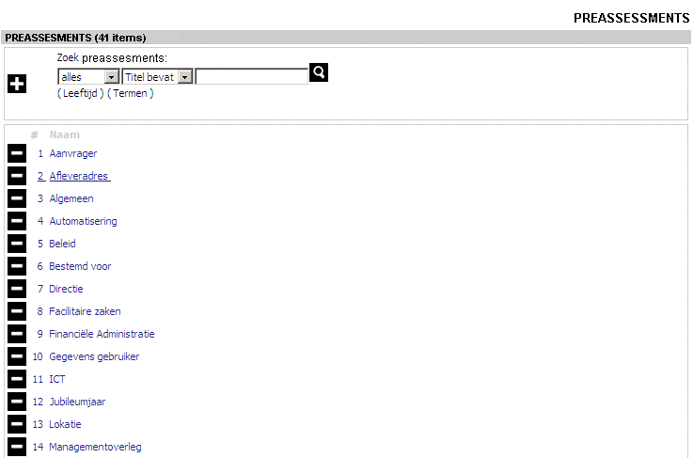
PROJECT | COMPETENCE MANAGEMENT
SCREEN | PreassesmentEdit1
DESCRIPTION | Overview of all available preassessments (generated with list.jsp from the editwizards)

Slide 4
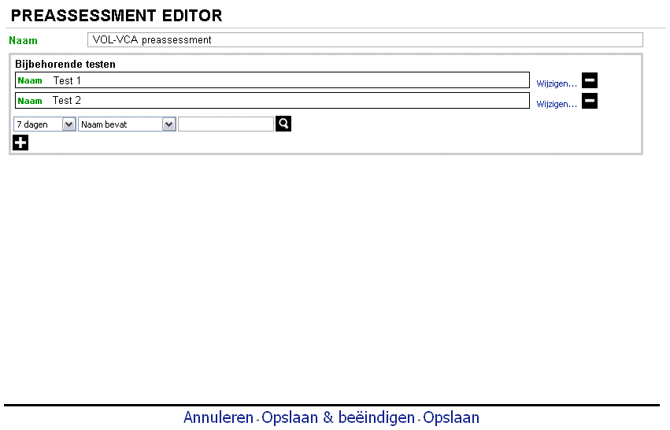
PROJECT | COMPETENCE MANAGEMENT
SCREEN | PreassessmentEdit2
DESCRIPTION | Editwizard for preassessment which allows course developers to add tests to preassesments.

Slide 5
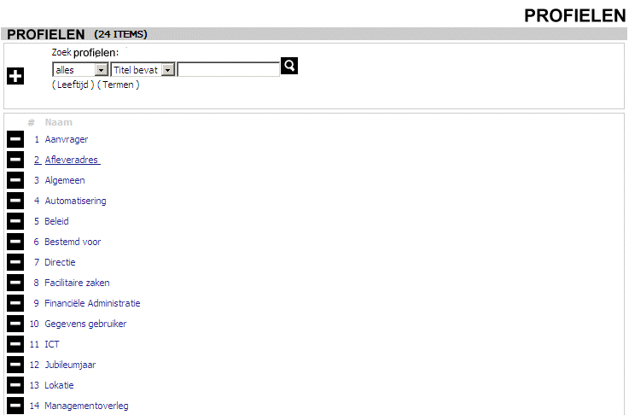
PROJECT | COMPETENCE MANAGEMENT
SCREEN | ProfilesEdit1
DESCRIPTION | Profiles in the “Competentie beheer” dir is a link to the editwizard for profiles. The editwizard contains the name of the profile and shows all (a) related competencies (use the related relationship) and (b) preassesment for the profile

Slide 6
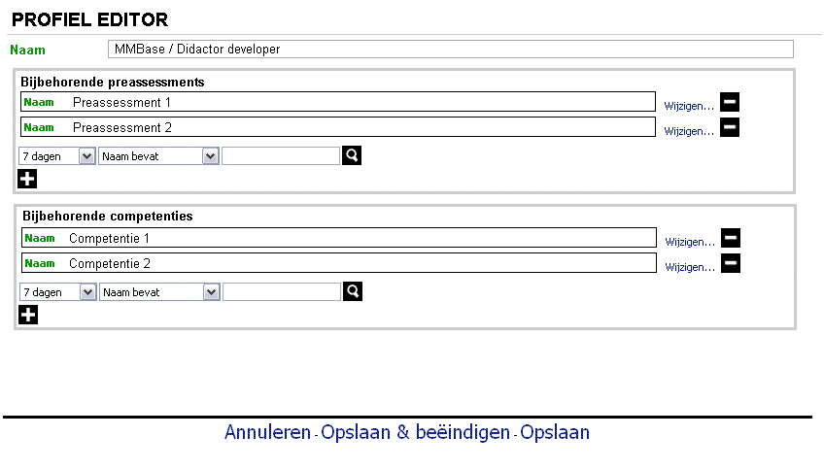
PROJECT | COMPETENCE MANAGEMENT
SCREEN | ProfilesEdit2
DESCRIPTION | The profiles editwizard contains the name of the profile and shows all (a) related competencies (use the related relationship) and (b) preassesment for the profile

Slide 7
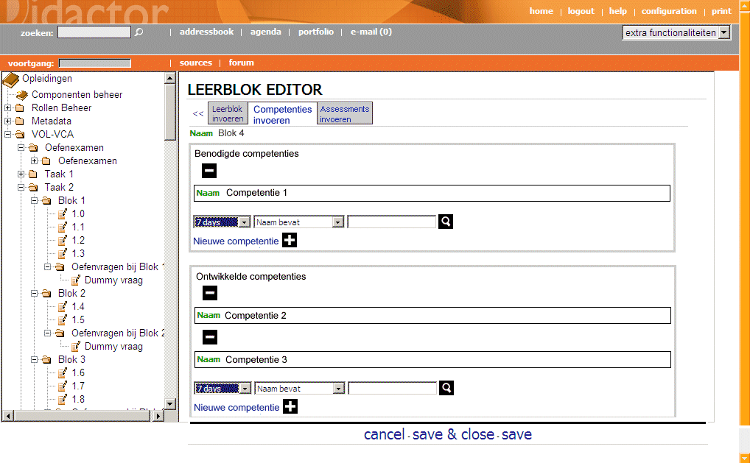
PROJECT | COMPETENCE MANAGEMENT
SCREEN | CompLearnObj1
DESCRIPTION | When a course developer clicks on a learning object, learning block or education in the tree an editwizard opens. On the second tab (Competenties invoeren) he can add required (= benodigde) and developed (=ontwikkelde) competencies to the learning object.

Slide 8
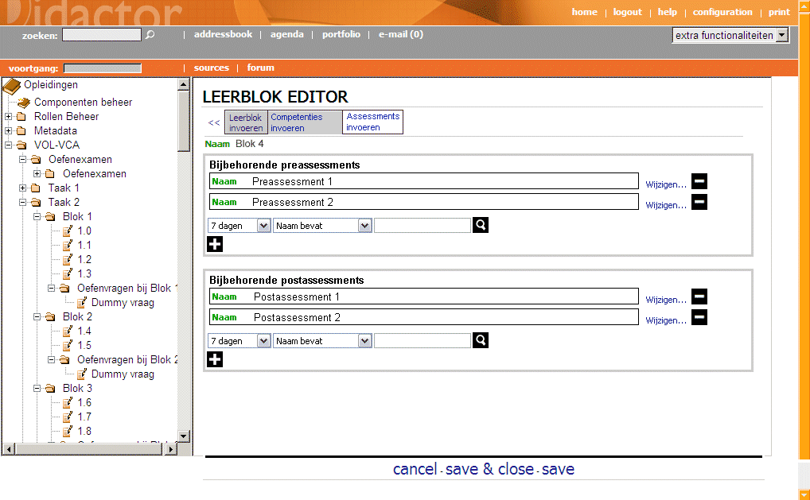
PROJECT | COMPETENCE MANAGEMENT
SCREEN | CompLearnObj2
DESCRIPTION | When a course developer clicks on a learning object, learning block or education in the tree an editwizard opens. On the third tab he can add pre- and postassessments for the learnobject.

Slide 9
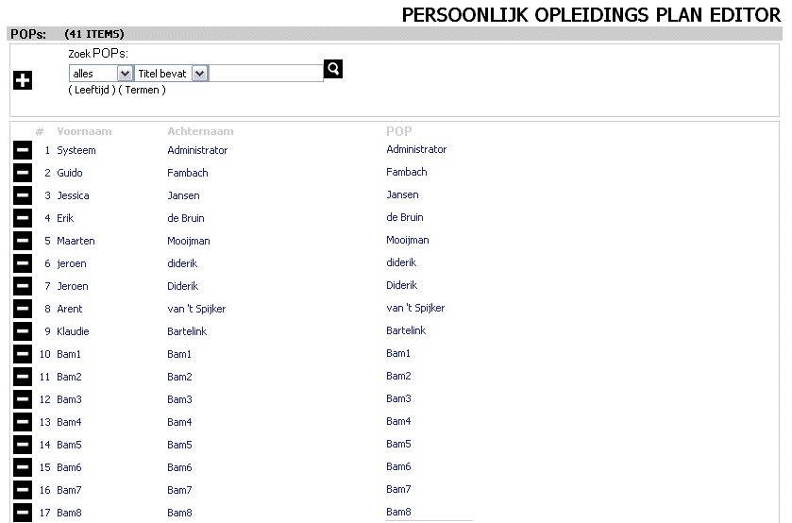
PROJECT | COMPETENCE MANAGEMENT
SCREEN | PopEdit1
DESCRIPTION | List of all People x POP’s (use list.jsp from the editwizards with nodepath=people,pop&fields=people.firstname,people.lastname,pop.name)

Slide 10
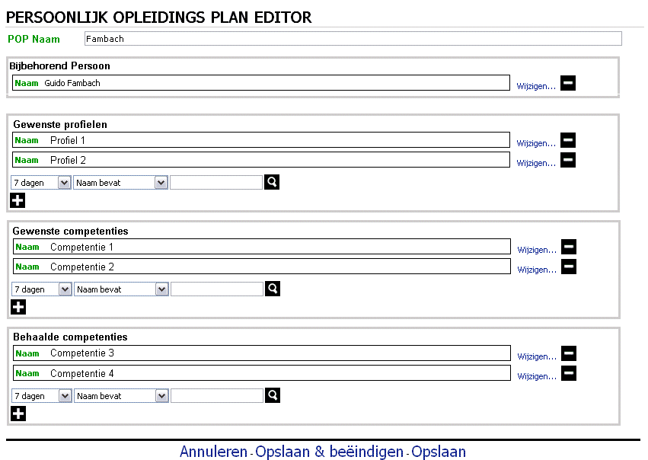
PROJECT | COMPETENCE MANAGEMENT
SCREEN | PopEdit2
DESCRIPTION | Editwizard for POP. The related person is mandatory (use dtminoccurence=dtmaxoccurence=1)

Slide 11
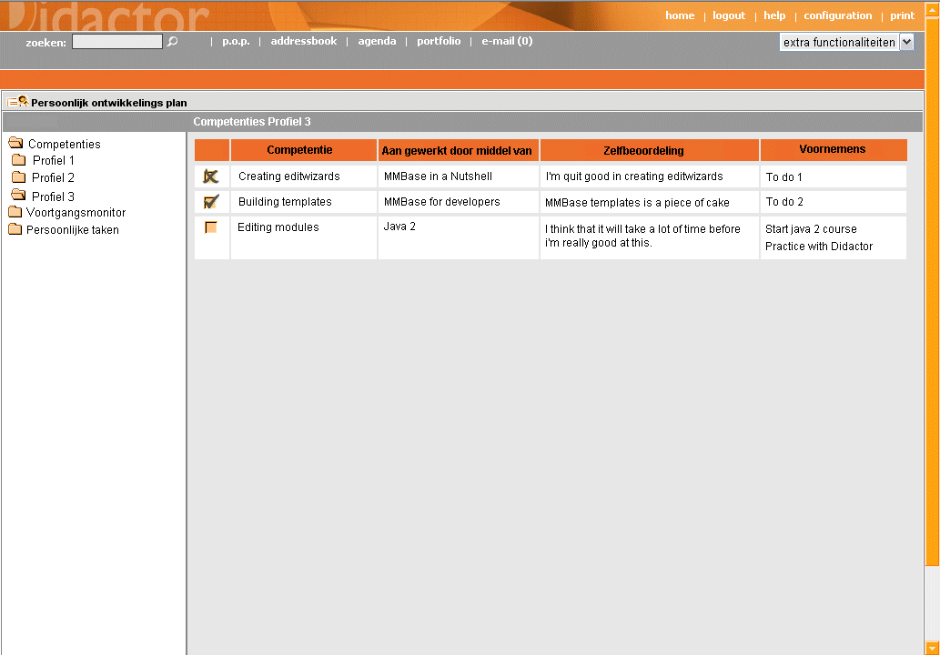
PROJECT | COMPETENCE MANAGEMENT
SCREEN | PopCompetencies
DESCRIPTION | Overview of competences (checkbox with cross = competence is present; checkbox with check = competence is developed; empty checkboxe = competence is needed)
Hi Nickolay,
When you find buttons which still need an alt-text, please add
to these buttons in the powerpoint, send the powerpoint to me and i will fill in the text
???

Slide 12
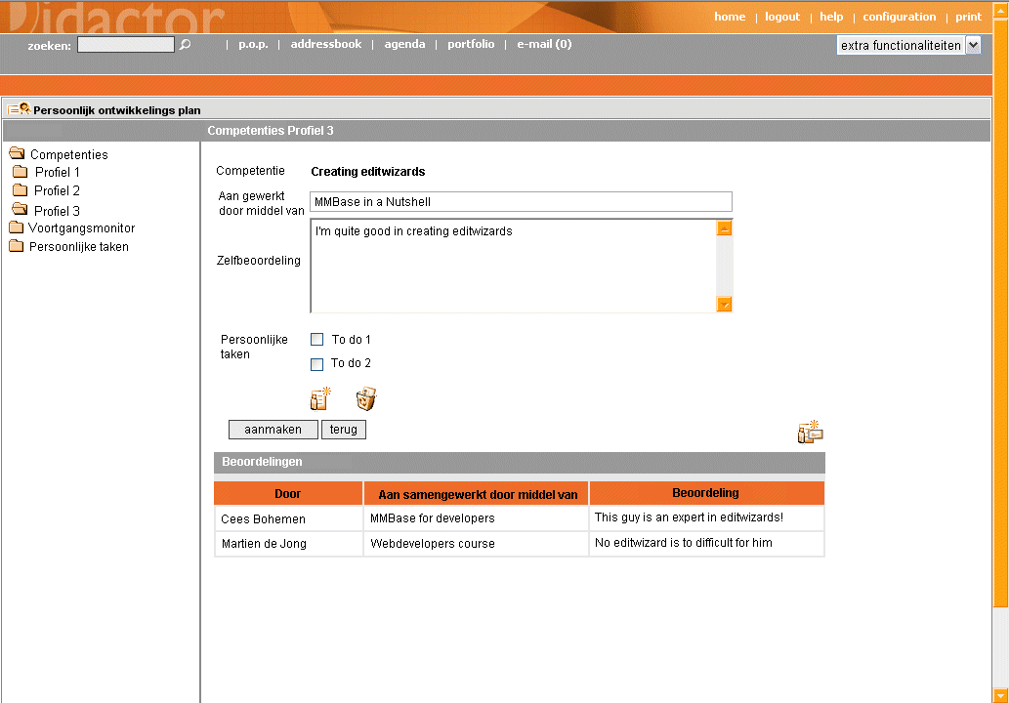
PROJECT | COMPETENCE MANAGEMENT
SCREEN | PopCompetenciesEdit
DESCRIPTION | Edit screen for competences (three buttons: new todo item, delete selected todo items, invite colleague student to give feedback) Use the following scheme: -PopCompetenciesEdit + Aanmaken -> PopCompetencies with message "Uw zelfbeoordeling is aangemaakt"" ? -PopCompetenciesEdit + Add new personal task -> PopTodoEdit -> PopCompetenciesEdit with message "Nieuwe persoonlijke taak is toegevoegd" -PopCompetenciesEdit + Delete selected personal task -> Prompt "Weet u zeker dat u de geselecteerde persoonlijke taken wilt verwijderen" -if yes-> PopCompetenciesEdit with message "De geselecteerde persoonlijke taken zijn verwijdert" -PopCompetenciesEdit + Invite colleague -> PopCompetencieInvite -> PopCompetenciesEdit with message "De uitnodiging voor een beoordeling over deze competentie is verstuurd"
Maak een nieuwe persoonlijke taak aan
Verwijder de geselecteerde persoonlijke taken
Nodig een collega uit om een feedback te geven op deze competentie

Slide 13
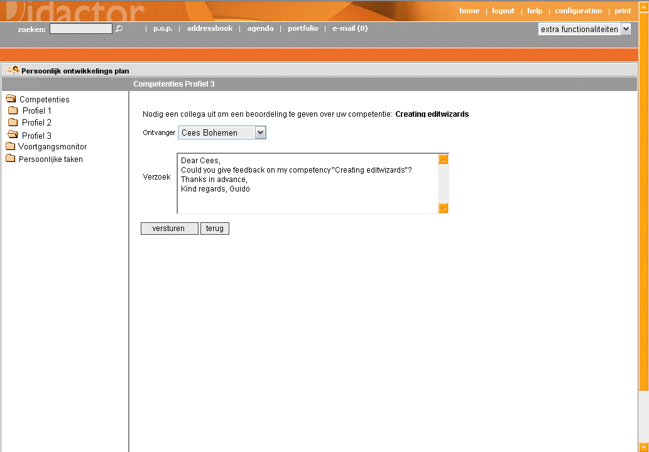
PROJECT | COMPETENCE MANAGEMENT
SCREEN | PopCompetencieInvite
DESCRIPTION | Screen for inviting colleague students to give feedback on one of your competences.

Slide 14
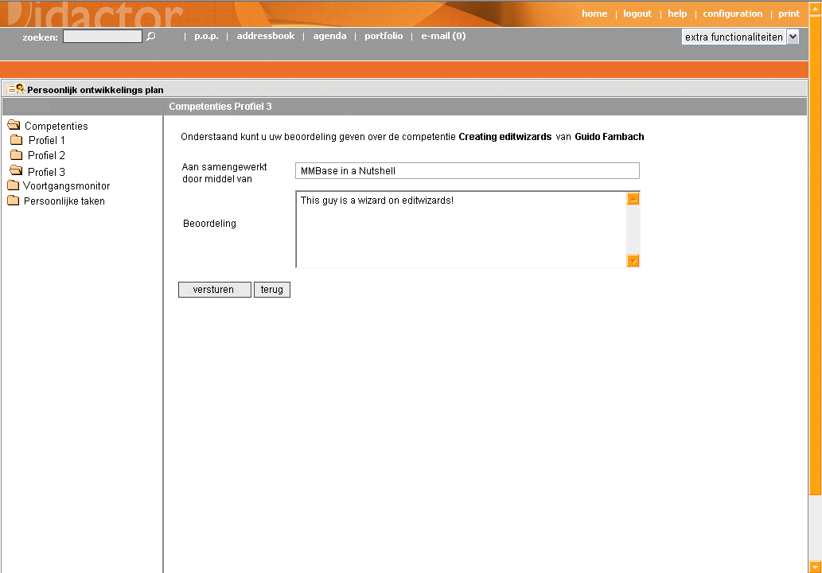
PROJECT | COMPETENCE MANAGEMENT
SCREEN | PopCompetenciesFeedback
DESCRIPTION | Screen to give feedback on one of the competences of a colleague student

Slide 15
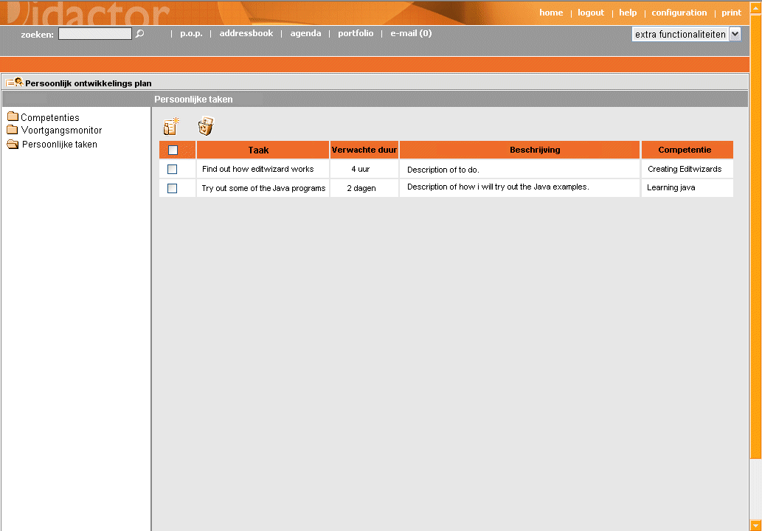
PROJECT | COMPETENCE MANAGEMENT
SCREEN | PopTodo
DESCRIPTION | Personal task list for a student.
Maak een nieuwe persoonlijke taak aan
Verwijder de geselecteerde persoonlijke taken

Slide 16
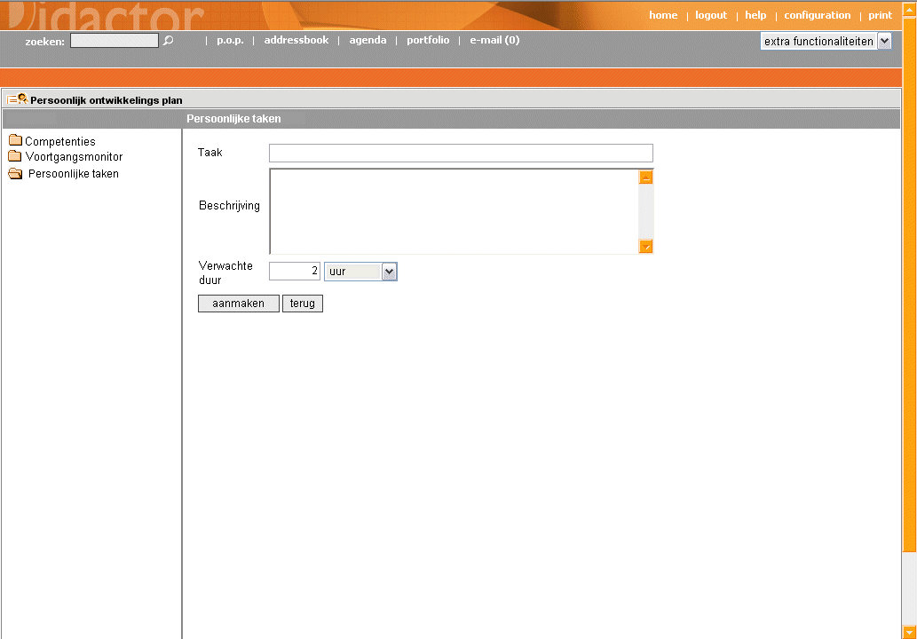
PROJECT | COMPETENCE MANAGEMENT
SCREEN | PopTodoEdit
DESCRIPTION | Edit form for personal tasks
dropdown with present, developed, and needed competencies onPPT16 would solve the problem (dropdown should also contain "...", for no competency related to todoitem)
Above buttons

Slide 17
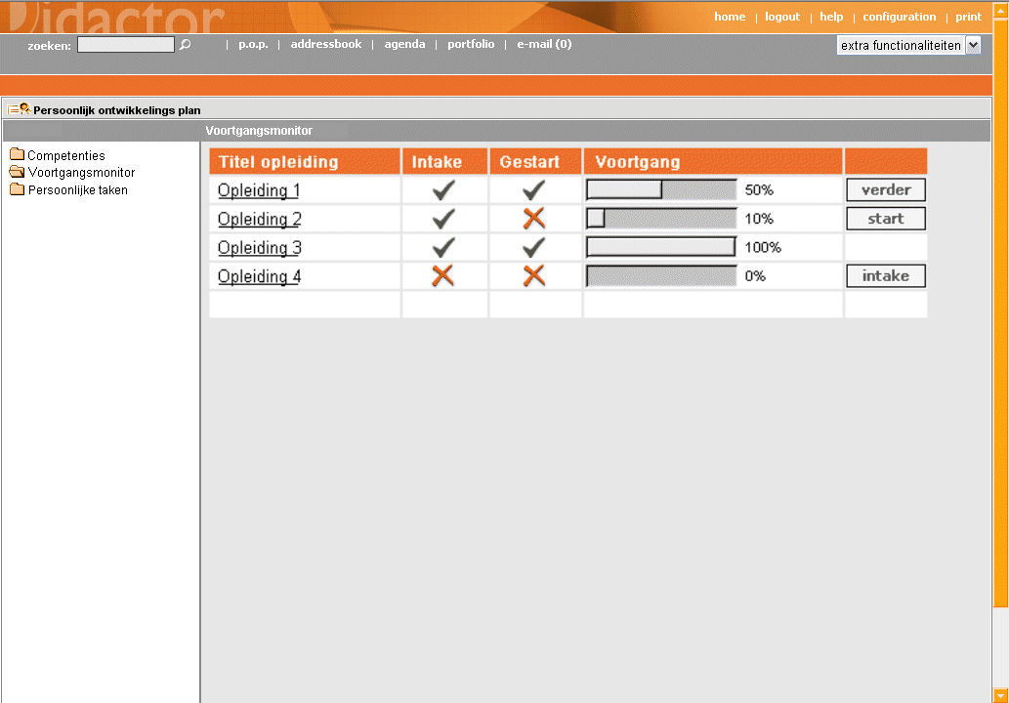
PROJECT | COMPETENCE MANAGEMENT
SCREEN | PopProgress
DESCRIPTION | Progress overview of the educations by which the students tries to acquire the competencies in his profile.
Ga verder met deze cursus
Begin met deze cursus
Bekijk de testresultaten
Doe de intake voor deze cursus

Slide 18
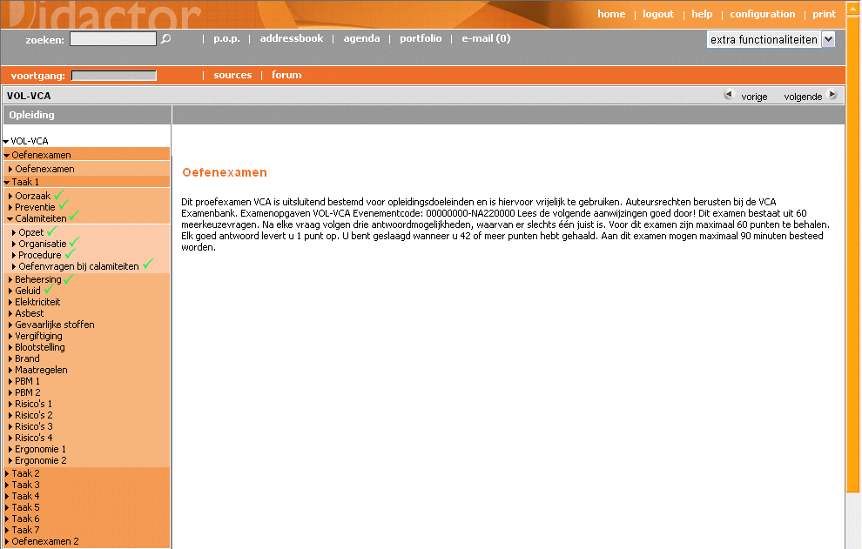
PROJECT | COMPETENCE MANAGEMENT
SCREEN | PopProgressEducation
DESCRIPTION | If the student clicks “verder” in PopProgress he continues the course where he stopped the last time. The learning objects related to competencies already developed by the student are marked with a

Slide 19
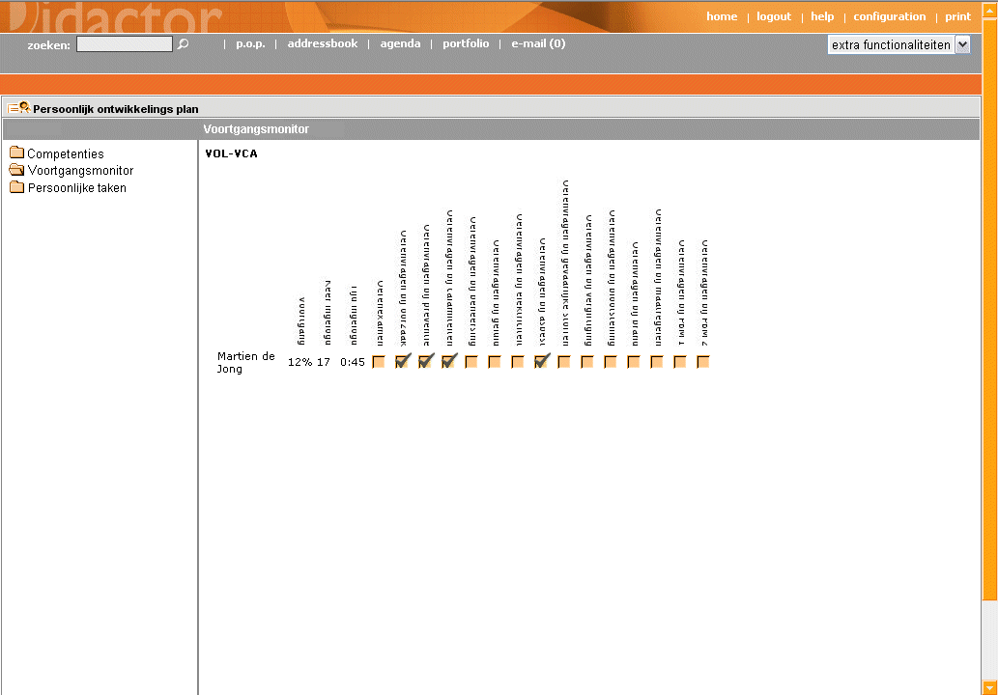
PROJECT | COMPETENCE MANAGEMENT
SCREEN | PopProgressDetail
DESCRIPTION | If the student clicks on the progressbar in PopProgress he gets details on his performance on the test in the selected education.

Slide 20
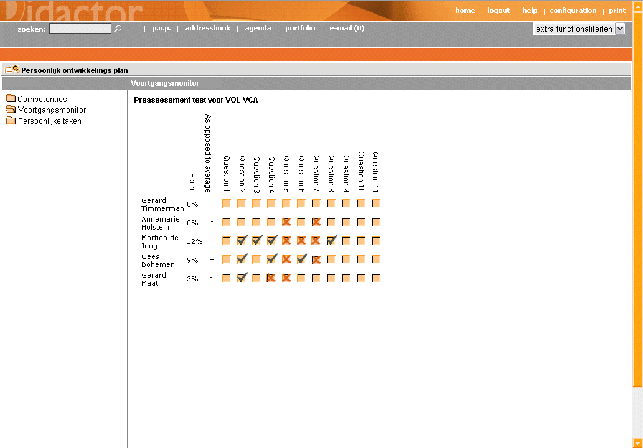
PROJECT | COMPETENCE MANAGEMENT
SCREEN | PopProgressTest
DESCRIPTION | If a teacher clicks on a test (e.g. in the progres page of students) he gets details on the performance of the students he guides on the test.

