Slide 1
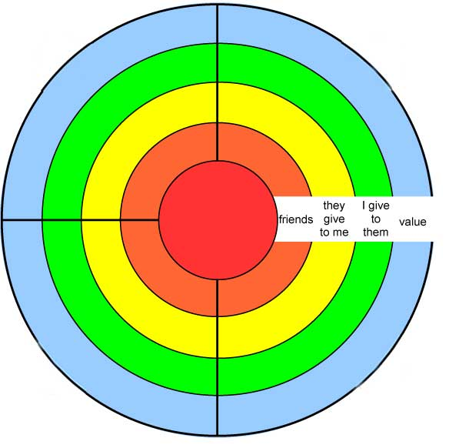
Friend 2
friend1
Your name
here
Friend 3
Friend 4

