Slide 1
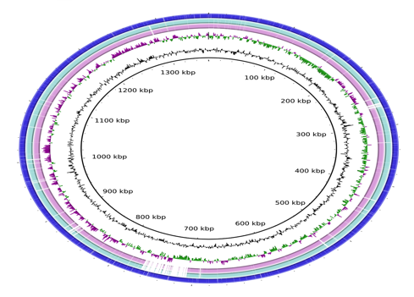
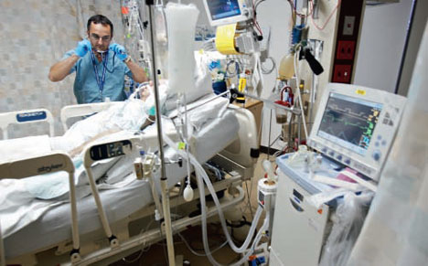
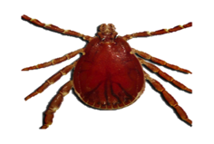
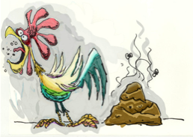
Adventures with metagenomics
Professor Mark Pallen

Slide 2
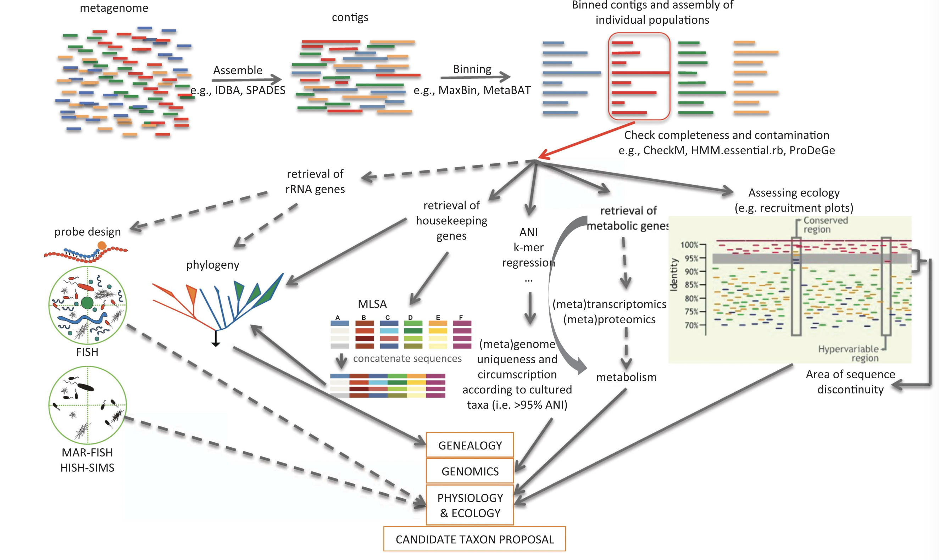


Plus:
Generation of 1000s of grammatically correct, distinctive Latin binomials!

Slide 3
Back-mapping and coverage
back-mapping refers to aligning MAGs or gene catalogues back to metagenomic reads
provides information on coverage, i.e. the average number of times a nucleotide in MAG or gene is represented in a sample
critical for determining the abundance of species or genes in each sample

Slide 4
What are MAGs?
Metagenome-Assembled Genomes (MAGs) are genomes constructed from metagenomic data
represent genomes of members of microbial communities in environmental samples.
vital for studying unculturable microorganisms
help in understanding microbial diversity and functions in various environments
reference-free approach to discovering unknown unknowns

Slide 5
Binning in Metagenomics
The process of grouping sequences from metagenomic datasets into 'bins'.
Each bin represents a potential genome from a single species or closely related group.

Slide 6
Automatic binning (SemiBin2)
Advanced tool for semiautomated binning
Uses machine learning to improve the binning process
Integrates sequence composition and abundance information
Employs deep learning for enhanced binning accuracy
User-friendly and suitable for large-scale metagenomic projects.

Slide 7
Manual binning (Anvi’o)
dynamic iterative exploration and refinement of bins with data through user-friendly interface
visualization of contig-level information like GC content, coverage, and taxonomy
users can visually inspect clusters of contigs and assign them to bins
refine and curate bins based on various data layers
helps in identifying and correcting misbinning errors
ideal for complex datasets where automated binning falls short

Slide 8
MAG QC with CheckM
CheckM is a tool designed to assess the quality of MAGs
Uses lineage-specific marker genes to estimate completeness and contamination
Completeness:
Percentage of expected marker genes found in the MAG
Contamination:
Percentage of marker genes found in multiple copies
High completeness with low contamination suggests a high-quality MAG

Slide 9
GTDB-Tk
A toolkit for assigning taxonomy to MAGs based on the Genome Taxonomy Database (GTDB)
Uses a comprehensive and up-to-date reference tree
Aligns MAGs to reference genomes
Places MAGs into the GTDB phylogenetic tree
Provides consistent standardized taxonomic classifications
Helps in comparing MAGs across different studies

Slide 10
Functional Content Analysis of MAGs
Enables prediction of the metabolic capabilities and ecological roles within microbial communities.
Predict CDSs and annotate MAGs for functional genes and metabolic pathways.
Integrate several data sources to provide a comprehensive metabolic overview
Output
Annotated genes, pathways, and putative functions

Slide 11
Case Study: waking the dead
Metagenomics in ancient DNA research
Case study 1: medieval Brucella
Case study 2: 200-year old TB genomes in Hungarian mummies

Slide 12
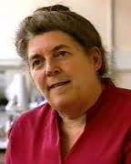
Metagenomics of ancient pathogen DNA
Substantial literature
TB, leprosy, plague, typhoid, influenza, hepatitis B, smallpox, malaria, Leishmania, trypanosomiasis, helminths
Palaeo-genomics of Black Death and TB
BUT risk of contamination with PCR
Why not try metagenomics?
Avoidance of amplification
Avoids risk of PCR amplicon carryover
Low risk of contamination with unamplified pathogen DNA
Avoidance of hybridisation capture
Assumption-free, finds unknown unknowns
No need to design and optimise capture probes
Potential problems
Might expect high abundance of human DNA
Post-mortem contamination
Helen Donaghue

Slide 13
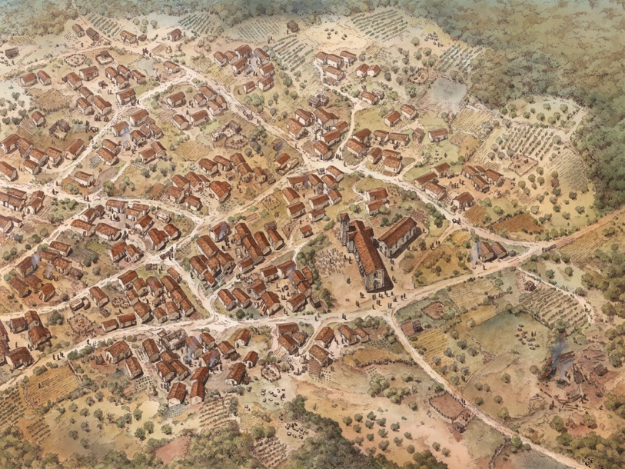
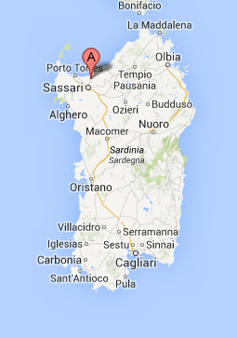
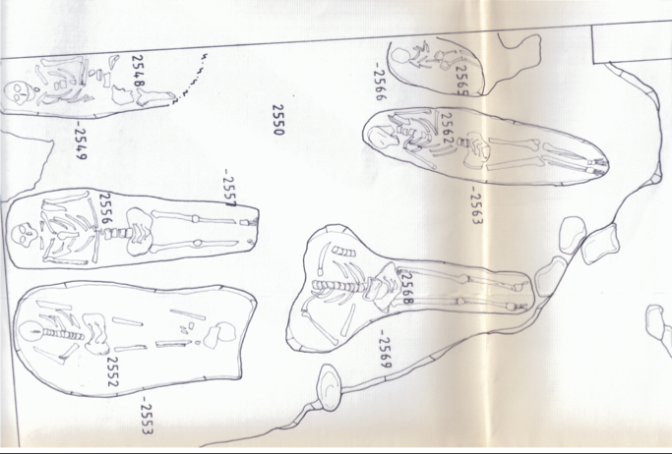
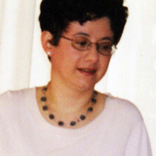
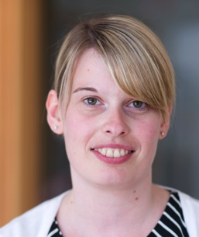

Medieval village of Geridu, abandoned 1426
Skeleton 2568
50-60 yr-old male
Buried second half of 1300s
Excavated 1997

Slide 14
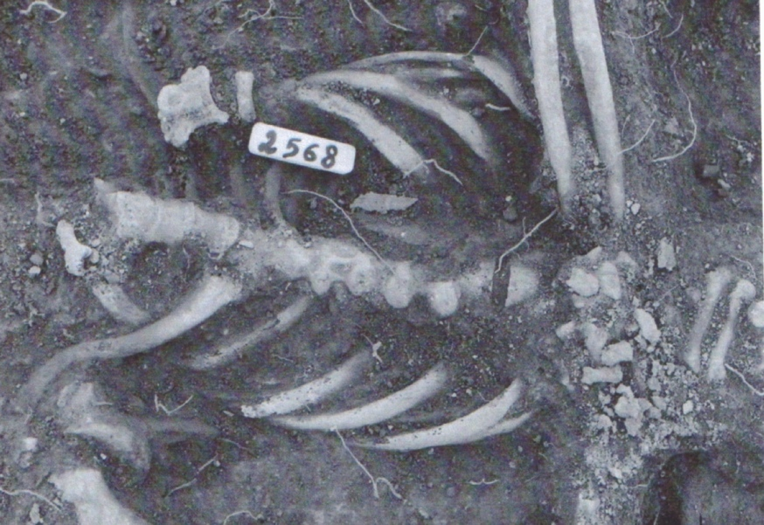
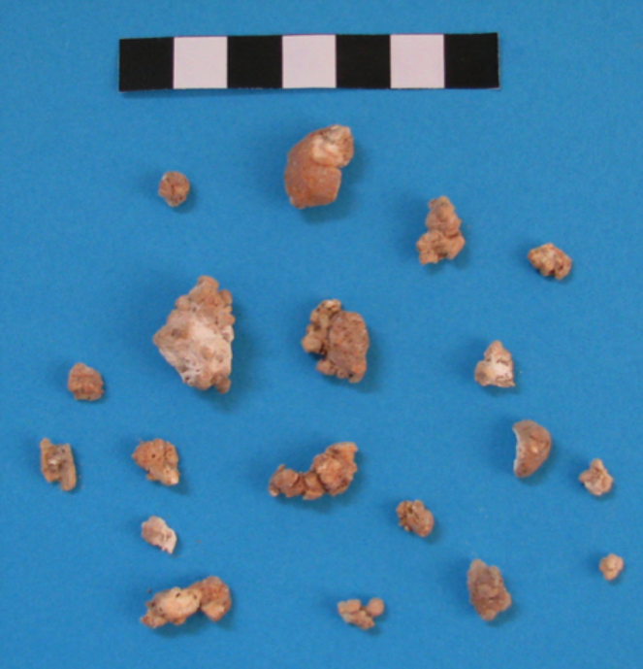
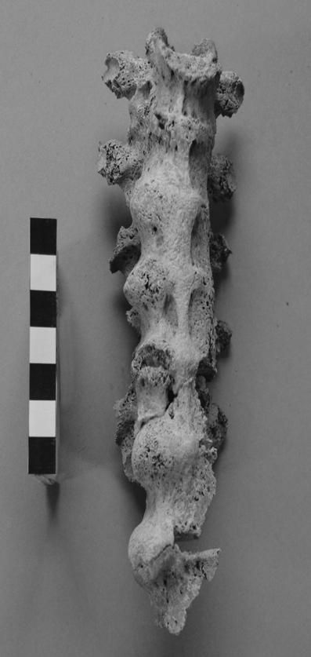
Skeleton 2568

Slide 15
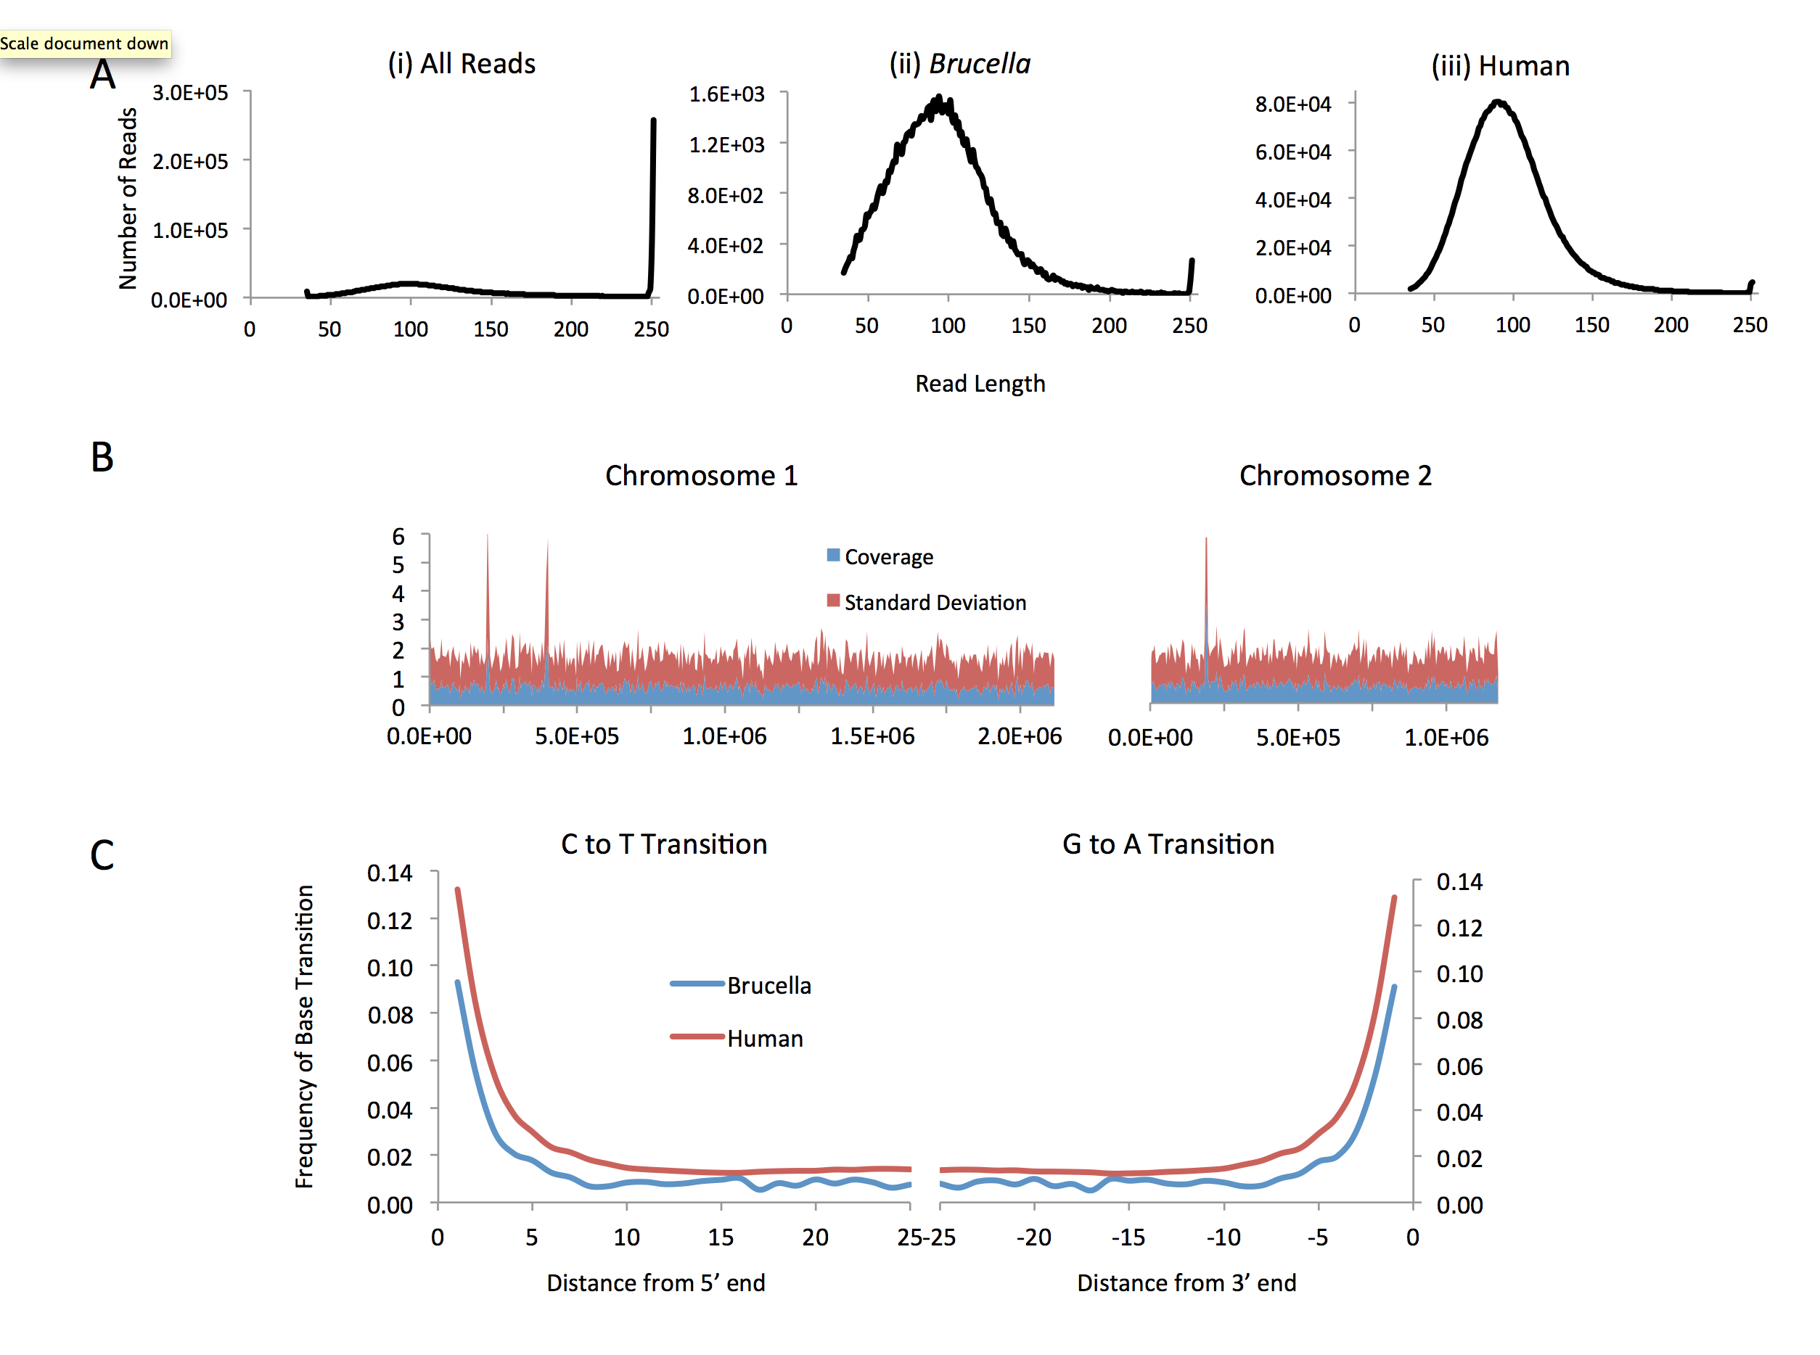

Slide 16
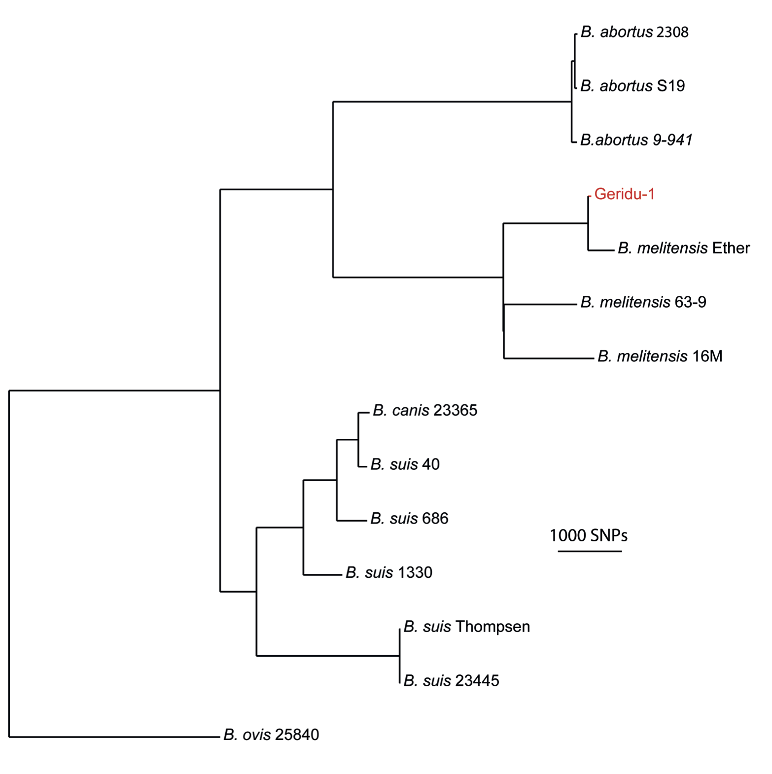
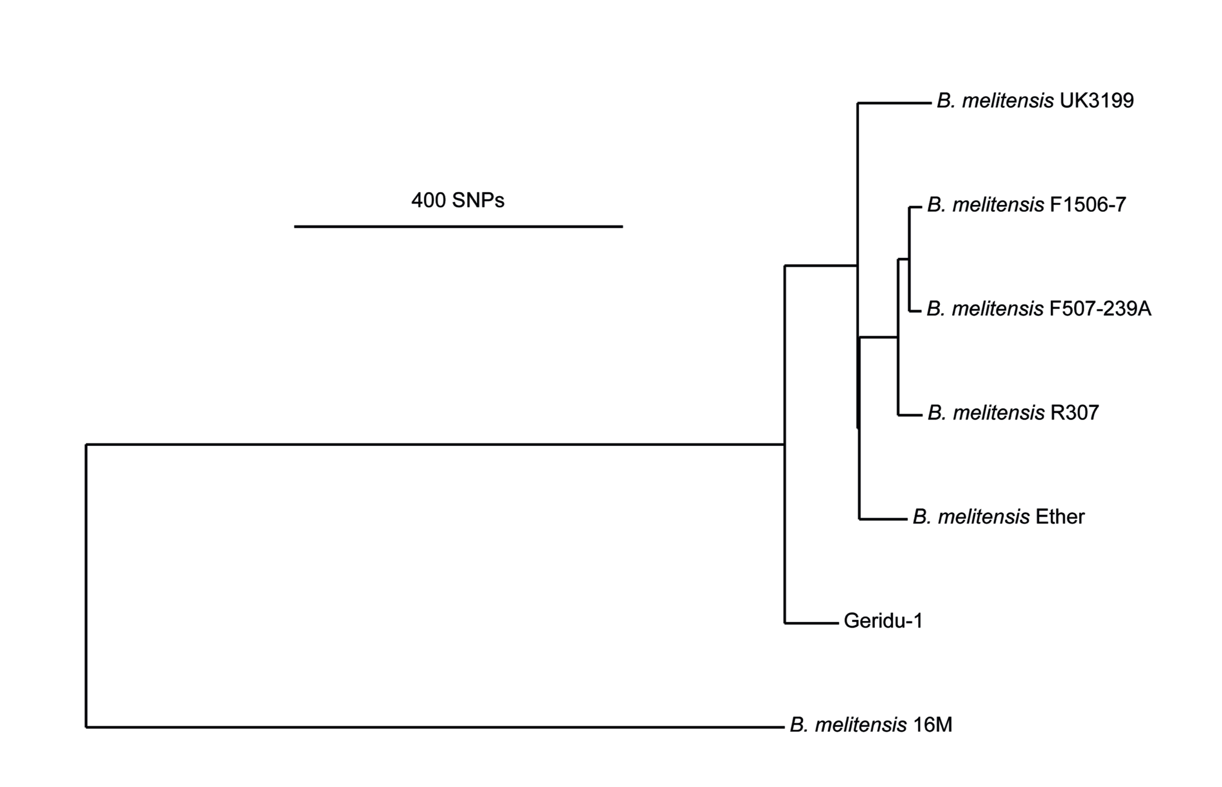

Slide 17
Brucellosis in Geridu in context
Long history of brucellosis in Italy from palaeopathology
Bony signs in Herculaneum skeletons
Only one other detection by aDNA; from 10-13th C Albania
Brucella melitensis acquired from sheep and goats
Long history of sheep (± goat) farming in Sardinia
Distinctive genomic signatures in 2 breeds
Sardinian mouflon
Unclear whether skeleton 2568 represents farmer or just someone who ate dairy produce
DISH associated with sedentary lifestyle

Slide 18
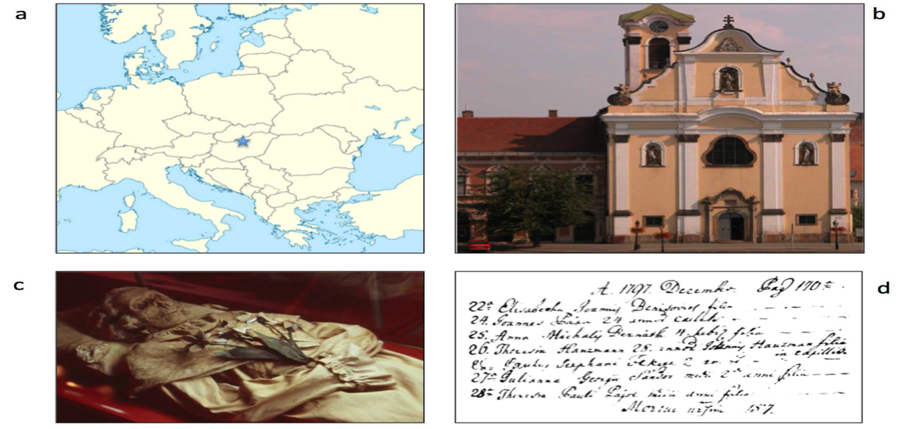

Hungarian mummies
In 1994, a crypt was discovered in Vác, Hungary, containing 242 bodies, many naturally mummified
Although all affluent middle-class Catholics, over half showed some evidence of TB
Mark Spigelman

Slide 19
Tuberculosis in 18th Century Hungary
Included the remains of Terézia Hausmann who died on 25 December 1797, aged 28 years
CXR clear, but she appeared cachectic, consistent with TB
Microbiological/molecular analyses on chest sample confirmed diagnosis of TB, provided genotypic and quantitative data, suggesting very good preservation of TB DNA

Slide 20
Metagenomics of 200-year-old lung tissue
5.5 million reads
<1% aligned against the human genome
8% aligned against the Mycobacterium tuberculosis reference strain H37Rv, providing an average 32-fold coverage of this genome
As we have not cultured MTB, nor performed any MTB-specific PCRs in our laboratory and as we have obtained deep and even genomic coverage, contamination can be ruled out

Slide 21
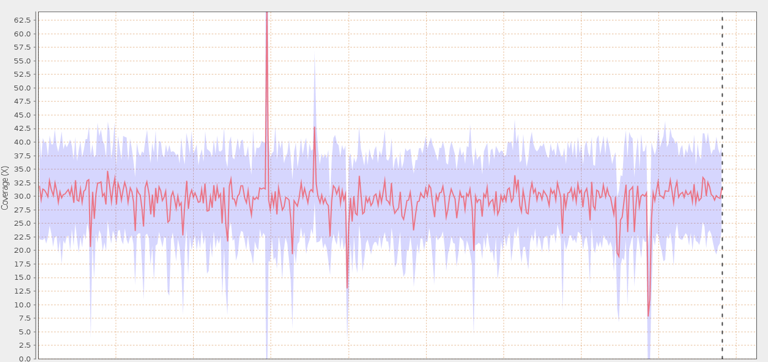
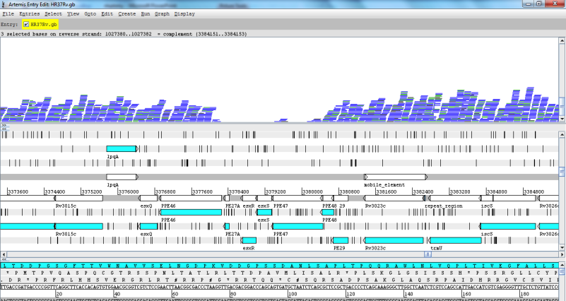
Mapping
Indels versus H37Rv characteristic of 7199/99 and Erdman strains from Haarlem lineage

Slide 22
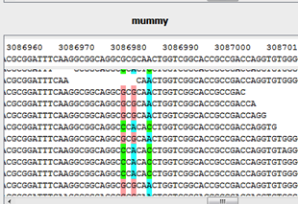
Mixed Infection
When the metagenomic reads were compared with H37Rv, we found evidence that TH suffered from a mixed infection with two MTB genotypes
Interestingly, previous spoligotyping studies identified two genotypes in samples from the Hausmann family

Slide 23
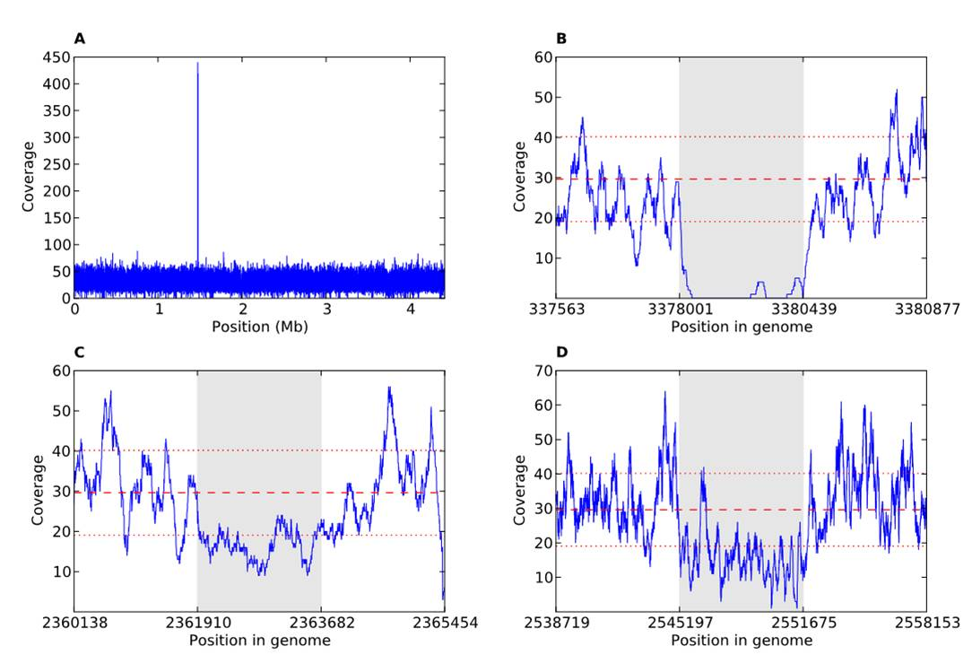
Coverage also Implicates Mixed Infection
Some of the deleted regions in 7199/77 showed 50% coverage
Loss in one strain but not the other

Slide 24
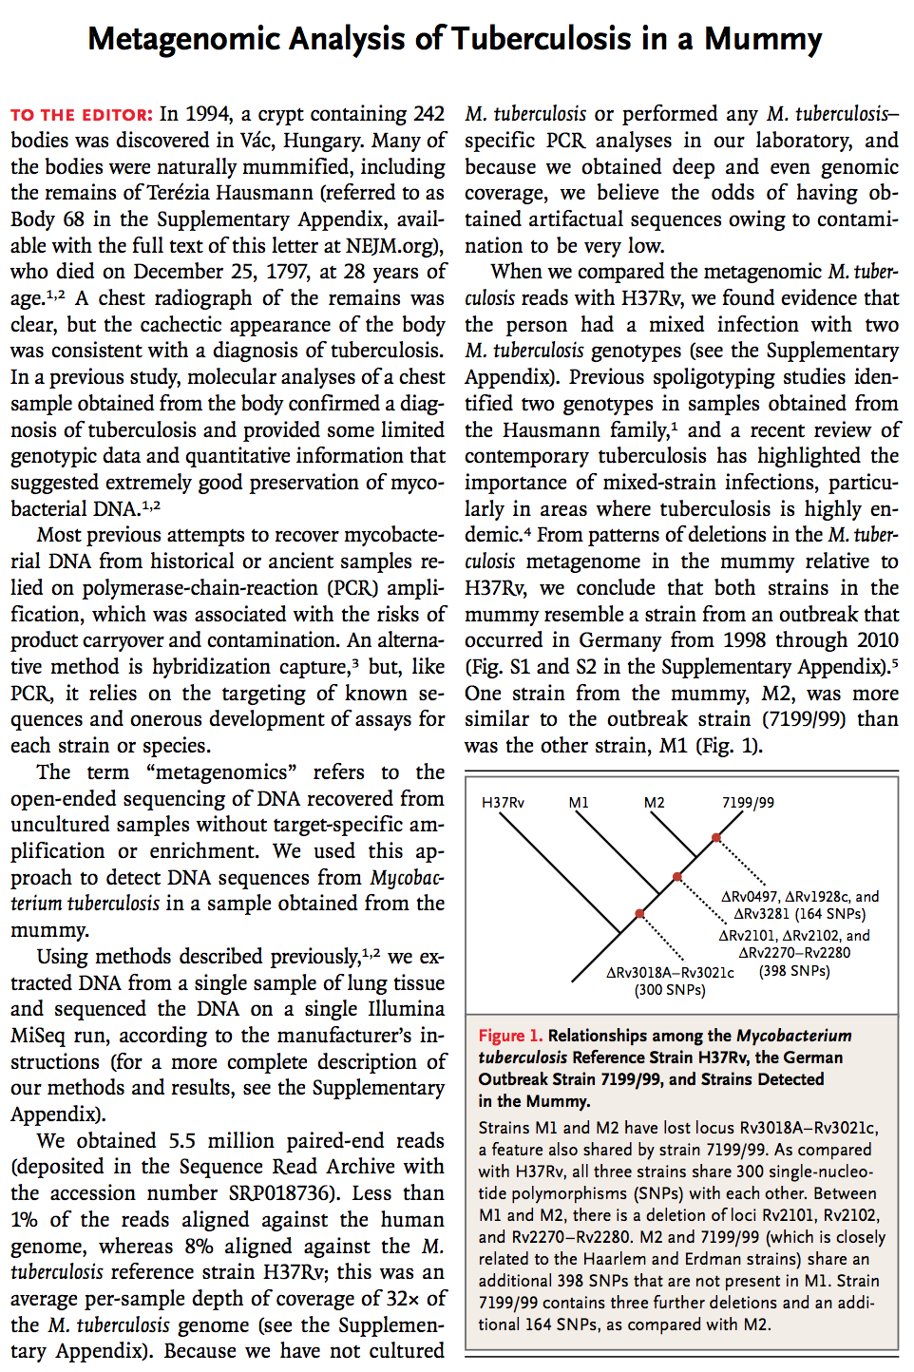

Slide 25
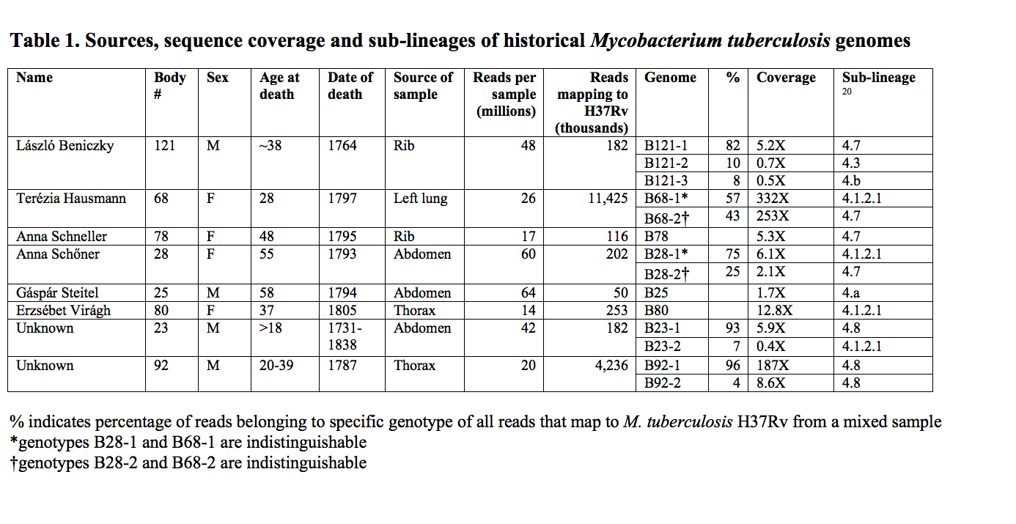
All 14 genomes have 7 bp deletion in pks15/1 gene, characteristic of the Euro-American lineage

Slide 26
Mixed infections common at peak prevalence of TB in Europe
5/8 bodies in our study yielded >1 Mtb genotype
Body 121 yielded 3 distinct genotypes
predominance of mixed infections probably reflects real difference between the epidemiology of TB in Europe today and in this historical setting
Ancient DNA studies re-contextualise modern microbiology
conventional TB microbiology not suited to detecting mixed infections
mixed infections still seen in up to 1 in 5 cases in high-prevalence areas
4 distinct Mtb genotypes reported from a single patient

Slide 27
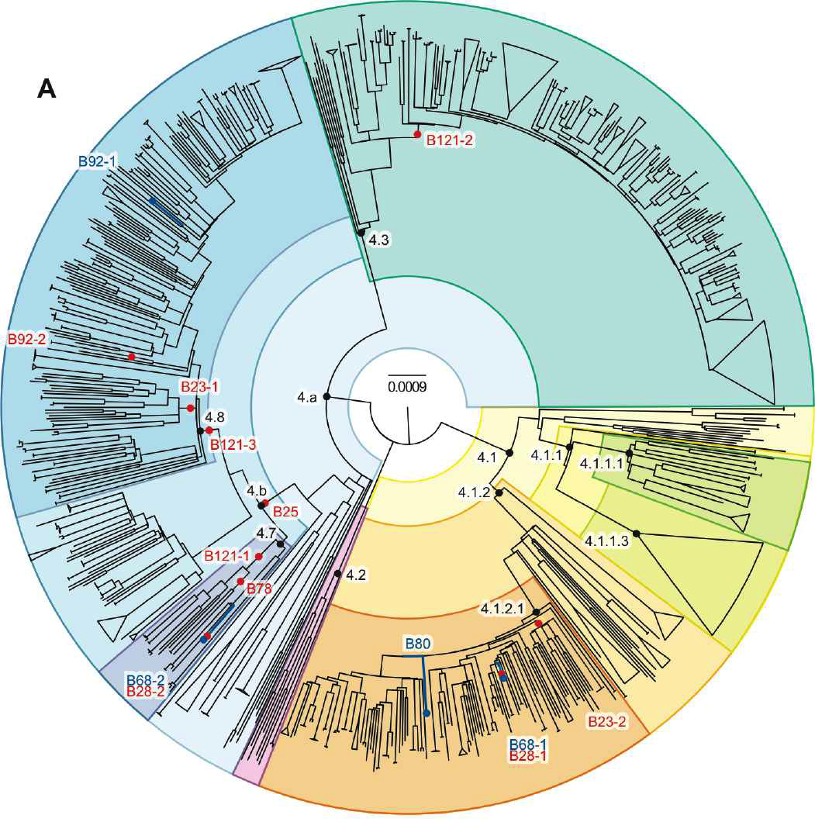
1500 genome phylogeny of modern Lineage 4 isolates
Phylogenetic placement
shows 12 distinct genotypes from Vác

Slide 28
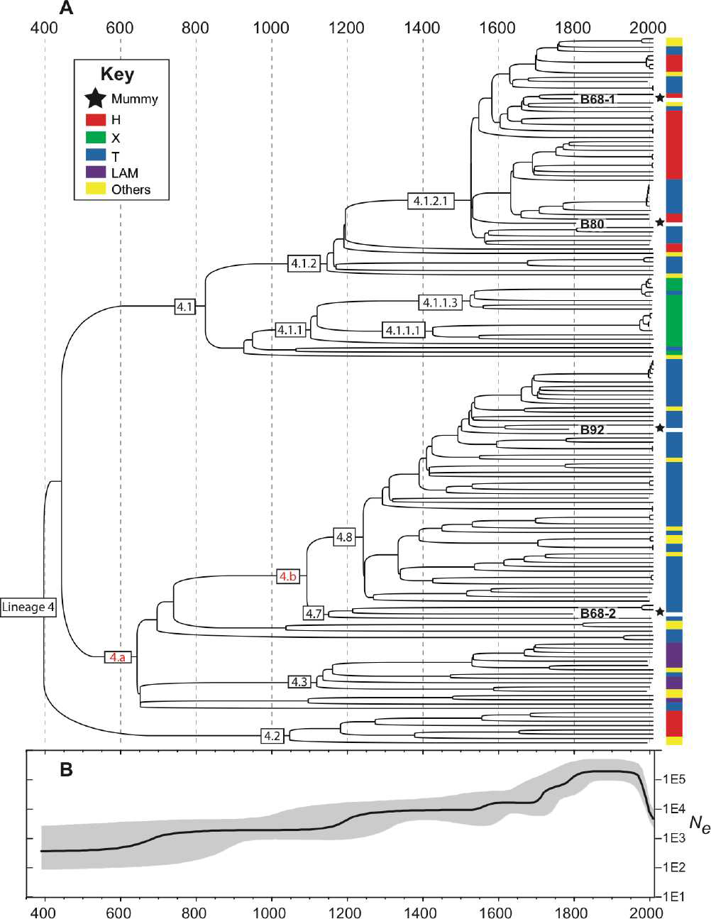
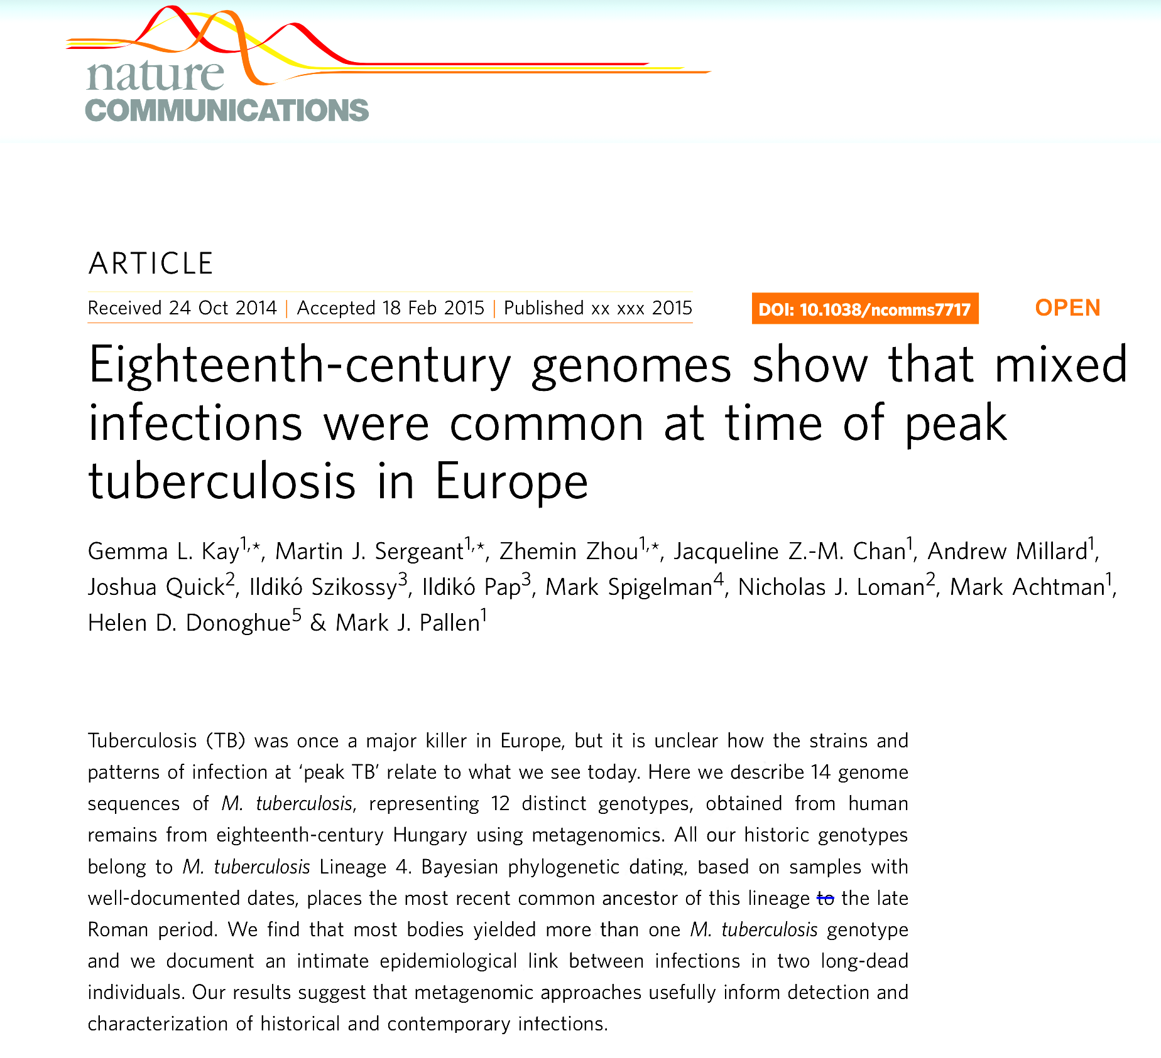
Lineage 4 MRCA in late Roman period
Consistent with relatively recent origin of MTB complex 6Kya
Conflicts with evidence of Neolithic TB

Slide 29
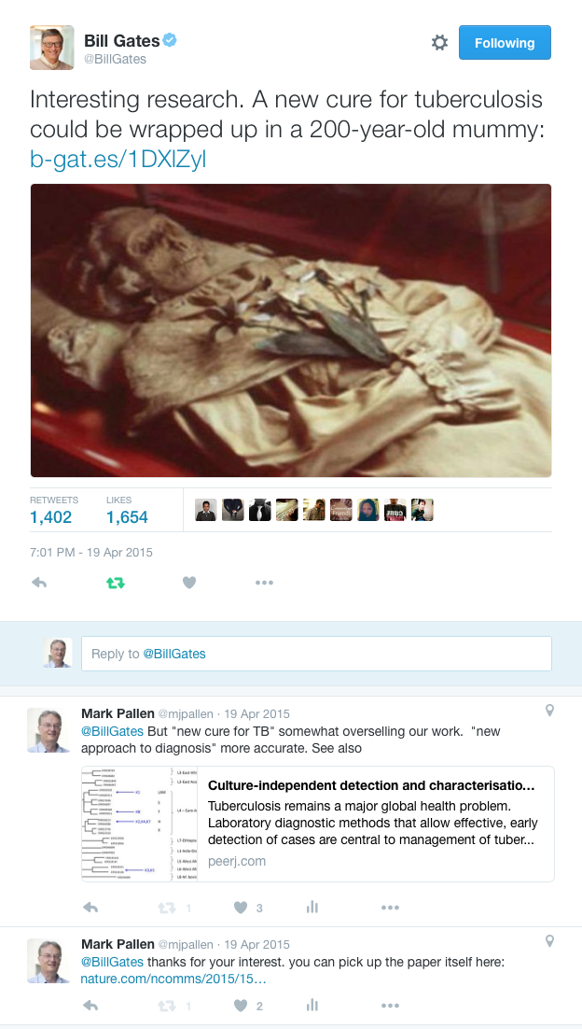
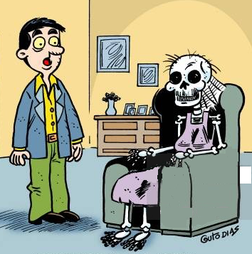
Ancient DNA: post-mortem diagnosis in the long dead!
The good news is we have a diagnosis. The bad news is that it is 200 years too late!

Slide 30
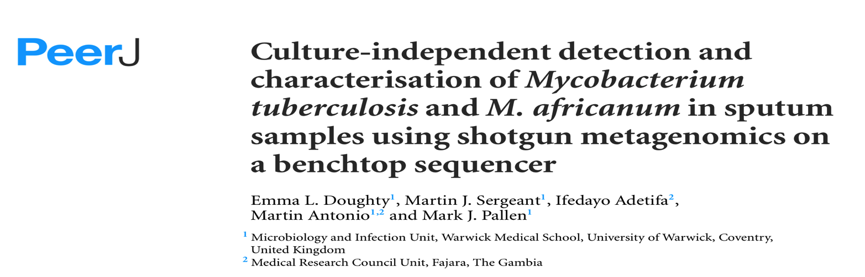
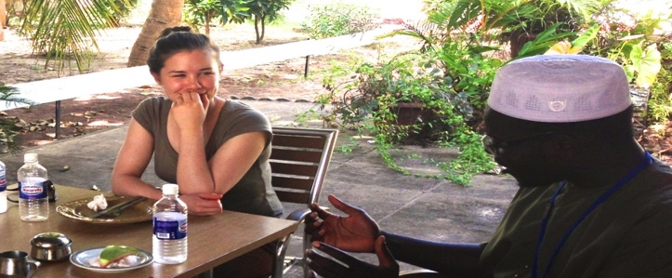
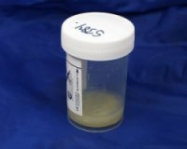

Metagenomic detection of TB in sputum

Slide 31
Any questions?

