Slide 1
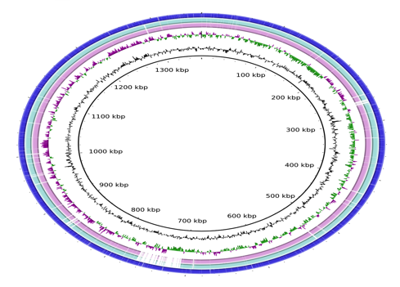
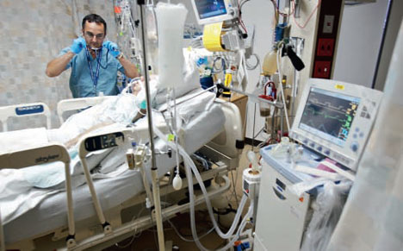
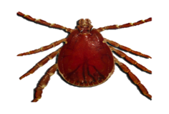
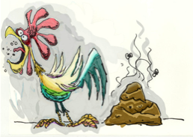
Adventures with metagenomics
Professor Mark Pallen

Slide 2
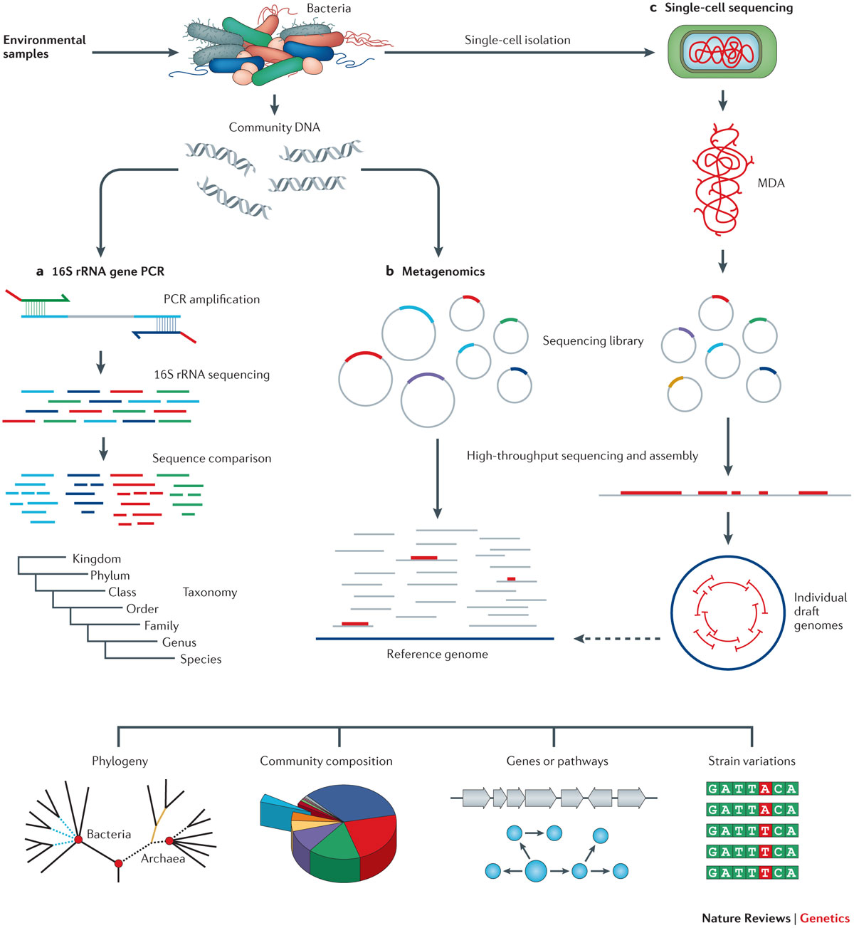
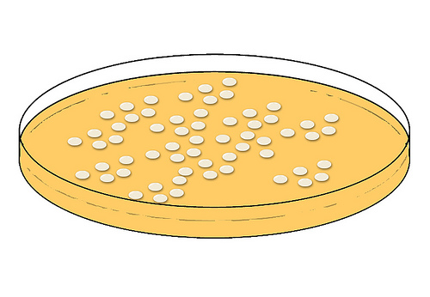
Methodologies
a. Culturomics with whole-genome sequencing
Clinical samples
Isolation of bacteria in pure culture
Extract DNA from cultured isolates
c. 16S rRNA PCR
b. Metagenomics

Slide 3
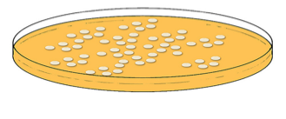
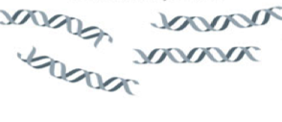
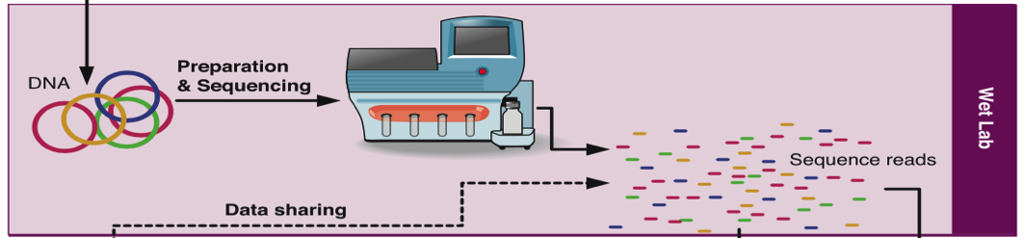
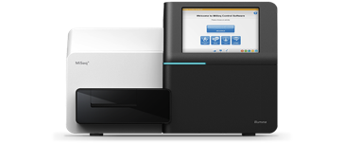
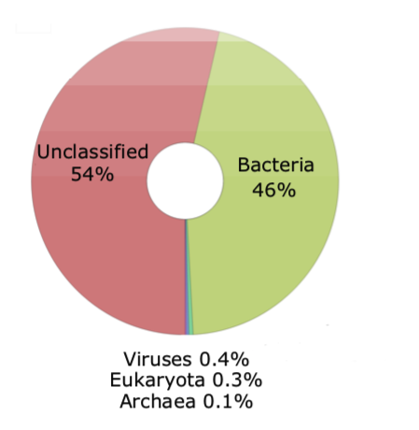
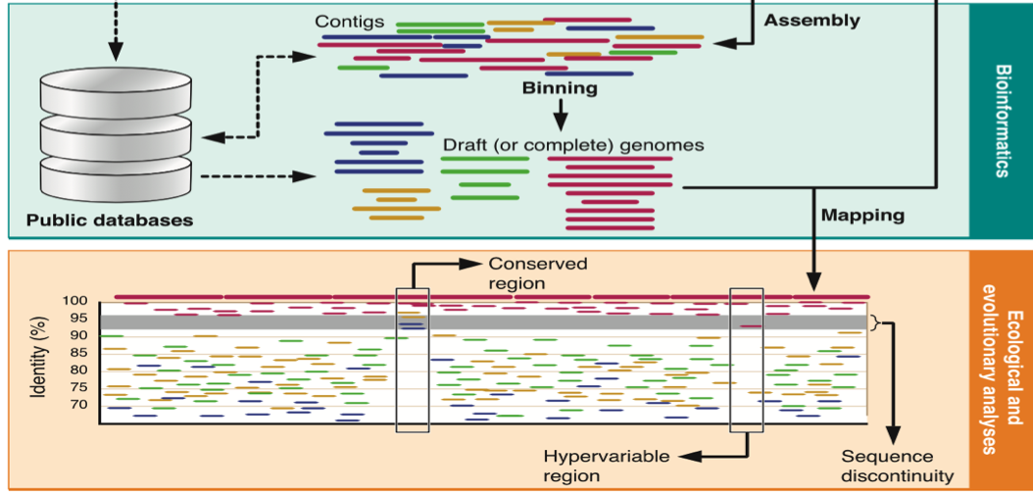
Collect samples
Culturomics with whole-genome sequencing
Isolation of microbes in pure culture
Extract DNA for
metagenome sequencing
Extract and sequence DNA from cultured isolates
Reference–based Phylogenetic profiling
Reference–free Phylogenomics
Kraken | Metaphlan2 | mOTUs | STAT
Mapping (if know what you are looking for)

Slide 4
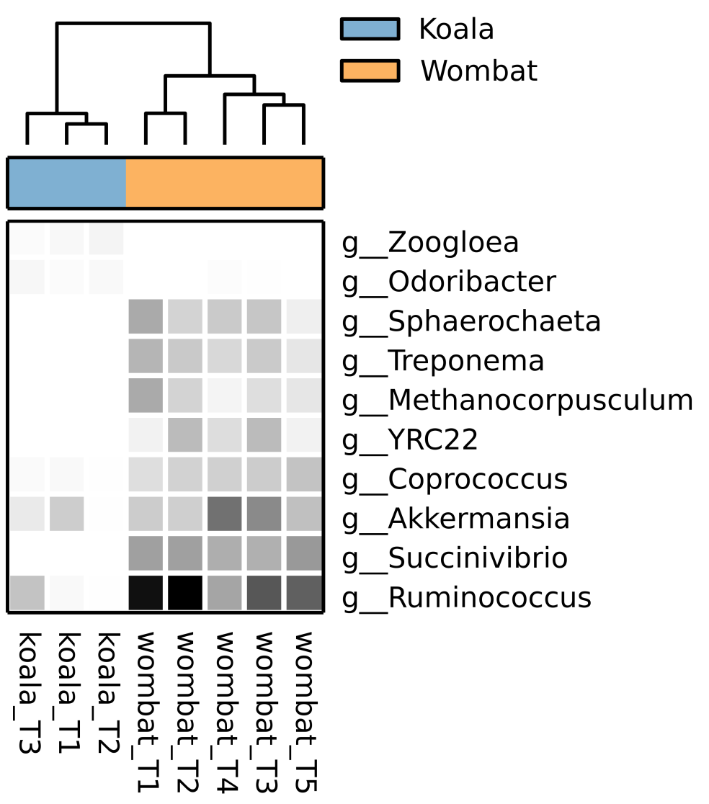


Assigning Taxonomic Labels to Metagenomic DNA Sequences
Notes:
Goal: assign taxonomy to metagenomic reads
Challenge:
reads are short (currently 100 to 300bp)
>>100 million reads
limited reference genomes (~2000 finished; ~25,000 draft)
Uses:
profiling of microbial communities
preprocessing for assembly

Slide 5
k-mers
Definition
k-mers are subsequences of length k contained within a biological sequence
Importance
fundamental units in genomic analysis for pattern recognition, sequencing and mapping
Example
In the sequence "ATCGATCGA," the 3-mers would be "ATC," "TCG," "CGA," etc.

Slide 6
Properties of k-mers
Fixed Length
All k-mers in a given analysis are of the same specified length k
Overlapping
k-mers can overlap with each other, sharing (k-1) bases with their adjacent k-mers
Frequency
The count of each unique k-mer within a sequence can be informative of sequence composition and complexity

Slide 7
Kraken
Kraken is a system designed to assign taxonomic labels to short DNA sequences using k-mers
It uses exact k-mer matches to known genomic sequences in a reference database
The system is known for its speed and accuracy in taxonomic classification

Slide 8
How Kraken Works
Database Construction:
Kraken builds an index of k-mers found in a reference set of DNA from known organisms
Classification Algorithm:
When analysing a sequence, Kraken searches for each k-mer within its database
Assignment:
Sequences are classified based on the highest number of k-mer matches to a particular organism in the database

Slide 9
Kraken: K-mer LCA database
Lowest common ancestor
database
Reference Genomes
(2,256 RefSeq Genomes)
Extract K-mers
K-mer | LCA
ACC … GT | g__Escherichia
ACG … GT | s__E. coli
AGT … AA | p__Proteobacteria
…
TGA … TT | d__Bacteria
(default, K = 31)
Only as good as the reference database used!
Wood and Salzberg, Genome Biology, 2014

Slide 10
Kraken: classification tree
Wood and Salzberg, Genome Biology, 2014

Slide 11
recovering genomes from metagenomic data
metagenome
contigs
reads
shotgun
sequencing
assembly
classify using coverage
and k-mer profiles
identify
strain-specific SNPs
binning
population genomes

Slide 12
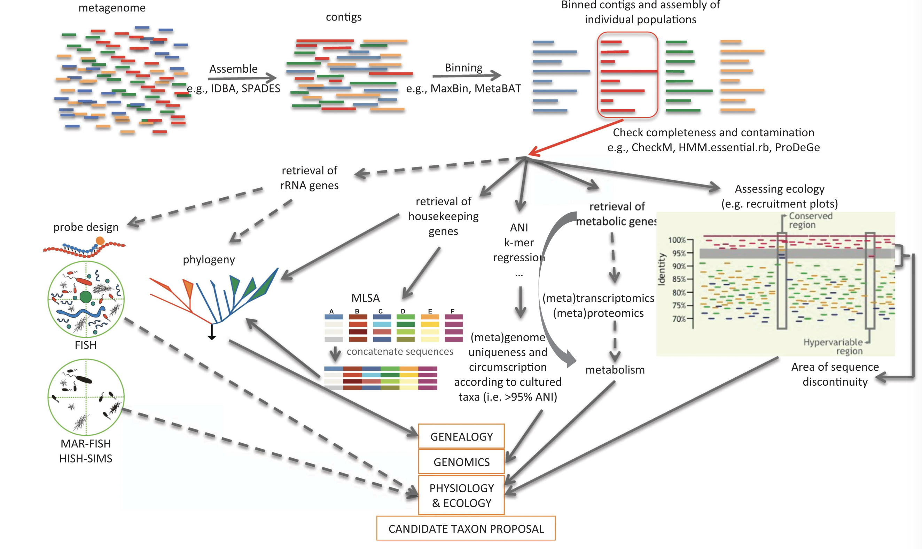


Plus:
Generation of 1000s of grammatically correct, distinctive Latin binomials!

Slide 13
Metagenomic Binning
Definition:
Metagenomic binning is the process of grouping together reads or contigs from a metagenomic dataset that belong to the same organism or closely related group of organisms
Objective:
To reconstruct genomes from the complex mixture of DNA fragments in a metagenomic sample without the need for culturing
Significance:
Enables the study of microbial communities and their functions in their natural environments

Slide 14
Binning Techniques
Composition-based Binning:
Uses features such as GC content, codon usage, and oligonucleotide frequencies to group sequences.
Differential Coverage Binning:
Utilizes the varying abundance of genomes across multiple samples to segregate them into bins.
Homology-based Binning:
Relies on sequence similarity to known sequences in databases
Analysis of conserved single copy genes used for QC

Slide 15
Anvi’o
Anvi'o is an open-source, community-driven analysis and visualization platform for metagenomic and metatranscriptomic data.
Capabilities:
Offers refined methods for metagenomic binning, integrating multiple data types (e.g., genomic, transcriptomic) for comprehensive analysis.
Interactive:
Anvi'o provides interactive visualization tools to better understand the complexity of microbial communities and their genomic make-up.

Slide 16
Anvi'o - Features and Functions
Multi-layered Binning:
Anvi'o allows the integration of various binning strategies, enhancing the accuracy of genome reconstructions.
Real-time Data Exploration:
Researchers can explore their data in real-time, making it easier to identify patterns and anomalies.
Extensive Community Support:
Provides extensive documentation, tutorials, and an active user community for troubleshooting and collaborative improvements.

Slide 17
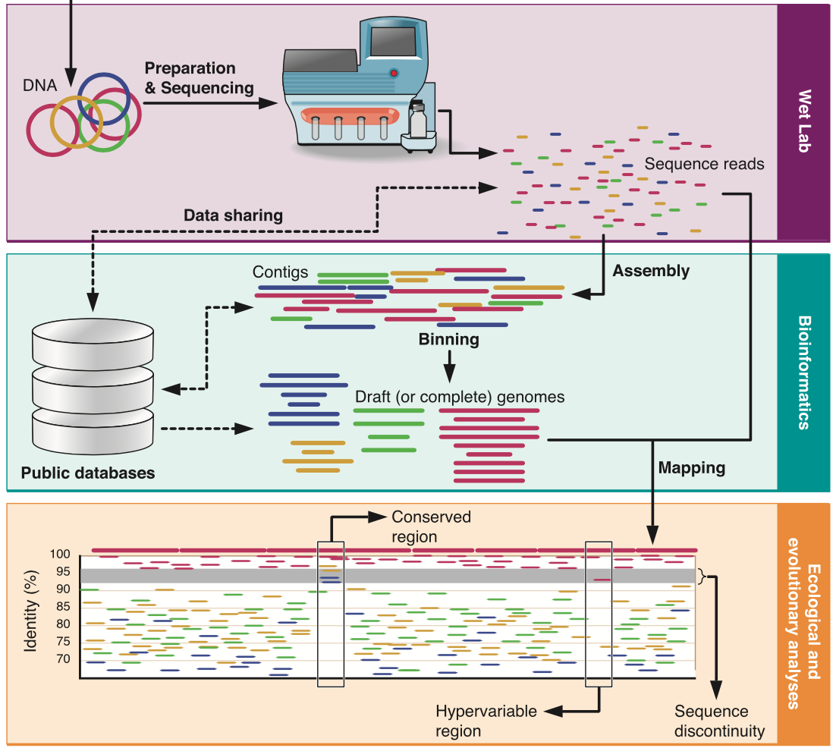


Case studies in shotgun metagenomics
Ticks
Chickens
ICU patients
Mummies
MAGs

Slide 18
Gut microbiota in ICU patients
ICU patients
Sickest patients in the hospital
wide range of patient needs
high use of antibiotics
prone to infection
Crucial role of gut microbiota
reservoir of pathogens and AMR
low microbial diversity linked to adverse clinical outcomes
Research Questions
What happens to gut microbiota in ICU patients?
How does microbiota respond to antibiotics?
Do antibiotics select for pathogens?
Can we address this using shotgun metagenomics?
Is there a case for FMT in ICU?

Slide 19





Clinical Microbiologist
Beryl Oppenheim
ICU physician
Tony Whitehouse
Microbial ecology and genomics
Mark Pallen, Anu Ravi, Willem van Schaik
Faecal samples n=275 from 30 ICU patients at QE Hospital Birmingham
with relevant metadata
Shotgun metagenome sequencing
Illumina NextSeq 500/550 Paired-end, 150bp read length
Taxonomic Classification
Antibiotic Resistance
Strain-level Resolution

Slide 20
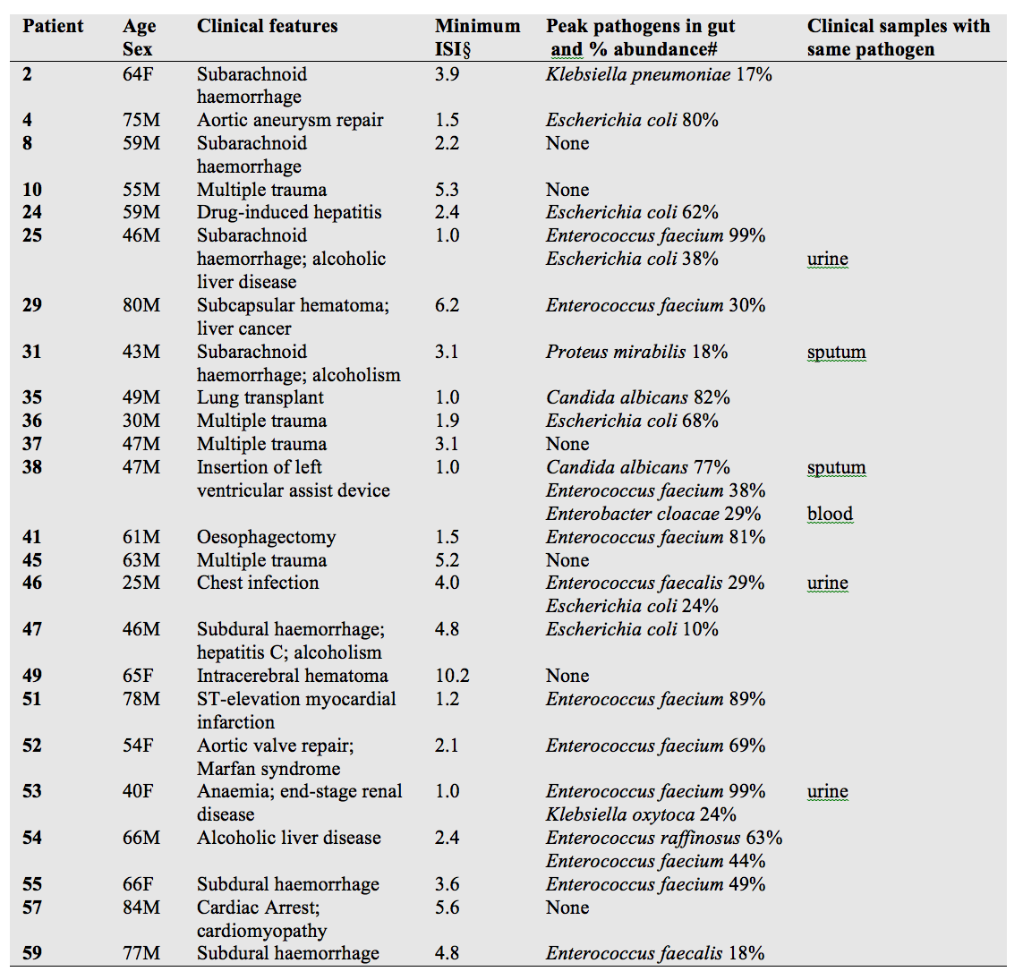
Gut microbiota in ICU patients
two-thirds of ICU patients experienced low gut microbial diversity; one third ultra-low diversity
in 75% of patients, episodes of gut domination by pathogenic strains,
evidence of nosocomial transmission of Enterococcus faecium

Slide 21
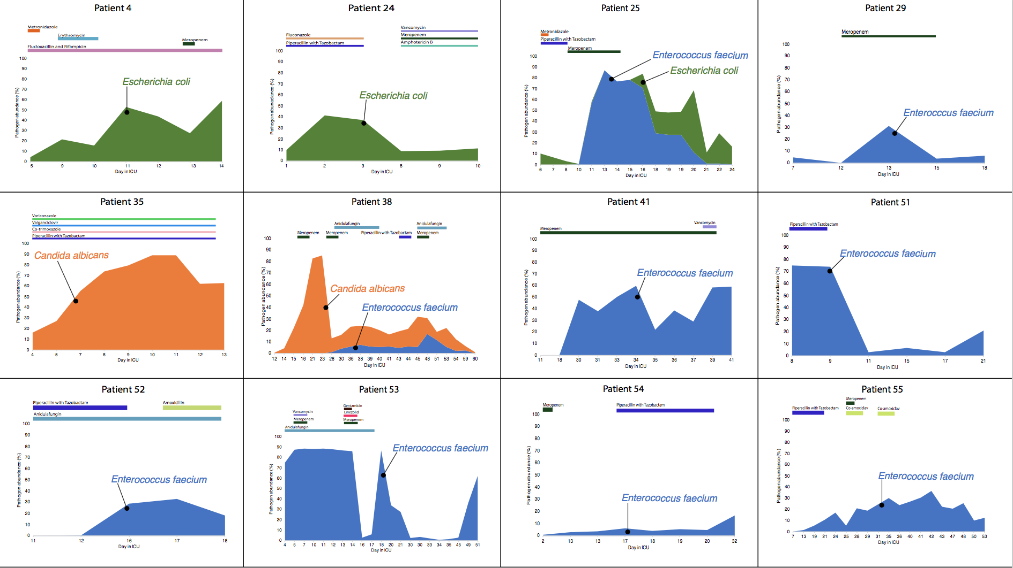

Slide 22
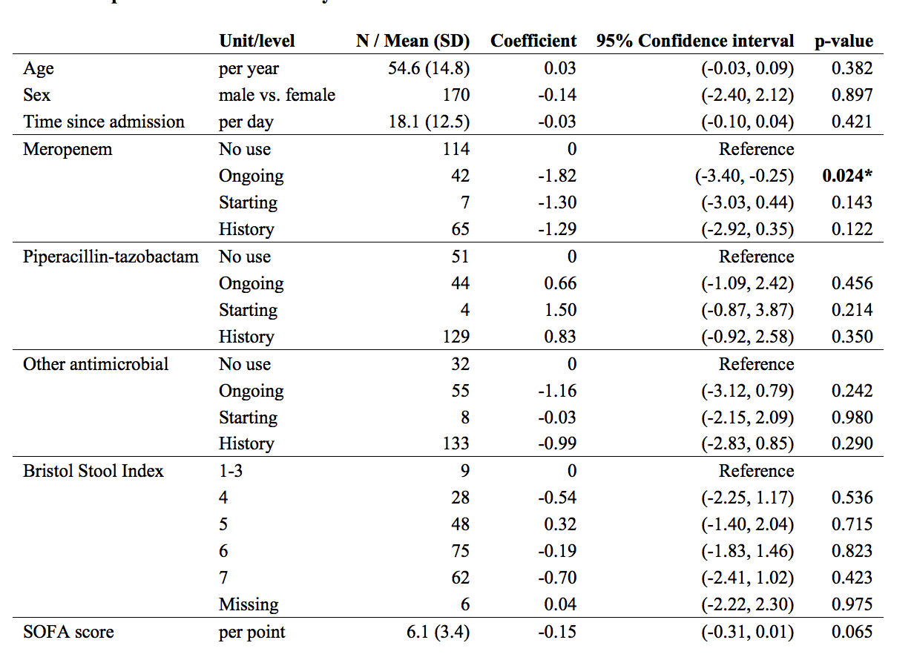
Gut microbiota in ICU patients
Meropenem has significant effect
Absence/loss of beneficial commensals in most patients
Gut domination by commensals such as Methanobrevibacter smithii
Severe loss of diversity and AMR pathogen domination provides rationale for trial of FMT in ICU patients?

Slide 23
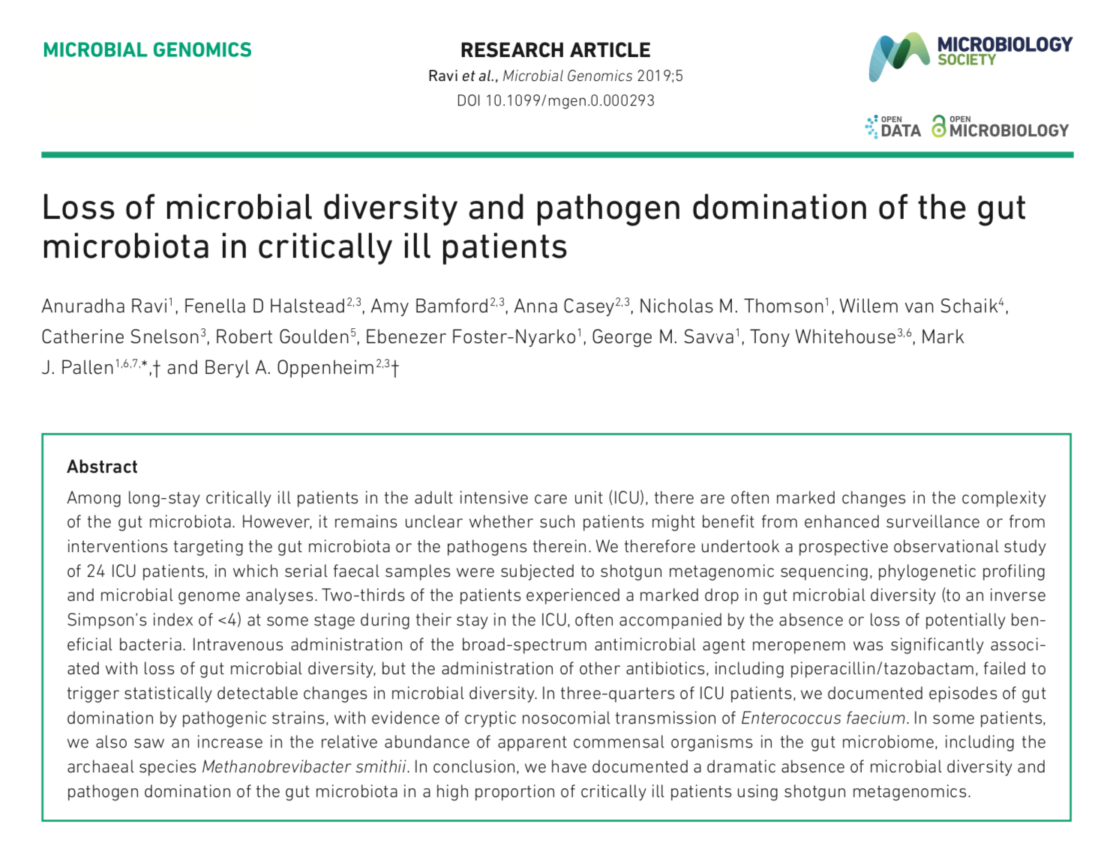
Conclusions
Shotgun metagenomics provides detailed information on microbiota trajectories and pathogens in ICU patients
Clonal blooms of MDR pathogens
Genome reconstructions provide insights into pathogen biology and epidemiology
Lays foundations for ecological interventions such as FMT?
https://doi.org/10.1099/mgen.0.000293

