Slide 1

CLIMB
Powering Microbial Genomics Research
Lisa Marchioretto
CLIMB Operations Manager AMAST Network and Partnerships Manager
Notes:
CLIMB, the Cloud Infrastructure for Microbial bioinformatics is a UK project, created in the UK, by UK-based researchers, with the needs of the UK community in mind​

Slide 2
Mission and Values
CLIMB exists to democratise access to cutting-edge computational resources for all bioinformaticians, no matter their career level.
We aim to accelerate scientific discovery by providing researchers with the infrastructure, tools, and support needed to analyse their data efficiently and effectively.
Notes:
What drives CLIMB. Researchers have ideas and data, but don’t always have access to computational resources. Our mission is to break down the walls between those who have access to powerful computing and those who don't. It doesn't matter if you’re in a rich Institute or not, if you're a professor or a PhD student - if you have research questions, you should have the tools to answer them.
It’s strategy. The UK's strength in microbial genomics comes from the power of its research community. If everyone can contribute at their highest level, the entire ecosystem is strengthened.

Slide 3

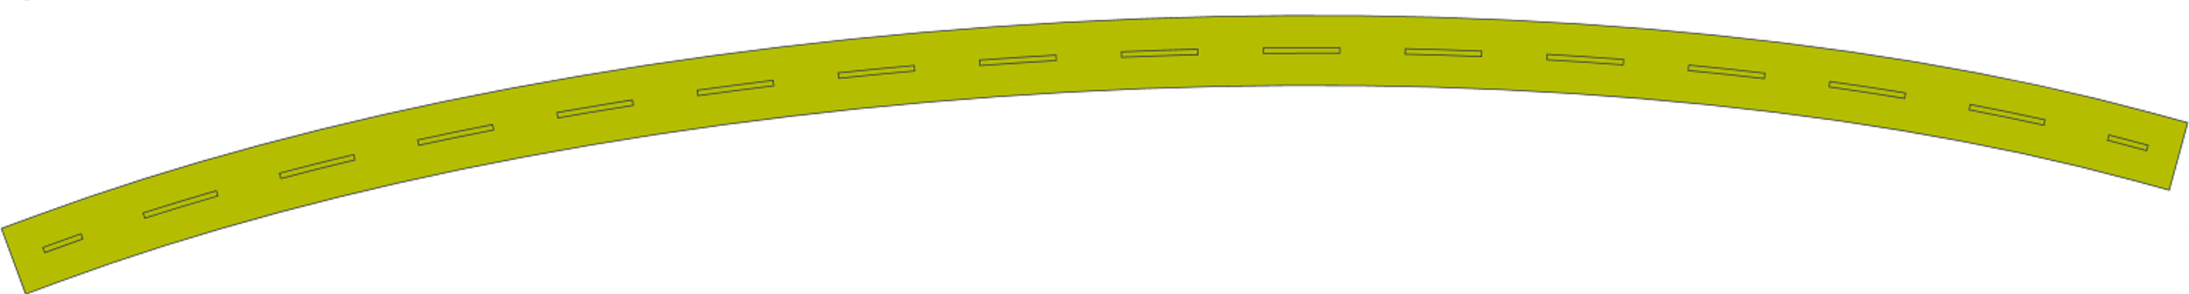
CLIMB Timeline
2019
2017
2020
2016
2025
2014
Wins HPCwire Readers’ Choice Awards for the first time
Reaches 1,400+ users across 80+ UK institutions
CLIMB-Big-Data begins; crucial role in COVID-19 response
CLIMB opens to UK microbiology community
Transitioning to self-sustainability model
MRC-CLIMB begins
Notes:
CLIMB's journey is 10-year long story.
CLIMB 1/ MRC-CLIMB started back in 2014 from a vision of Mark Pallen, Tom Connor, Sam Sheppard and Nick Loman “what if we could build cloud computing infrastructure specifically designed for microbiologists?” The MRC backed this vision with £8 million over six years, and by 2016 we opened the doors to the UK microbiology community.
By 2017, we were gaining international recognition.
By 2019, we had 1,400 users across more than 80 UK institutions, and were running at capacity, with a waiting list of users. And CLIMB 1 was about to end.
So we handed in the CLIMB-BIG-DATA application and in 2020, just as we were launching CLIMB-BIG-DATA with £2 million in new funding, the pandemic hit. With a bit (a lot) of luck, CLIMB became the backbone of COG-UK.
Over the past five years we worked to become self sustainable and from April 2025, we’ve transitioned to self-sustainability.

Slide 4
What does CLIMB offer?
Notebook Servers
Storage Solutions
Additional Resources
Jupyter-based interface
Flexible CPU and RAM allocation
GPU options
Collaborative features
Team Shared Storage
S3 Object Storage
Public Reference Data
R-Studio
Nextflow Integration - on Kubernetes infrastructure
Training Environments
Notes:
With CLIMB you open your browser, log in and you are in a fully-configured Cloud-native computational environment. Our Notebook servers are built on JupyterLab with Terminal access. Working on machine learning? You can spin up a GPU notebook.
What users (and trainers) find really powerful is the collaborative features: you can share data with other team members, work on the same terminal, on the same analysis. Or you can share data with the world. You are in control.
On top of that, we integrated Nextflow running on Kubernetes – this means that your workflow can automatically scale up virtually across our entire infrastructure.
In terms of scalability, CLIMB is built to serve individual researchers as well as national surveillance programmes.

Slide 5
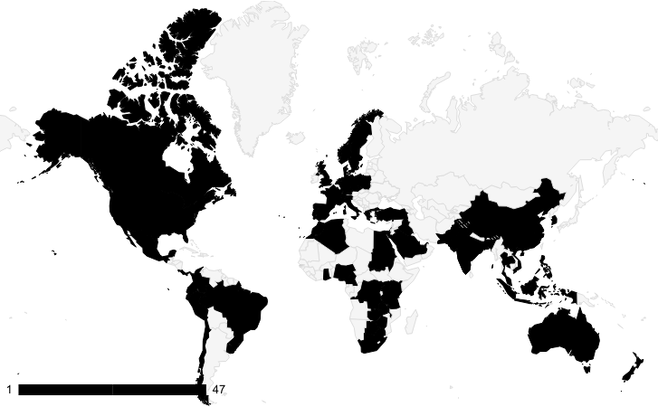
CLIMB Impact – Individual Teams and Users
Research, Training, Hackathons
2,500 Users in the last 10 years
350+ Papers
Enabler for £40M of research funding
3,000+ Scientists trained worldwide
4 Hackathons (Nextflow, AntiMicrobial Resistance, Pathogen Surveillance, Food Safety)
Notes:
This slide is about how we have amplified human potential across the globe.
Over the past decade, CLIMB supported 2,500 individual users in the UK.
Through workshops and hackathons have reached 6 continents.
The research output: these are studies that might not have been possible without CLIMB.
£40 million - think about the multiplier effect there. Investment of £10 million over a decade has enabled at least £40 million in additional research funding.

Slide 6

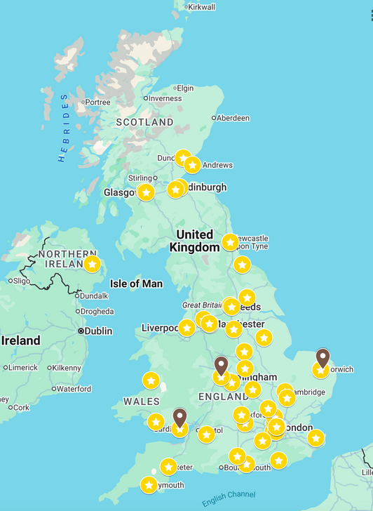
CLIMB Impact – National
CLIMB-COVID
Core infrastructure for COG-UK, processing 3.5M genomes, strengthening UK’s leadership position in microbial bioinformatics
mSCAPE
World-first metagenomics initiative by UKHSA to enhance health security through rapid pathogen detection and surveillance
PATH-SAFE
FSA-led research programme which aims to improve the detection and tracking of foodborne human pathogens and AMR through the whole agrifood systems
Notes:
CLIMB acts as a trusted research environment for these initiatives:
COVID and COG-UK is where CLIMB proved it could handle national-scale challenges. 3.5 million genomes processed on CLIMB made the UK a leader in pathogen surveillance.
Then we have mSCAPE, a UKHSA-led metagenomics initiative to pilot the use of metagenomic data for public health surveillance and pathogen analysis.
And PATH-SAFE showwd how CLIMB can enable OneHealth approaches – This is an FSA-lead programme to track foodborne pathogens and AMR from farm to fork.
For these initiatives, CLIMB is the computational environment where health agencies, authorities and researchers can collaborate securely.

Slide 7

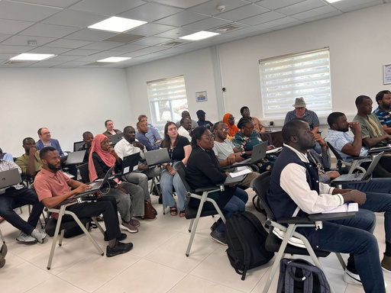

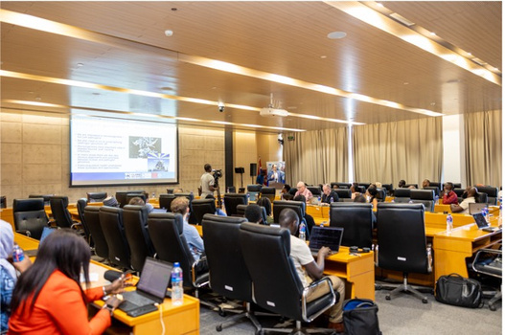
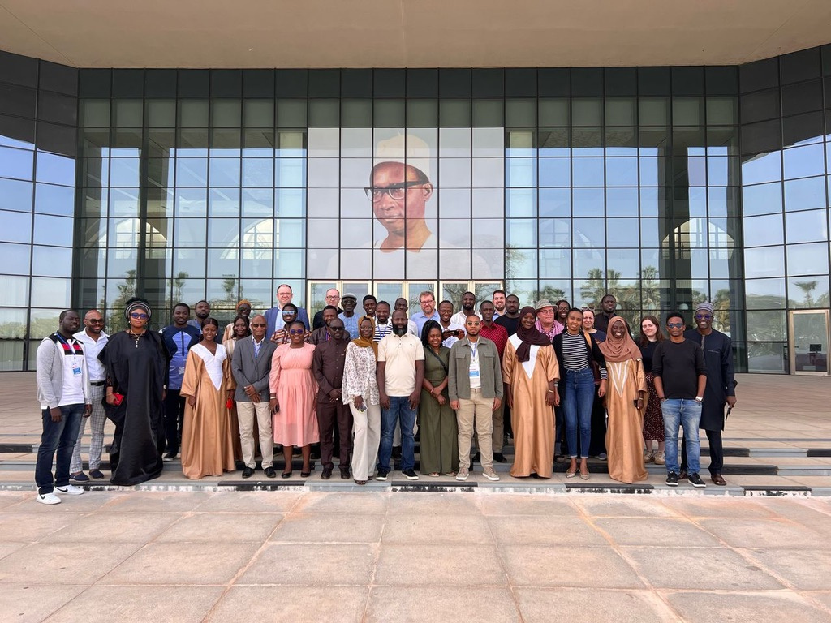
CLIMB Impact – Global Health
Cloud Computing in Africa
From 7 to 31 African countries with sequencing capacity (2019-2022)
Infrastructure gap: computational capacity lagging behind laboratory capabilities
Critical need for sustainable cloud computing for pathogen surveillance in the African Continent
CLIMB identified as model for
“CLIMB Africa” development
Notes:
CLIMB's impact extends beyond the UK borders.
Bit of context: From 2019 to 2022, the African continent went from 7 countries having sequencing capacity to 31. But while laboratory capabilities have expanded rapidly, computational infrastructure hasn't kept pace.
And this matters enormously - Africa (and LMICs in general) bear a disproportionate burden of infectious diseases. Strong genomic surveillance there is vital for global health security.
Last February, 30 leading researchers from across the African Continent gathered at MRC Gambia to develop a strategic roadmap to build sustainable capacity in Africa. They identified CLIMB as the model for what they want to build - And we have the opportunity to be technical partner and mentor for this initiative, so QIB is leader in global health development.

Slide 8
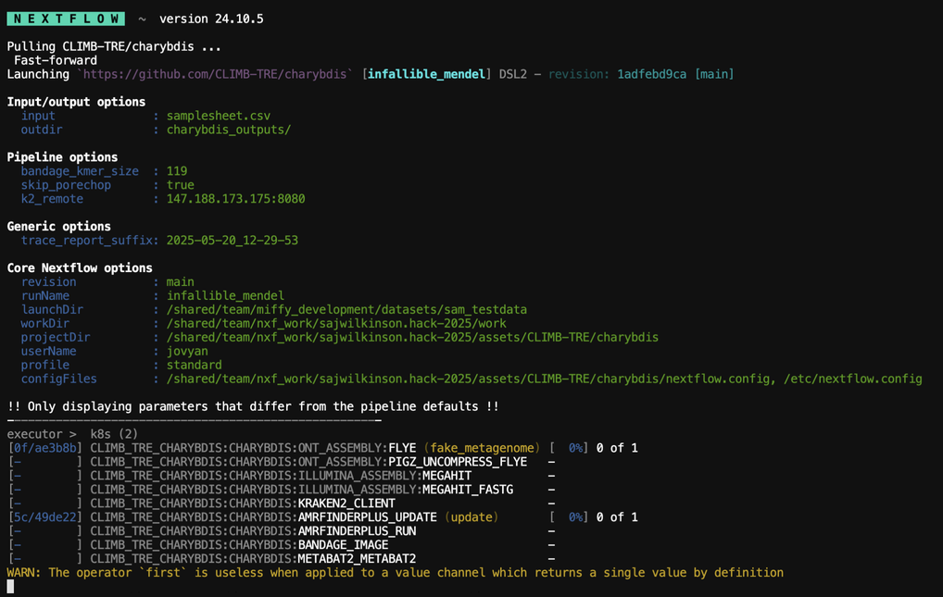

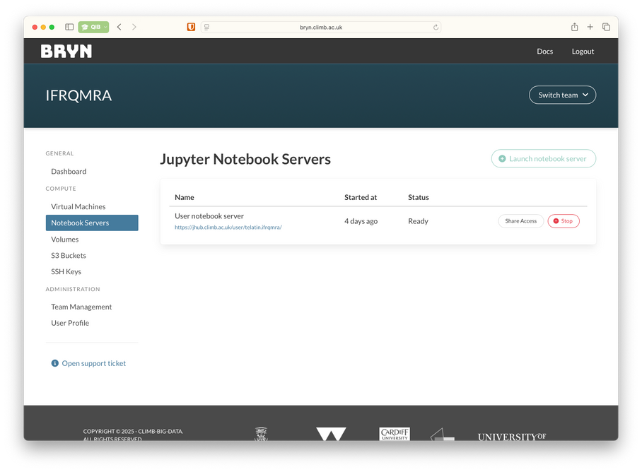
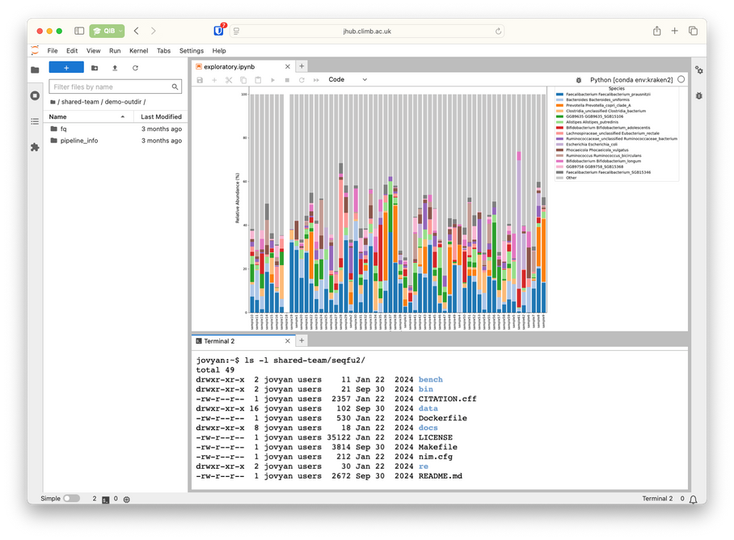
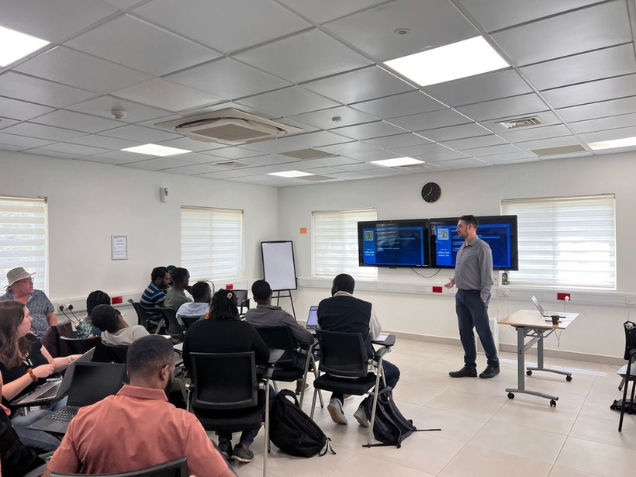
CLIMB Impact – Training Environment
Training the next generation of microbial bioinformaticians
Pathogens in Aquaculture
Phage Genome Assembly and Annotation
Analysing Microbial Genomic Data
ARTIC Training
MMB DTP Bioinformatics Training
Phage Isolation, Genome Analysis and Comparative Genomics – 8 International Partners
Notes:
If you are a trainer and are thinking to deliver a hands-on bioinformatics workshop: what we offer Jupyter environments that can be spun up for short durations at low cost. For organisers, this means they can create pre-configured environments with all the tools, data, and workflows ready to go. Participants just click a link and are ready to go.
Researchers trained on CLIMB can became trainers themselves, in their teams or elsewhere, creating a sustainable model for capacity building that extends far beyond the original training court

Slide 9

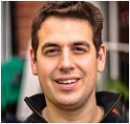
CLIMB now
Model for Sustainable Research Infrastructure
Operational
Strategic Leadership
Nick Loman – 20% appointment at QIB Partnership between University of Birmingham and QIB
Benefits
Shared expertise across institutions
Risk distribution through federated model
Resilience and reliability
Notes:
CLIMB has transitioned from a grant-dependent project to a self-sustaining model.
Over the past few years, users started paying to access CLIMB resources, and we closed CLIMB-BIG-DATA with enough money to operate for at least another year after the end of the grant.
The QIB is now leading CLIMB, we brough in Nick Loman at 20% capacity to lead this partnership between the QIB and the University of Birmingham (with other partners to join soon).
Let’s talk about the funding landscape - there's increasingly little money available for research infrastructure and CLIMB is proving that hybrid funding models can work - and QIB is leading the way in demonstrating this new approach to sustainable infrastructure models.

Slide 10






CONTACT US
Phone
+44 (0)1603 255392
Email
climb@quadram.ac.uk
Website
www.climb.ac.uk
Location
Quadram Institute Bioscience, Norwich Research Park, NR4 7UQ

Slide 11


Acknowledgements
CLIMB Operational Committee
Matt Gilmour - QIB
Graeme Brown - QIB
Steve Hindmarsh – NBI RC
Carol Sandys – U, Birmingham
Chris King – QIB
+ Nick, Lisa, Radoslaw, Andrea
NBI Research Computing
MRC-CLIMB and CLIMB-BIG-DATA
Mark Pallen - QIB
Tom Connor – Cardiff University
Sam Sheppard – University of Oxford
Andy Millard – University of Leicester
Chris Quince - EI
Andrew Page – QIB
Martin Antonio – LSHTM @ MRC Gambia
Simon Ellwood-Thompson – Swansea University
Simon Thompson – University of Birmingham
+ Daniel Falush, Maciej Filocha, Matthew Ismail, Matt Bull, Imran Hussain, Fran Terry, Ben Pascoe, Sion Bayliss, Mavis Foster-Nyarko, Michaela Matthews, Ewan Short, Charles Pallen, Thanh Le-Viet, Nabil-Fareed Alikhan
CLIMB Team @ Bham
Nick Loman
Radoslaw Poplawski
Andy Smith
Tom Brier
Sam Wilkinson
Leo Turnell Ritson
QIB Core Bioinformatics
Andrea Telatin
Sam Haynes
QIB Business Development Team
Roberto Zanchi
Thank you to all CLIMB Users

