Slide 1
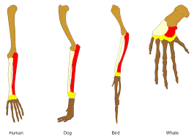
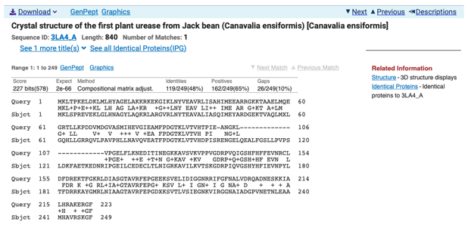
Sequence Profiling
Mark Pallen

Slide 2
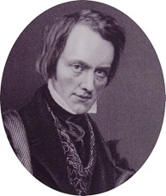
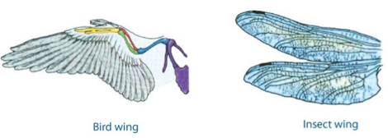
Defining homology
Term "homology" first used in biology by anatomist Richard Owen in 1843 studying vertebrate fins and limbs, defining it as "same organ in different animals under every variety of form and function”
contrasting with "analogy” to describe different structures with same function.
Owen’s criteria for determining homology:
position, development, composition.
homologous organs not necessarily similar (at least similarity may not be obvious)
similar organs are not necessarily homologous

Slide 3
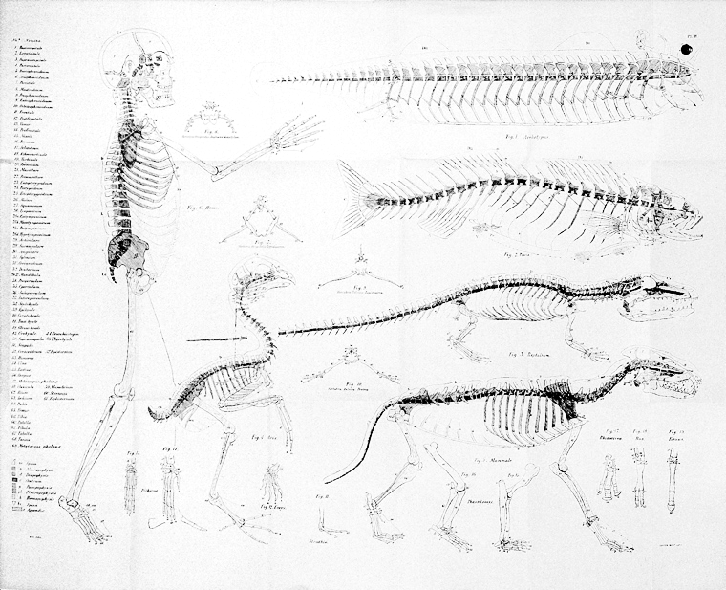
Darwin redefines homology
Biological features in different taxa are homologous if they show similarity based on descent from a common ancestor
Homology thus implies divergent evolution or “descent with modification”

Slide 4
Darwin on Homology
Nothing can be more hopeless than to attempt to explain this similarity of pattern in members of the same class, by utility or by the doctrine of final causes. The hopelessness of the attempt has been expressly admitted by Owen in his most interesting work on the 'Nature of Limbs.' On the ordinary view of the independent creation of each being, we can only say that so it is;—that it has so pleased the Creator to construct each animal and plant.
The explanation is manifest on the theory of the natural selection of successive slight modifications,—each modification being profitable in some way to the modified form, but often affecting by correlation of growth other parts of the organisation. In changes of this nature, there will be little or no tendency to modify the original pattern, or to transpose parts. The bones of a limb might be shortened and widened to any extent, and become gradually enveloped in thick membrane, so as to serve as a fin; or a webbed foot might have all its bones, or certain bones, lengthened to any extent, and the membrane connecting them increased to any extent, so as to serve as a wing: yet in all this great amount of modification there will be no tendency to alter the framework of bones or the relative connexion of the several parts. If we suppose that the ancient progenitor, the archetype as it may be called, of all mammals, had its limbs constructed on the existing general pattern, for whatever purpose they served, we can at once perceive the plain signification of the homologous construction of the limbs throughout the whole class. So with the mouths of insects, we have only to suppose that their common progenitor had an upper lip, mandibles, and two pair of maxillæ, these parts being perhaps very simple in form; and then natural selection will account for the infinite diversity in structure and function of the mouths of insects. Nevertheless, it is conceivable that the general pattern of an organ might become so much obscured as to be finally lost, by the atrophy and ultimately by the complete abortion of certain parts, by the soldering together of other parts, and by the doubling or multiplication of others,—variations which we know to be within the limits of possibility.
http://darwin-online.org.uk/content/frameset?pageseq=452&itemID=F373&viewtype=side

Slide 5
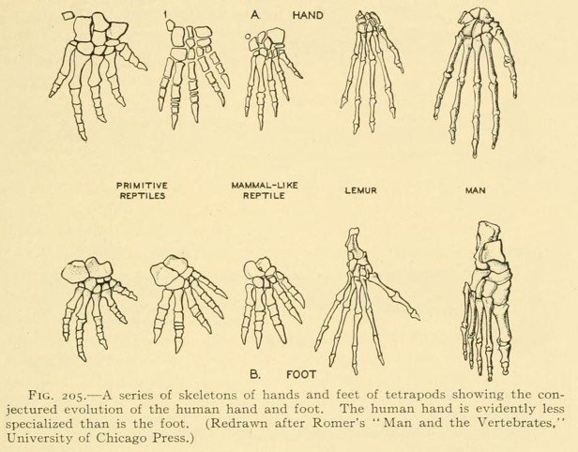
Darwin on Homology
There is another and equally curious branch of the present subject; namely, the comparison not of the same part in different members of a class, but of the different parts or organs in the same individual. Most physiologists believe that the bones of the skull are homologous with—that is correspond in number and in relative connexion with—the elemental parts of a certain number of vertebræ.
On the theory of natural selection, we can satisfactorily answer these questions. In the vertebrata, we see a series of internal vertebræ bearing certain processes and appendages; in the articulata, we see the body divided into a series of segments, bearing external appendages; and in flowering plants, we see a series of successive spiral whorls of leaves. An indefinite repetition of the same part or organ is the common characteristic (as Owen has observed) of all low or little-modified forms; therefore we may readily believe that the unknown progenitor of the vertebrata possessed many vertebræ; the unknown progenitor of the articulata, many segments; and the unknown progenitor of flowering plants, many spiral whorls of leaves. We have formerly seen that parts many times repeated are eminently liable to vary in number and structure; consequently it is quite probable that natural selection, during a long-continued course of modification, should have seized on a certain number of the primordially similar elements, many times repeated, and have adapted them to the most diverse purposes. And as the whole amount of modification will have been effected by slight successive steps, we need not wonder at discovering in such parts or organs, a certain degree of fundamental resemblance, retained by the strong principle of inheritance.
Now called “paralogy”

Slide 6
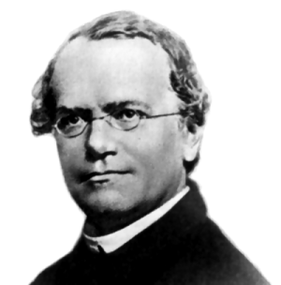
From 1859 to 1959: Genetics
1860s
Mendel’s experiments on peas
1900s onwards
Rediscovery of Mendel (de Vries, Correns, Bateson)
Soma/germ-line distinction (Weismann)
Chromosomes; mutations (Morgan)
1940s
“Modern Synthesis” of Evolution and Genetics (Fisher, Haldane, Wright, Dodzhansky, Mayr)

Slide 7
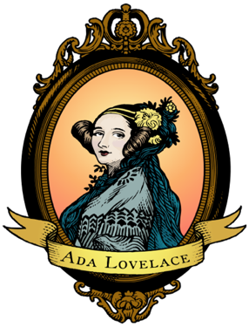
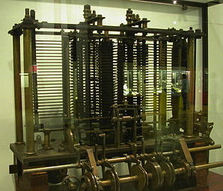
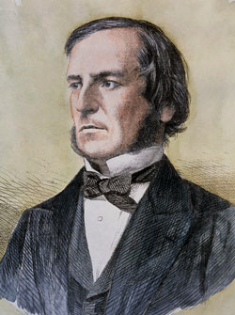
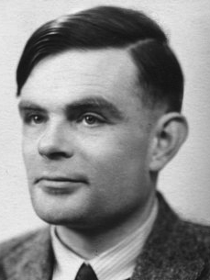
From 1830s to 1959: Computing
1837
Analytical Engine: Babbage
1842
Ada Lovelace: first program
1854
Boolean algebra
1936
Turing machines
1950s
First transisterized computers

Slide 8
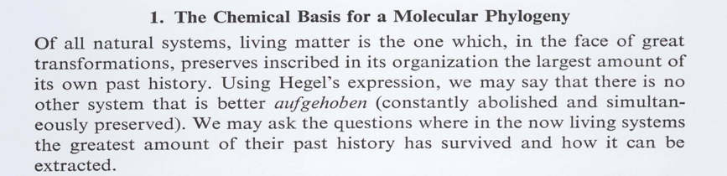
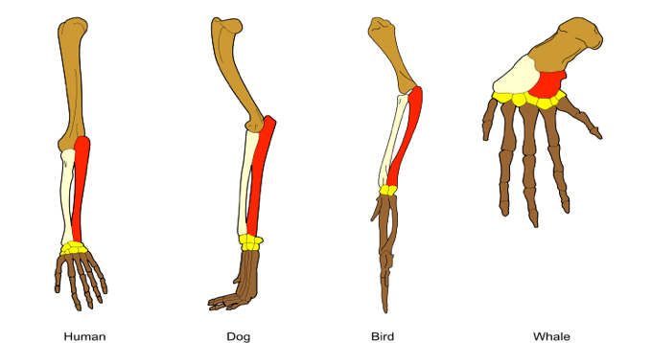
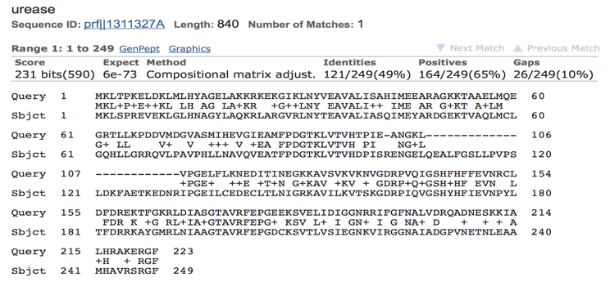
1965: Zuckerkandl and Pauling sequence homology and molecular phylogenetics

Slide 9
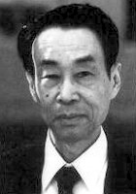
1968: Kimura and the neutral theory
Motoo Kimura
neutral mutations predominate in evolution
downplays role of natural selection in DNA and protein evolution
neutral changes show clock-like behaviour
basis of genomic epidemiology

Slide 10
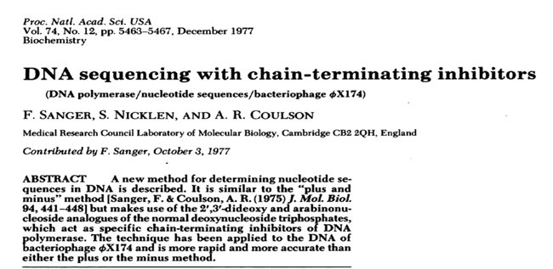
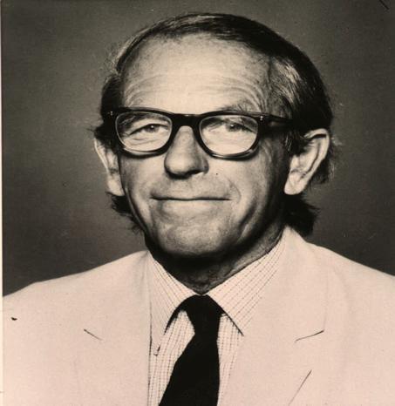
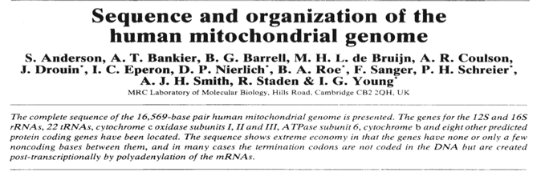
Late 1970s Sanger invents DNA sequencing

Slide 11
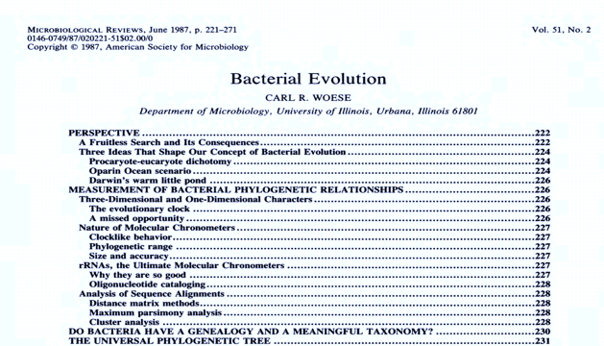
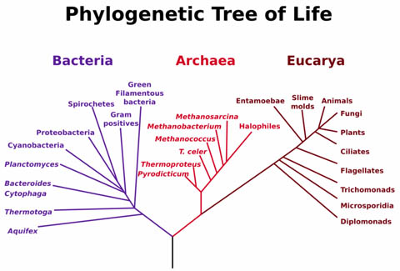
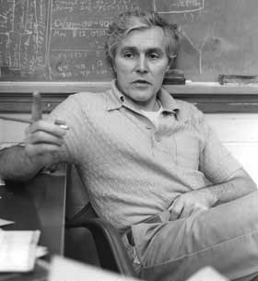
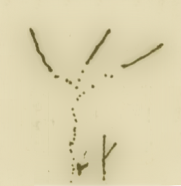
1987: Bacteria join Darwin’s tree of life
Eucarya
Archaea
Bacteria

Slide 12
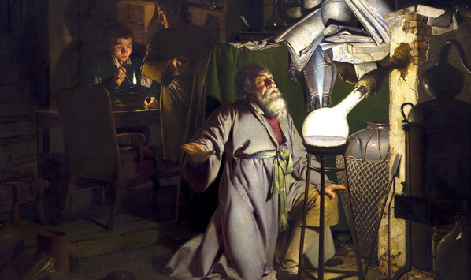
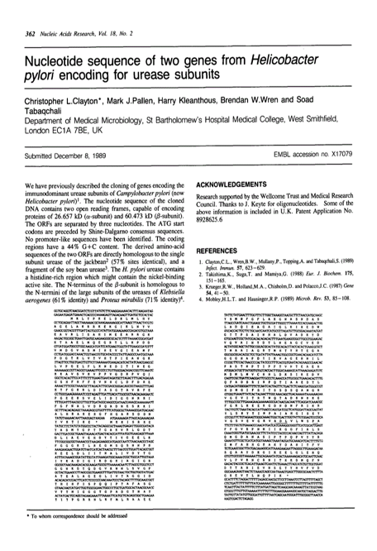
15 September 1989
Then felt I like some watcher of the skies
When a new planet swims into his ken;
Or like stout Cortez when with eagle eyes
He star'd at the Pacific—and all his men
Look'd at each other with a wild surmise—
Silent, upon a peak in Darien.

Slide 13
Sequence homology
Languages and informational macromolecules consist of sequences of characters that show “descent with modification”
Similarity due to descent from common ancestor (homology) can be used to infer function or meaning
one, two, three
eins, zwei, drei
un, deux, troi
uno, dos, tres
Hittite (20-13th C BCE)
nu NINDA-n ezzateni watar-ma ekutteni
nu BREAD-n ezzateni watar-ma ekutteni
Now you will eat BREAD,
And you will drink water
Hrozný, Bedřich (1917)
Notes:
12

Slide 14
Sequence alignment and homology
Easy if have exact match
...but sequences diverge over time
Need alignment and search methods that allow for variability
Gap penalties
Substitution scores
ATCGATCGGGCT
||||||||||||
ATCGATCGGGCT
TDAAINPGNSG
|||||||||||
TDAAINPGNSG
ATCGATCGGGCT
||| ||||||||
ATCCATCGGGCT
TDAAINPGNSG
|||:|||||||
TDASINPGNSG
ATCG-ATCGGGCT
||| |||||||
ATCCAATCGGGCT
TDA-------AINPGNSG
||| |:||
TGGvspyadpNTCRGDSG
TTTTTTT------
-------GGGGGG

Slide 15
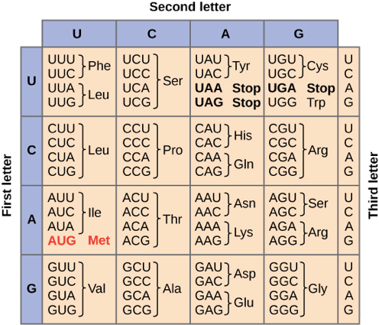
Sequence alignment and homology
Amino acid sequences more highly conserved than nucleotide
SER LEU GLY PRO
TCT CTA GGG CCC
|| || || ||
TCG CTT GGC CCG
4/4 Identical amino acids
8/12 nt matches
SER LEU GLY PRO
TCT CTA GGG CCC
| || ||
AGT TTG GGC CCG
4/4 Identical amino acids
5/12 nt matches

Slide 16
Gap extend penalty?
Single block of insertions/deletions is more likely than multiple in/del events
NV-ELKAET
|| | |
NVDE--A-TNFELKAET
NV------ELKAET
|| ||||||
NVDEATNFELKAET

Slide 17
Homology vs. Similarity
Presence of similar features because of common decent
Cannot be observed since the ancestors are not anymore
Is inferred as a conclusion based on ‘similarity’
Some authorities claim homology is like pregnancy: either one is or one isn’t! (Gribskov – 1999)
Quantifies a ‘likeness’
Uses statistics to determine ‘significance’ of a similarity
Statistically significant similar sequences are considered ‘homologous’

Slide 18
Homology Searches
The aim of homology searches is to identify sequences within these databases that are homologous to your sequence.
This involves comparing your sequence with all the database sequences, looking for stretches of sequence that appear to be similar, then scoring the matches and ranking them. Usually a measure of the significance of the match will be given
BLASTN
Nucleotide query versus nucleotide database
BLASTP
protein query versus protein database
BLASTX
automatic 6-frame translation of nucleotide query versus protein database
TBLASTN
protein query versus automatic 6-frame translation of nucleotide database
TBLASTX
automatic 6-frame translation of nucleotide query versus automatic 6-frame translation of nucleotide database

Slide 19
Evidence for homology
similarity extends over a long stretch of sequence and is statistically significant by criteria known to be reliable (e.g. BLAST e values)
if sequence similarity is low, same pattern of identical or similar amino acid residues seen in multiple sequences
pattern of sequence similarity reflects the similarity between experimentally determined structures of the respective proteins or at least corresponds to the known key elements of one such structure
conserved stretches suggest important functions

Slide 20
Evidence for homology
not just interested in score for an alignment...
...but how likely we are to get that alignment by chance alone
it is this ‘non-random’ alignment that implies homology
Statistics are used to estimate this chance
The expect value or E-value
Probability of obtaining this score by chance
Best measure of how biologically significant an alignment is
Used for ranking results by default
Karlin-Altschul statistics
Statistical theory based on the extreme value distribution of the best scores for pairs of sequences; used for E-value calculation in BLAST

Slide 21
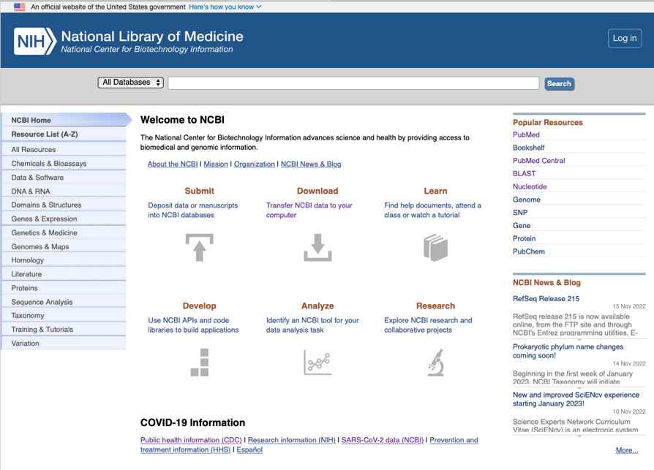
The awesome power of NCBI!
https://www.ncbi.nlm.nih.gov

Slide 22
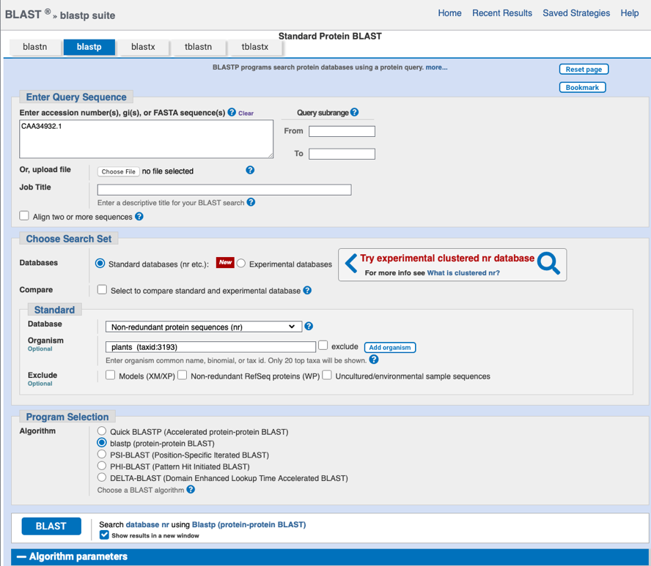
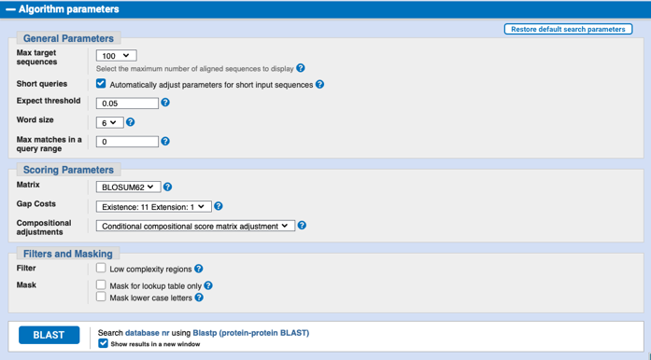

Slide 23
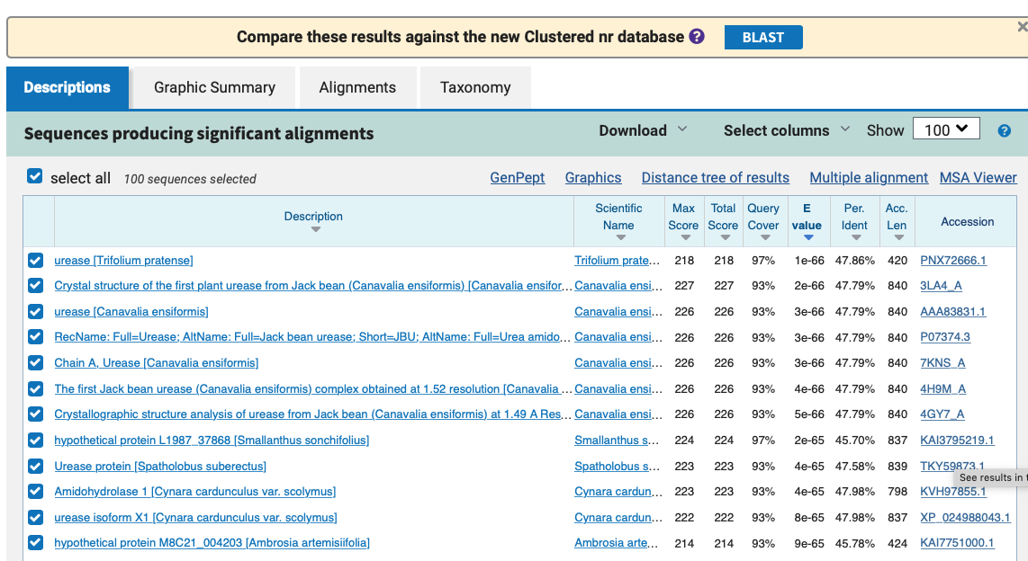

Slide 24
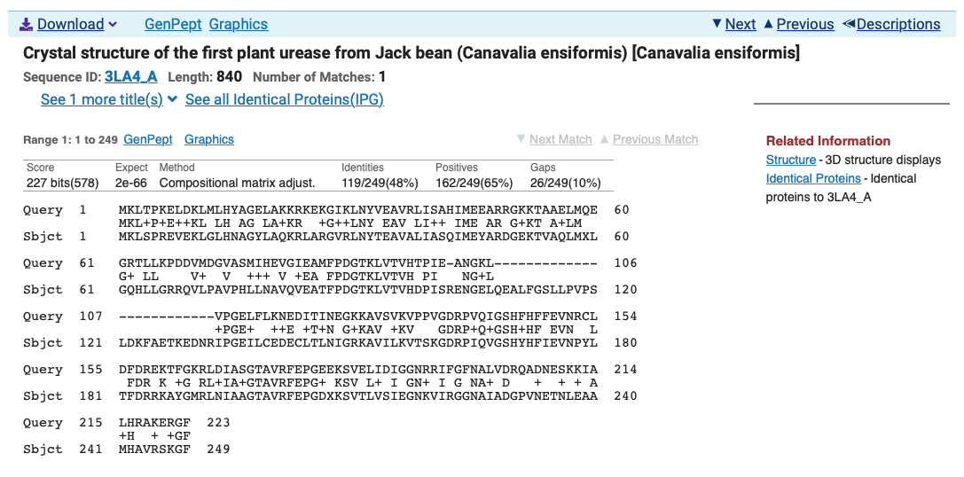

Slide 25
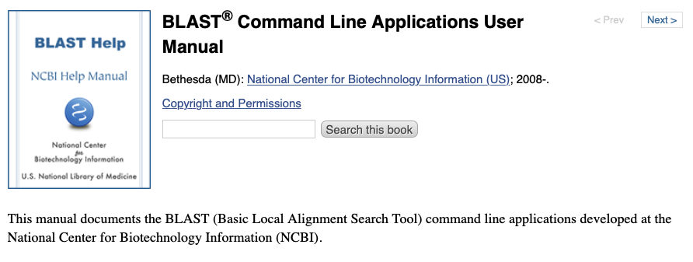

https://www.ncbi.nlm.nih.gov/books/NBK279690/

Slide 26
k-mers
Definition
k-mers are subsequences of length k contained within a biological sequence
Importance
fundamental units in genomic analysis for pattern recognition, sequencing and mapping
Example
In the sequence "ATCGATCGA," the 3-mers would be "ATC," "TCG," "CGA," etc.

Slide 27
Properties of k-mers
Fixed Length
All k-mers in a given analysis are of the same specified length k
Overlapping
k-mers can overlap with each other, sharing (k-1) bases with their adjacent k-mers
Frequency
The count of each unique k-mer within a sequence can be informative of sequence composition and complexity

Slide 28
Kraken
Kraken is a system designed to assign taxonomic labels to short DNA sequences using k-mers
It uses exact k-mer matches to known genomic sequences in a reference database
The system is known for its speed and accuracy in taxonomic classification

Slide 29
How Kraken Works
Database Construction:
Kraken builds an index of k-mers found in a reference set of DNA from known organisms
Classification Algorithm:
When analysing a sequence, Kraken searches for each k-mer within its database
Assignment:
Sequences are classified based on the highest number of k-mer matches to a particular organism in the database

Slide 30
Kraken: K-mer LCA database
Lowest common ancestor
database
Reference Genomes
(2,256 RefSeq Genomes)
Extract K-mers
K-mer | LCA
ACC … GT | g__Escherichia
ACG … GT | s__E. coli
AGT … AA | p__Proteobacteria
…
TGA … TT | d__Bacteria
(default, K = 31)
Only as good as the reference database used!
Wood and Salzberg, Genome Biology, 2014

Slide 31
Kraken: classification tree
Wood and Salzberg, Genome Biology, 2014

Slide 32
Further reading and acknowledgments
https://www.ncbi.nlm.nih.gov/books/NBK20260/
https://www.ncbi.nlm.nih.gov/books/NBK1734/
https://www.ncbi.nlm.nih.gov/home/tutorials/
https://www.ncbi.nlm.nih.gov/Class/BLAST/blast_course.short.html
Sequence searching and alignments - Andrew Cowley EBI
www.ebi.ac.uk/sites/ebi.ac.uk/files/content.ebi.ac.uk/materials/2012/120508_Rotterdam/sequence_searching_alignments_cowley.2012.pptx

