Slide 1
Modeling adolescent BMI
Meera Beauchamp
HMS 520 Final Presentation

Slide 2
AGENDA
Data
Variable Selection
​Model Creation
Model Evaluation

Slide 3
Data: California Health Interview Survey
Telephone based survey about health and healthcare
Conducted in 6 languages
Demographic: adolescents aged 12 to 17 in California
Years: 2017 & 2018
Observations: 440 per year = 880 total
Source: https://healthpolicy.ucla.edu/chis/data/public-use-data-file/Documents/CHIS%202017%20PUF%20Data%20Dictionary%20-%20Teen.pdf

Slide 4
Data: Prep Data Steps
Load .dta files with the haven package
Import two years of data
195 columns vs 192 columns
Identify columns which are the same using intersect()
185 columns overlap
Concatenate datasets with rbind()
Set seed and create train and test indicators
90% train, 10% test
Source: https://healthpolicy.ucla.edu/chis/data/public-use-data-file/Documents/CHIS%202017%20PUF%20Data%20Dictionary%20-%20Teen.pdf

Slide 5
Variable Selection
Dependent variable: body mass index (BMI)
Read data dictionary and selected 7 out of 185 variables
Sex
Age
Hours of sleep
5+ fruits & vegetables per day (binary)
Poverty level (1: 0-99% FPL, 4: 300%+ FPL)
# of fruits consumed per day
# of vegetables consumed per day
Variable creation:
# of fruits/vegetables consumed per day = # fruits + # of vegetables

Slide 6
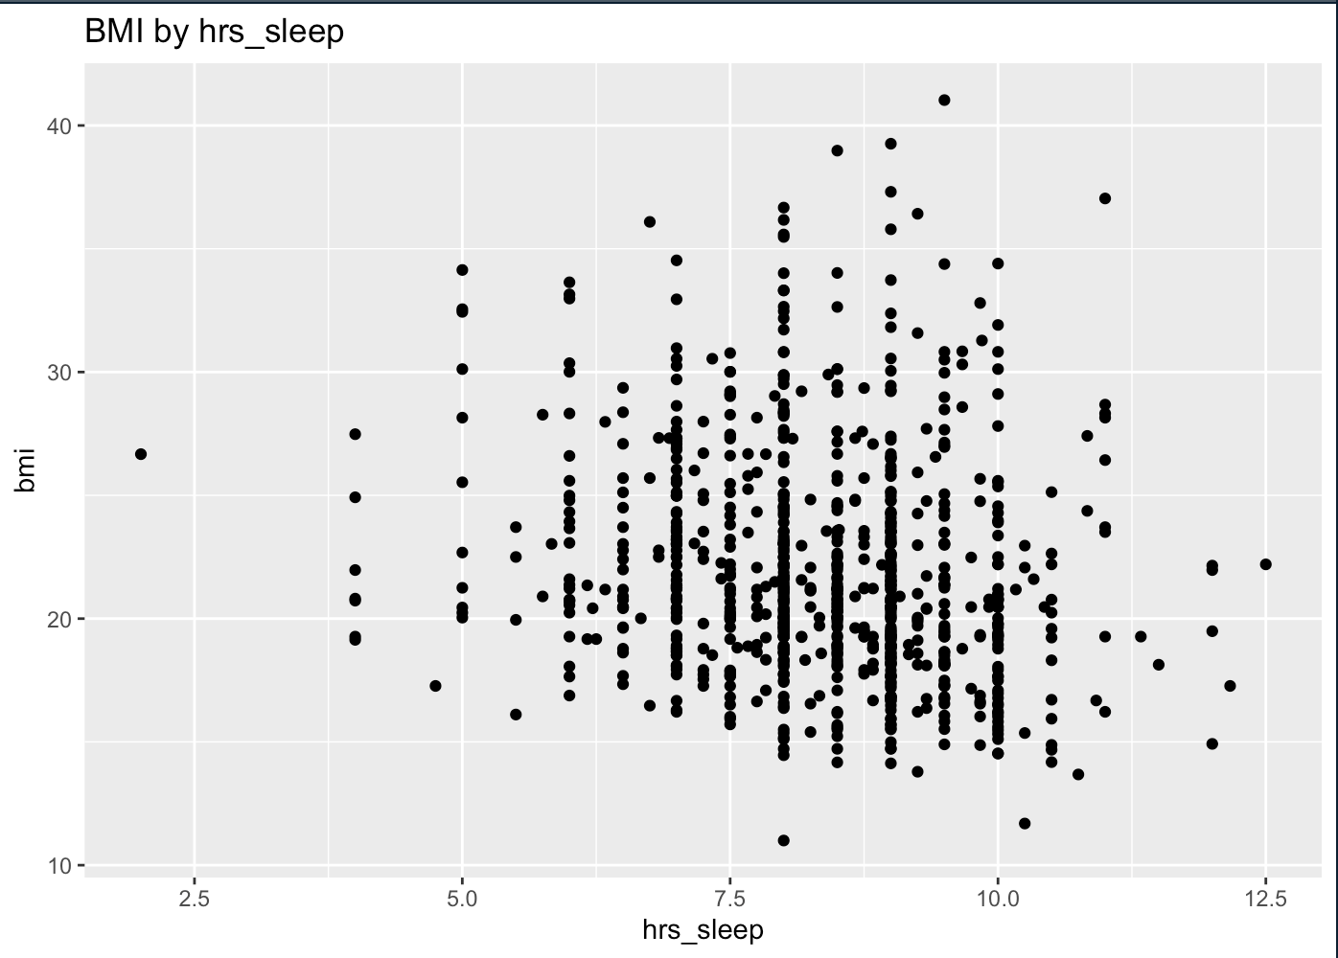
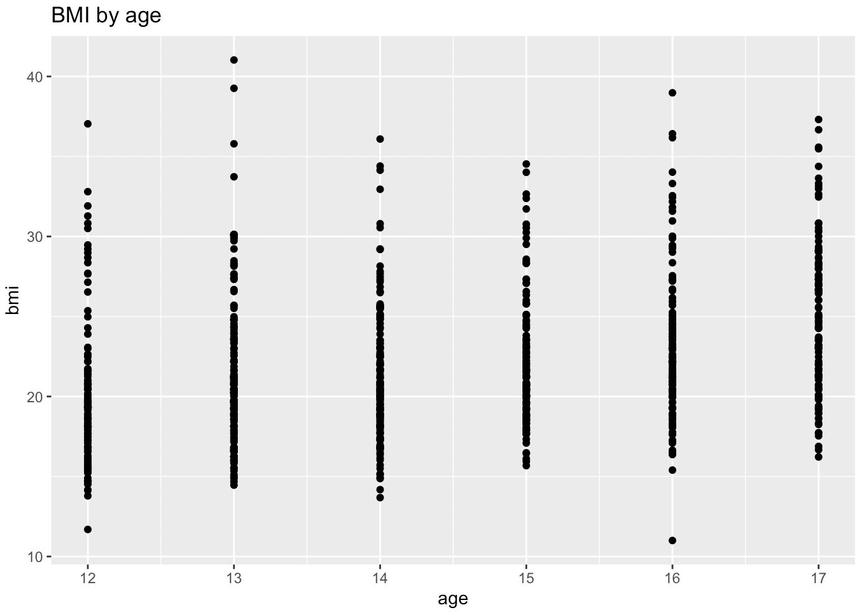
Variable Selection
Scatter plots
Scatter plot of BMI by each of the 7 variables to visually explore relationship
Function using ggplot2 to create plot and save as pdf
Lapply to apply function to each variable
BMI & sleep: Negative correlation
BMI & age: Positive correlation

Slide 7
Variable Selection
Univariate Regressions
Run univariate regressions on each possible variable and bmi using lm() and lappy()
Results:
Variable | Coefficient | P-value
Age | 0.85 | 2e⁻¹⁶
Poverty level | -0.92 | 1.58e⁻¹¹
Hours of sleep | -0.55 | 2.89e⁻⁶
# fruits & veg | -0.20 | 0.01
5+ fruit/veg (binary) | 0.32 | 0.37
Sex | 0.24 | 0.45
Removed non-statistically significant variables from vector of variables of interest

Slide 8
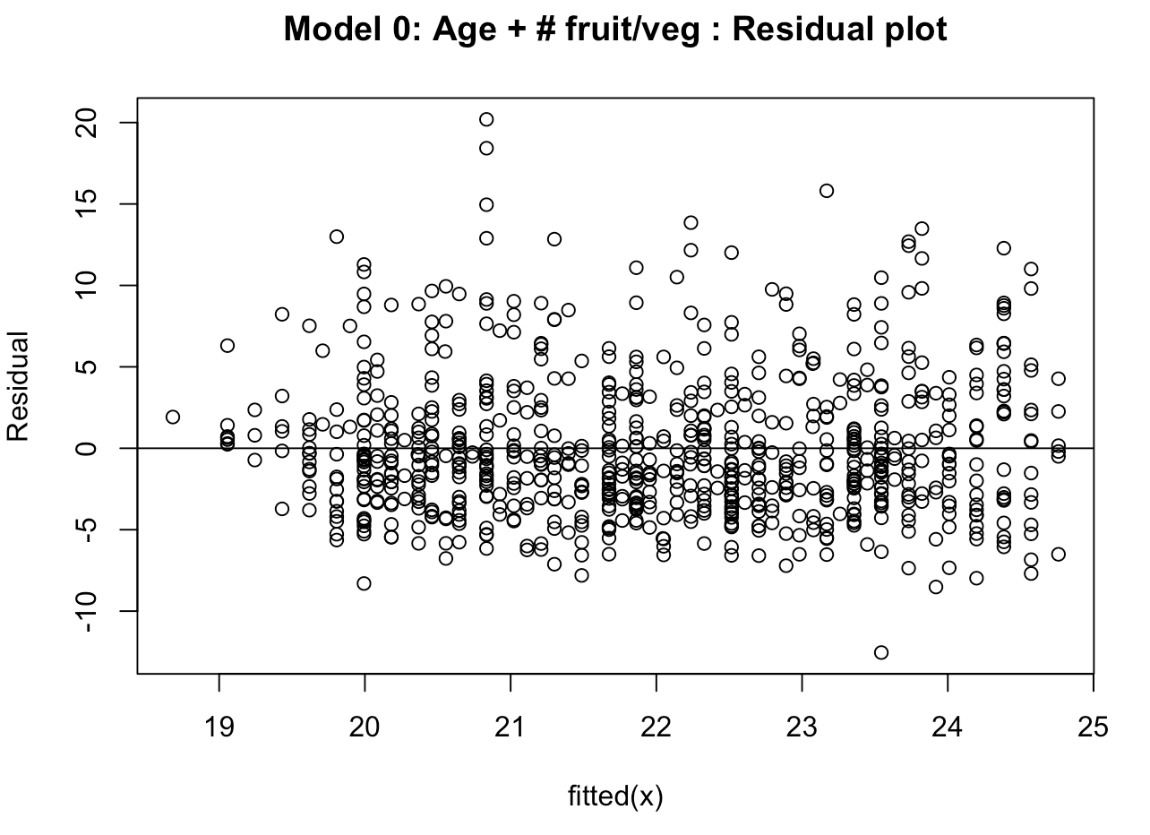
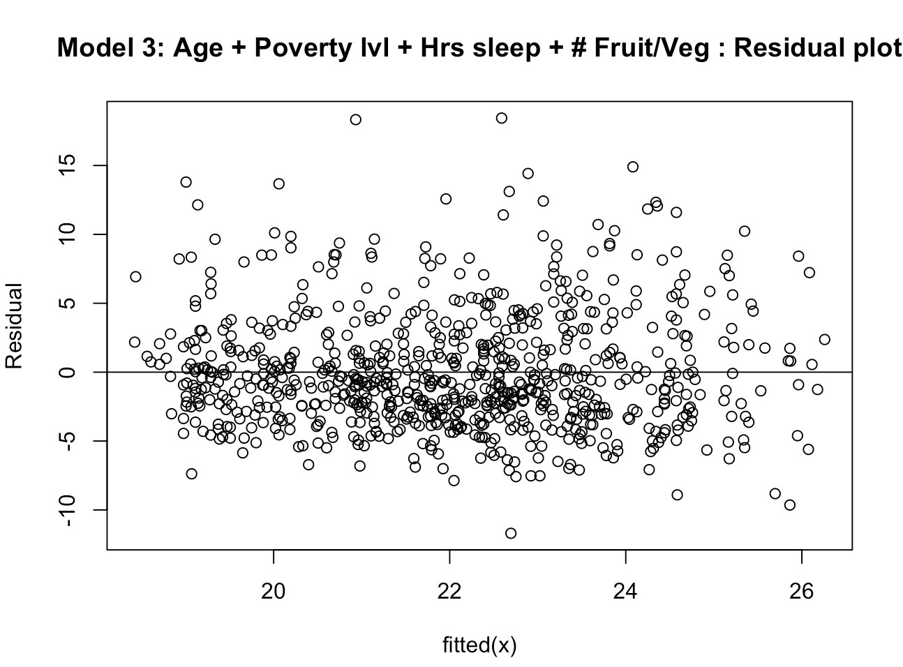
Model Creation
Dependent variable: body mass index (BMI)
Add variables one by one in order of statistical significance (one with variables based on previous knowledge)
Created function to create model and plot residuals

Slide 9
Model Evaluation
Use models and predict() to create predictions on 10% test set
Calculate out-of-sample residual mean squared error (RMSE)
Model | Out-sample RMSE
0: Age + # fruit/veg | 4.35
1: Age + Poverty lvl | 4.25
2: Age + Poverty lvl + Hrs sleep | 4.25
3: Age + Poverty lvl + Hrs sleep + # Fruit/Veg | 4.24
RMSE slightly improves

Slide 10
THANK YOU

