Slide 1


Slide 2


LEAVE & OVERTIME,
without the email chase.
One intelligent assistant for employees, line managers, and HR.
FILE
APPROVE
TRACK
UPDATE
Notes:
0:00–0:35
Today, leave and overtime requests travel through email. Each request triggers manual checking, approval follow-ups, tracker updates, notifications, and calendar changes. We created LIA, the Leave Intelligent Assistant, to connect those steps in one simple experience.
[Sources]
Visual on this slide was generated with Microsoft Copilot.

Slide 3

01 • THE REAL SITUATION
Email is the form. People are the workflow.
The burden sits with employees, line managers, and HR.
EMPLOYEES
Repeat details and wait for status
LINE MANAGERS
Search threads and chase context
HR
Reconcile emails, trackers, and calendars
HOW MIGHT WE automate filing and tracking of leave and overtime?
Notes:
0:35–1:15
Our empathy map showed that the problem is bigger than a form. Employees repeatedly enter information and lack visibility. Managers search email for context. HR manually consolidates requests across messages, trackers, and calendars. Our question became: how might we automate filing and tracking of leave and overtime?
[Sources]
Visual on this slide was generated with Microsoft Copilot.

Slide 4

02 • THE LIA EXPERIENCE
One request. One connected flow.
LIA guides the employee and orchestrates the work behind the request.
GUIDE
01
Capture the right leave or overtime details
ROUTE
02
Send the request to the right approver
UPDATE
03
Notify the employee and update calendars
INFORM
04
Give HR a clearer workforce view
Not another digital form. The intelligent layer connecting the whole journey.
Notes:
1:15–2:05
LIA gives employees one guided experience to submit the correct request. The assistant captures details, routes the request to the right manager, tracks the decision, notifies the employee, and updates the calendar after approval. For HR, the same connected process creates a foundation for useful workforce insights.
[Sources]
Visual on this slide was generated with Microsoft Copilot.

Slide 5
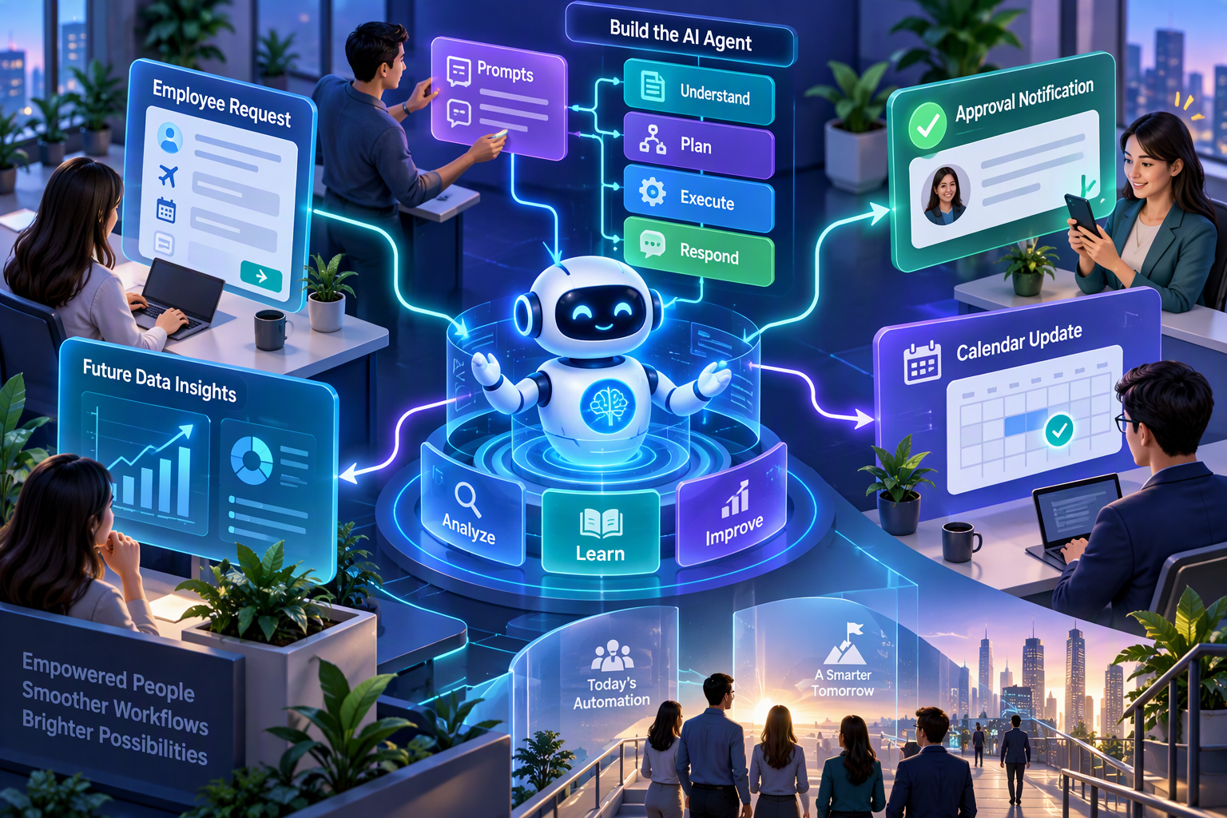
03 • BUILT WITH AI
Prototype today. Connected platform tomorrow.
We prompted the goal, requirements, and flow, then created an agent to execute the commands.
BUILT & TESTED
Prompt-driven agent prototype for the intended request and approval flow.
UNFINISHED
No database or master-data integration yet. This remains a prototype.
NEXT PROOF POINT
Connect secure employee data, pilot approvals and calendar updates, then measure time saved.
LIA gives time back to people.
Notes:
2:05–3:00
We used AI by prompting the business goal, requirements, and desired flow, then creating an agent to execute the commands. Today, LIA is a working prototype and experience vision. It does not yet have a database or master-data integration. Next, we will connect secure employee data, pilot the approval and calendar loop, and measure filing time, approval turnaround, and tracking effort. LIA gives time back to people.
[Sources]
Visual on this slide was generated with Microsoft Copilot.

Slide 6
LIA: Leave made simple. Decisions made smarter.

