Slide 1
Chapter 4: The Data Link Layer
Our goals:
understand principles behind data link layer services:
  error detection, correction
  sharing a broadcast channel: multiple access
  link layer addressing
  reliable data transfer, flow control: done!
instantiation and implementation of various link layer technologies
Overview:
link layer services
error detection, correction
multiple access protocols and LANs
link layer addressing, ARP
specific link layer technologies:
  Ethernet
  hubs, bridges, switches
  IEEE 802.11 LANs
  PPP
  ATM
4: DataLink Layer

Slide 2
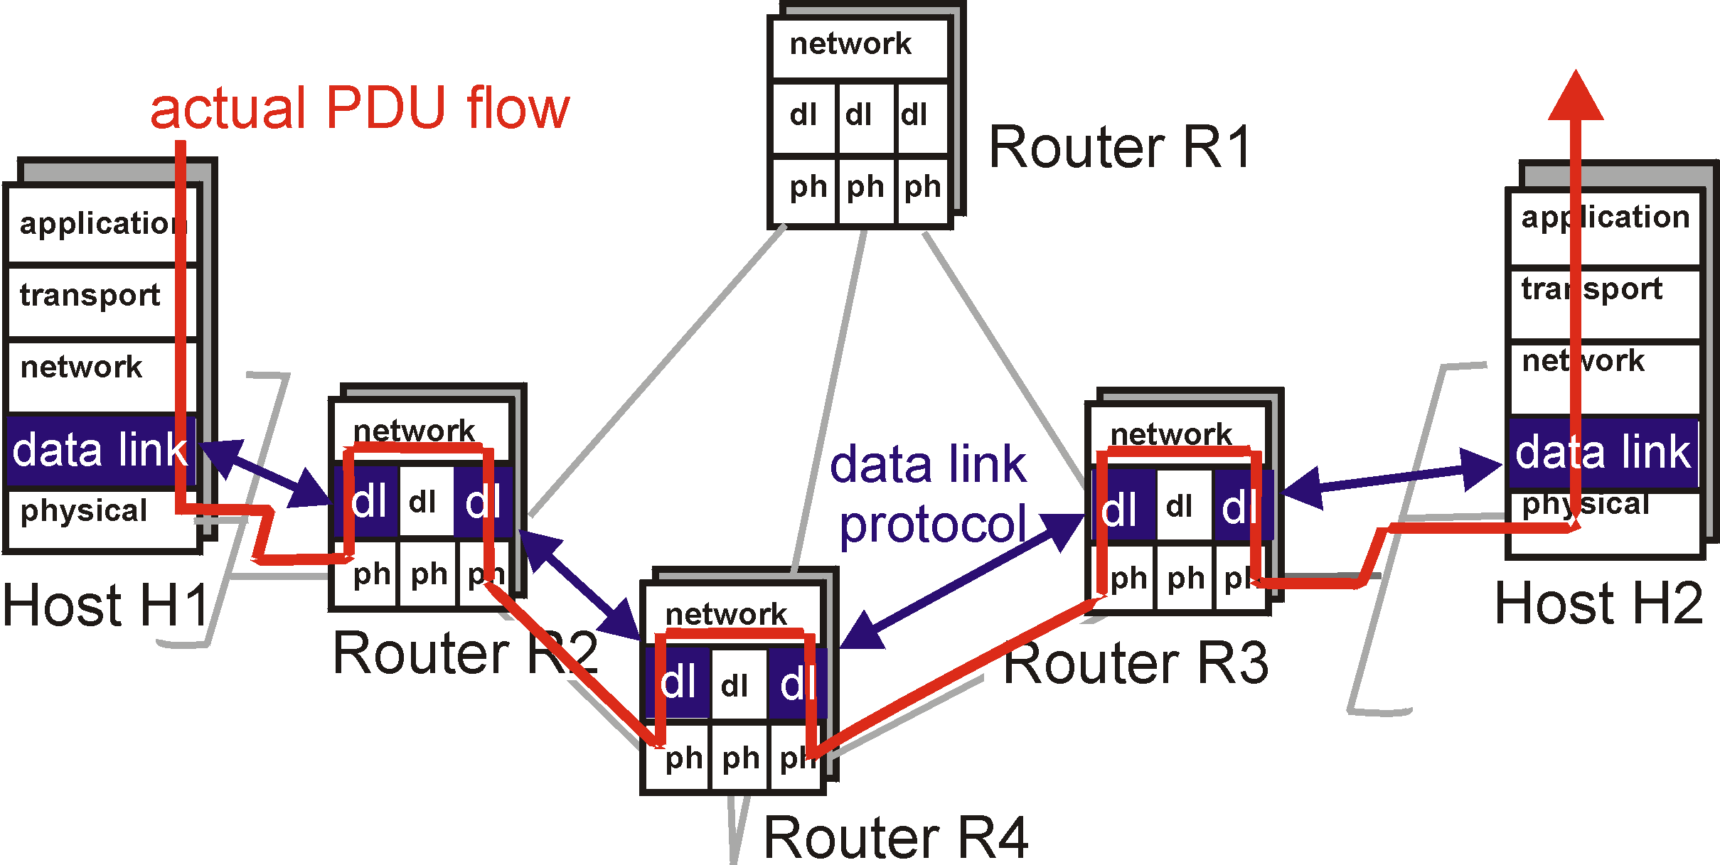
Link Layer: setting the context
4: DataLink Layer

Slide 3

Link Layer: setting the context
two physically connected devices:
  host-router, router-router, host-host
unit of data: frame
M
application
transport
network
link
physical
network
link
physical
H
t
M
H
H
M
data link
protocol
n
t
H
H
H
H
H
H
M
l
n
t
M
l
n
t
frame
phys. link
adapter card

Slide 4
Link Layer Services
Framing, link access:
  encapsulate datagram into frame, adding header, trailer
  implement channel access if shared medium,
  ‘physical addresses’ used in frame headers to identify source, dest
    different from IP address!
Reliable delivery between two physically connected devices:
  we learned how to do this already (chapter 3)!
  seldom used on low bit error link (fiber, some twisted pair)
  wireless links: high error rates
    Q: why both link-level and end-end reliability?
4: DataLink Layer

Slide 5
Link Layer Services (more)
Flow Control:
  pacing between sender and receivers
Error Detection:
  errors caused by signal attenuation, noise.
  receiver detects presence of errors:
    signals sender for retransmission or drops frame
Error Correction:
  receiver identifies and corrects bit error(s) without resorting to retransmission
4: DataLink Layer

Slide 6
Link Layer: Implementation
implemented in “adapter”
  e.g., PCMCIA card, Ethernet card
  typically includes: RAM, DSP chips, host bus interface, and link interface
M
application
transport
network
link
physical
network
link
physical
H
t
M
H
H
M
data link
protocol
n
t
H
H
H
H
H
H
M
l
n
t
M
l
n
t
frame
phys. link
adapter card
4: DataLink Layer

Slide 7

Error Detection
EDC= Error Detection and Correction bits (redundancy)
D = Data protected by error checking, may include header fields
Error detection not 100% reliable!
  protocol may miss some errors, but rarely
  larger EDC field yields better detection and correction

Slide 8


Parity Checking
Single Bit Parity:
Detect single bit errors
Two Dimensional Bit Parity:
Detect and correct single bit errors
0
0
4: DataLink Layer

Slide 9
Internet checksum
Goal: detect “errors” (e.g., flipped bits) in transmitted segment (note: used at transport layer only)
Sender:
treat segment contents as sequence of 16-bit integers
checksum: addition (1’s complement sum) of segment contents
sender puts checksum value into UDP checksum field
Receiver:
compute checksum of received segment
check if computed checksum equals checksum field value:
  NO - error detected
  YES - no error detected. But maybe errors nonethless? More later ….
4: DataLink Layer

Slide 10

Checksumming: Cyclic Redundancy Check
view data bits, D, as a binary number
choose r+1 bit pattern (generator), G
goal: choose r CRC bits, R, such that
  <D,R> exactly divisible by G (modulo 2)
  receiver knows G, divides <D,R> by G. If non-zero remainder: error detected!
  can detect all burst errors less than r+1 bits
widely used in practice (ATM, HDCL)
4: DataLink Layer

Slide 11

CRC Example
Want:
  D.2^{r} XOR R = nG
equivalently:
  D.2^{r} = nG XOR R
equivalently:
if we divide D.2^{r} by G, want reminder R
D.2^{r}
G
R = remainder[ ]
4: DataLink Layer

Slide 12

Multiple Access Links and Protocols
Three types of “links”:
point-to-point (single wire, e.g. PPP, SLIP)
broadcast (shared wire or medium; e.g, Ethernet, Wavelan, etc.)
switched (e.g., switched Ethernet, ATM etc)
4: DataLink Layer

Slide 13
Multiple Access protocols
single shared communication channel
two or more simultaneous transmissions by nodes: interference
  only one node can send successfully at a time
multiple access protocol:
  distributed algorithm that determines how stations share channel, i.e., determine when station can transmit
  communication about channel sharing must use channel itself!
  what to look for in multiple access protocols:
    synchronous or asynchronous
    information needed about other stations
    robustness (e.g., to channel errors)
    performance
4: DataLink Layer

Slide 14
MAC Protocols: a taxonomy
Three broad classes:
Channel Partitioning
  TDMA: time division multiple access
  FDMA: frequency division multiple access
  CDMA (Code Division Multiple Access) Read!
Random Access
  allow collisions
  “recover” from collisions
“Taking turns”
  tightly coordinate shared access to avoid collisions
Goal: efficient, fair, simple, decentralized
4: DataLink Layer

Slide 15
Random Access protocols
When node has packet to send
  transmit at full channel data rate R.
  no a priori coordination among nodes
two or more transmitting nodes -> “collision”,
random access MAC protocol specifies:
  how to detect collisions
  how to recover from collisions (e.g., via delayed retransmissions)
Examples of random access MAC protocols:
  slotted ALOHA and ALOHA
  CSMA and CSMA/CD
4: DataLink Layer

Slide 16
CSMA: Carrier Sense Multiple Access)
CSMA: listen before transmit:
If channel sensed idle: transmit entire pkt
If channel sensed busy, defer transmission
  Persistent CSMA: retry immediately with probability p when channel becomes idle (may cause instability)
  Non-persistent CSMA: retry after random interval
human analogy: don’t interrupt others!
4: DataLink Layer

Slide 17

CSMA collisions
spatial layout of nodes along ethernet
collisions can occur:
propagation delay means
two nodes may not year
hear each other’s transmission
collision:
entire packet transmission
time wasted
note:
role of distance and propagation delay in determining collision prob.
4: DataLink Layer

Slide 18
CSMA/CD (Collision Detection)
CSMA/CD: carrier sensing, deferral as in CSMA
  collisions detected within short time
  colliding transmissions aborted, reducing channel wastage
  persistent or non-persistent retransmission
collision detection:
  easy in wired LANs: measure signal strengths, compare transmitted, received signals
  difficult in wireless LANs: receiver shut off while transmitting
human analogy: the polite conversationalist
4: DataLink Layer

Slide 19

CSMA/CD collision detection
4: DataLink Layer

Slide 20
“Taking Turns” MAC protocols
channel partitioning MAC protocols:
  share channel efficiently at high load
  inefficient at low load: delay in channel access, 1/N bandwidth allocated even if only 1 active node!
Random access MAC protocols
  efficient at low load: single node can fully utilize channel
  high load: collision overhead
“taking turns” protocols
  look for best of both worlds!
4: DataLink Layer

Slide 21
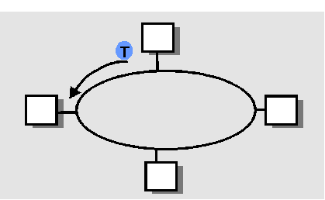
“Taking Turns” MAC protocols
Polling:
master node “invites” slave nodes to transmit in turn
Request to Send, Clear to Send msgs
concerns:
  polling overhead
  latency
  single point of failure (master)
Token passing:
control token passed from one node to next sequentially.
token message
concerns:
  token overhead
  latency
  single point of failure (token)
4: DataLink Layer

Slide 22
Summary of MAC protocols
What do you do with a shared media?
  Channel Partitioning, by time, frequency or code
    Time Division,Code Division, Frequency Division
  Random partitioning (dynamic),
    ALOHA, S-ALOHA, CSMA, CSMA/CD
    carrier sensing: easy in some technologies (wire), hard in others (wireless)
    CSMA/CD used in Ethernet
  Taking Turns
    polling from a central cite, token passing
4: DataLink Layer

Slide 23
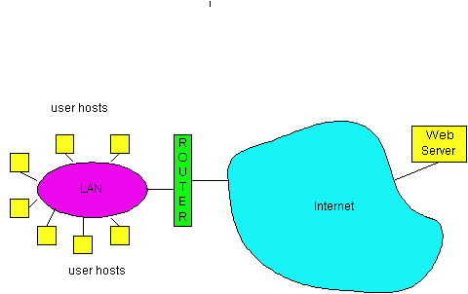
LAN technologies
Data link layer so far:
  services, error detection/correction, multiple access
Next: LAN technologies
  addressing
  Ethernet
  hubs, bridges, switches
  802.11
  PPP
  ATM

Slide 24
LAN Addresses and ARP
32-bit IP address:
network-layer address
used to get datagram to destination network (recall IP network definition)
LAN (or MAC or physical) address:
used to get datagram from one interface to another physically-connected interface (same network)
48 bit MAC address (for most LANs)
burned in the adapter ROM
4: DataLink Layer

Slide 25
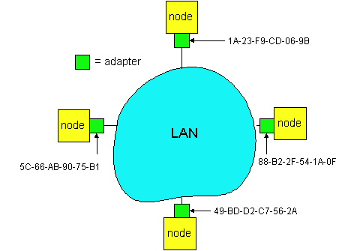
LAN Addresses and ARP
Each adapter on LAN has unique LAN address
4: DataLink Layer

Slide 26
LAN Address (more)
MAC address allocation administered by IEEE
manufacturer buys portion of MAC address space (to assure uniqueness)
Analogy:
(a) MAC address: like Social Security Number
(b) IP address: like postal address
MAC flat address => portability
  can move LAN card from one LAN to another
IP hierarchical address NOT portable
  depends on network to which one attaches
4: DataLink Layer

Slide 27
Recall earlier routing discussion
Starting at A, given IP datagram addressed to B:
look up net. address of B, find B on same net. as A
link layer send datagram to B inside link-layer frame
A
223.1.1.1
223.1.2.1
223.1.1.2
223.1.1.4
223.1.2.9
B
223.1.2.2
E
223.1.1.3
223.1.3.27
223.1.3.1
223.1.3.2
frame source,
dest address
datagram source,
dest address
B’s MAC
addr
A’s MAC
addr
A’s IP
addr
B’s IP
addr
IP payload
datagram
frame
4: DataLink Layer

Slide 28
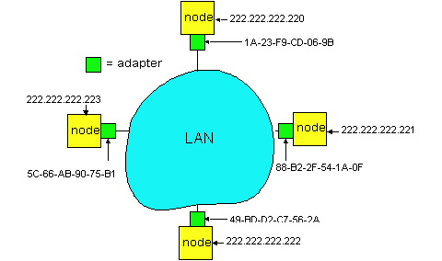
ARP: Address Resolution Protocol
Question: how to determine
MAC address of B
given B’s IP address?
Each IP node (Host, Router) on LAN has ARP module, table
ARP Table: IP/MAC address mappings for some LAN nodes
< IP address; MAC address; TTL>
< ………………………….. >
  TTL (Time To Live): time after which address mapping will be forgotten (typically 20 min)
4: DataLink Layer

Slide 29
ARP protocol
A knows B's IP address, wants to learn physical address of B
A broadcasts ARP query pkt, containing B's IP address
  all machines on LAN receive ARP query
B receives ARP packet, replies to A with its (B's) physical layer address
A caches (saves) IP-to-physical address pairs until information becomes old (times out)
  soft state: information that times out (goes away) unless refreshed
4: DataLink Layer

Slide 30
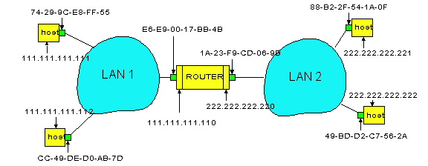
Routing to another LAN
walkthrough: routing from A to B via R
In routing table at source Host, find router 111.111.111.110
In ARP table at source, find MAC address E6-E9-00-17-BB-4B, etc
A
R
B
4: DataLink Layer

Slide 31
A creates IP packet with source A, destination B
A uses ARP to get R’s physical layer address for 111.111.111.110
A creates Ethernet frame with R's physical address as dest, Ethernet frame contains A-to-B IP datagram
A’s data link layer sends Ethernet frame
R’s data link layer receives Ethernet frame
R removes IP datagram from Ethernet frame, sees its destined to B
R uses ARP to get B’s physical layer address
R creates frame containing A-to-B IP datagram sends to B
A
R
B
4: DataLink Layer

Slide 32

Ethernet
“dominant” LAN technology:
cheap $20 for 100Mbs!
first wildey used LAN technology
Simpler, cheaper than token LANs and ATM
Kept up with speed race: 10, 100, 1000 Mbps
Metcalfe’s Etheret
sketch
: DataLink Layer

Slide 33

Ethernet Frame Structure
Sending adapter encapsulates IP datagram (or other network layer protocol packet) in Ethernet frame
Preamble:
7 bytes with pattern 10101010 followed by one byte with pattern 10101011
used to synchronize receiver, sender clock rates
: DataLink Layer

Slide 34
Ethernet Frame Structure (more)
Addresses: 6 bytes, frame is received by all adapters on a LAN and dropped if address does not match
Type: indicates the higher layer protocol, mostly IP but others may be supported such as Novell IPX and AppleTalk)
CRC: checked at receiver, if error is detected, the frame is simply dropped
: DataLink Layer

Slide 35
Ethernet: uses CSMA/CD
A: sense channel, if idle
  then {
  transmit and monitor the channel;
      If detect another transmission
      then {
      abort and send jam signal;
        update # collisions;
        delay as required by exponential backoff algorithm;
        goto A
        }
      else {done with the frame; set collisions to zero}
    }
  else {wait until ongoing transmission is over and goto A}
: DataLink Layer

Slide 36
Ethernet’s CSMA/CD (more)
Jam Signal: make sure all other transmitters are aware of collision; 48 bits;
Exponential Backoff:
Goal: adapt retransmission attempts to estimated current load
  heavy load: random wait will be longer
first collision: choose K from {0,1}; delay is K x 512 bit transmission times
after second collision: choose K from {0,1,2,3}…
after ten or more collisions, choose K from {0,1,2,3,4,…,1023}
: DataLink Layer

Slide 37
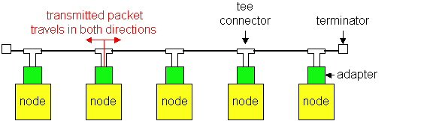
Ethernet Technologies: 10Base2
10: 10Mbps; 2: under 200 meters max cable length
thin coaxial cable in a bus topology
repeaters used to connect up to multiple segments
repeater repeats bits it hears on one interface to its other interfaces: physical layer device only!
: DataLink Layer

Slide 38
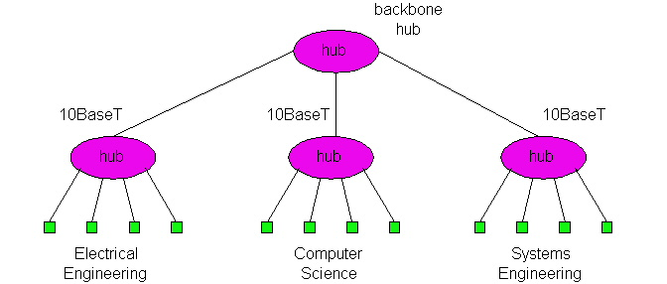
10BaseT and 100BaseT
10/100 Mbps rate; latter called “fast ethernet”
T stands for Twisted Pair
Hub to which nodes are connected by twisted pair, thus “star topology”
CSMA/CD implemented at hub
: DataLink Layer

Slide 39
10BaseT and 100BaseT (more)
Max distance from node to Hub is 100 meters
Hub can disconnect “jabbering adapter
Hub can gather monitoring information, statistics for display to LAN administrators
: DataLink Layer

Slide 40
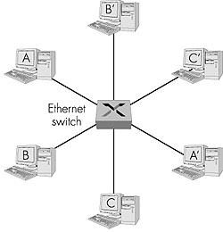
Ethernet Switches
layer 2 (frame) forwarding, filtering using LAN addresses
Switching: A-to-B and A’-to-B’ simultaneously, no collisions
large number of interfaces
often: individual hosts, star-connected into switch
  Ethernet, but no collisions!
: DataLink Layer

Slide 41
Ethernet Switches
cut-through switching: frame forwarded from input to output port without awaiting for assembly of entire frame
  slight reduction in latency
combinations of shared/dedicated, 10/100/1000 Mbps interfaces
: DataLink Layer

Slide 42
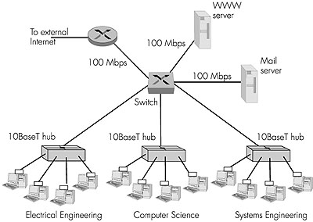
Ethernet Switches (more)
Dedicated
Shared
: DataLink Layer

Slide 43

Token Passing: IEEE802.5 standard
4 Mbps
max token holding time: 10 ms, limiting frame length
SD, ED mark start, end of packet
AC: access control byte:
  token bit: value 0 means token can be seized, value 1 means data follows FC
  priority bits: priority of packet
  reservation bits: station can write these bits to prevent stations with lower priority packet from seizing token after token becomes free
: DataLink Layer

Slide 44
Token Passing: IEEE802.5 standard
FC: frame control used for monitoring and maintenance
source, destination address: 48 bit physical address, as in Ethernet
data: packet from network layer
checksum: CRC
FS: frame status: set by dest., read by sender
  set to indicate destination up, frame copied OK from ring
  DLC-level ACKing
: DataLink Layer

Slide 45
Interconnecting LANs
Q: Why not just one big LAN?
Limited amount of supportable traffic: on single LAN, all stations must share bandwidth
limited length: 802.3 specifies maximum cable length
large “collision domain” (can collide with many stations)
limited number of stations: 802.5 have token passing delays at each station
: DataLink Layer

Slide 46
Hubs
Physical Layer devices: essentially repeaters operating at bit levels: repeat received bits on one interface to all other interfaces
Hubs can be arranged in a hierarchy (or multi-tier design), with backbone hub at its top
4: DataLink Layer

Slide 47
Hubs (more)
Each connected LAN referred to as LAN segment
Hubs do not isolate collision domains: node may collide with any node residing at any segment in LAN
Hub Advantages:
  simple, inexpensive device
  Multi-tier provides graceful degradation: portions of the LAN continue to operate if one hub malfunctions
  extends maximum distance between node pairs (100m per Hub)
4: DataLink Layer

Slide 48
Hub limitations
single collision domain results in no increase in max throughput
  multi-tier throughput same as single segment throughput
individual LAN restrictions pose limits on number of nodes in same collision domain and on total allowed geographical coverage
cannot connect different Ethernet types (e.g., 10BaseT and 100baseT)
4: DataLink Layer

Slide 49
Bridges
Link Layer devices: operate on Ethernet frames, examining frame header and selectively forwarding frame based on its destination
Bridge isolates collision domains since it buffers frames
When frame is to be forwarded on segment, bridge uses CSMA/CD to access segment and transmit
4: DataLink Layer

Slide 50
Bridges (more)
Bridge advantages:
  Isolates collision domains resulting in higher total max throughput, and does not limit the number of nodes nor geographical coverage
  Can connect different type Ethernet since it is a store and forward device
  Transparent: no need for any change to hosts LAN adapters
4: DataLink Layer

Slide 51
Bridges: frame filtering, forwarding
bridges filter packets
  same-LAN -segment frames not forwarded onto other LAN segments
forwarding:
  how to know which LAN segment on which to forward frame?
  looks like a routing problem (more shortly!)
4: DataLink Layer

Slide 52
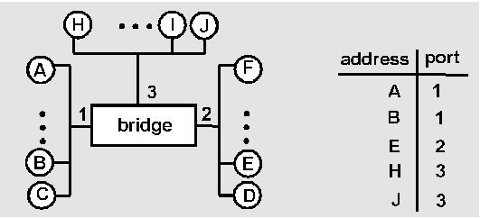
Bridge Learning: example
Suppose C sends frame to D and D replies back with frame to C
C sends frame, bridge has no info about D, so floods to both LANs
  bridge notes that C is on port 1
  frame ignored on upper LAN
  frame received by D
4: DataLink Layer

Slide 53
Bridge Learning: example
D generates reply to C, sends
  bridge sees frame from D
  bridge notes that D is on interface 2
  bridge knows C on interface 1, so selectively forwards frame out via interface 1
4: DataLink Layer

Slide 54

Bridges vs. Routers
both store-and-forward devices
  routers: network layer devices (examine network layer headers)
  bridges are Link Layer devices
routers maintain routing tables, implement routing algorithms
bridges maintain filtering tables, implement filtering, learning and spanning tree algorithms
4: DataLink Layer

Slide 55
Routers vs. Bridges
Bridges + and -
+ Bridge operation is simpler requiring less processing bandwidth
- Topologies are restricted with bridges: a spanning tree must be built to avoid cycles
- Bridges do not offer protection from broadcast storms (endless broadcasting by a host will be forwarded by a bridge)
4: DataLink Layer

Slide 56
Routers vs. Bridges
Routers + and -
+ arbitrary topologies can be supported, cycling is limited by TTL counters (and good routing protocols)
+ provide firewall protection against broadcast storms
- require IP address configuration (not plug and play)
- require higher processing bandwidth
bridges do well in small (few hundred hosts) while routers used in large networks (thousands of hosts)
4: DataLink Layer

Slide 57
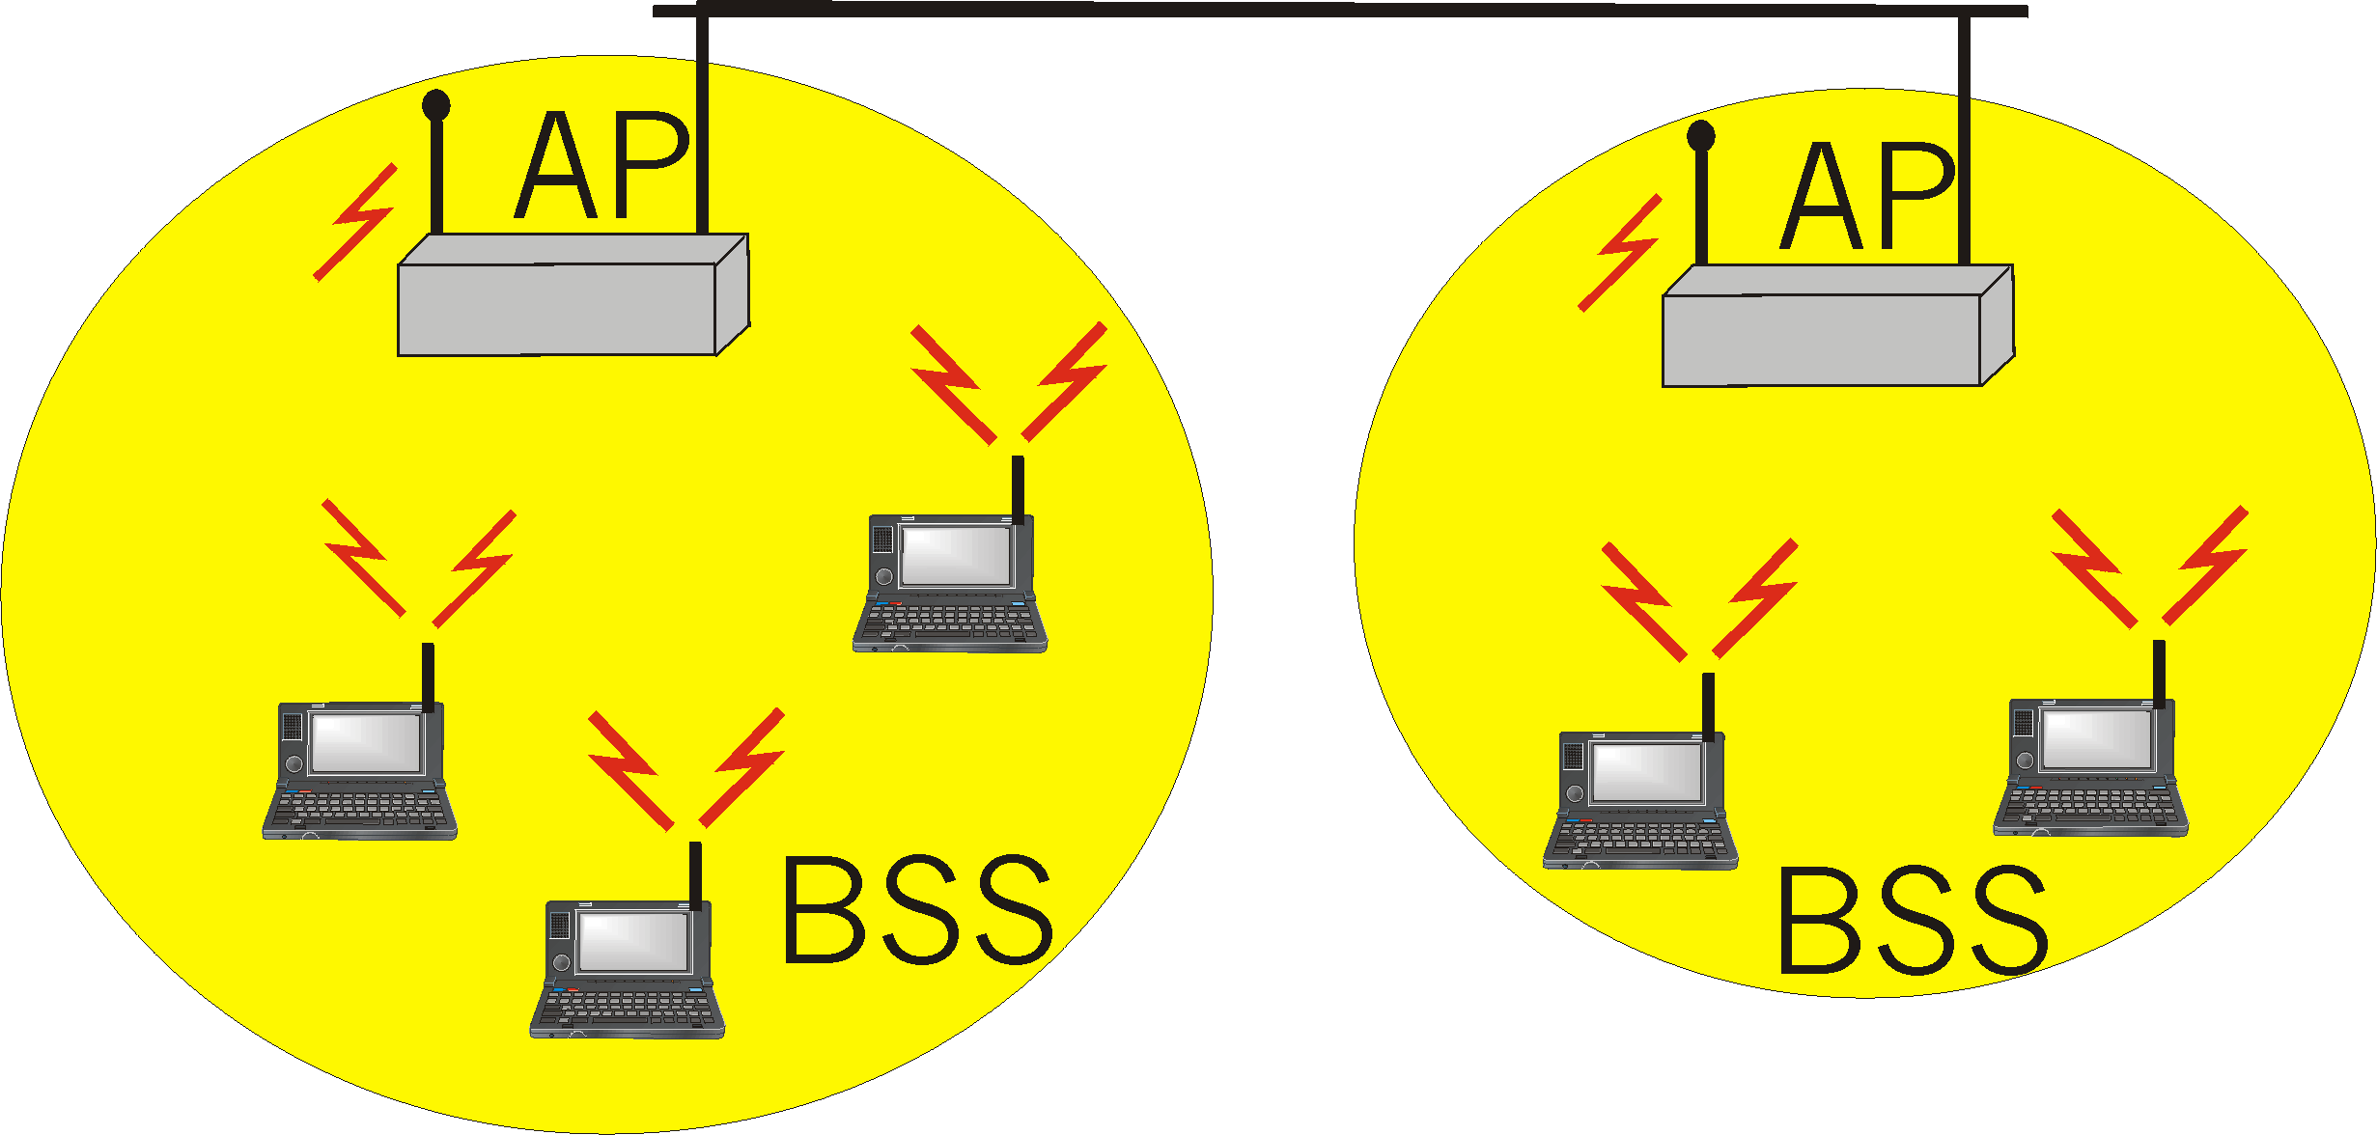
IEEE 802.11 Wireless LAN
wireless LANs: untethered (often mobile) networking
IEEE 802.11 standard:
  MAC protocol
  unlicensed frequency spectrum: 900Mhz, 2.4Ghz
Basic Service Set (BSS) (a.k.a. “cell”) contains:
  wireless hosts
  access point (AP): base station
BSS’s combined to form distribution system (DS)

Slide 58
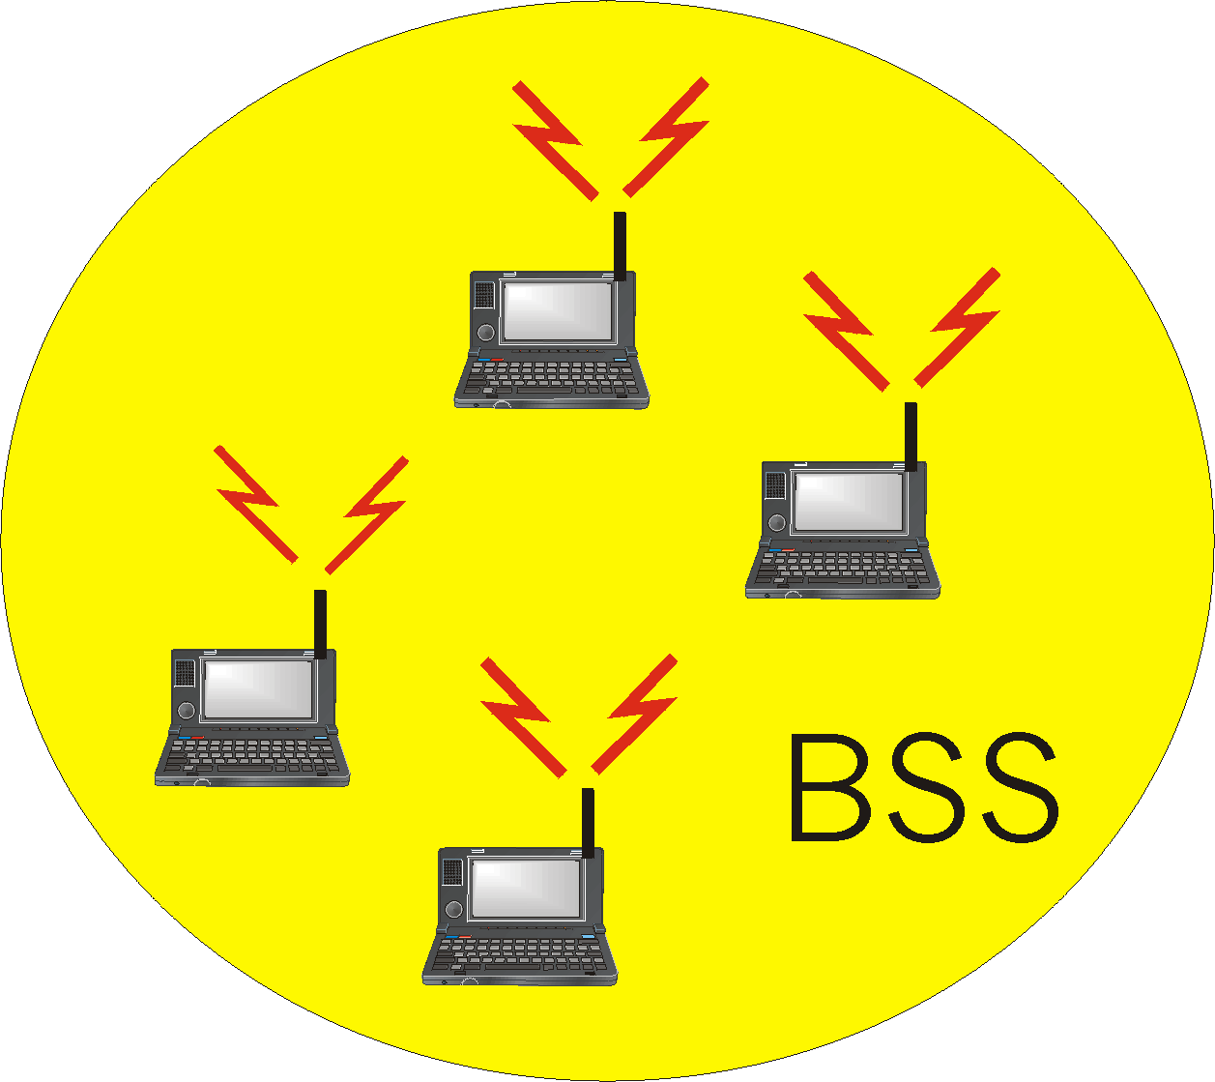
Ad Hoc Networks
Ad hoc network: IEEE 802.11 stations can dynamically form network without AP
Applications:
  “laptop” meeting in conference room, car
  interconnection of “personal” devices
  battlefield
IETF MANET
(Mobile Ad hoc Networks)
working group

Slide 59
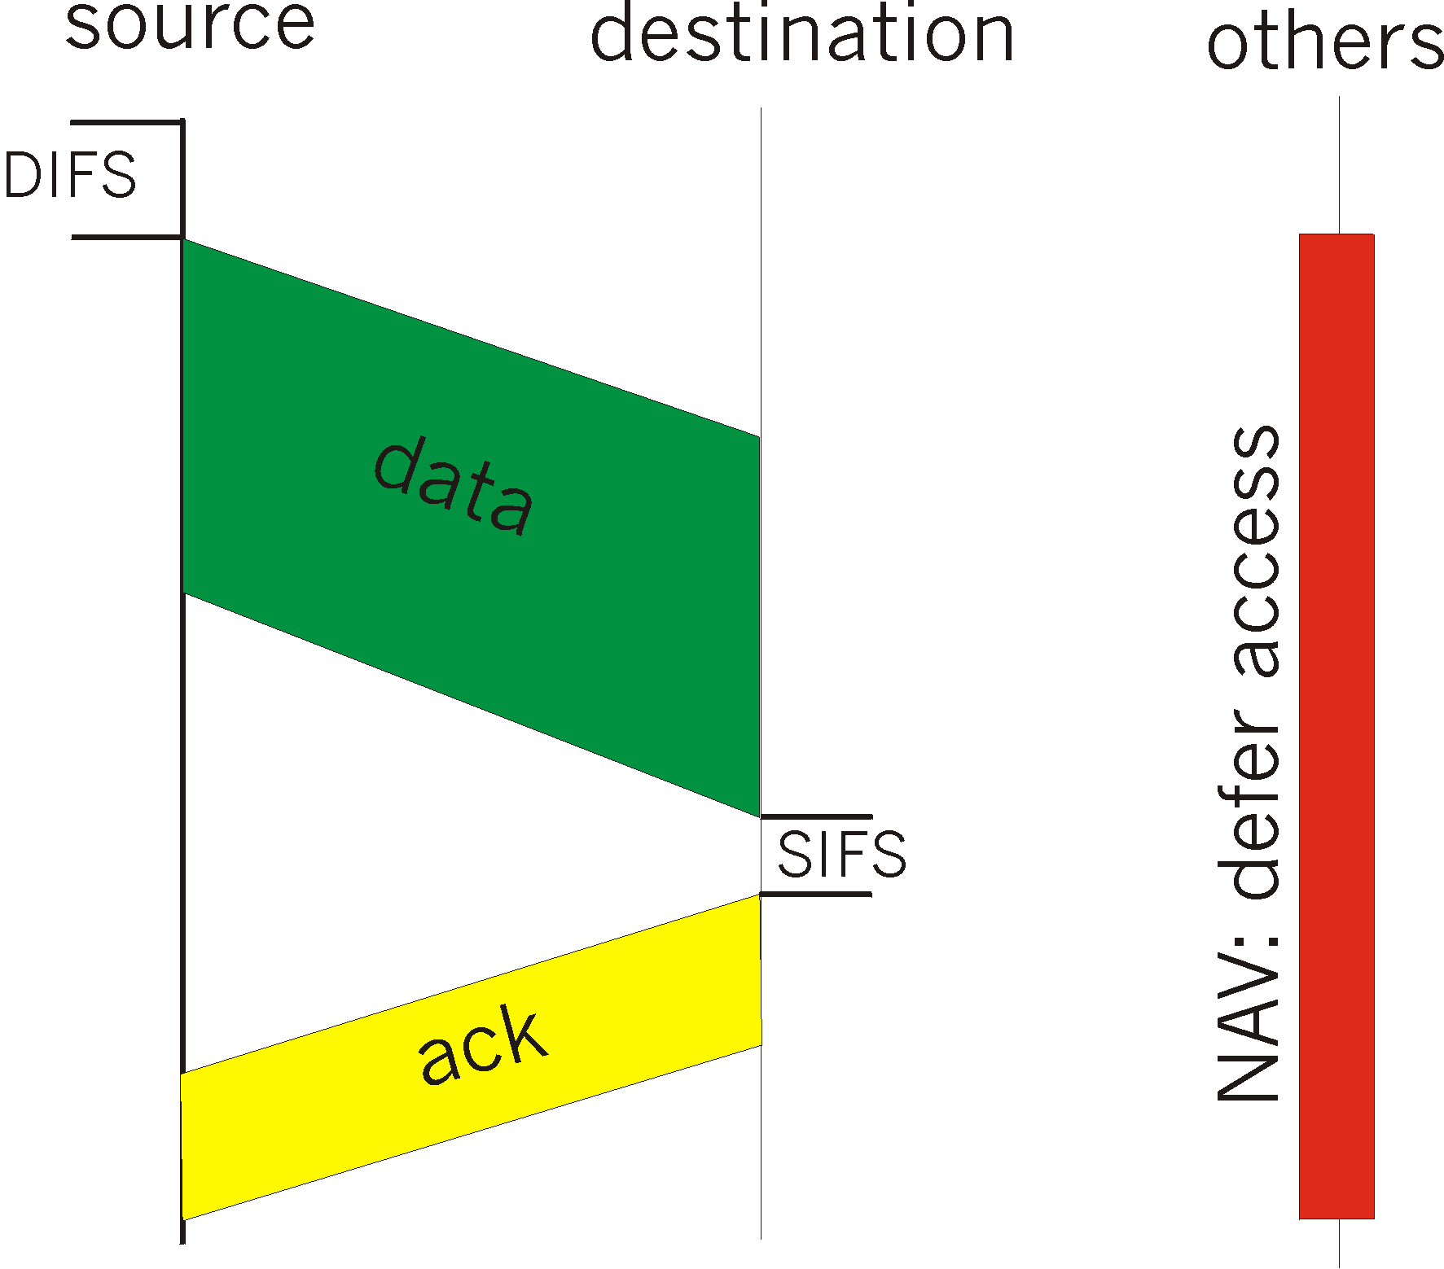
IEEE 802.11 MAC Protocol: CSMA/CA
802.11 CSMA: sender
- if sense channel idle for DIFS (Distributed Inter Frame Spacing) sec.
then transmit entire frame (no collision detection)
-if sense channel busy
then binary backoff
802.11 CSMA receiver:
if received OK
return ACK after SIFS (Short Inter Frame Spacing)

Slide 60
IEEE 802.11 MAC Protocol
802.11 CSMA Protocol: others
NAV: Network Allocation
Vector
802.11 frame has transmission time field
others (hearing sata) defer access for NAV time units

Slide 61
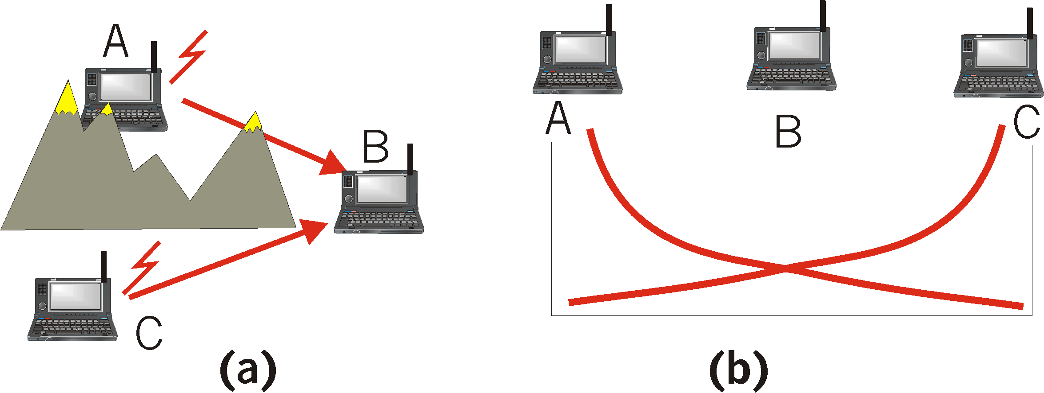
Hidden Terminal effect
hidden terminals: A, C cannot hear each other
  obstacles, signal attenuation
  collisions at B
goal: avoid collisions at B
CSMA/CA: CSMA with Collision Avoidance

Slide 62
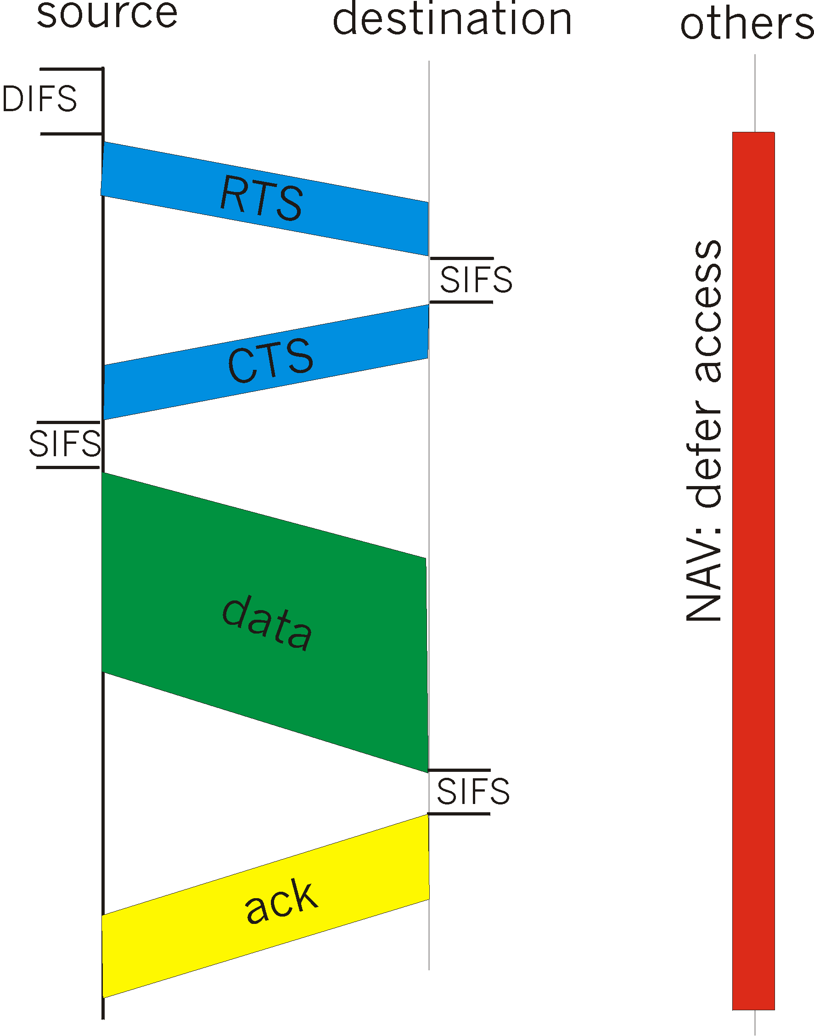
Collision Avoidance: RTS-CTS exchange
CSMA/CA: explicit channel reservation
  sender: send short RTS: request to send
  receiver: reply with short CTS: clear to send
CTS reserves channel for sender, notifying (possibly hidden) stations
avoid hidden station collisions

Slide 63
Collision Avoidance: RTS-CTS exchange
RTS and CTS short:
  collisions less likely, of shorter duration
  end result similar to collision detection
IEEE 802.11 alows:
  CSMA
  CSMA/CA: reservations
  polling from AP

Slide 64
Point to Point Data Link Control
one sender, one receiver, one link: easier than broadcast link:
  no Media Access Control
  no need for explicit MAC addressing
  e.g., dialup link, ISDN line
popular point-to-point DLC protocols:
  PPP (point-to-point protocol)
  HDLC: High level data link control (Data link used to be considered “high layer” in protocol stack!

Slide 65
PPP Design Requirements [RFC 1557]
packet framing: encapsulation of network-layer datagram in data link frame
  carry network layer data of any network layer protocol (not just IP) at same time
  ability to demultiplex upwards
bit transparency: must carry any bit pattern in the data field
error detection (no correction)
connection livenes: detect, signal link failure to network layer
network layer address negotiation: endpoint can learn/configure each other’s network address

Slide 66
PPP non-requirements
no error correction/recovery
no flow control
out of order delivery OK
no need to support multipoint links (e.g., polling)
Error recovery, flow control, data re-ordering
all relegated to higher layers!|

Slide 67

PPP Data Frame
Flag: delimiter (framing)
Address: does nothing (only one option)
Control: does nothing; in the future possible multiple control fields
Protocol: upper layer protocol to which frame delivered (eg, PPP-LCP, IP, IPCP, etc)

Slide 68
PPP Data Frame
info: upper layer data being carried
check: cyclic redundancy check for error detection

Slide 69
Byte Stuffing
“data transparency” requirement: data field must be allowed to include flag pattern <01111110>
  Q: is received <01111110> data or flag?
Sender: adds (“stuffs”) extra < 01111101> byte after each < 01111110> data byte
Receiver:
  two 01111110 bytes in a row: discard first byte, continue data reception
  single 01111110: flag byte

Slide 70

Byte Stuffing
flag byte
pattern
in data
to send
flag byte pattern plus
stuffed byte in transmitted data

Slide 71

PPP Data Control Protocol
Before exchanging network-layer data, data link peers must
configure PPP link (max. frame length, authentication)
learn/configure network
layer information
  for IP: carry IP Control Protocol (IPCP) msgs (protocol field: 8021) to configure/learn IP address

Slide 72
Asynchronous Transfer Mode: ATM
1980s/1990’s standard for high-speed (155Mbps to 622 Mbps and higher) Broadband Integrated Service Digital Network architecture
Goal: integrated, end-end transport of carry voice, video, data
  meeting timing/QoS requirements of voice, video (versus Internet best-effort model)
  “next generation” telephony: technical roots in telephone world
  packet-switching (fixed length packets, called “cells”) using virtual circuits

Slide 73
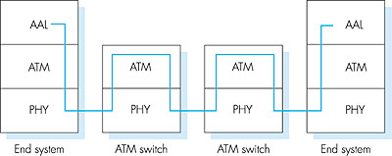
ATM architecture
adaptation layer: only at edge of ATM network
  data segmentation/reassembly
  roughly analagous to Internet transport layer
ATM layer: “network” layer
  cell switching, routing
physical layer

Slide 74
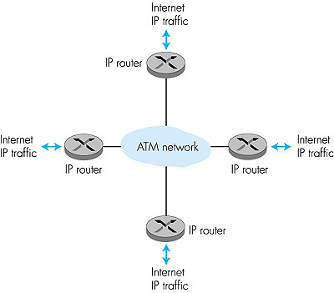
ATM: network or link layer?
Vision: end-to-end transport: “ATM from desktop to desktop”
  ATM is a network technology
Reality: used to connect IP backbone routers
  “IP over ATM”
  ATM as switched link layer, connecting IP routers

Slide 75
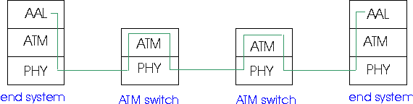
ATM Adaptation Layer (AAL)
ATM Adaptation Layer (AAL): “adapts” upper layers (IP or native ATM applications) to ATM layer below
AAL present only in end systems, not in switches
AAL layer segment (header/trailer fields, data) fragmented across multiple ATM cells
  analogy: TCP segment in many IP packets

Slide 76
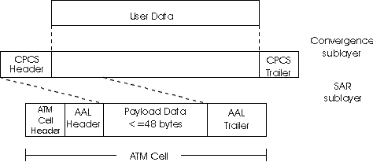
ATM Adaption Layer (AAL) [more]
Different versions of AAL layers, depending on ATM service class:
AAL1: for CBR (Constant Bit Rate) services, e.g. circuit emulation
AAL2: for VBR (Variable Bit Rate) services, e.g., MPEG video
AAL5: for data (eg, IP datagrams)
User data
AAL PDU
ATM cell

Slide 77

AAL5 - Simple And Efficient AL (SEAL)
AAL5: low overhead AAL used to carry IP datagrams
  4 byte cyclic redundancy check
  PAD ensures payload multiple of 48bytes
  large AAL5 data unit to be fragmented into 48-byte ATM cells

Slide 78
ATM Layer
Service: transport cells across ATM network
analagous to IP network layer
very different services than IP network layer
Network
Architecture
Internet
ATM
ATM
ATM
ATM
Service
Model
best effort
CBR
VBR
ABR
UBR
Guarantees ?
Congestion
feedback
no (inferred
via loss)
no
congestion
no
congestion
yes
no
Bandwidth
none
constant
rate
guaranteed
rate
guaranteed
minimum
none
Loss
no
yes
yes
no
no
Order
no
yes
yes
yes
yes
Timing
no
yes
yes
no
no

Slide 79
ATM Layer: Virtual Circuits
VC transport: cells carried on VC from source to dest
  call setup, teardown for each call before data can flow
  each packet carries VC identifier (not destination ID)
  every switch on source-dest path maintain “state” for each passing connection
  link,switch resources (bandwidth, buffers) may be allocated to VC: to get circuit-like perf.
Permanent VCs (PVCs)
  long lasting connections
  typically: “permanent” route between to IP routers
Switched VCs (SVC):
  dynamically set up on per-call basis

Slide 80
ATM VCs
Advantages of ATM VC approach:
  QoS performance guarantee for connection mapped to VC (bandwidth, delay, delay jitter)
Drawbacks of ATM VC approach:
  Inefficient support of datagram traffic
  one PVC between each source/dest pair) does not scale (N*2 connections needed)
  SVC introduces call setup latency, processing overhead for short lived connections

Slide 81

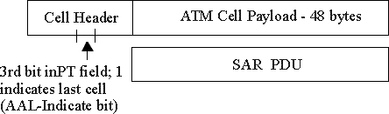
ATM Layer: ATM cell
5-byte ATM cell header
48-byte payload
  Why?: small payload -> short cell-creation delay for digitized voice
  halfway between 32 and 64 (compromise!)
Cell header
Cell format

Slide 82
ATM cell header
VCI: virtual channel ID
  will change from link to link thru net
PT: Payload type (e.g. RM cell versus data cell)
CLP: Cell Loss Priority bit
  CLP = 1 implies low priority cell, can be discarded if congestion
HEC: Header Error Checksum
  cyclic redundancy check

Slide 83
ATM Physical Layer (more)
Two pieces (sublayers) of physical layer:
Transmission Convergence Sublayer (TCS): adapts ATM layer above to PMD sublayer below
Physical Medium Dependent: depends on physical medium being used
TCS Functions:
  Header checksum generation: 8 bits CRC
  Cell delineation
  With “unstructured” PMD sublayer, transmission of idle cells when no data cells to send

Slide 84
ATM Physical Layer
Physical Medium Dependent (PMD) sublayer
SONET/SDH: transmission frame structure (like a container carrying bits);
  bit synchronization;
  bandwidth partitions (TDM);
  several speeds: OC1 = 51.84 Mbps; OC3 = 155.52 Mbps; OC12 = 622.08 Mbps
TI/T3: transmission frame structure (old telephone hierarchy): 1.5 Mbps/ 45 Mbps
unstructured: just cells (busy/idle)

Slide 85
IP-Over-ATM
IP over ATM
replace “network” (e.g., LAN segment) with ATM network
ATM addresses, IP addresses
Classic IP only
3 “networks” (e.g., LAN segments)
MAC (802.3) and IP addresses
ATM
network
Ethernet
LANs
Ethernet
LANs

Slide 86
IP-Over-ATM
Issues:
IP datagrams into ATM AAL5 PDUs
from IP addresses to ATM addresses
  just like IP addresses to 802.3 MAC addresses!
ATM
network
Ethernet
LANs

Slide 87
Datagram Journey in IP-over-ATM Network
at Source Host:
  IP layer finds mapping between IP, ATM dest address (using ARP)
  passes datagram to AAL5
  AAL5 encapsulates data, segments to cells, passes to ATM layer
ATM network: moves cell along VC to destination
at Destination Host:
  AAL5 reassembles cells into original datagram
  if CRC OK, datgram is passed to IP

Slide 88
ARP in ATM Nets
ATM network needs destination ATM address
  just like Ethernet needs destination Ethernet address
IP/ATM address translation done by ATM ARP (Address Resolution Protocol)
  ARP server in ATM network performs broadcast of ATM ARP translation request to all connected ATM devices
  hosts can register their ATM addresses with server to avoid lookup

Slide 89
X.25 and Frame Relay
Like ATM:
wide area network technologies
virtual circuit oriented
origins in telephony world
can be used to carry IP datagrams
  can thus be viewed as Link Layers by IP protocol

Slide 90
X.25
X.25 builds VC between source and destination for each user connection
Per-hop control along path
  error control (with retransmissions) on each hop using LAP-B
    variant of the HDLC protocol
  per-hop flow control using credits
    congestion arising at intermediate node propagates to previous node on path
    back to source via back pressure

Slide 91
IP versus X.25
X.25: reliable in-sequence end-end delivery from end-to-end
  “intelligence in the network”
IP: unreliable, out-of-sequence end-end delivery
  “intelligence in the endpoints”
gigabit routers: limited processing possible
2000: IP wins

Slide 92
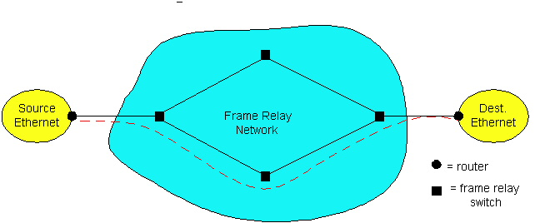
Frame Relay
Designed in late ‘80s, widely deployed in the ‘90s
Frame relay service:
  no error control
  end-to-end congestion control

Slide 93
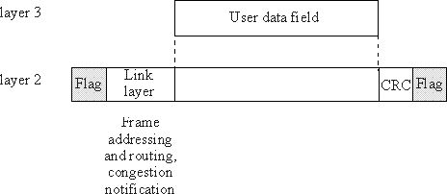
Frame Relay (more)
Designed to interconnect corporate customer LANs
  typically permanent VC’s: “pipe” carrying aggregate traffic between two routers
  switched VC’s: as in ATM
corporate customer leases FR service from public Frame Relay network (eg, Sprint, ATT)

Slide 94
Chapter 5: Summary
principles behind data link layer services:
  error detection, correction
  sharing a broadcast channel: multiple access
  link layer addressing, ARP
various link layer technologies
  Ethernet
  hubs, bridges, switches
  IEEE 802.11 LANs
  PPP
  ATM
  X.25, Frame Relay
journey down the protocol stack now OVER!
  Next stops: security, network management

