Slide 1
CS 854 – Hot Topics in Computer and Communications Security
Fall 2006
Introduction to
Cryptography and Security

Slide 2
Slides
based on
  Kurose & Ross, Computer networking, Chapter 8
  Stallings, Cryptography and Network Security

Slide 3
Overview
Network security
Symmetric-key encryption
Public-key encryption
Message integrity and authentication
Entity authentication
Key distribution
Computer security

Slide 4



System Model
Alice and Bob want to communicate “securely”
Trudy may intercept, delete, add, or modify messages
Alice
Bob
channel
data, control messages
secure
sender
secure
receiver
data
data
Trudy

Slide 5
Aside: Alice & Bob
Alice wants to send a message to Bob
Eve, the eavesdropper (passive)
Mallory, the malicious attacker (active)
Trudy, the intruder (same as Mallory)

Slide 6
What is secure communication?
Confidentiality: only Alice and Bob should see message contents
Authentication: Alice and Bob can confirm identity of each other
Message Integrity: Alice and Bob can ensure message not altered without detection
Nonrepudiation: receiver can prove to third party that sender in fact sent message
Traffic Analysis: Alice and Bob hide that they are communicating
No Denial of Service: Alice and Bob can communicate

Slide 7
Threat Model
Q: What can a “bad guy” do?
A: a lot!
  eavesdrop: passively intercept messages
  actively insert, modify, or delete messages into connection
  impersonation: can fake (spoof) source address in network packet (or any field in packet)
  hijacking: “take over” ongoing connection by removing sender or receiver, inserting himself in place
  denial of service: prevent service from being used by others (e.g., by overloading resources)
  but (typically) not drop a nuclear bomb on Alice and Bob

Slide 8
Overview
Network security
Symmetric-key encryption
Public-key encryption
Message integrity and authentication
Entity authentication
Key distribution
Computer security

Slide 9

The language of cryptography
Alice’s
encryption
key
Bob’s
decryption
key
K
K
A
B
plaintext
encryption
algorithm
ciphertext
decryption
algorithm
plaintext
symmetric-key crypto: sender and receiver keys identical and secret
public-key crypto: encryption key public, decryption key secret (private)

Slide 10
Symmetric-key cryptography
K
K
A-B
A-B
plaintext
message, m
encryption
algorithm
ciphertext
decryption
algorithm
plaintext
m = K ( )
K (m)
K (m)
A-B
A-B
A-B
symmetric key crypto: Bob and Alice share know same (symmetric) key: K
e.g., key is knowing substitution pattern in mono alphabetic substitution cipher
Q: how do Bob and Alice agree on key value?
A-B

Slide 11
Symmetric key cryptography
substitution cipher: substituting one thing for another
  monoalphabetic cipher: substitute one letter for another
plaintext: abcdefghijklmnopqrstuvwxyz
ciphertext: mnbvcxzasdfghjklpoiuytrewq
E.g.:
Plaintext: bob. i love you. alice
ciphertext: nkn. s gktc wky. mgsbc
Q: How hard to break this simple cipher?:
  brute force (how hard?)
  other?

Slide 12
Attacks on encryption schemes
Known to attacker (in addition to encryption scheme and ciphertext to be decrypted):
Ciphertext only: nothing else
Known plaintext: plaintext-ciphertext pair(s)
Chosen plaintext: plaintext(s) chosen by attacker and corresponding ciphertext(s)
Chosen ciphertext: ciphertext(s) chosen by attacker and corresponding plaintext(s)

Slide 13
Block and Stream Ciphers
Block cipher:
  operates on fix-sixed blocks at a time
    today’s ciphers: 128 bits
  reversible
  plaintext and ciphertext have same size
  common key sizes: 128 or 256 bit
  Kerckhofs’ principle: structure of cipher is publicly known
Stream cipher:
  operates on single bit (byte) at a time

Slide 14
Symmetric key crypto: DES
DES: Data Encryption Standard
US encryption standard [NIST 1993]
56-bit symmetric key, 64-bit plaintext input
How secure is DES?
  DES Challenge: 56-bit-key-encrypted phrase (“Strong cryptography makes the world a safer place”) decrypted (brute force) in 4 months (1997)
  no known “backdoor” decryption approach
making DES more secure:
  use three keys sequentially (3DES) on each block
  slow

Slide 15
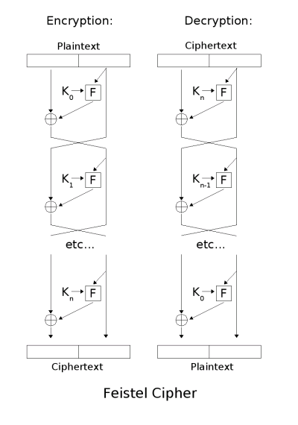
Symmetric key crypto: DES
DES operation
initial permutation
16 identical “rounds” of function application, each using different 48 bits of key, derived from 56-bit key
final permutation
From Wikipedia
Notes:
Encryption similar to decryption, same F box

Slide 16
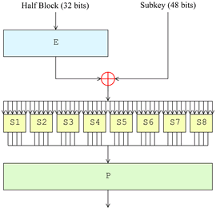
DES F-Function
Expansion
Key mixing
Substitution (“S-Box”)
  Provides non-linearity
Permutation
All of them together provide diffusion
From Wikipedia
Notes:
Diffusion: change single bit, multiple output bits get changed, else small change in plaintext would lead to small change in ciphertext

Slide 17
AES: Advanced Encryption Standard
new (Nov. 2001) symmetric-key NIST standard, replacing DES
processes data in 128-bit blocks
iterative, rather than Feistel cipher
  operates on entire data block in every round
  decryption different from encryption
  efficient implementation
128, 192, or 256 bit keys
brute force decryption (try each key) taking 1 sec on DES takes 149 trillion years for 128-bit AES

Slide 18

AES
From Stallings

Slide 19
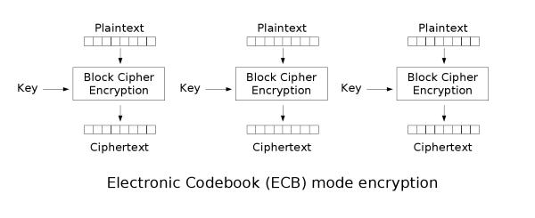
Block Cipher Modes
Block cipher modes enable processing of messages with arbitrary length
Electronic Codebook Mode (ECB)
Don’t use ECB
From Wikipedia

Slide 20
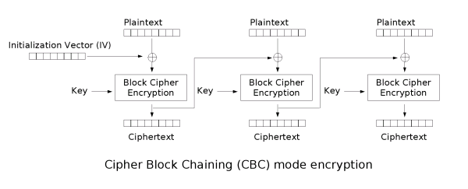
Block Cipher Modes
Cipher Block Chaining Mode (CBC)
Most widely used
IV (Initialization vector)
  Does not need to be kept secret
  Fixed value, counter, or random?
From Wikipedia
Notes:
Fixed: ECB problem for first block
Counter: predictable difference might allow conclusions about plaintext of first block

Slide 21
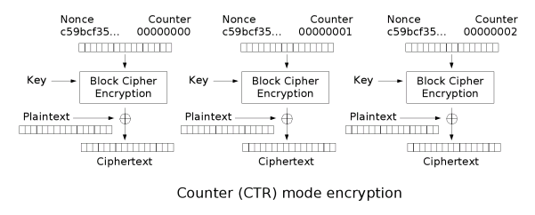
Block Cipher Modes
Counter Mode (CTR)
Block cipher to implement stream cipher
  Encryption and decryption are identical
Never reuse key/nonce combination
From Wikipedia
Notes:
Don’t need decyryption part of block cipher

Slide 22
Overview
Network security
Symmetric-key encryption
Public-key encryption
Message integrity and authentication
Entity authentication
Key distribution
Computer security

Slide 23

Public-Key Cryptography
symmetric-key crypto
requires sender, receiver know shared secret key
Q: how to agree on key in first place (particularly if never “met”)?
public-key cryptography
radically different approach [Diffie-Hellman76, RSA78]
sender, receiver do not share secret key
public encryption key known to all
private decryption key known only to receiver

Slide 24
Public key cryptography
+
Bob’s public
key
K
B
-
Bob’s private
key
K
B
plaintext
message, m
encryption
algorithm
ciphertext
decryption
algorithm
plaintext
message
+
K (m)
-
+
B
m = K (K (m))
B
B

Slide 25
Public key encryption algorithms
Requirements:
.
.
+
-
1
need K ( ) and K ( ) such that
B
B
-
+
K (K (m)) = m
B
B
2
+
given public key K , it should be impossible to compute private key K
B
-
B
RSA: Rivest, Shamir, Adelman algorithm

Slide 26
RSA: Choosing keys
1. Choose two large prime numbers p, q such that
their product has at least 1024 bits
2. Compute n = pq, z = (p-1)(q-1)
3. Choose e (with e<n) such that e, z are relatively prime.
4. Choose d such that ed-1 is exactly divisible by z.
(in other words: ed mod z = 1 ).
5. Public key is (n,e). Private key is (n,d).
+
-
K
K
B
B

Slide 27
RSA: Encryption, decryption
0. Given (n,e) and (n,d) as computed above
1. To encrypt bit pattern, m, compute
e
e
c = m mod n
(i.e., remainder when m is divided by n)
2. To decrypt received bit pattern, c, compute
d
d
m = c mod n
(i.e., remainder when c is divided by n)
Magic
happens!
e
d
m = (m mod n)
mod n
c

Slide 28
RSA: Why is that
e
d
m = (m mod n)
mod n
Useful number theory result: If p,q prime and
n = pq, then:
y
y mod (p-1)(q-1)
x mod n = x mod n
e
d
ed
(m mod n)
mod n = m mod n
ed mod (p-1)(q-1)
= m mod n
(using number theory result above)
1
= m mod n
(since we chose ed to be divisible by
(p-1)(q-1) with remainder 1 )
= m

Slide 29
RSA: Security
relies on the assumption that there are no algorithms for quickly factoring n into p and q
  would allow attacker to compute z=(p-1)(q-1) and d using ed mod z = 1
but we don’t know whether there exist such fast algorithms…

Slide 30
RSA: Issues
RSA exponentiation is slow
  at least 100 times slower than DES
  use hybrid scheme, e.g.,
    AES for encrypting actual data
    RSA for encrypting corresponding AES session key
RSA can be vulnerable, e.g.,
  small d or e
  deterministic
  timing attacks
  do not use your own implementation of RSA

Slide 31
RSA: another important property
The following property will be very useful later:
-
+
+
-
K (K (m)) = m
=
K (K (m))
B
B
B
B
use public key first, followed by private key
use private key first, followed by public key
Result is the same!

Slide 32
El Gamal
Prime p, random g (< p)
Private key: d
Public key: e = g^{d} mod p
Encryption: message m, random r
c = (g^{r}, me^{r}) (mod p)
Decryption: c = (c₁,c₂)
c₂/(c₁^{d}) = me^{r}/g^{dr} = mg^{dr}/g^{dr} = m
assumes that computing discrete logarithms is hard
probabilistic scheme (ciphertext > plaintext)

Slide 33
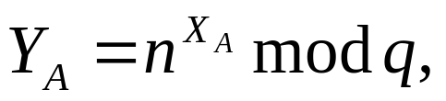

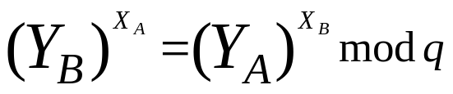
Diffie-Hellman Key Exchange
first published public-key algorithm
Alice and Bob establish joint secret even though Eve is reading all the exchanged messages!
assumption: public prime q, integer n
Alice: Choose secret X_{A}, compute
and give Y_{A} to Bob
Bob: Choose secret X_{B}, compute
and give Y_{B} to Alice
Joint secret:
Also relies on discrete logarithms problem
Susceptible to man-in-the-middle attack

