Slide 1

Molecular Classification of Cancer by Gene Expression Monitoring
Md Muhtasim Billah
Namrata Ray
Jugal Marfatia

Slide 2

INTRODUCTION
Although cancer classification has improved over the last few decades, yet there are only a few approaches reported in literature for detecting new cancer classes (class discovery) or for assigning tumors to known classes (class prediction).
The current study uses data to classify patients with acute myeloid leukemia (AML) and acute lymphoblastic leukemia (ALL), the general symptoms of which are very similar.
The goal of the current study is to examine how new cases of cancer can be classified by gene expression monitoring (via DNA microarray) and thereby provided a general approach for identifying new cancer classes and assigning tumors to known classes.

Slide 3
DATA AND METHODS
The dataset was originally taken from a study by Golub et al.(1999) published in Science that was made available online on Kaggle.
https://www.kaggle.com/crawford/gene-expression
The datasets used in the paper contains 72 observations with 7123 genetic expression for each observation. These datasets contain measurements corresponding to ALL and AML samples from Bone Marrow and Peripheral Blood. Intensity values have been re-scaled such that overall intensities for each chip are equivalent.
Methods include PCA and K-Means Clustering

Slide 4
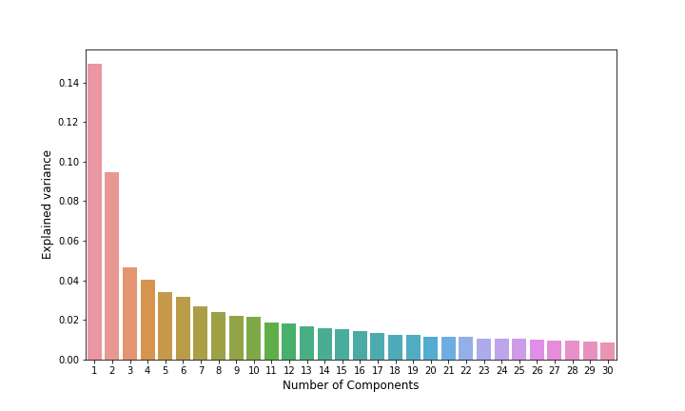
RESULTS
Overall, there were 7123 genes of 72 individuals in the study.
After implementing PCA, we zero upon 30 components for this study.

Slide 5
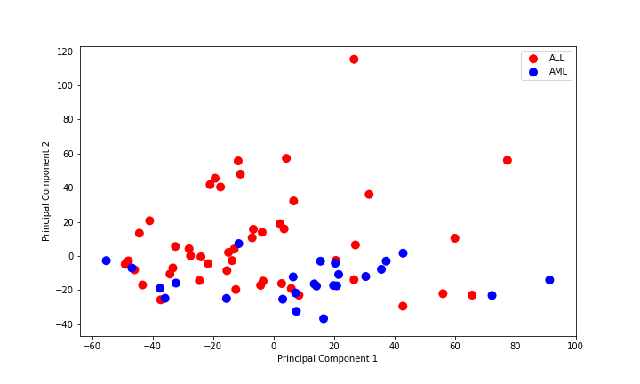
Scatter Plot of Component 1 versus Component 2

Slide 6
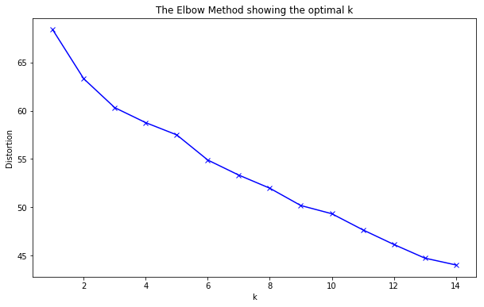
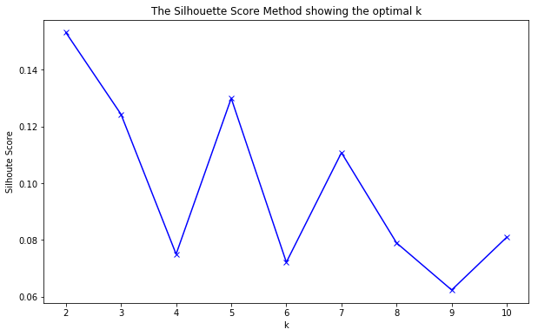
Validation of Clusters

Slide 7
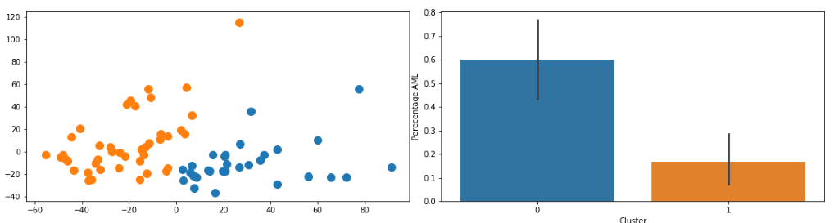
Figure 5: Cluster with K = 2. Left is the scatter plot of cluster. Right represents the proportion of people that have AML in each cluster.

Slide 8
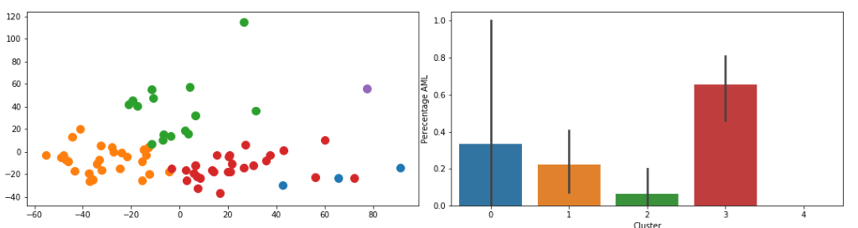
Figure 6: Cluster with K = 5. Left plot is the scatter plot of cluster. Right plot represents the proportion of people that have AML in each cluster.

Slide 9
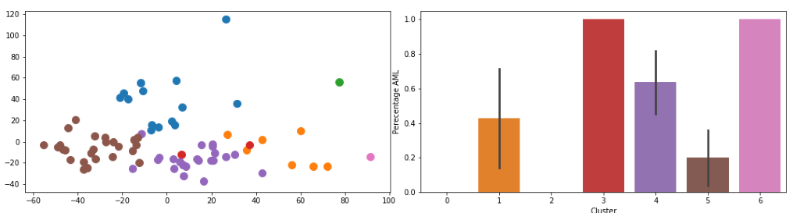
Figure 7: Cluster with K = 7. Left plot is the scatter plot of cluster. Right plot represents the proportion of people that have AML in each cluster.

Slide 10
Conclusion
Clustering Techniques are subjective
The study accomplished the goal of reducing data dimensionality by examining 30 principal components that explain major variation
The results from clustering give a different picture depending on the number of clusters.
Partitioning into seven clusters explain 90% of AML incidence

Slide 11
References
Golub, Todd R., Donna K. Slonim, Pablo Tamayo, Christine Huard, Michelle Gaasenbeek, Jill P. Mesirov, Hilary Coller et al. "Molecular classification of cancer: class discovery and class prediction by gene expression monitoring." science 286, no. 5439 (1999): 531-537.
https://www.kaggle.com/crawford/gene-expression

