Slide 1
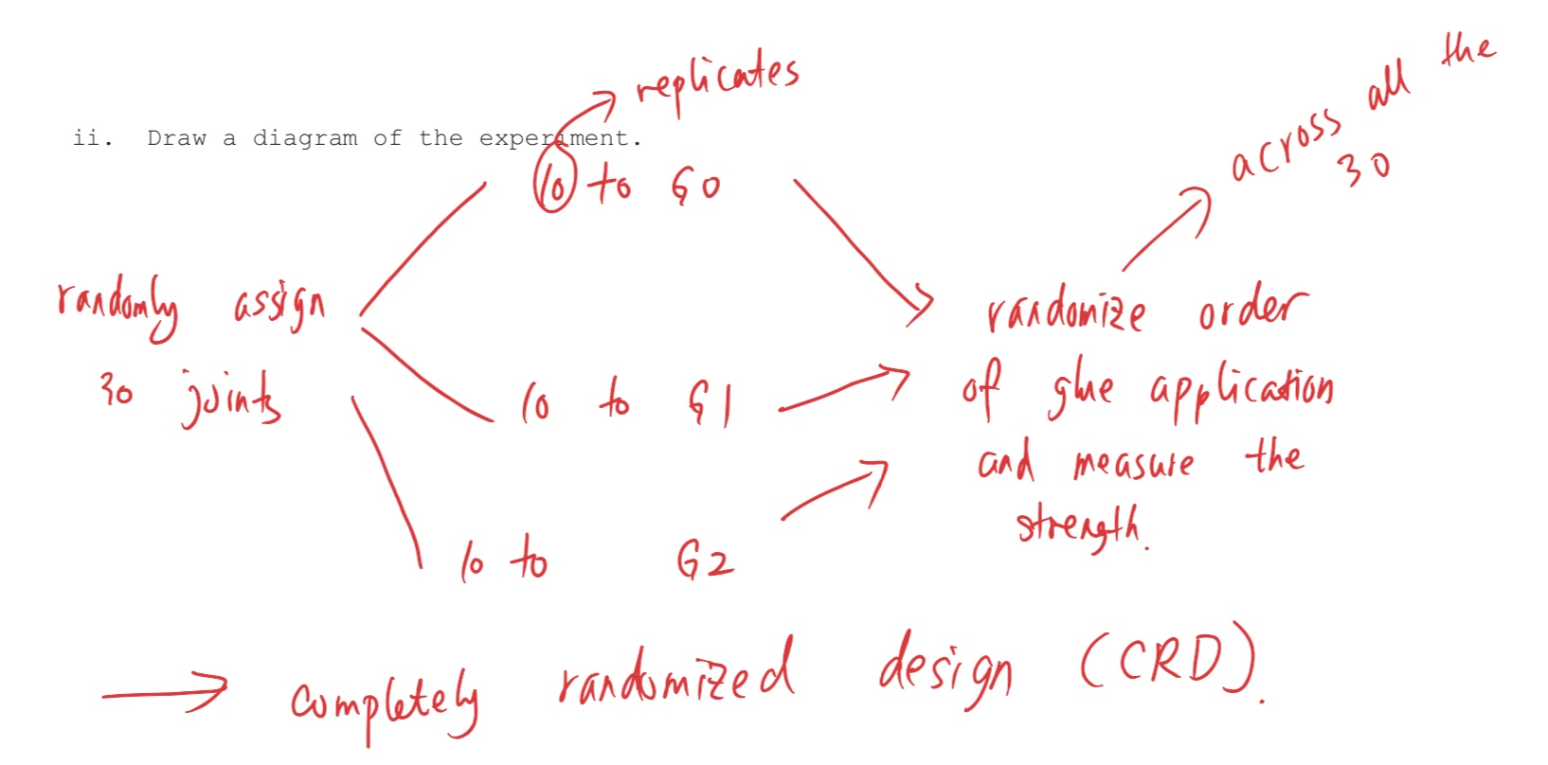

Slide 2
Randomly assign 800 people
200 to 1g of vitamin c per day
a turmeric curcumin complex pill
200 to flu vaccine

Slide 3
Randomly assign 800 people
200 to flu vaccine
200 to 1g of vitamin c per day
Randomize order of application of four treatments (across all 800 people)
200 to a turmeric curcumin complex pill
200 to a placebo taken daily
Measure the effectiveness in preventing flue
Randomization
Randomization
Control
Replication

Slide 4
