Slide 1
building mmbot
*
* FOR PRONUNCIATION SEE THE HANSON FAMILY
Notes:
Palette - http://www.colourlovers.com/web/trends/websites/7598/Superawesome_-_design_for_Web

Slide 2

@petegoo
Notes:
Github - Jesse Newland – ChatOps at GitHub http://www.youtube.com/watch?v=NST3u-GjjFw

Slide 3


< >
+

Slide 4


Slide 5


A CUSTOMIZABLE
KEGERATOR-POWERED
LIFE EMBETTERMENT ROBOT
Notes:
Built using Coffee script, running on node

Slide 6
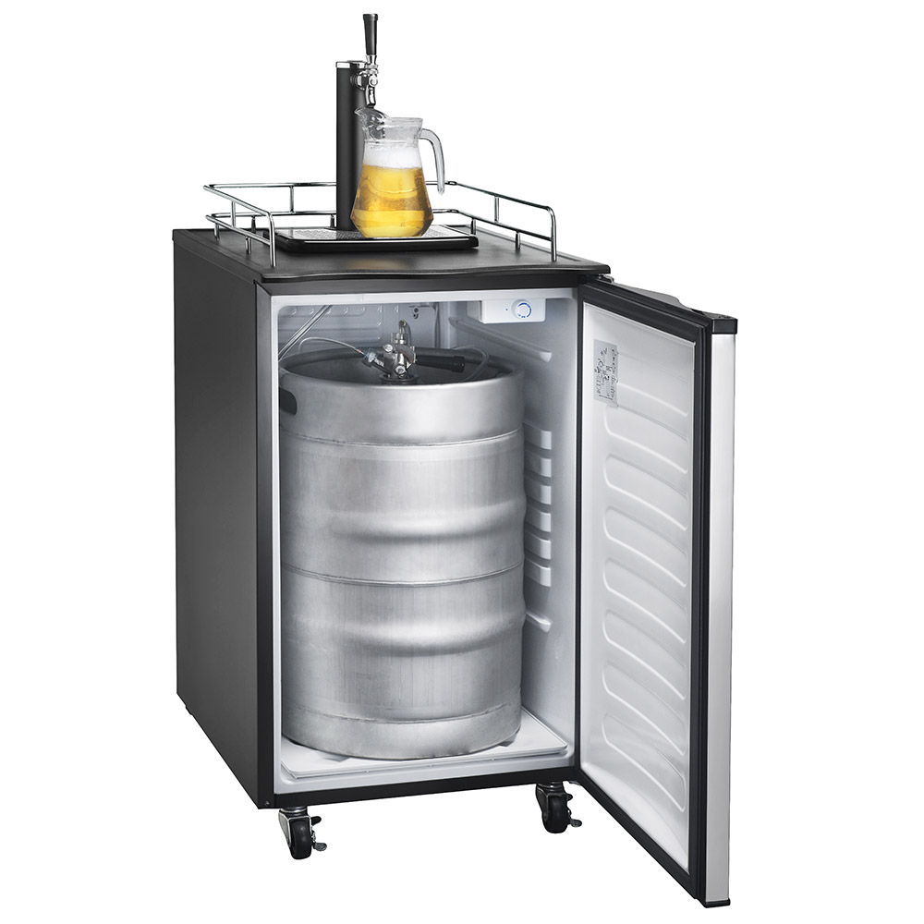
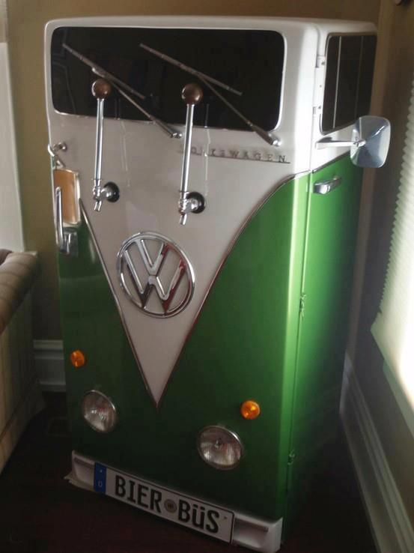
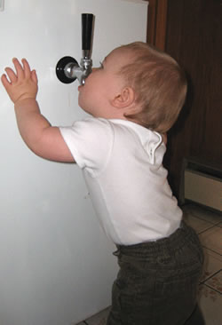
http://laughingsquid.com/a-kegerator-fridge-that-looks-like-a-vw-bus/ http://www.naesaa.com/ http://www.kegerators.com/articles/kid-proofing-a-kegerator.php
Notes:
This is what a Kegerator is

Slide 7
unlock the door to the office • print out a list of the people currently in the office based on their wifi presence • find an apartment in the area to rent • deploy GitHub • play an audio sample of deadmau5 to everyone through hacked Propane HTML5 <audio> tags • give you a quote from any movie or TV show • tell you the build status of any git branch • track and map packages • SMS any GitHubber from Campfire • embed a seven day weather forecast • say an arbitrary string over the office speakers
http://zachholman.com/posts/why-github-hacks-on-side-projects/

Slide 8
but but......
I like C#
Generics
Linq
Lambdas
Async/await
#regions

Slide 9

Enter mmbot
A BOT FOR AUTOMATING BORING STUFF ....AND CAT GIFS
Notes:
Greg Troll - https://gist.github.com/dkarzon/7420857

Slide 10
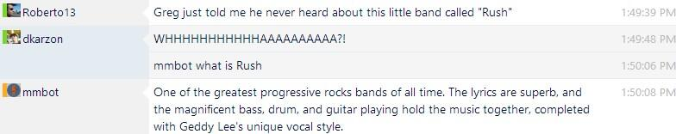
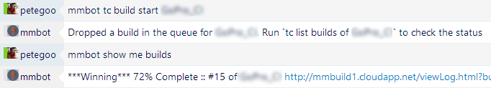
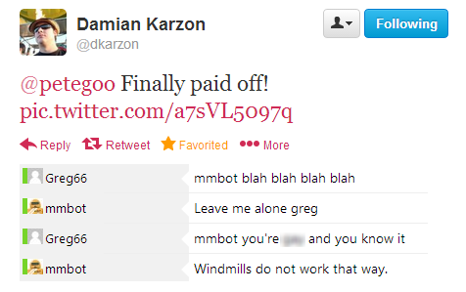
Notes:
Greg Troll - https://gist.github.com/dkarzon/7420857

Slide 11




akavache
scripting
router
key/value

Slide 12


Relay router
azure
Http Post
SignalR
on-site
event source
Notes:
Like Relay-Binding
Web jobs

Slide 13


co-co-ordinators
@dkarzon
@jamessantiago
+ some awesome contributers

Slide 14
?
Questions

