Slide 1
and now it's time for some...

Slide 2
audience participation!!1!1

Slide 3
get your smartphone and ...
1. connect to „evoke“ WiFi
2. go to http://mmmball.evoke.eu/
(chrome/firefox/safari supported)
3. enter your name and play!

Slide 4
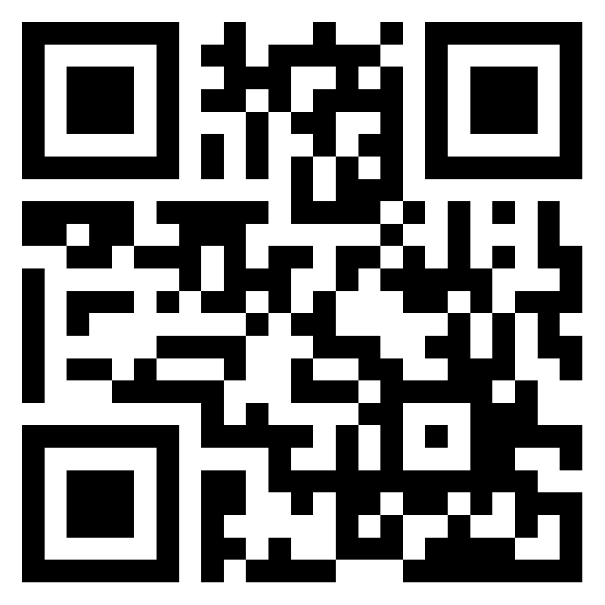
connect
„evoke“
WiFi
scan →
connect
„evoke“
WiFi
← scan

