Slide 1
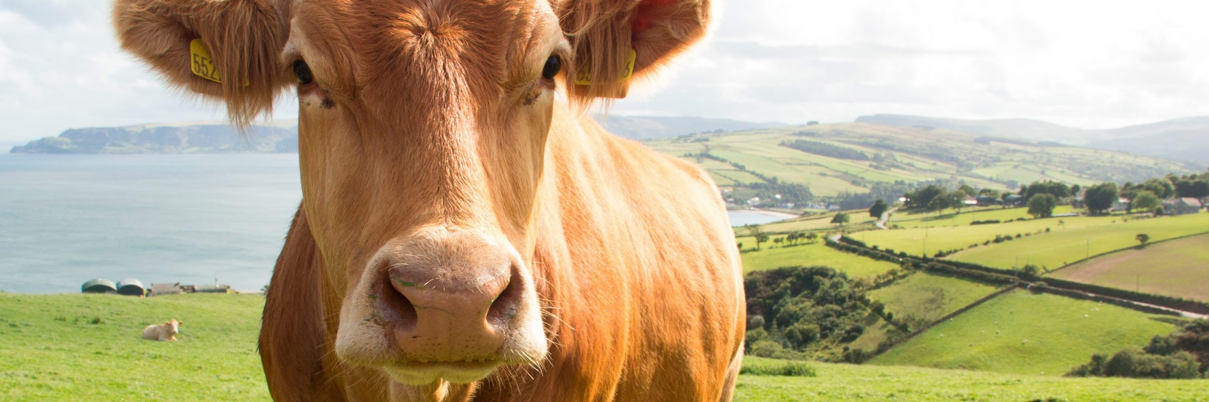

COMPRESSION AND DECOMPRESSION OF IMAGES FOR PRECISION FARMING

Slide 2
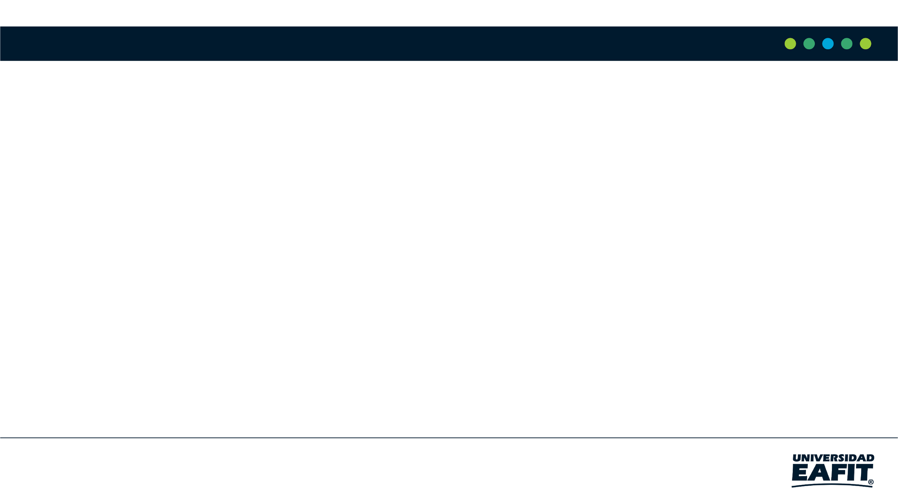
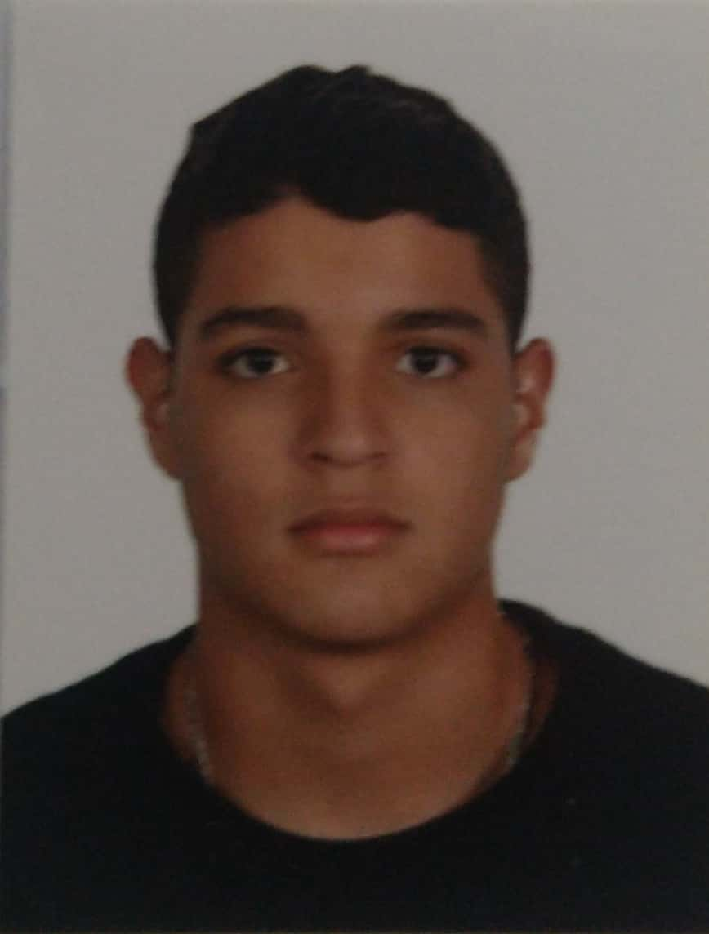

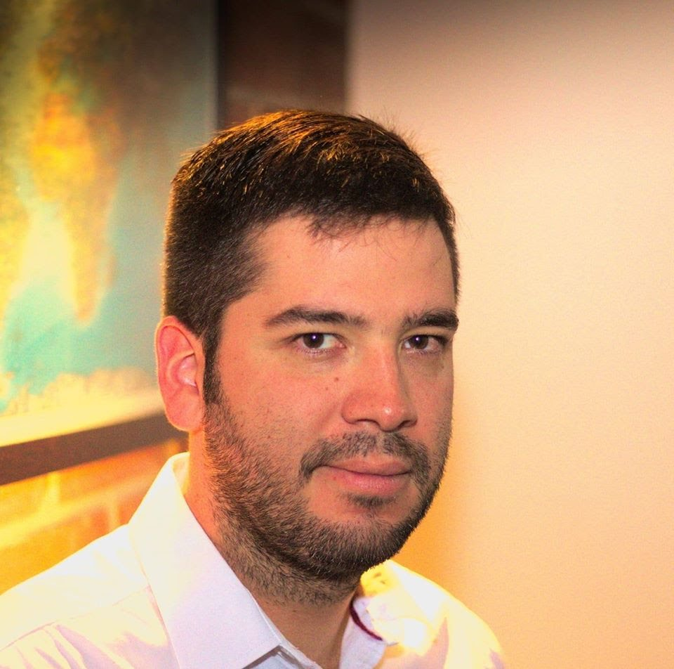


Team Presentation
Alejandro Torres Muñoz
Mateo Muñoz Cadavid
Simón Marín
Mauricio
Toro
https://github.com/mmc31-08/ProyectoDatos_y_Algoritmos

Slide 3
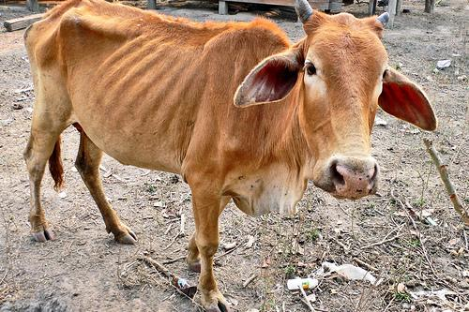
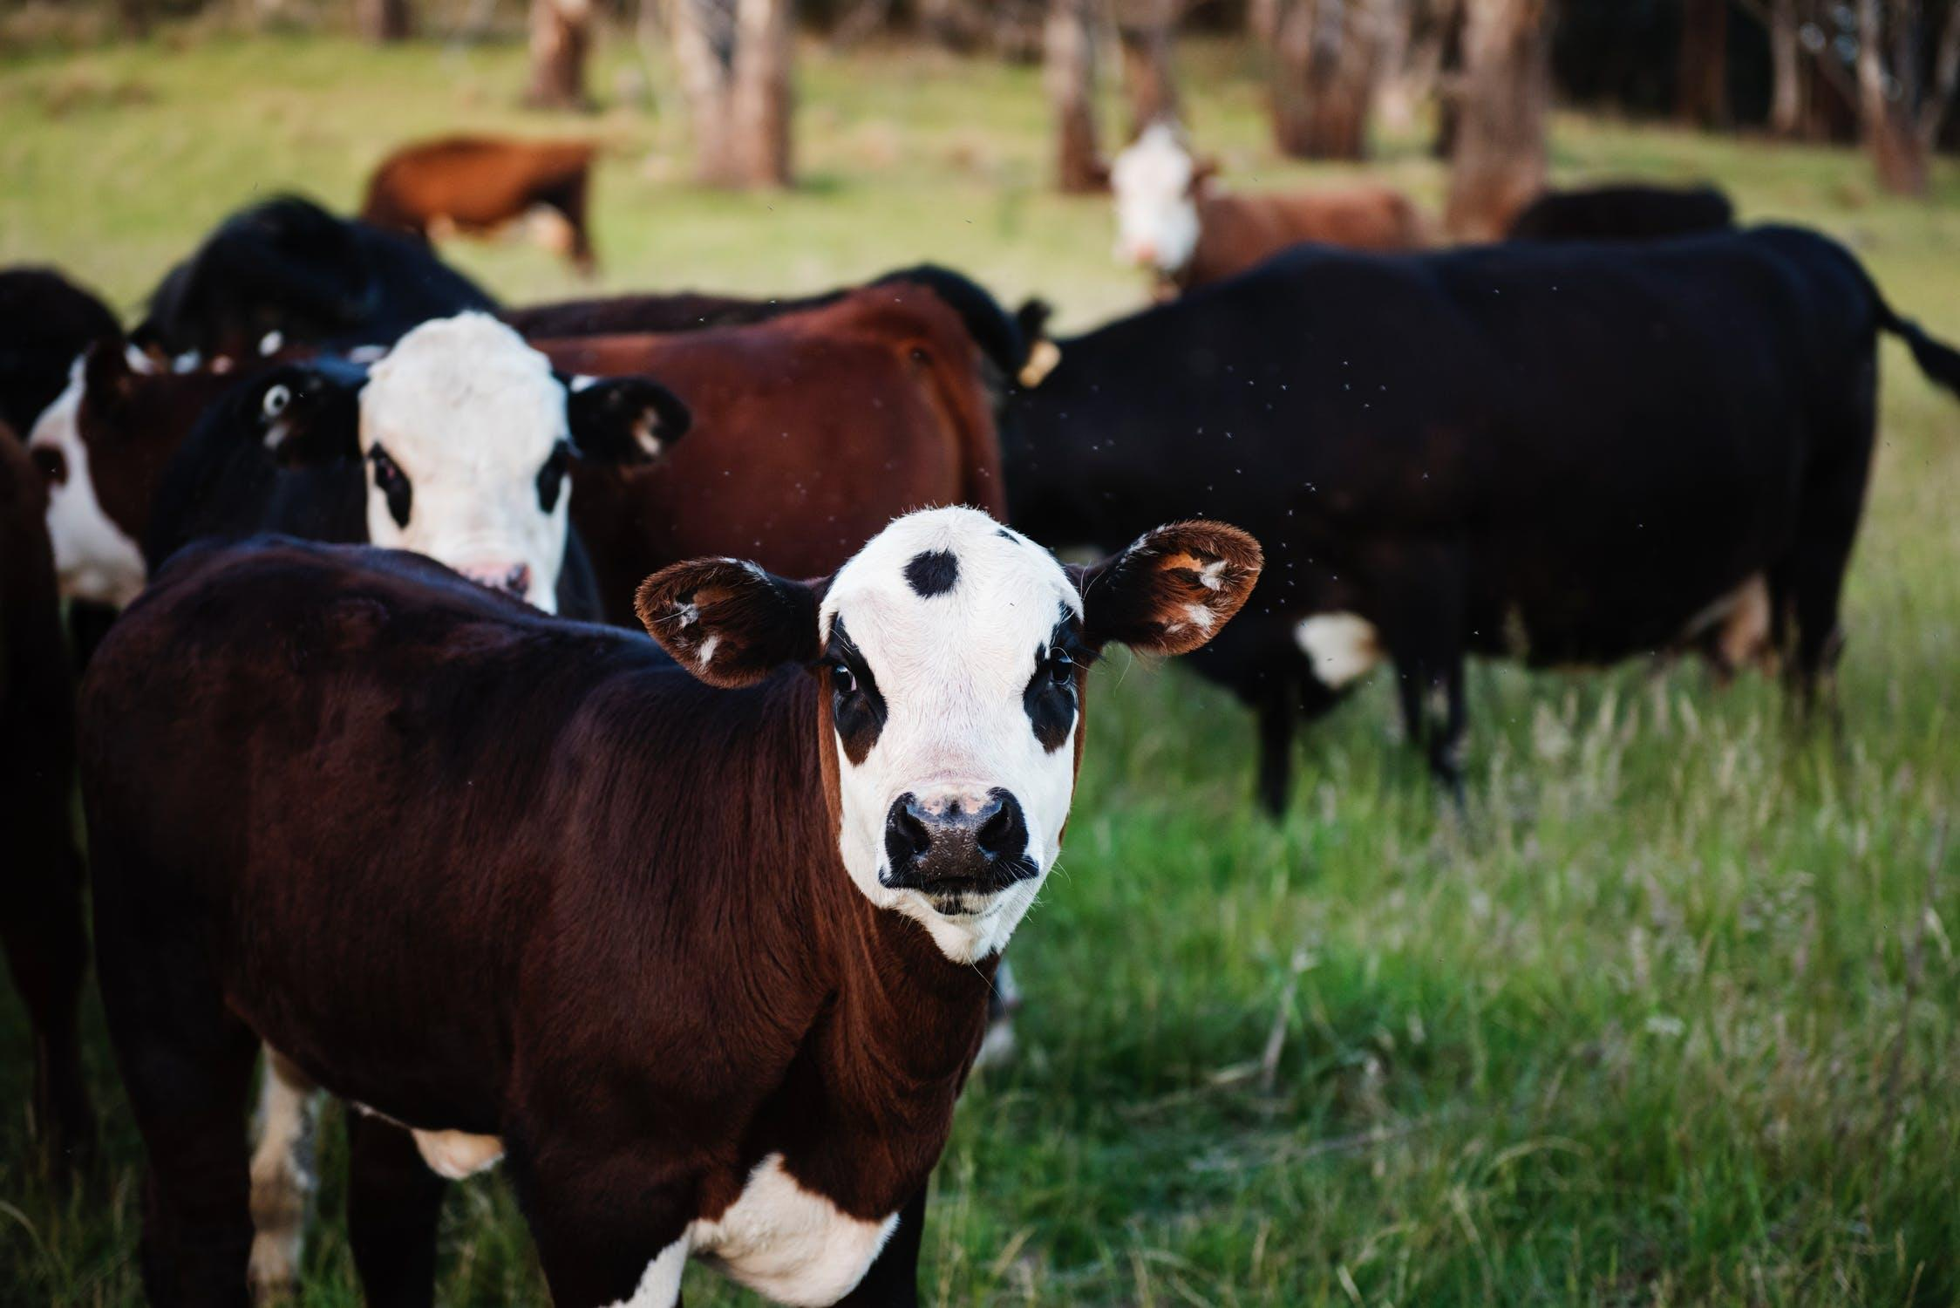
Training Process
Convolutional Neural Network
Sick-Cattle Images
Classification Algorithm
Classification Model
Healthy-Cattle Images

Slide 4
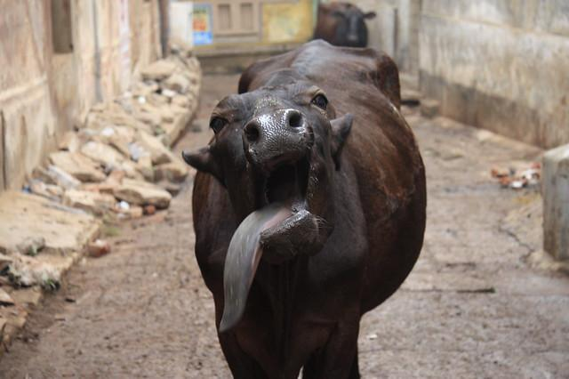
Testing Process
Image Scaling/ Run length
Is sick
Cattle Image
Compression Algorithm
Classification Model
Output

Slide 5
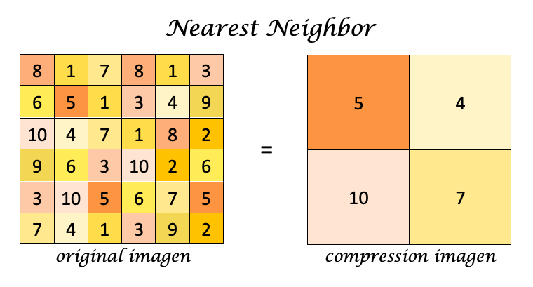
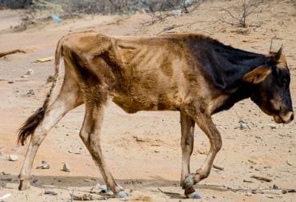
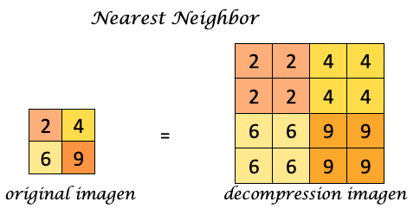
Compression Algorithm Design
Image compression and decompression algorithm for animal-health automatic classification generated from Nearest Neighbor interpolation, we increase or decrease the size of the image by replacing each pixel with the closest one in the output.

Slide 6
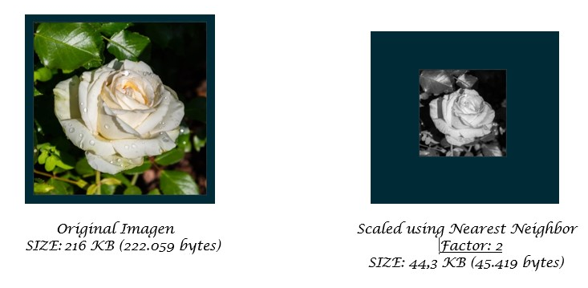
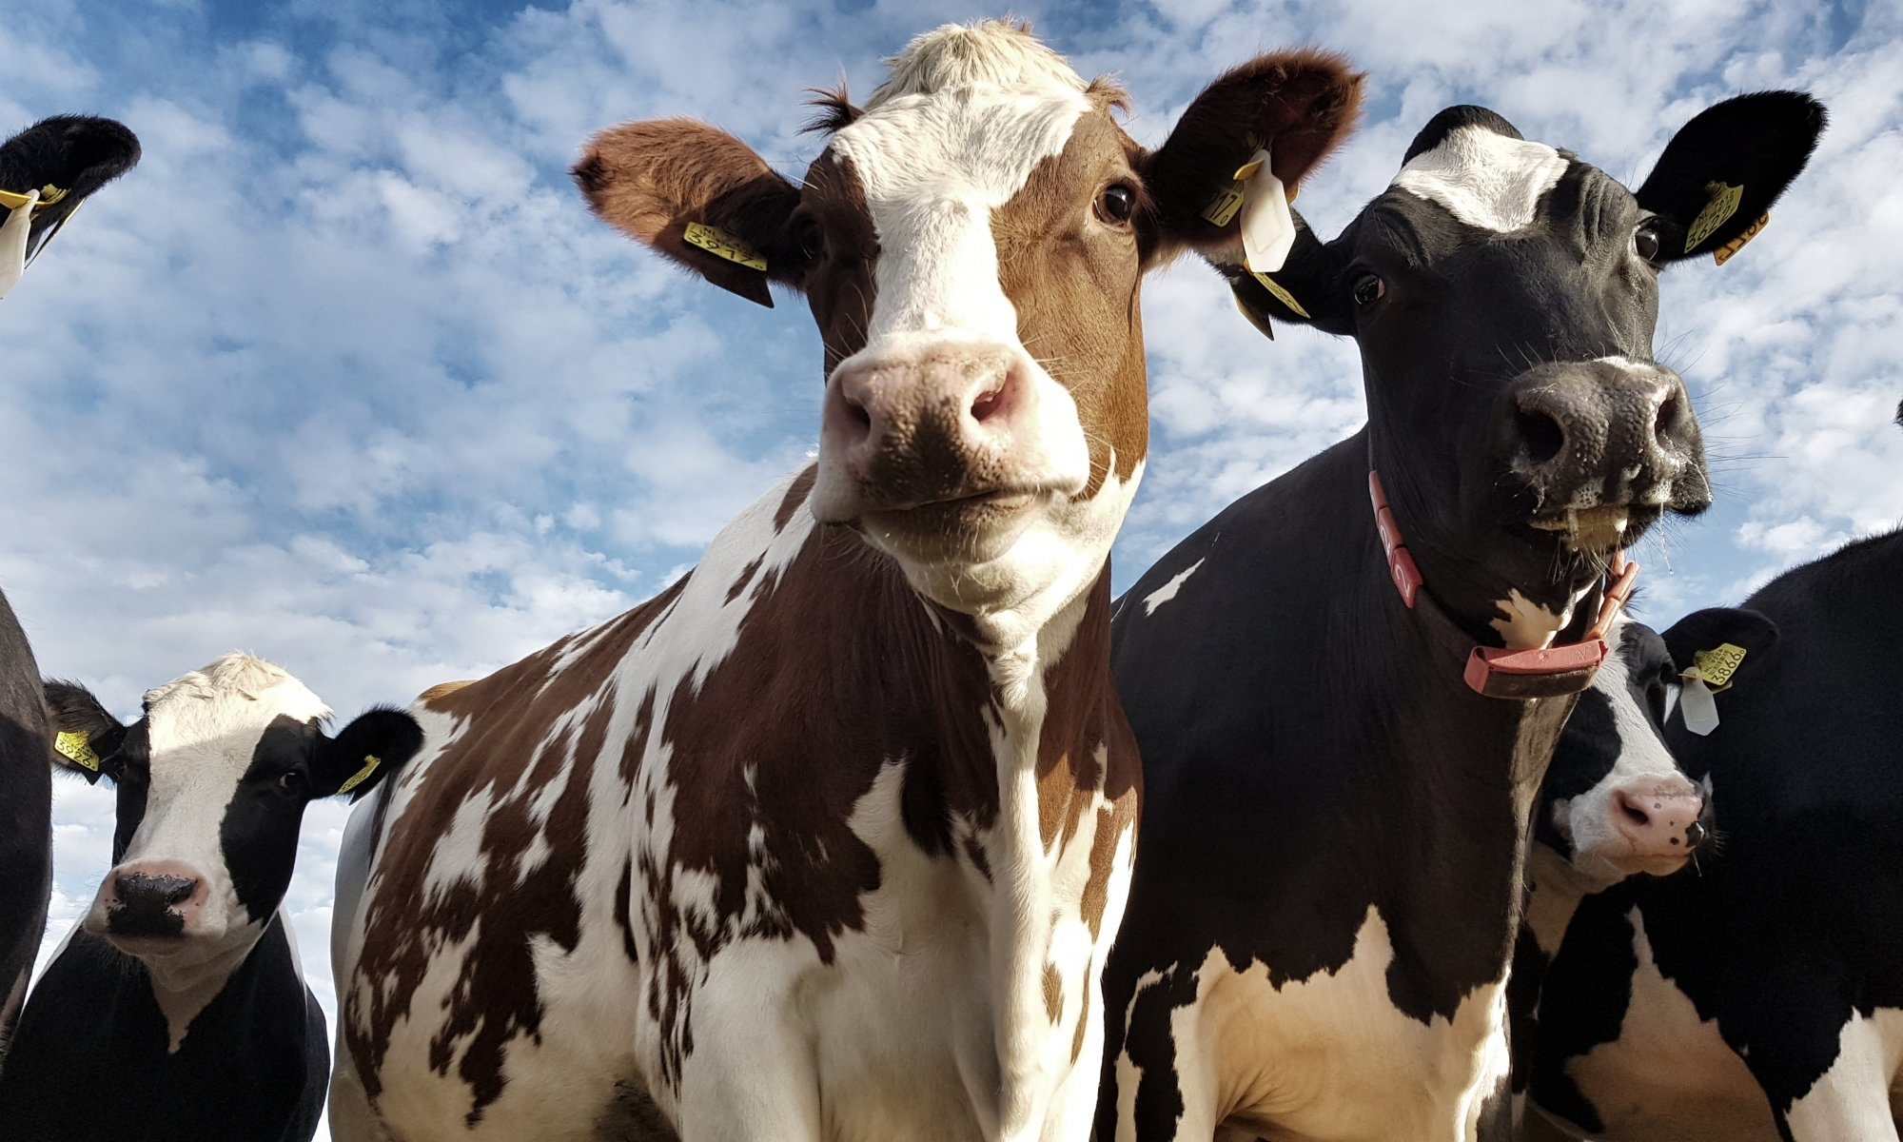
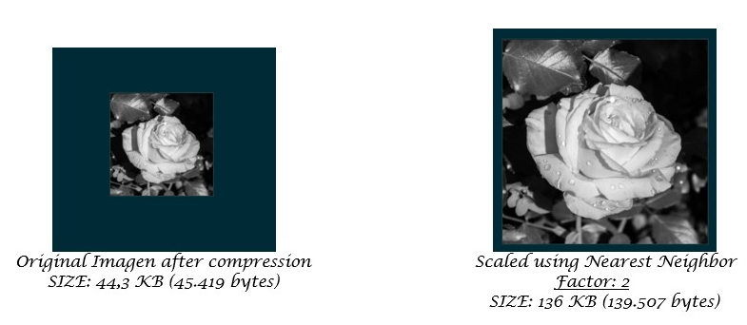
Compression Algorithm Design
Compression and decompression generated using Image Scaling with Nearest Neighbor and BFS.

Slide 7
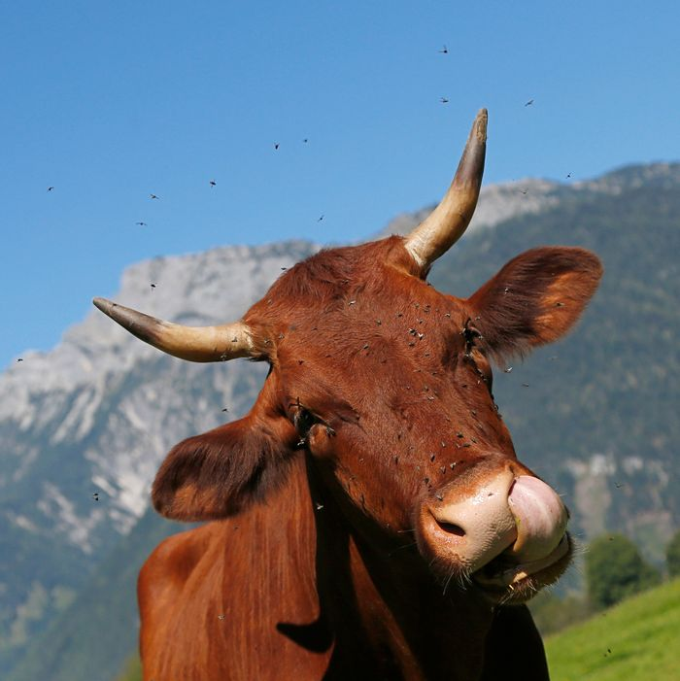
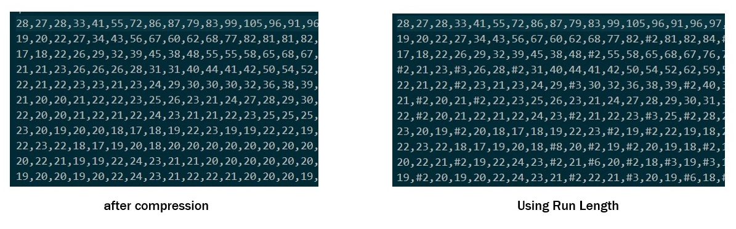
Compression Algorithm Design
The first image shows the original data of the image with its repetitions, the second image shows the compression with the number of repetitions denoted by a '#' and the repeated number next to it.
Image compression and decompression algorithm for animal-health automatic classification generated from Run Length.

Slide 8
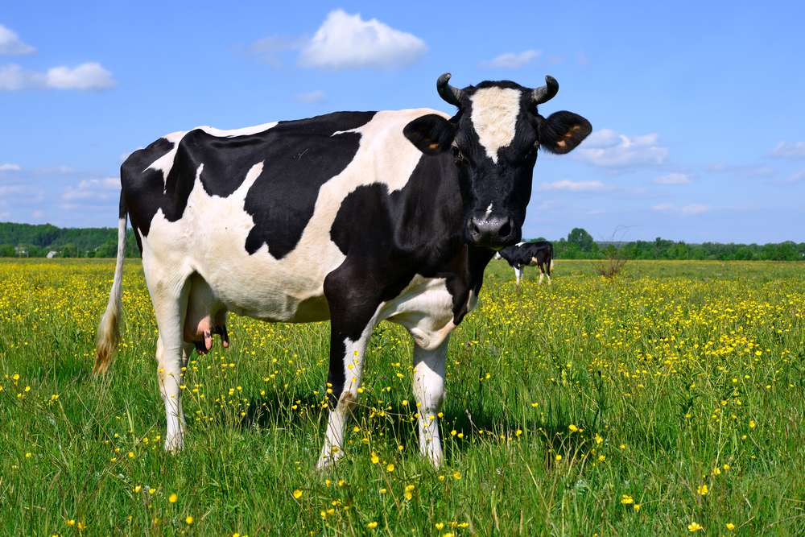
Compression Algorithm Complexity
 | Time Complexity | Memory Complexity
Image Scalling Compression | O(N*M) | O(N*M)
Image Scalling Decompression | O(N*M) | O(N*M)
Run Length Compression | O(N*M) | O(N*M)
Run Length Decompression | O(N*M) | O(N*M)
Each of these algorithms have a time and memory consumption O (N * M), where N and M are the length of the matrix (Columns and Rows). This, thanks to the fact that they travel the image matrix only once and behave linearly both in the compression and decompression of the image.

Slide 9
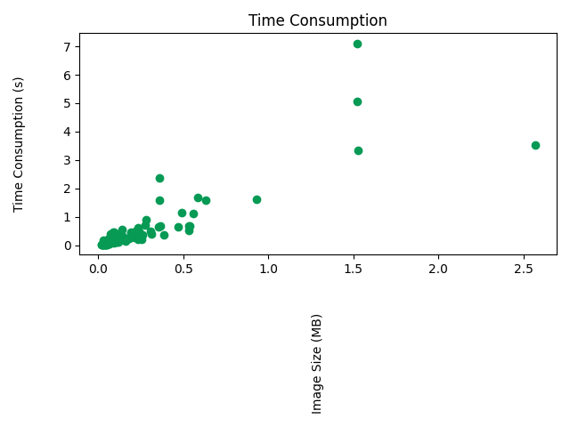
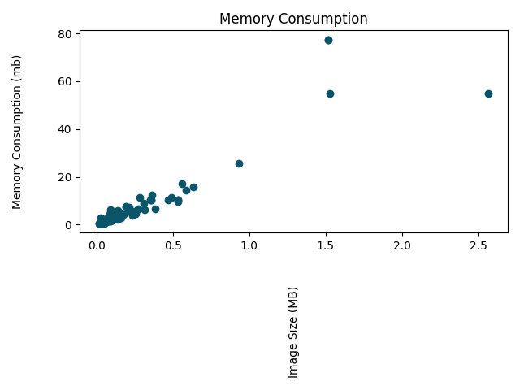


Time and Memory Consumption
Time Consumption
Memory Consumption
Compression Image Scaling

Slide 10
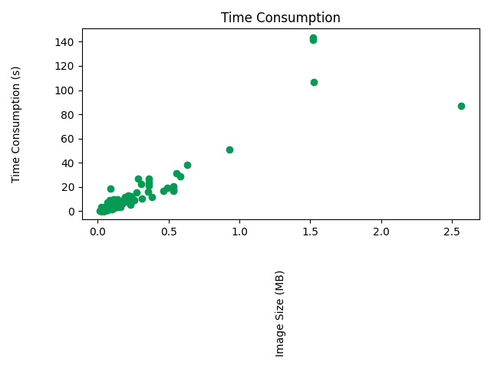
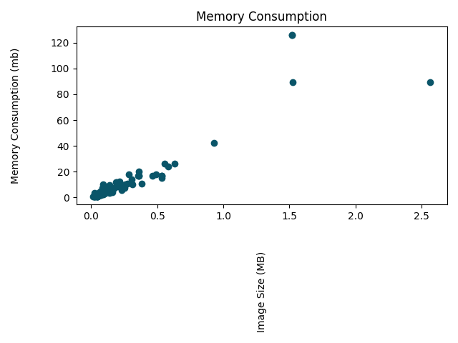
Time and Memory Consumption
Time Consumption
Memory Consumption
Decompression Image Scaling

Slide 11
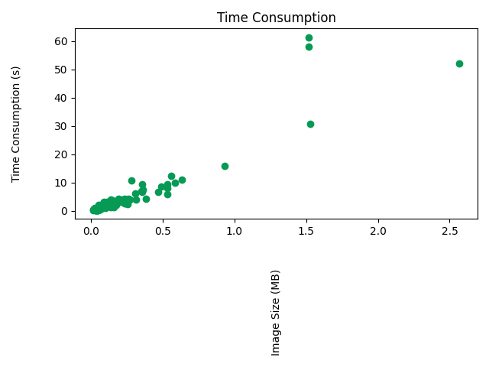
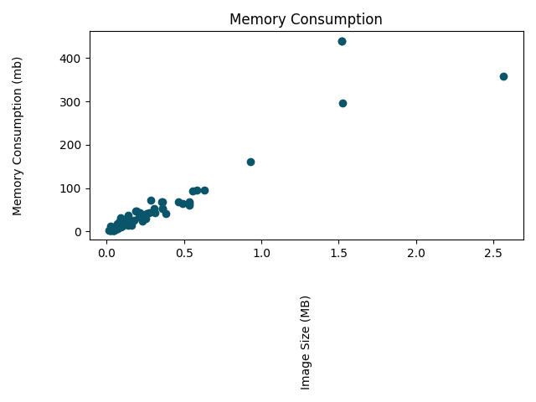
Time and Memory Consumption
Time Consumption
Memory Consumption
Compression Run Length

Slide 12

Time and Memory Consumption
Time Consumption
Memory Consumption
Decompression Run Length

Slide 13
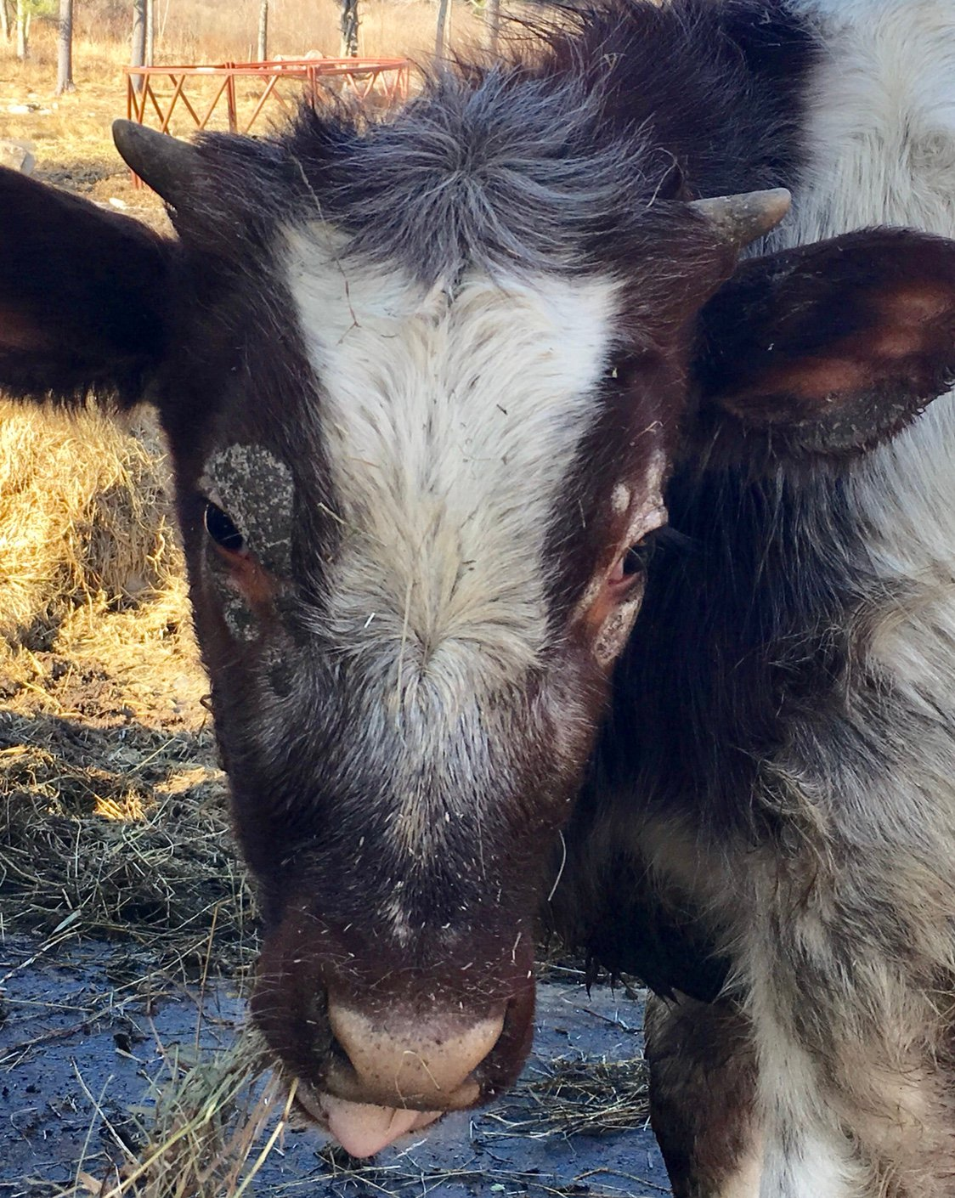
Average Compression Ratio
 | Compression Ratio
Healthy Cattle | 11 : 1
Sick Cattle | 11 : 1
Average compression ratio for Healthy Cattle and Sick Cattle.

Slide 14
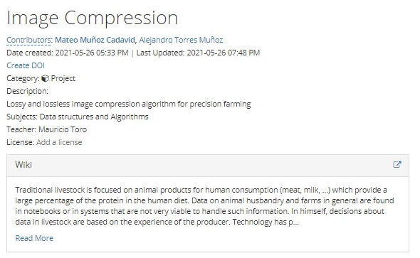
Report Accepted on arXiv
Cadavid, M. M., & Muñoz, A. T. (2021, May 27). Image Compression. Retrieved from https://osf.io/twzm9/

Slide 15
THANK YOU!.

