Slide 1
Modality Prediction by K-Nearest Neighbor Regression
Michaela M^{c}Cown

Slide 2
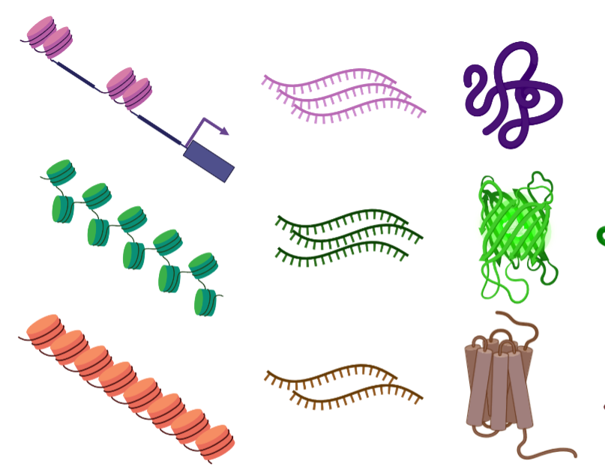
Multimodal Single-cell Data
ATAC GEX ADT
Single cell data is increasingly common
DNA accessibility
gene expression
or protein abundance
Multimodal data is rare; harder to acquire
Comparison of different modalities would
Allow comparison of single-cell studies
Provide insight to levels of regulation
Gene 1
Gene 2
Gene 3

Slide 3
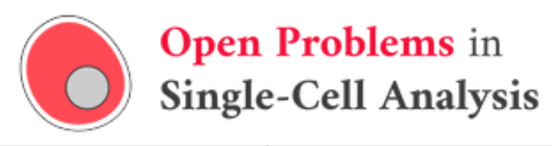
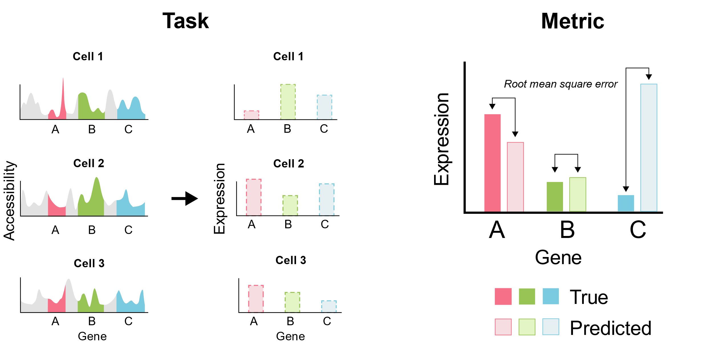
Task 1. Prediction
Goal: Use one of ATAC, GEX, or ADT data to predict another modality
Figure from: https://openproblems.bio/neurips_docs/about_tasks/task1_modality_prediction/
Notes:
“In this task, the goal is to take one modality (ATAC or RNA) and predict the other modality (RNA or Protein) for all features in each cell (only ATAC + RNA shown). Performance is measured using Root Mean Square Error on log1p size-factor normalized counts.”

Slide 4
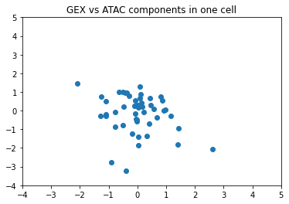
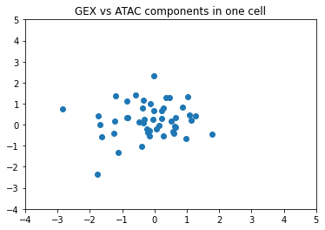
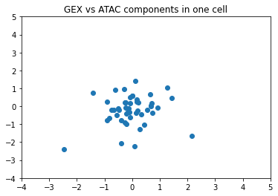
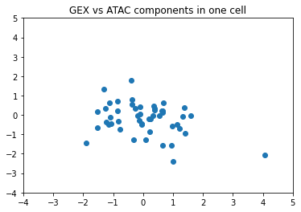
Why K-Nearest Neighbor Regression
No assumption of linear relationship between modalities
Non-parametric

Slide 5
How KNN Regression Works
Calculates distance between test point and input data by modality 1
Python Sklearn defaults to Minkowski method of calculating distance
sum(|x - y|^p)^(1/p) where x and y are vectors
Selects K nearest points
Calculates estimated as mean of those points’ modality 2 values
Can be inverse weighted by distance – closest have strongest effect
Python’s sklearn defaults to uniform, or unweighted

Slide 6
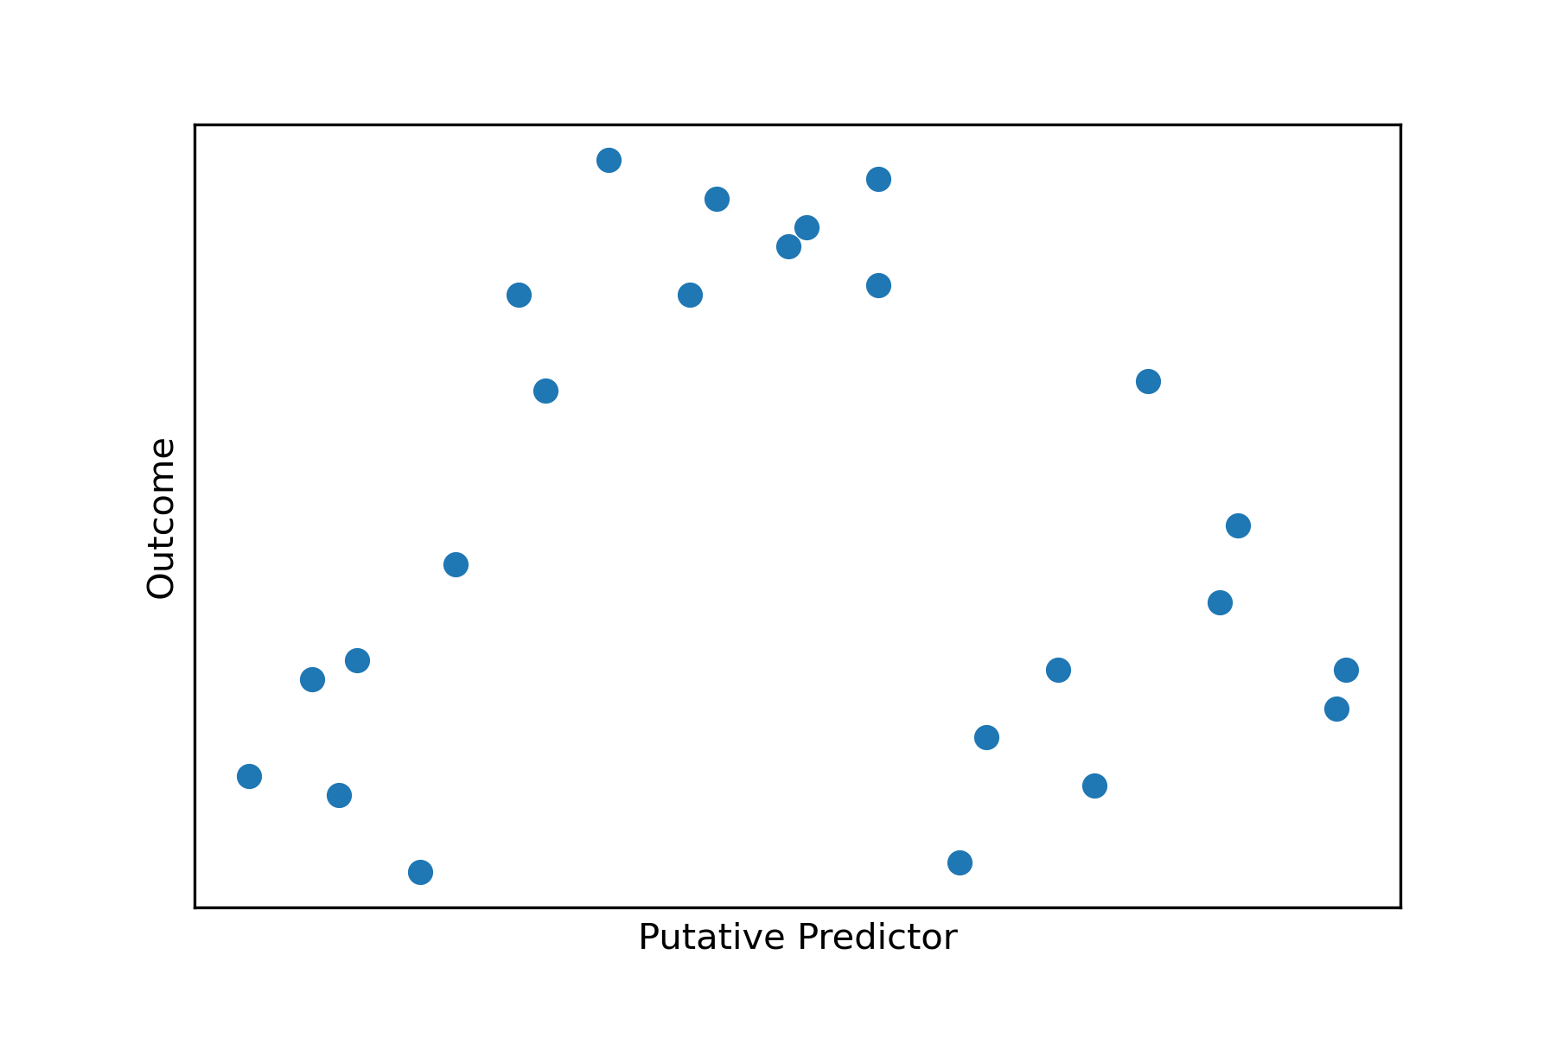
How KNN Regression Works
Distance
K Nearest Neighbors
Average of outcomes

Slide 7
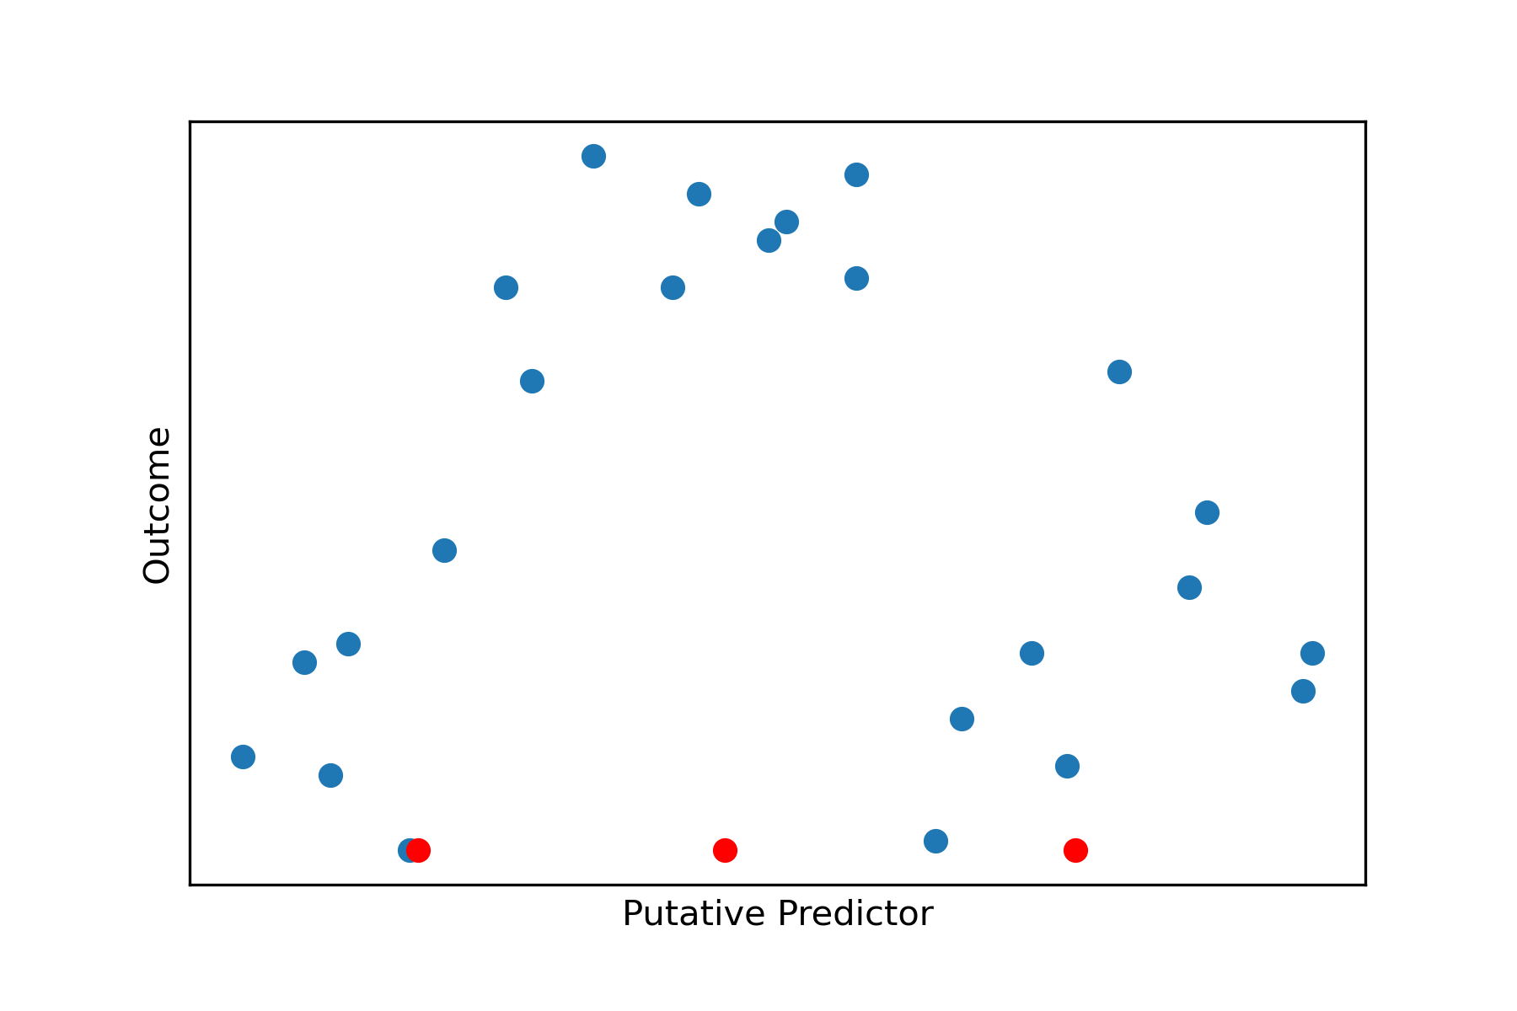
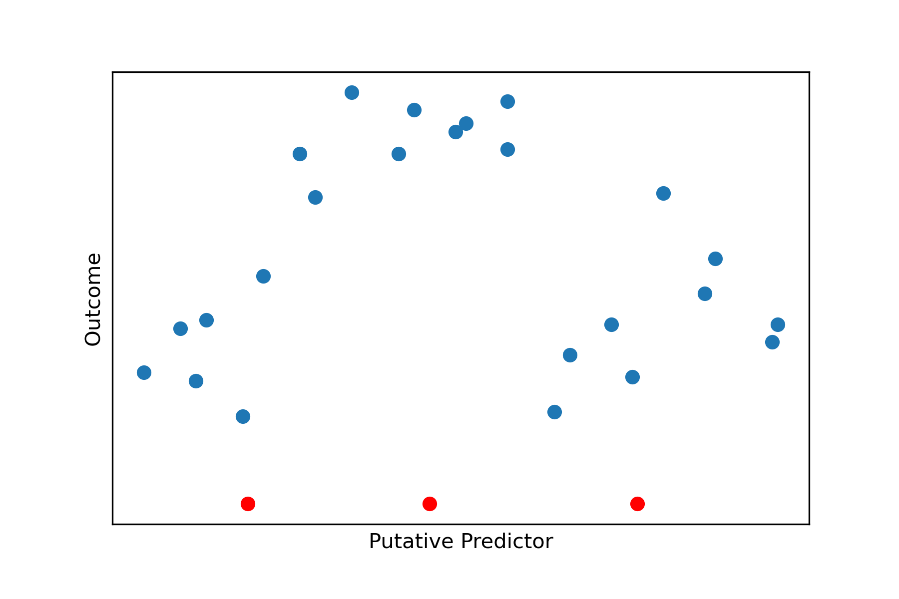
How KNN Regression Works
Distance
K Nearest Neighbors
Average of outcomes
k = 3 in example plot

Slide 8
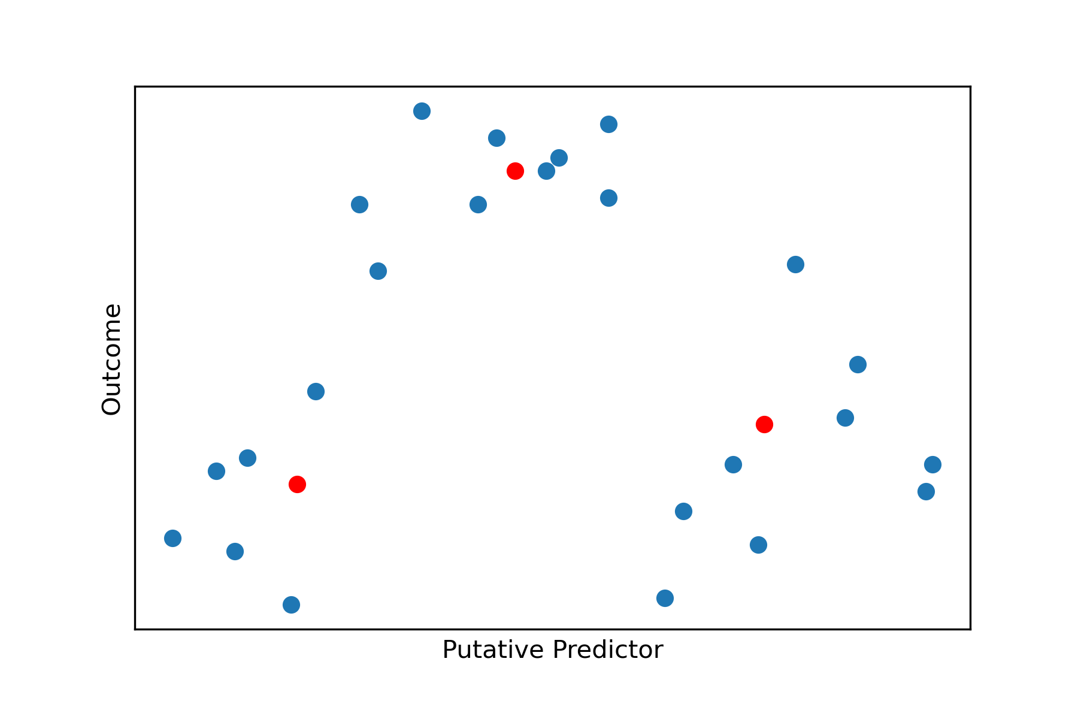
How KNN Regression Works
Distance
K Nearest Neighbors
Average of outcomes

Slide 9
Implementation
Truncated SVD (as with starter kit) to 50 variables, i.e., genes or proteins
Calculate k equal to sqrt(N) where N is the number of observations, or in this case cells
Train model using sklearn’s KNeighborsRegressor
Predict modality2 for the test set

Slide 10
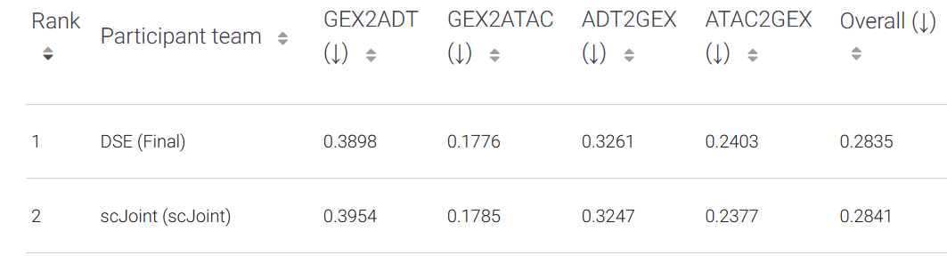
Performance – Overall 13th place

Slide 11
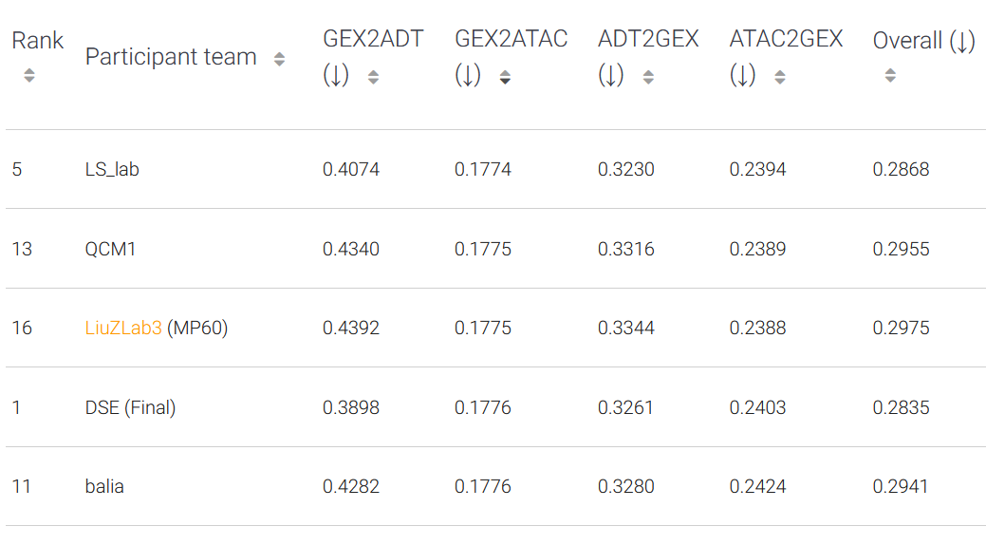
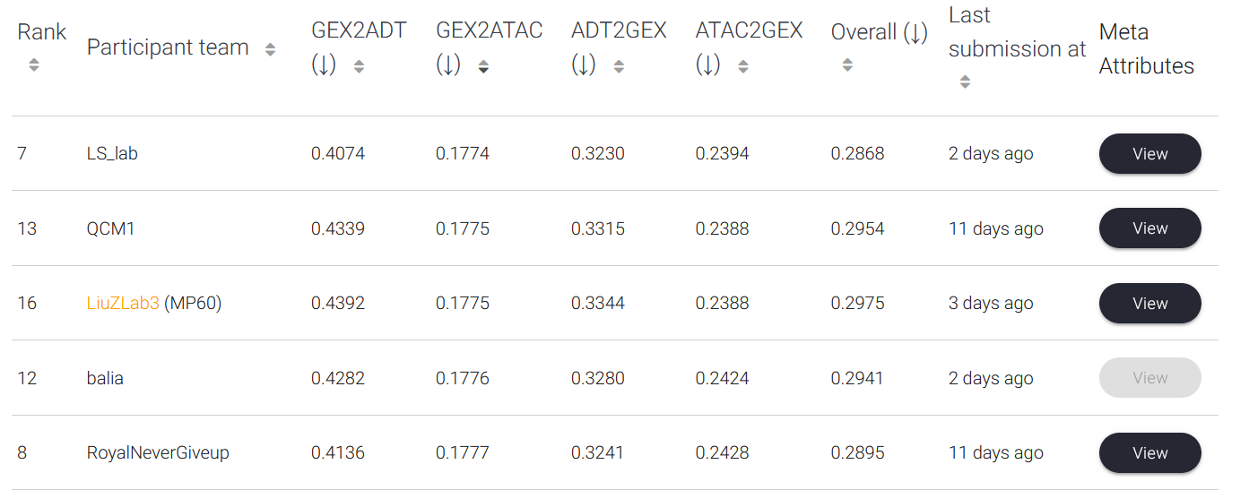
Performance – 2nd in GEX2ATAC

Slide 12
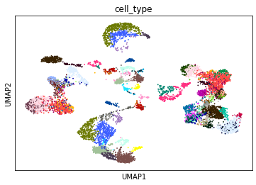
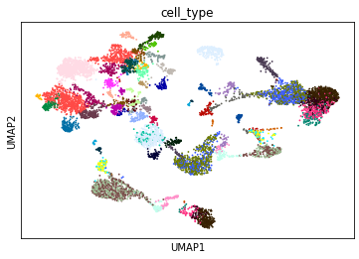
Potential Improvements
Separate predictions for cell type
GEX
ADT
From: https://github.com/openproblems-bio/neurips2021-notebooks/blob/main/notebooks/explore/explore_citeseq.ipynb

Slide 13
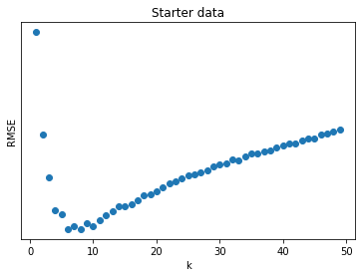
Potential Improvements
Separate predictions for cell type
Optimize k

Slide 14
Potential Improvements
Separate predictions for cell type
Optimize k
Distance weighted
predictions

Slide 15
Conclusion
ATAC GEX ADT
Gene 1
Gene 2
Gene 3
KNN Regression is reasonably effective at multimodal prediction

