Slide 1

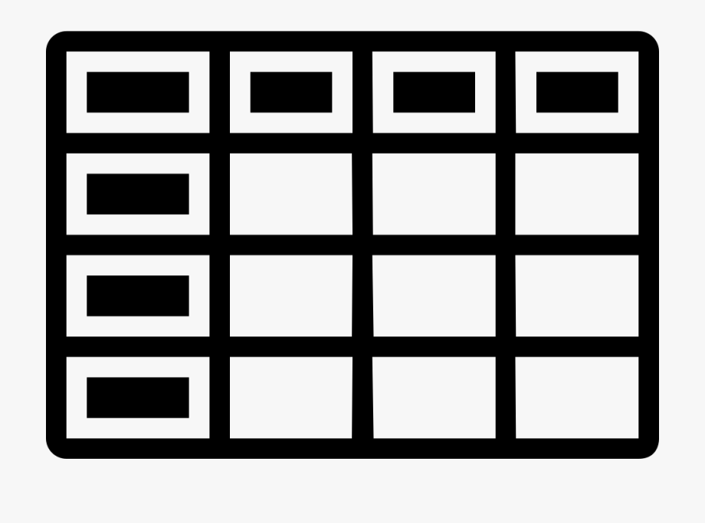

Matching Dictionary
Table 1
Golden Table
Table 2
Updated Matching Dictionary
Table 3
Updated Golden Table

Slide 2
Name
Bill Smith
John Jones
Tom Smithfield
id_number | Name
1 | Bill Smith
2 | John Jones
3 | Tom Smithfield
4 | Tina Turner
{“Johnny Jones”: “John Jones”}
Name
Bill Smith
Johnny Jones
Tina Turner
id_number | Name
1 | Bill Smith
2 | John Jones
3 | Tom Smithfield
4 | Tina Turner
5 | Tim Clark
{“Johnny Jones”: “John Jones”,
“Tommy Smithfield”: “Tom Smithfield”,
“Jon Jones”, “John Jones”}
Name
Tommy Smithfield
Tina Turner
Jon Jones
Tim Clark

