Slide 1
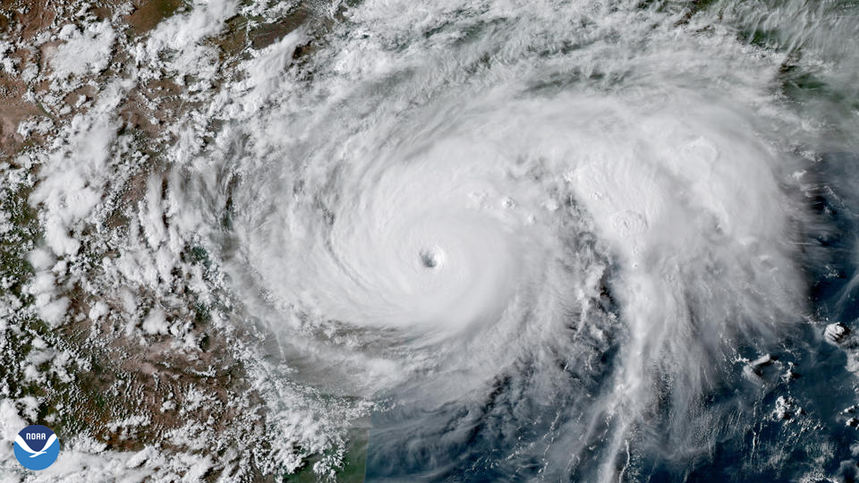
Identifying flood damage with Convolution Neural Networks Thinkful DS Final Capstone By: Mike McIntire
Image Credit: NOAA

Slide 2
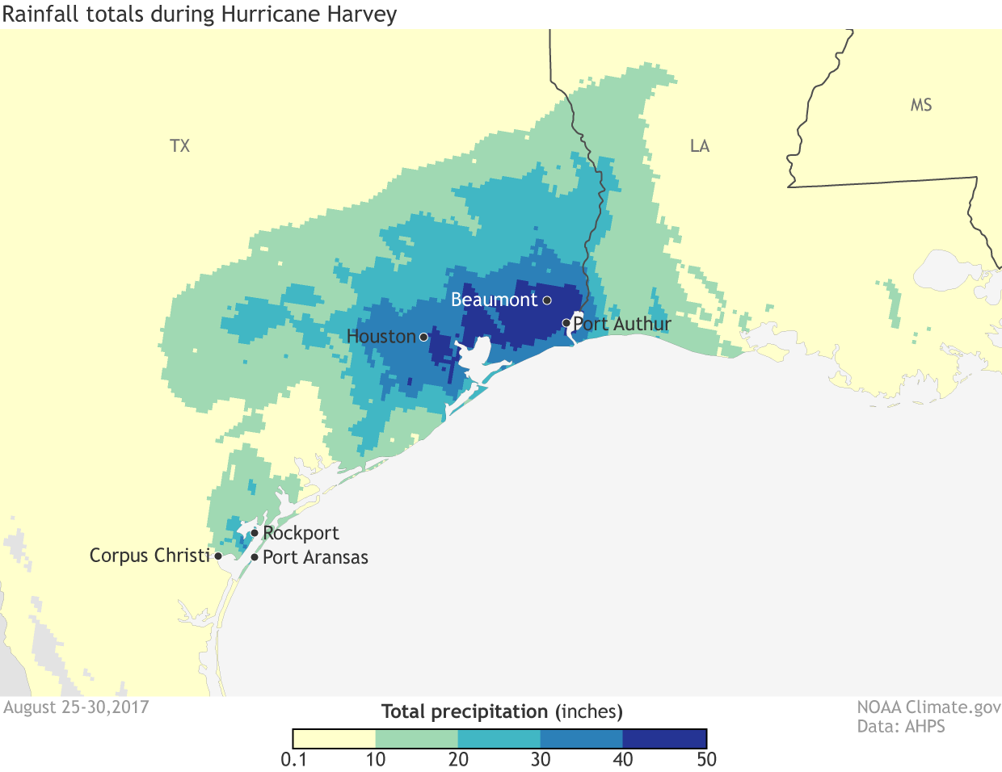
Background
Climate change is causing more intense hurricanes and rainfall events.
As major storm events intensify, the scale and cost of the clean-up of damaged homes and businesses will increase.
Source: NOAA Climate.gov

Slide 3
Introduction
FEMA and insurance companies need a more effective way to identify damaged homes after major storm events.
Deep learning coupled with satellite imagery will help these entities to quickly identify hardest hit areas after a major storm.
Convolution Neural Network (CNN) models are able to classify damaged homes using satellite imagery.

Slide 4
Overview
Executive Summary
Data Exploration
Results
Limitations
Conclusions
Recommendations

Slide 5
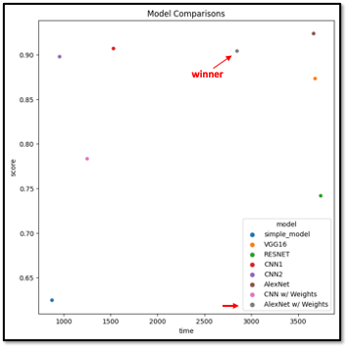
Executive Summary
23000 satellite images taken from after Hurricane Harvey (2017).
Tested 7 models.
Winning model results: Recall for homes with/without damage is .89 and .92, respectively.
Deployment via ArcGIS or web-based image classifier app.

Slide 6
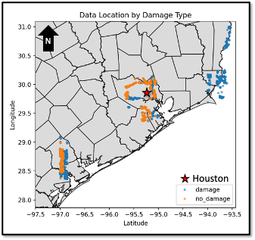
Data Exploration
Dataset of 23000 images from SE Texas after Hurricane Harvey (2017)
Data taken from Kaggle
Image shape: 128, 128, 3 (RGB)
Imbalanced dataset:
15000 ”damage” images
8000 “no_damage” images
Split data into 80% Training, 20% Test
20% Validation data from Training

Slide 7
Image Augmentation
Image Augmentation using ImageDataGenerator()
Brightness range = 0.5-1.5
Rotation = 90
Horizonal flip
Vertical flip

Slide 8
Models Tested
”Simple” Dense Neural Network
VGG16
ResNet
CNN Model 1
CNN Model 2 (with and without class weights)
AlexNet (with and without class weights)

Slide 9
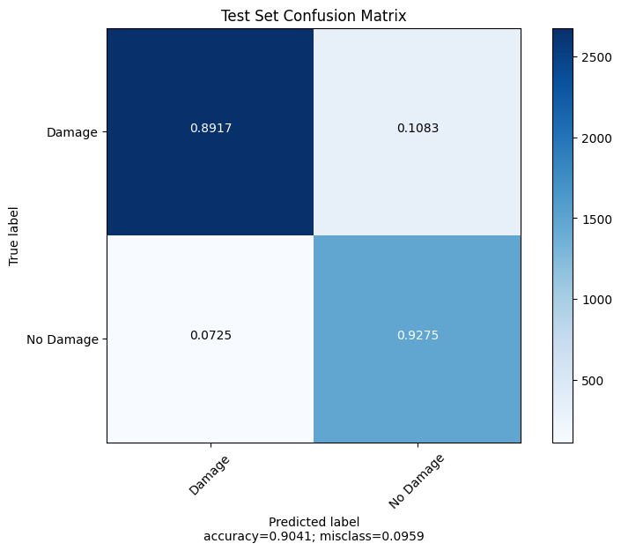
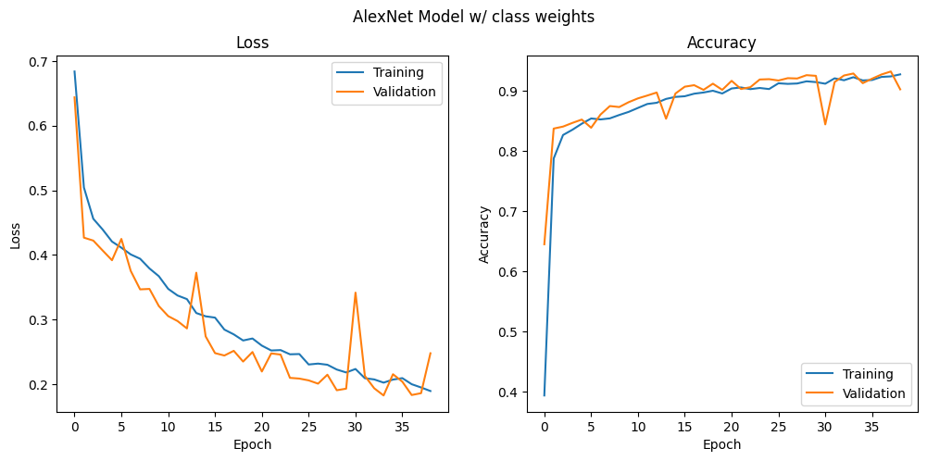
Results
AlexNet w/ class weights gave the best Recall values with .89 and .92 and faster run time than the AlexNet model

Slide 10
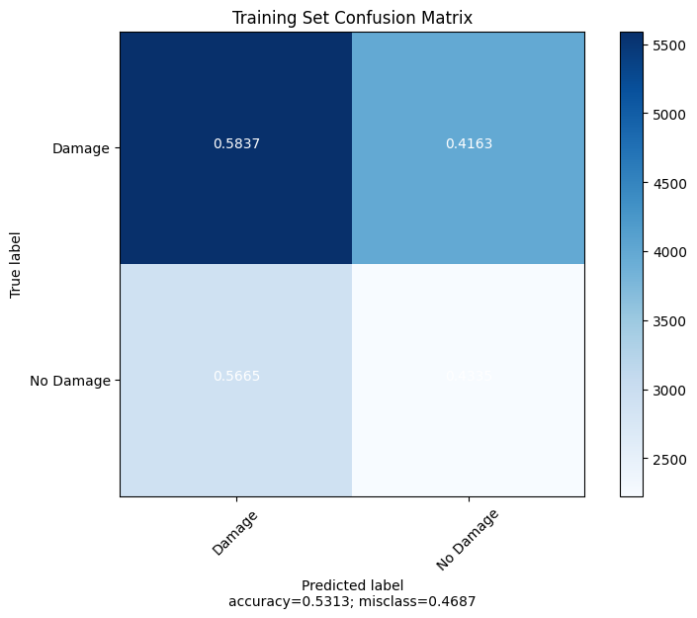
Limitations
Possible issues with data leakage
Differences between predictions on the training data and the test data
How this issue was addressed:
Stratified train_test_split() on target variable.
Experimented with larger test sets.
Confirmed identical damage/no_damage ratio in train and test.
No changes observed

Slide 11
Conclusions
AlexNet Model with class weights applied yielded the best results
89% Recall damage
92% Recall no damage
Issues with training vs. test results need to be addressed

Slide 12
Recommendations
Deployed at scale as a module in ArcGIS or simpler deployment using Heroku to build a web-based image classification app

Slide 13
Sources
[1] Original Dataset: https://ieee-dataport.org/open-access/detecting-damaged-buildings-post-hurricane-satellite-imagery-based-customized
[2] Original Dataset paper: https://arxiv.org/abs/1807.01688
[3] Kaggle Dataset: https://www.kaggle.com/kmader/satellite-images-of-hurricane-damage
[4] Nasa Climate Change Research: https://climate.nasa.gov/
[5] Western US Fires: https://climate.nasa.gov/blog/3066/the-climate-connections-of-a-record-fire-year-in-the-us-west/
[6] Rising Sea Levels (Kiribati): https://www.nytimes.com/2016/07/03/world/asia/climate-change-kiribati.html
[7] Hurricane Harvey facts: https://tdem.texas.gov/hurricane-harvey-dr-4332-2/c
[8] Texas counties shapefile (TXDOT): https://gis-txdot.opendata.arcgis.com/datasets/texas-county-boundaries-detailed/explore?location=31.168805%2C-100.077018%2C6.70
[9] Guide to CNN: https://towardsdatascience.com/a-comprehensive-guide-to-convolutional-neural-networks-the-eli5-way-3bd2b1164a53
[10] Kaggle Computer Vision Course: https://www.kaggle.com/learn/computer-vision
[11] IBM Computer Vision Explanation: https://www.ibm.com/topics/computer-vision
[12] IBM CNN Explanation: https://www.ibm.com/cloud/learn/convolutional-neural-networks
[13] Climate.gov-Hurricane Harvey: https://www.climate.gov/news-features/event-tracker/reviewing-hurricane-harveys-catastrophic-rain-and-flooding

Slide 14
Appendix

Slide 15
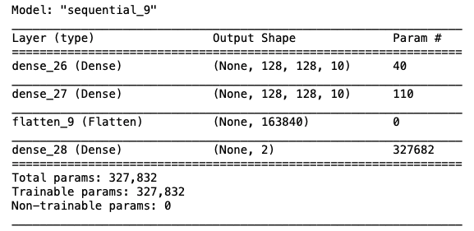
“Simple” Model Architecture
Input
Hidden Layers (x2)
Output
128x128x3 = 49152
10
10
2

Slide 16
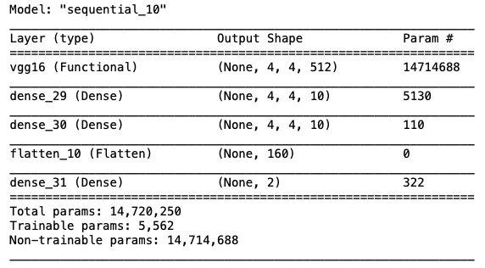
VGG16 Transfer Learning Model

Slide 17
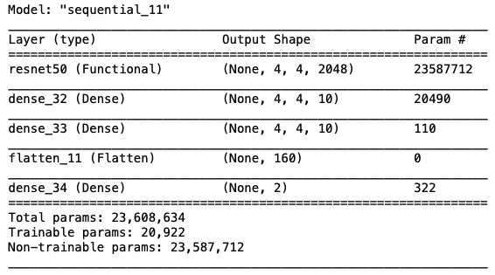
ResNet50 Transfer Learning Model

Slide 18
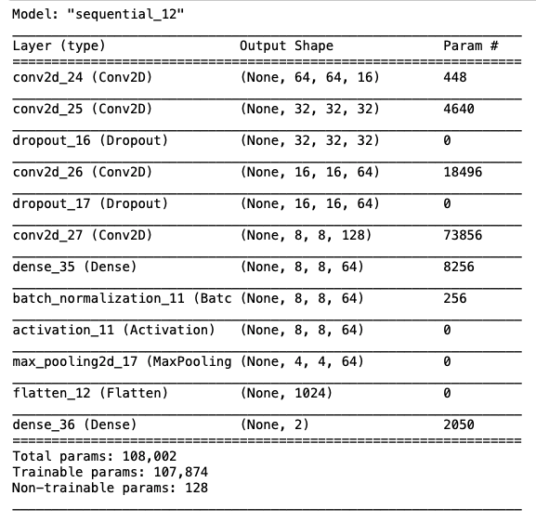
CNN Model 1

Slide 19
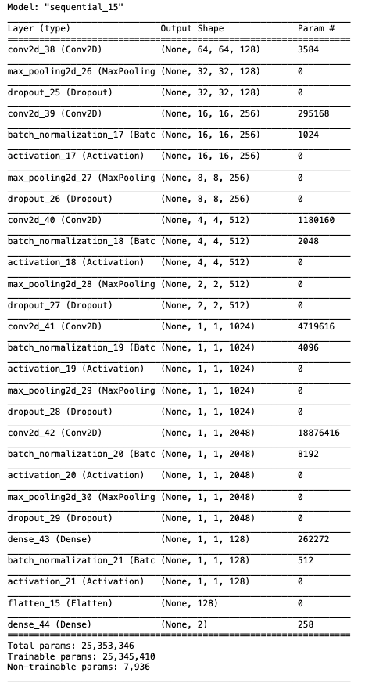
CNN Model 2

Slide 20
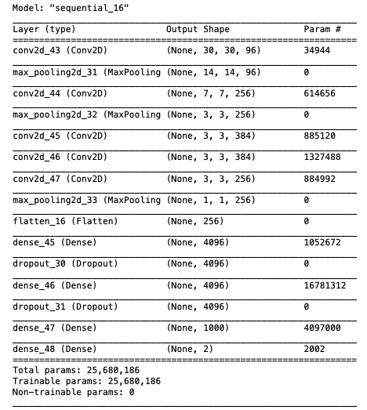
AlexNet Model

