Slide 1
Analysis of Lease Sale Bids in the Gulf of Mexico from 2014-2020
By: Mike McIntire

Slide 2
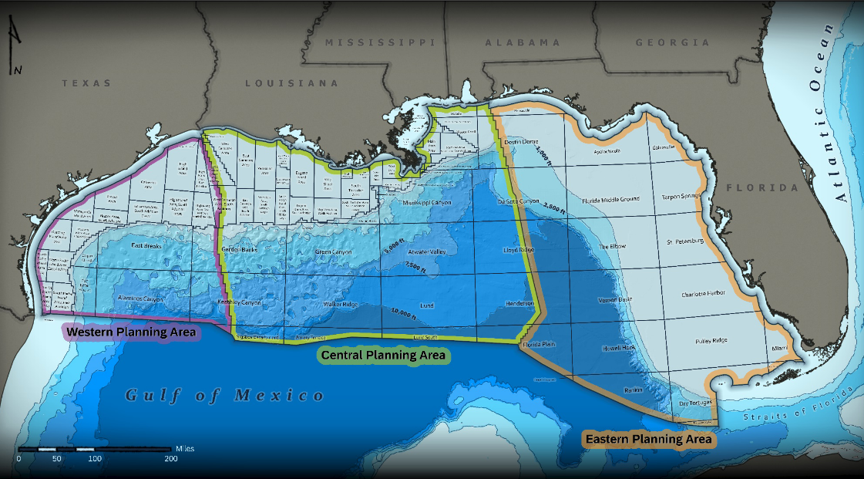
Introduction
Gulf of Mexico Protraction Area Distribution
Question: Is using mean lease sale bids per year a good indicator of a company’s commitment to exploration?
Key audience: Subsurface staff (geoscientists and reservoir engineers), middle management, and executives.
Why should you care? One of the jobs of subsurface staff is to monitor competitor leasing activity. Management frequently asks questions about a specific companies leasing behavior and regional leasing trends.
Credit : BOEM OCS Report 2021-005
Notes:
The Gulf of Mexico (GOM) is considered one of the most prolific oil and gas basins in the world. The basin has produced to date more than 5.2 Billion Barrels of Oil Equivalent (BBOE) as of 2017 (Figure 1). The GOM is divided into protraction areas and these protraction areas are further broken into 3 mile by 3 mile lease blocks. The blocks are controlled by the Bureau of Ocean and Energy Management (BOEM). Oil and gas companies with a license to operate in the GOM can bid on available leases in yearly lease sales. Lease terms vary from 5-10 years depending on water depth.
One of the jobs of the subsurface staff at an oil and gas company is to monitor competitor lease acquisition. This can show where a specific company, or the industry as a whole, are focusing money and exploration efforts. Competitor intelligence can also help companies create their own strategies for leasing, building exploration campaigns, or provide justification to drill a well. It's important to remember that the lease boundaries created by the federal government do not control the geology in the subsurface. Oil and gas fields frequently cross lease boundaries, so understanding what other companies in your area are doing can prevent
This analysis would be used by the subsurface staff (geologists, geophysicists, reservoir engineers) to convey to middle management and executives what exploration is occurring in areas we currently operate, potential deals/joint ventures, and new exploration trends.
5.2 billion barrels of oil is equal to more than 218 billion gallons (1 barrel = 42 us gallons)

Slide 3
Hypothesis
Purpose of analysis: To compare the changes in the average lease bids for each company participating in the lease sales between 2014-2020.
Ho: There is no significant difference in the average net lease bid per company between 2014-2020
Ha: There is a significant difference in the the average net lease bid per company between 2014-2020

Slide 4
Data analyzed
Publicly available lease sale data from BOEM website
Used GOMSmart to create .csv for data
Raw dataset contains 1708 records and 17 variables
Also pulled average oil price per year from EIA website

Slide 5
Methods for Analysis
Data Visualization
Normality Check
Kruskal-Wallis
Pairwise Tukey HSD
Pivot tables for mean lease bids
Histograms for mean and median distributions
Plot mean and median bids per company between 2014-2020 using Seaborn
Tested mean and median lease bid
Skew and kurtosis indicate data is not normal
Test statistic > 1.96 for both mean and median lease bids
Reject null hypothesis
Pairwise comparison for companies

Slide 6
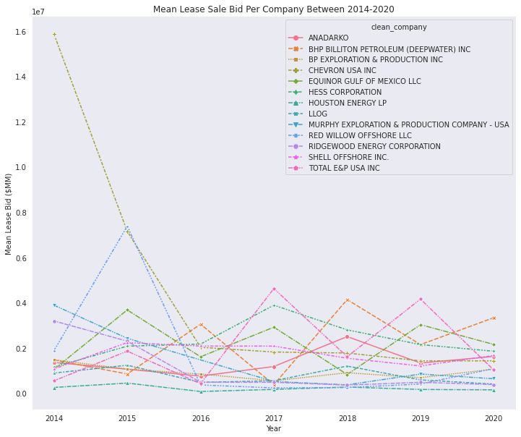
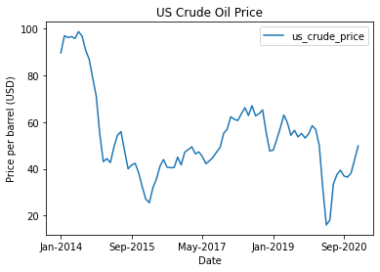
Visualizing mean bids over time

Slide 7
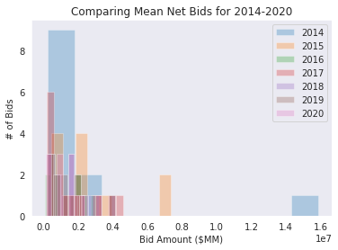
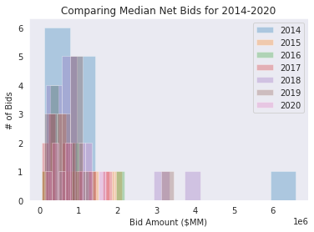
Normality Check
Not Normal
Not Normal

Slide 8
Recommendations
Comparing medians instead of means
Major oil price crashes (2016, 2020) likely cause for large difference over 7 year span.
Majors remain committed to exploration despite low oil prices.
Recommendation: With mean bids decreasing during an oil price decline, companies that maintain a strong balance sheet should focus more budget on lease bids.
Areas of possible bias:
Companies that did not participate in the lease sale each year were not include in the analysis (sampling bias)
Lease availability each year (contextual bias)

Slide 9
Additional Analysis
Comparing median net bid price over time
Comparing mean/median net bid price per protraction areas over time
Number of bids per company per year
Incorporate average oil price
Number of exploration well permits filed per company per year
Total volumes produced per company per year
Lease availability vs. lease bids submitted
Type or size of company (major vs private equity)
Stock price for publicly traded companies

Slide 10
References
Raw lease sale data: https://github.com/mmcintire00/tf_exp_design/blob/main/gom_ls_high_bids_2014-2020.csv
BOEM Gulf of Mexico 2019 Annual Report: https://www.boem.gov/sites/default/files/documents/about-boem/Deepwater-Gulf-of-Mexico-Report-2019.pdf
Oil price data: https://www.eia.gov/dnav/pet/hist/LeafHandler.ashx?n=PET&s=F000000__3&f=A

