Slide 1
Day 3: Continued Data Visualization & Data tidying

Slide 2
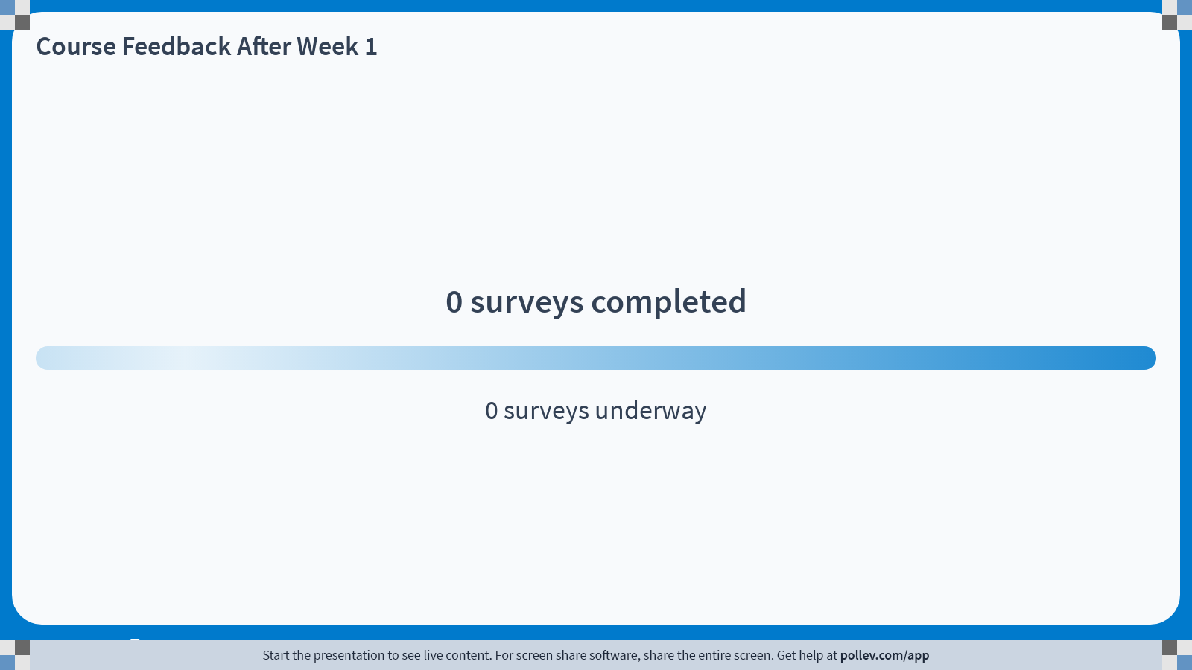
Notes:
Do not modify the notes in this section to avoid tampering with the Poll Everywhere activity. More info at polleverywhere.com/support Course Feedback After Week 1
https://www.polleverywhere.com/surveys/7Cs7eVLW24l0YH1DdD6WF?flow=Default&onscreen=persist

Slide 3
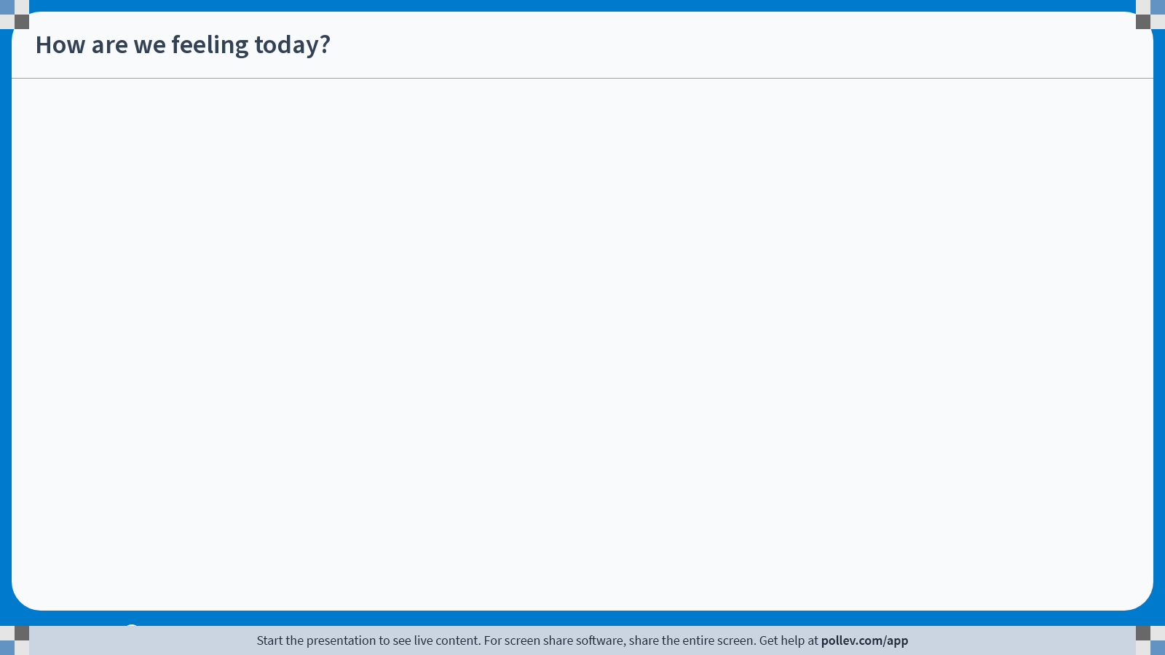
Notes:
Do not modify the notes in this section to avoid tampering with the Poll Everywhere activity. More info at polleverywhere.com/support How are we feeling today?
https://www.polleverywhere.com/clickable_images/2VuehRisFo5nq7ov373AF

Slide 4
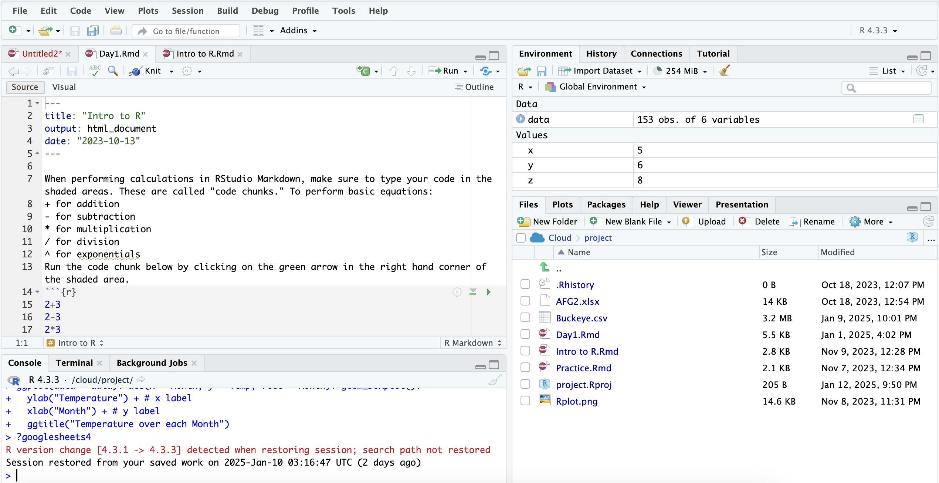
First, download our Day3.RMD from Github and Upload to Posit Cloud

Slide 5
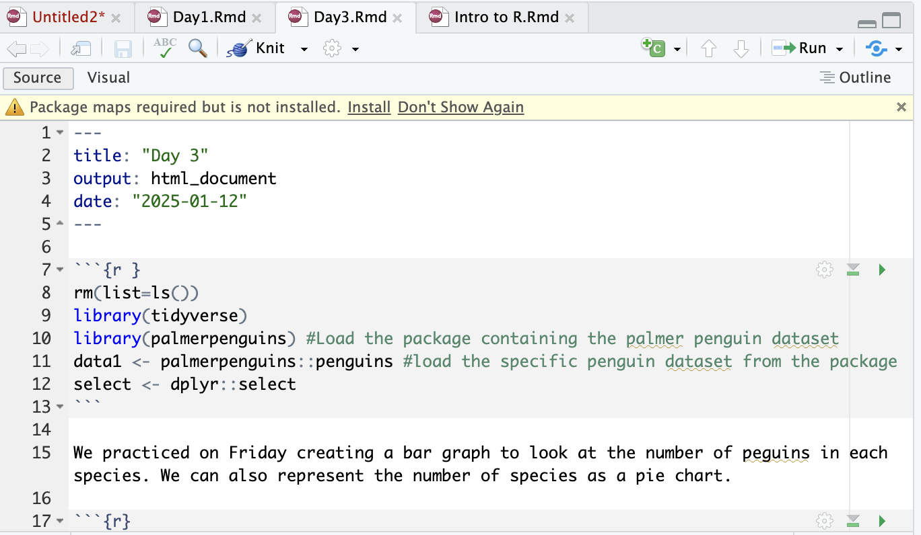
Are all of your packages installed?

Slide 6
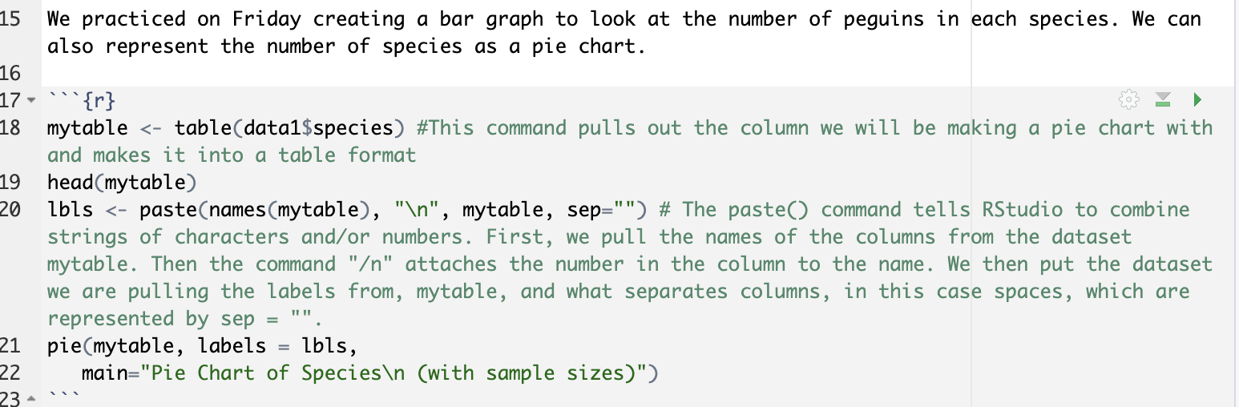

Slide 7
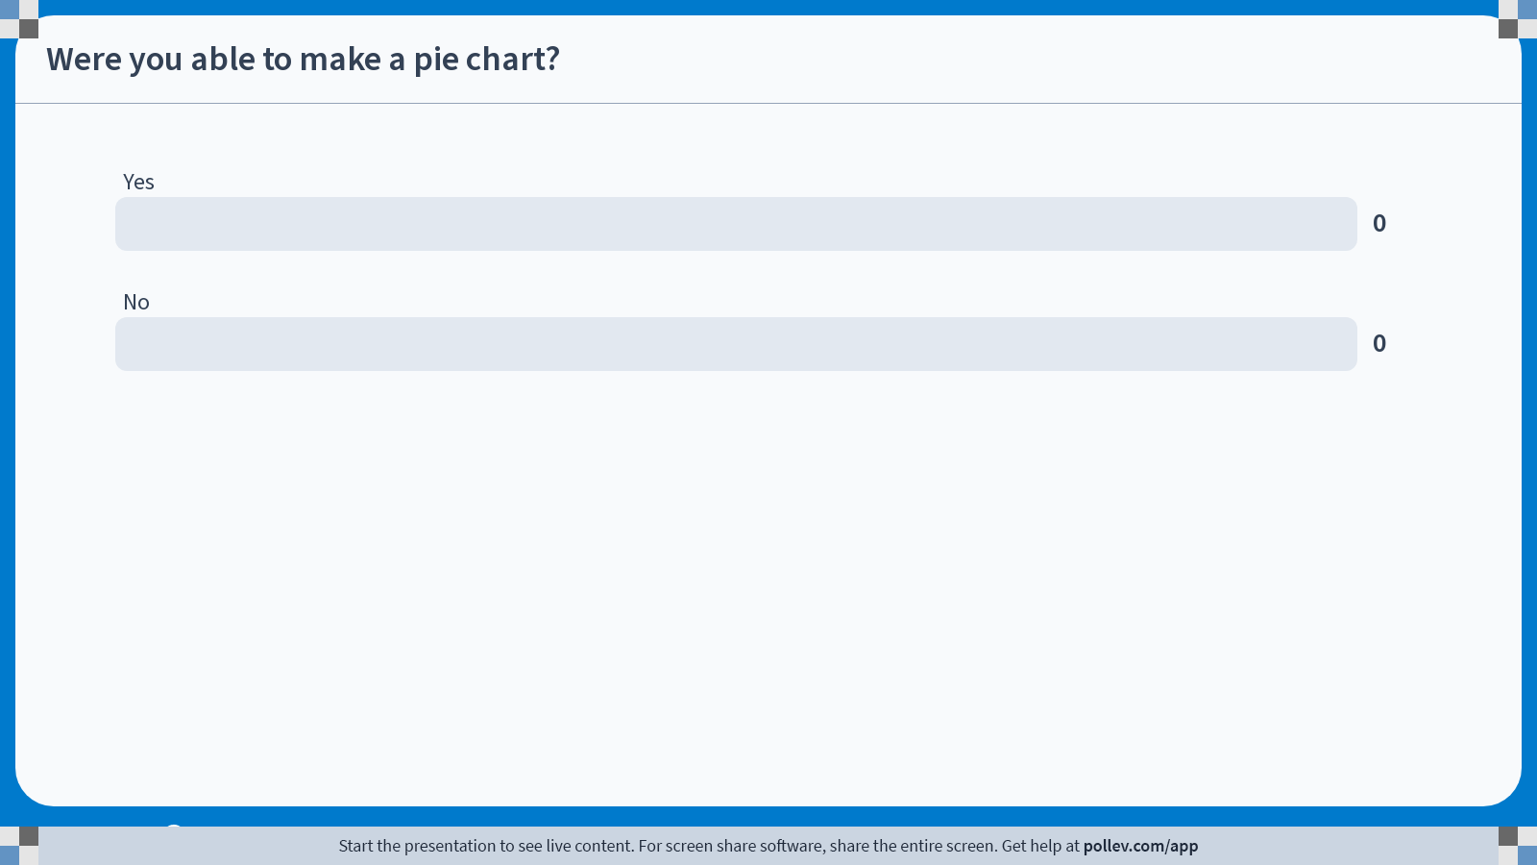
Notes:
Do not modify the notes in this section to avoid tampering with the Poll Everywhere activity. More info at polleverywhere.com/support Were you able to make a pie chart?
https://www.polleverywhere.com/multiple_choice_polls/vWLJVKDGK4XXsA4Mgg7PQ?state=opened&flow=Default&onscreen=persist

Slide 8
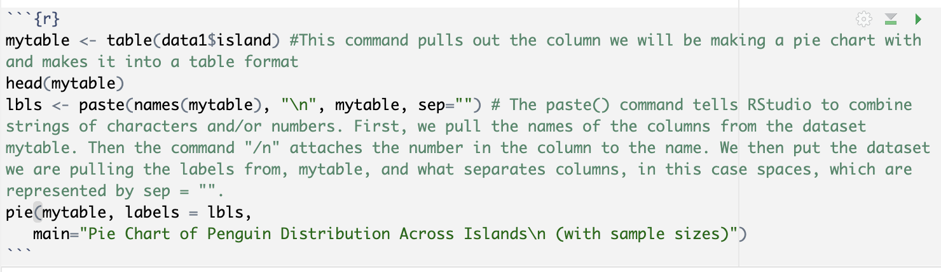
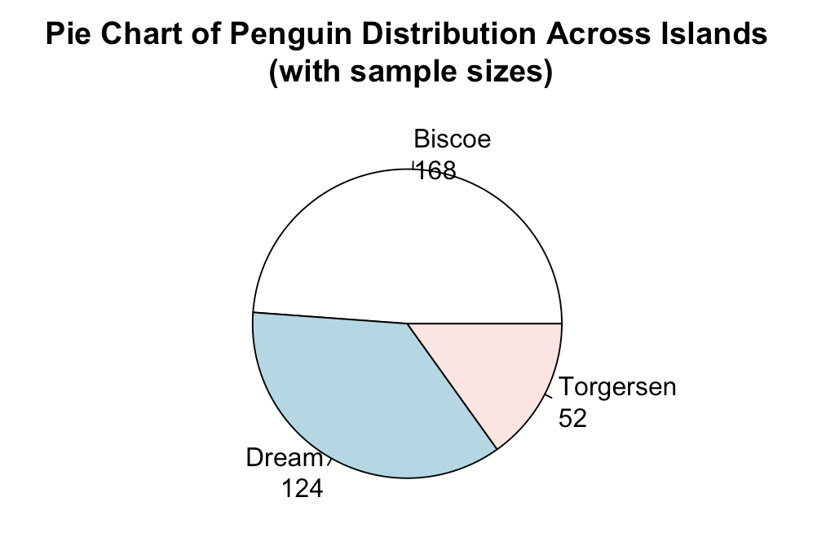

Slide 9
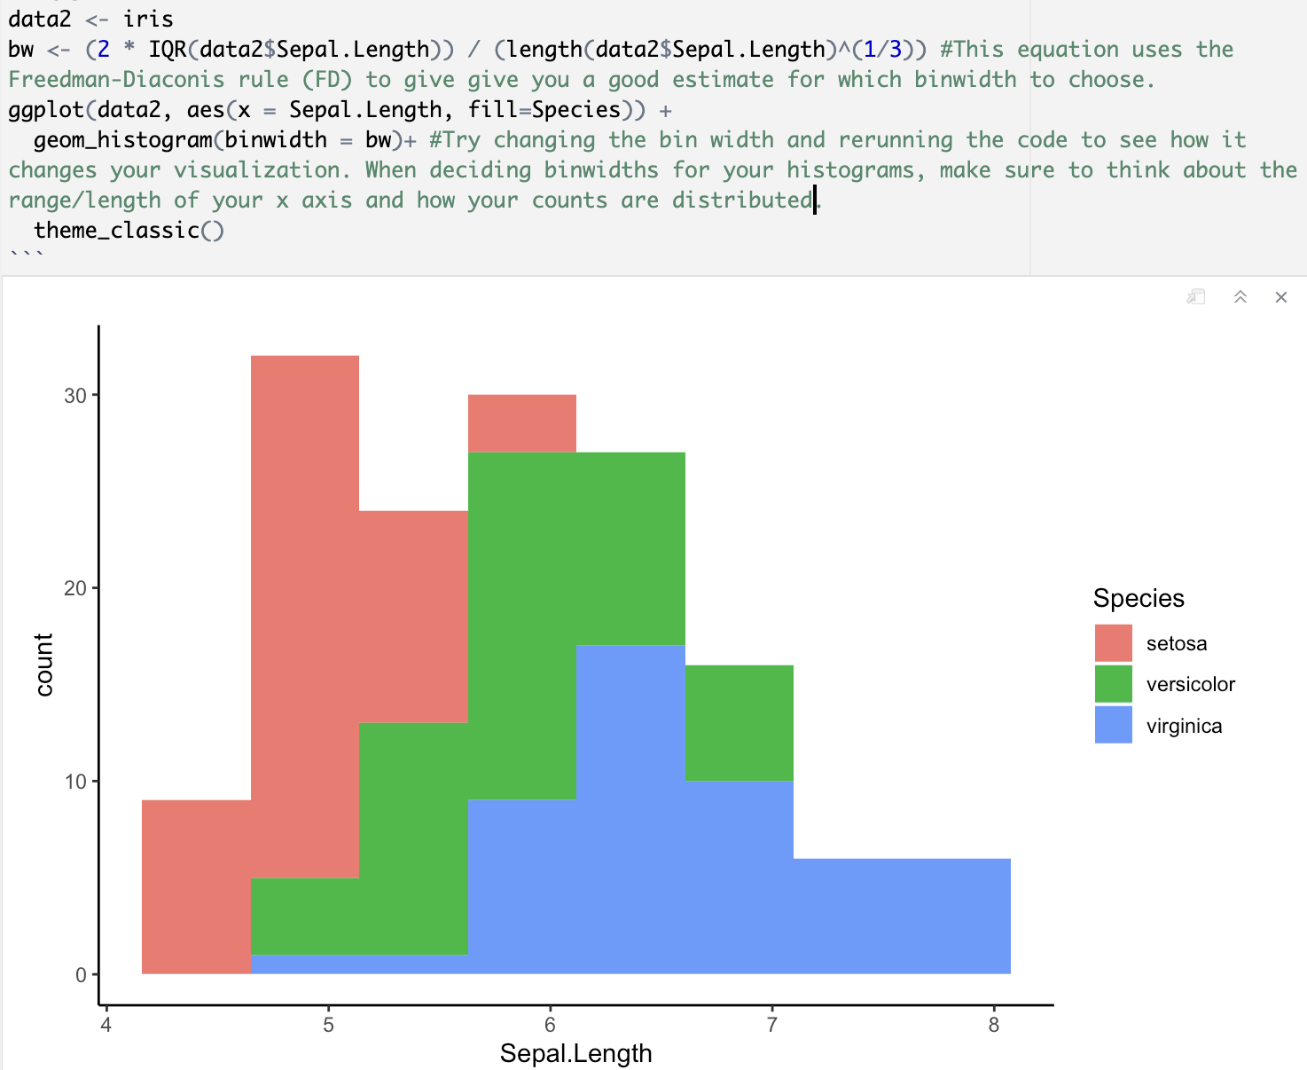
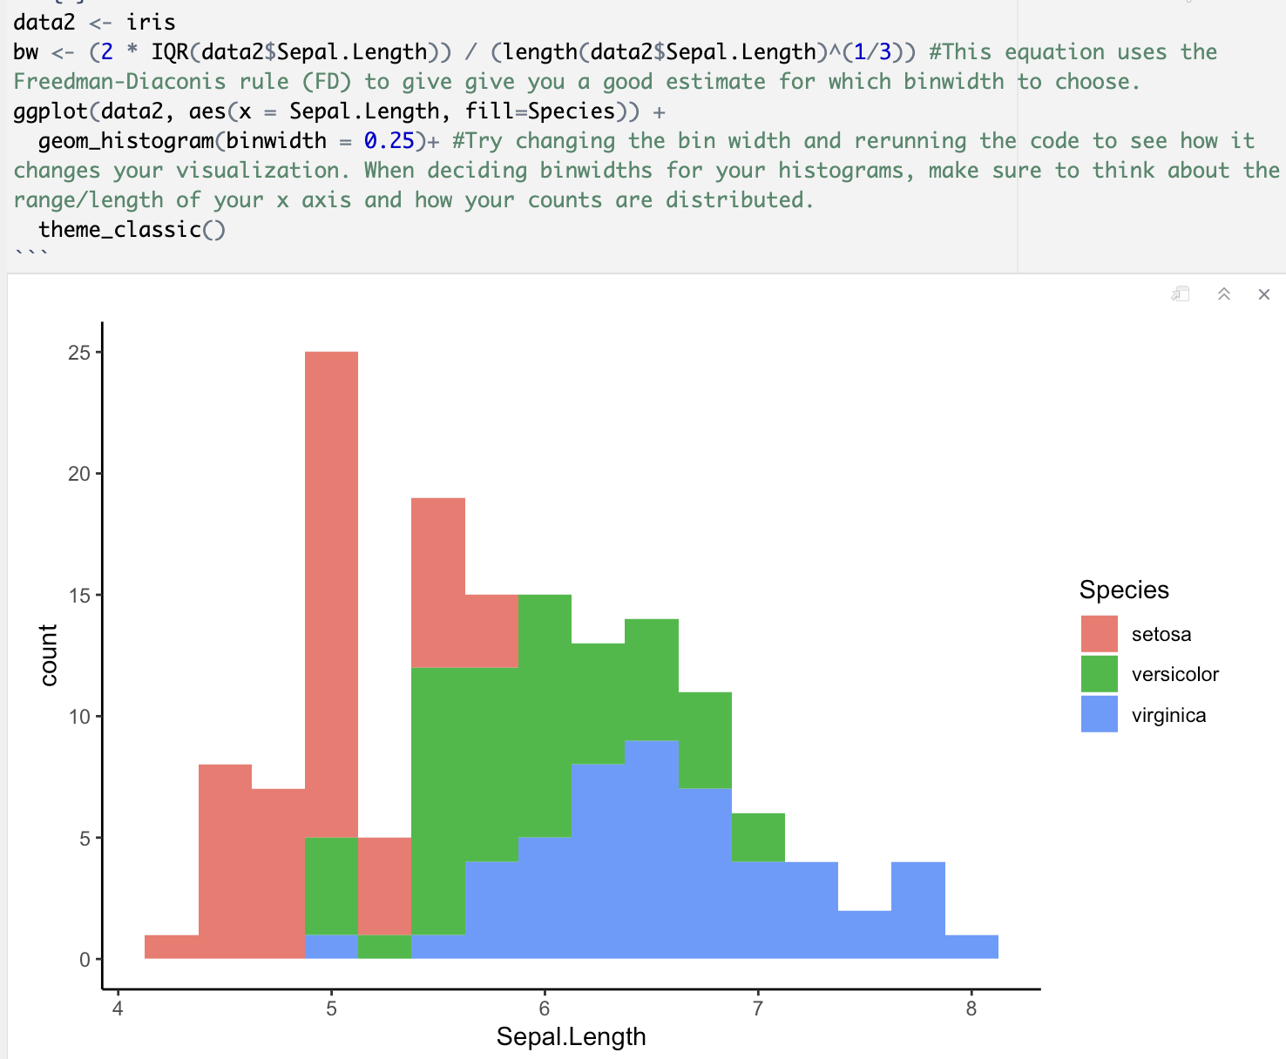

Slide 10
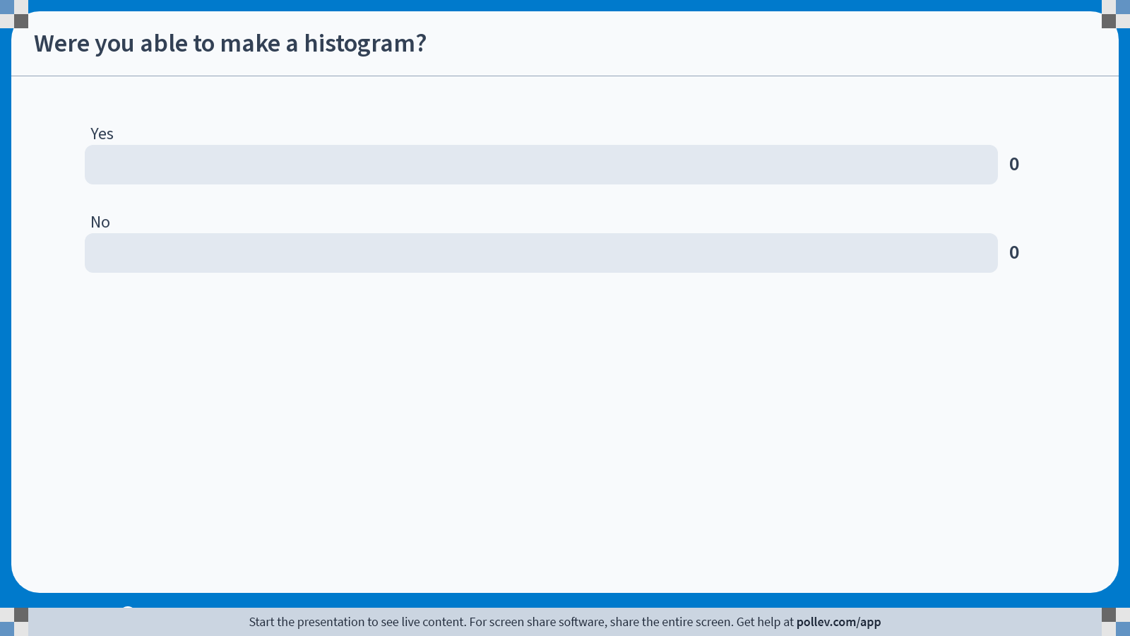
Notes:
Do not modify the notes in this section to avoid tampering with the Poll Everywhere activity. More info at polleverywhere.com/support Were you able to make a histogram?
https://www.polleverywhere.com/multiple_choice_polls/8M1k6VECnY4Hk0QgD3sPc?state=opened&flow=Default&onscreen=persist

Slide 11
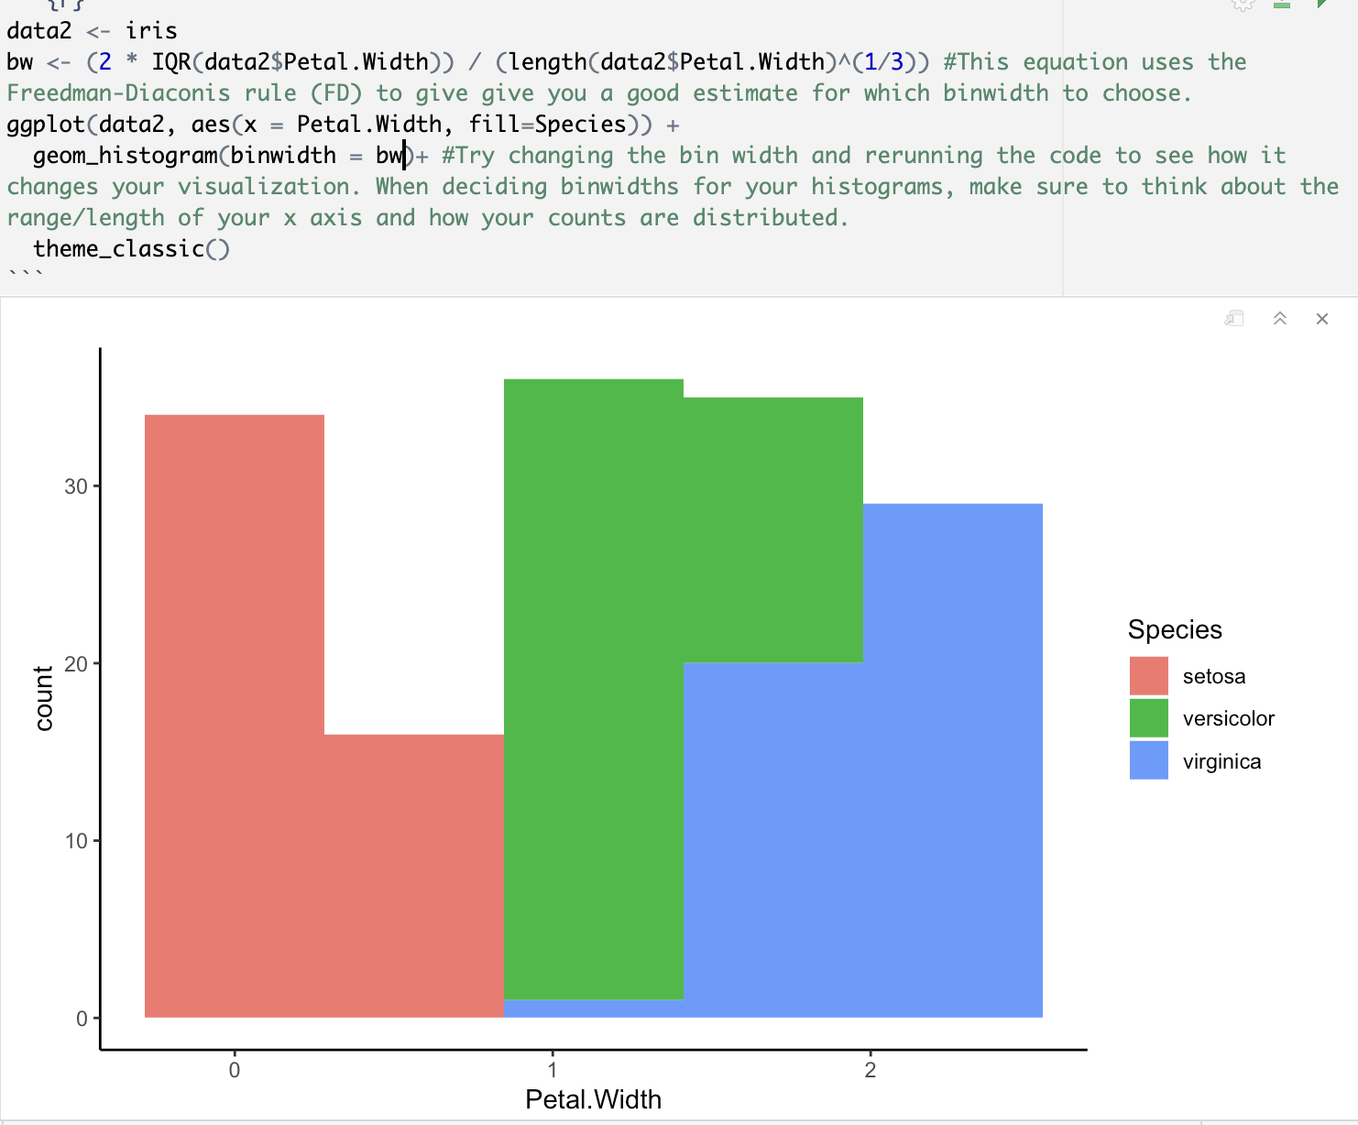

Slide 12
Question to explore:
How does sepal size vary among flower species?

Slide 13
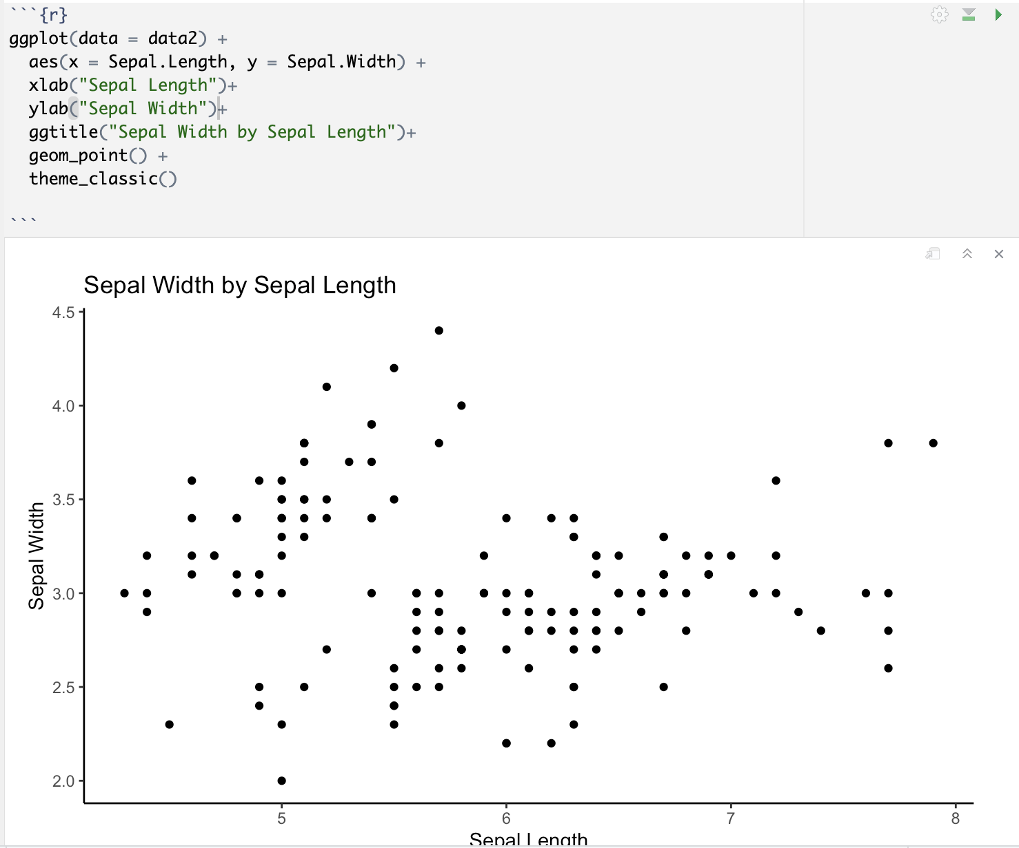

Slide 14
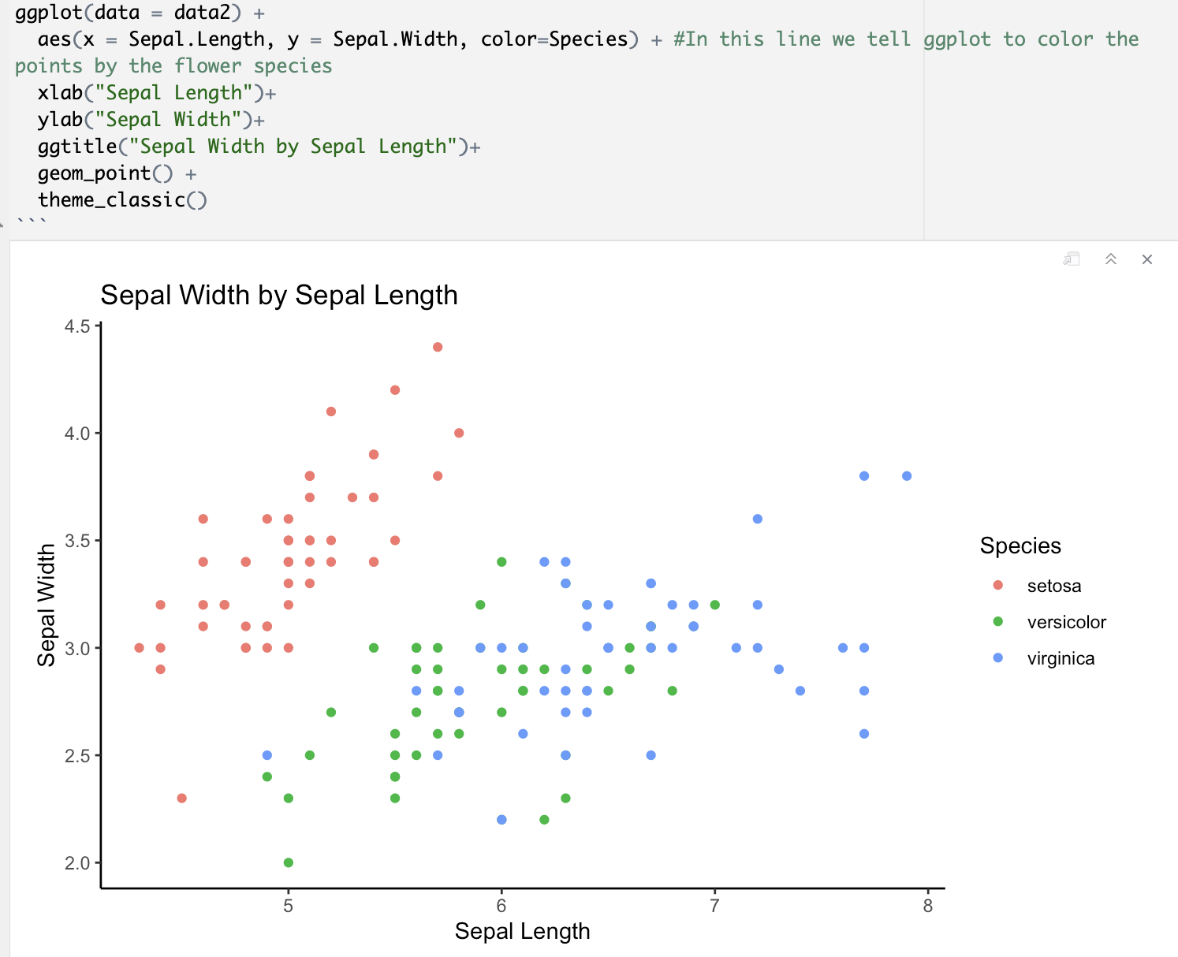

Slide 15
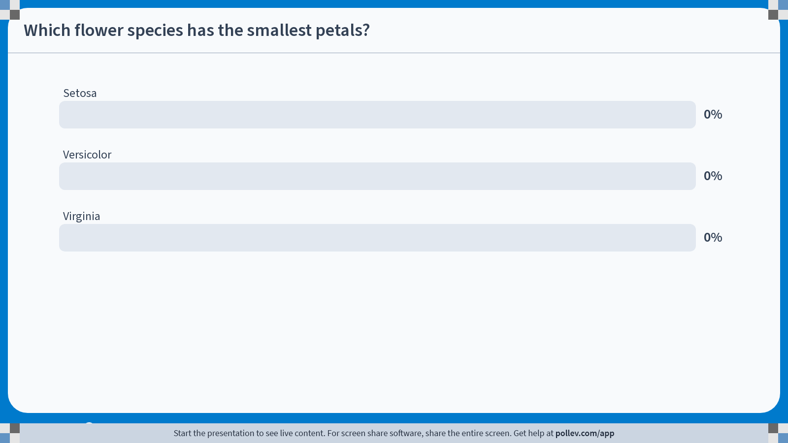
Notes:
Do not modify the notes in this section to avoid tampering with the Poll Everywhere activity. More info at polleverywhere.com/support Which flower species has the smallest petals?
https://www.polleverywhere.com/multiple_choice_polls/HK9NNXKrdJWcquyHaQRYZ?state=opened&flow=Default&onscreen=persist

Slide 16
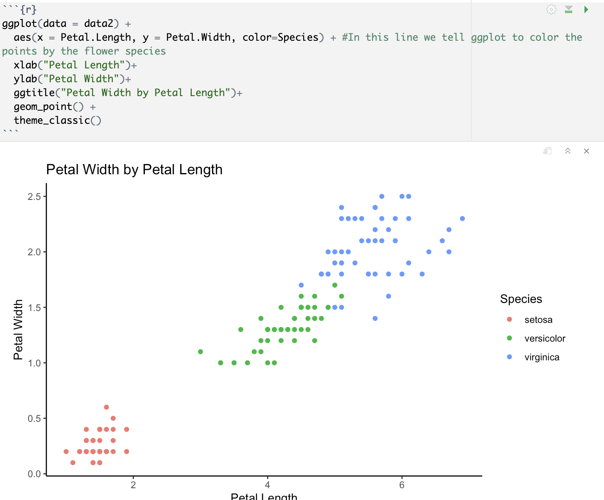

Slide 17
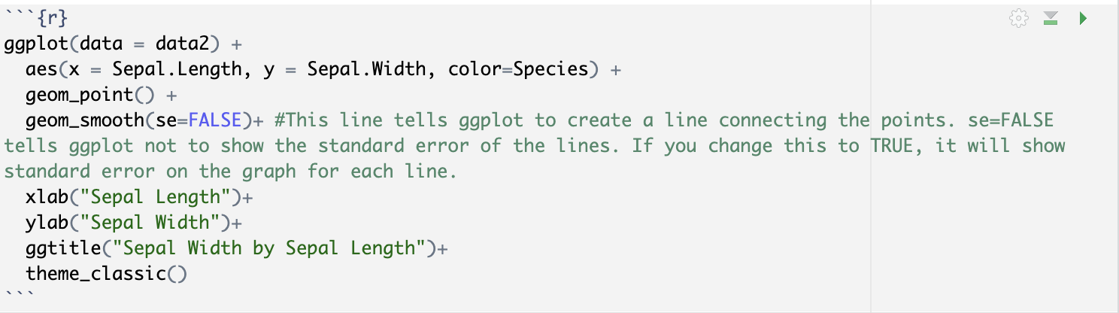
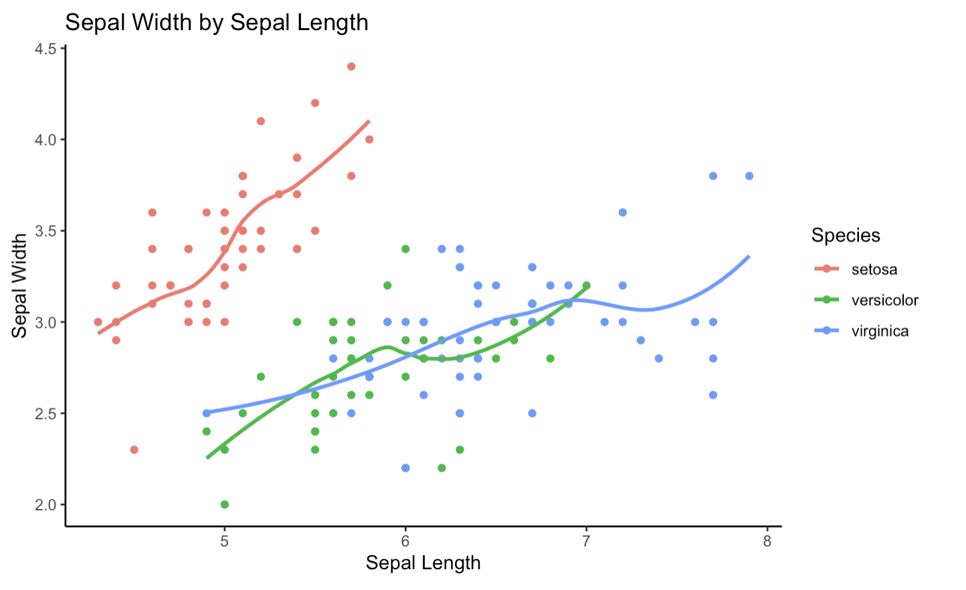

Slide 18
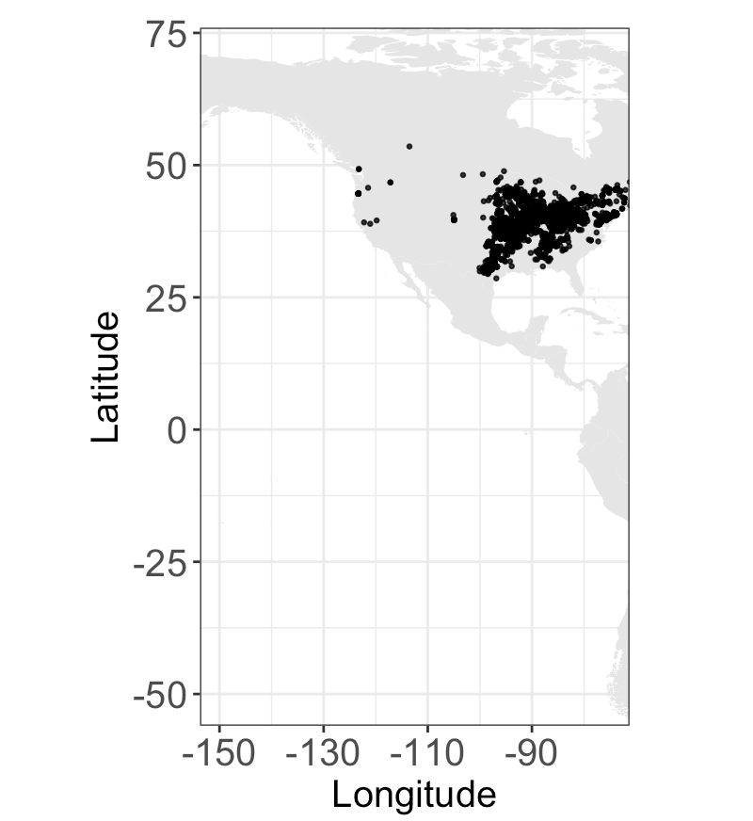

Slide 19
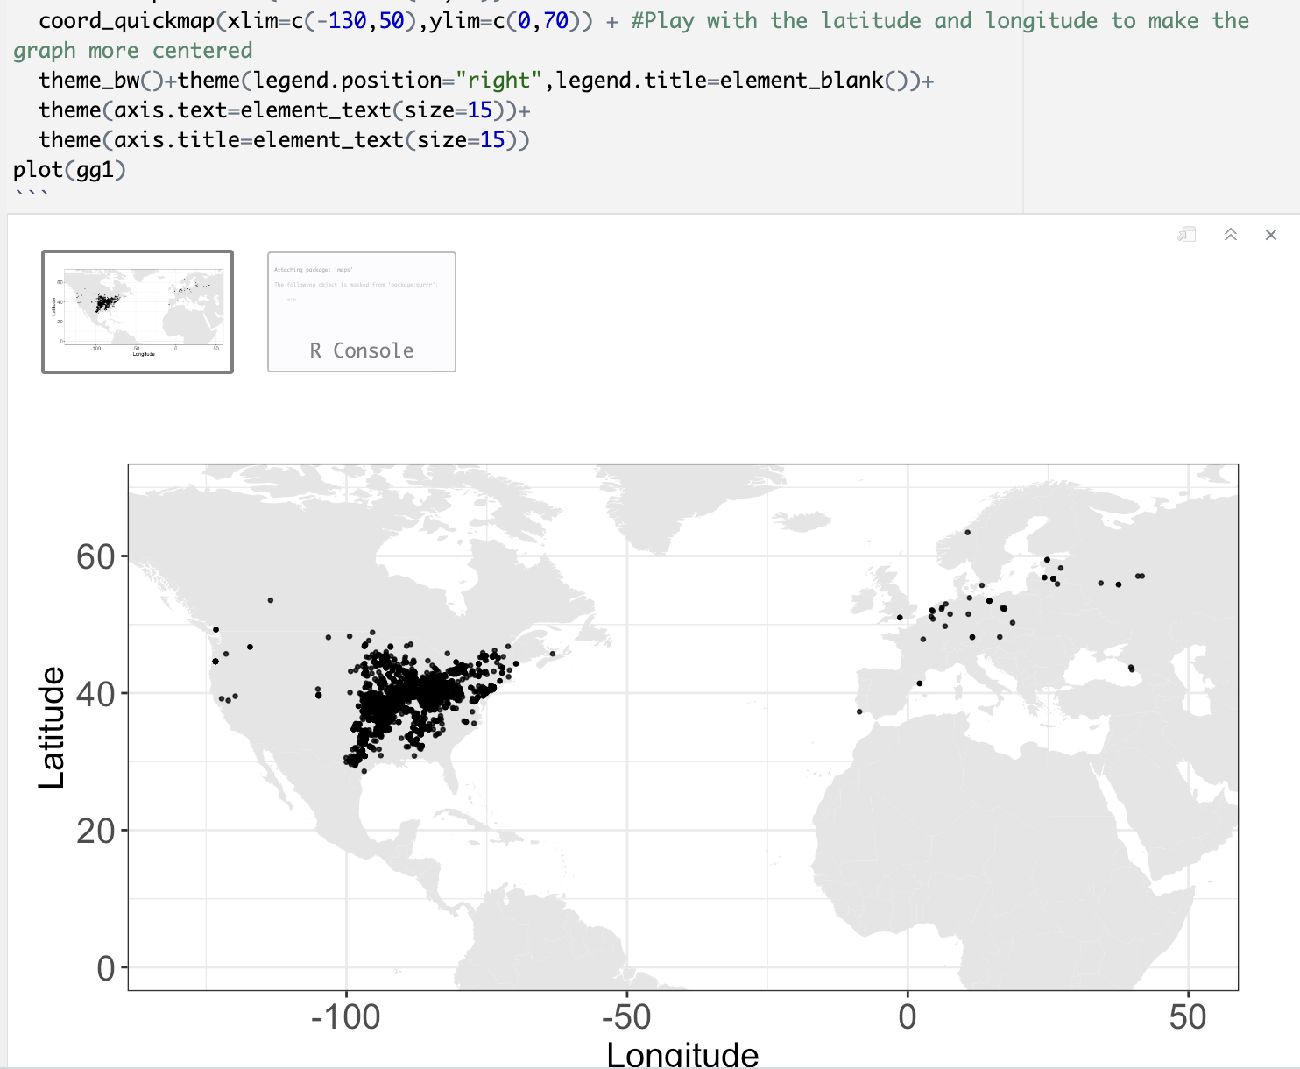

Slide 20
Part 2: Data Tidying

Slide 21
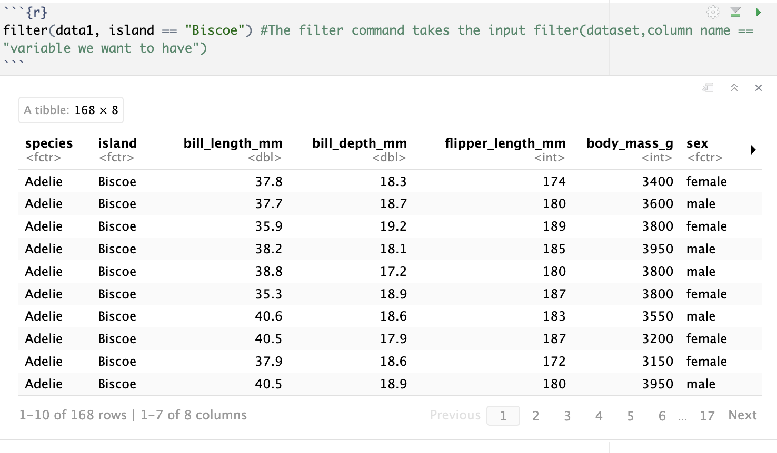

Slide 22
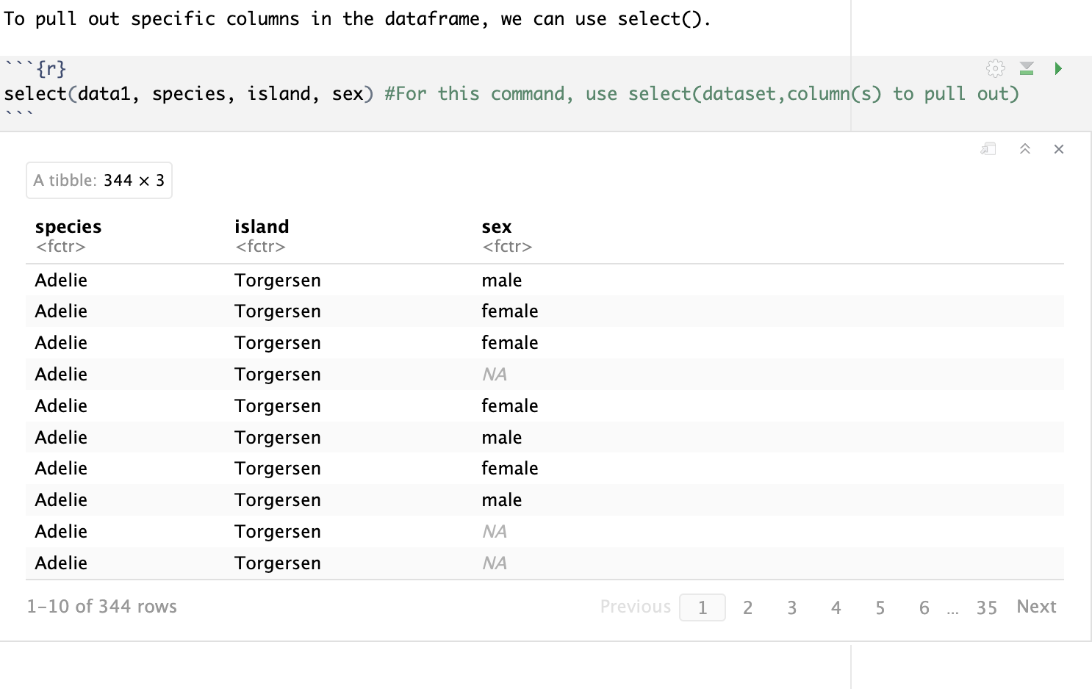

Slide 23
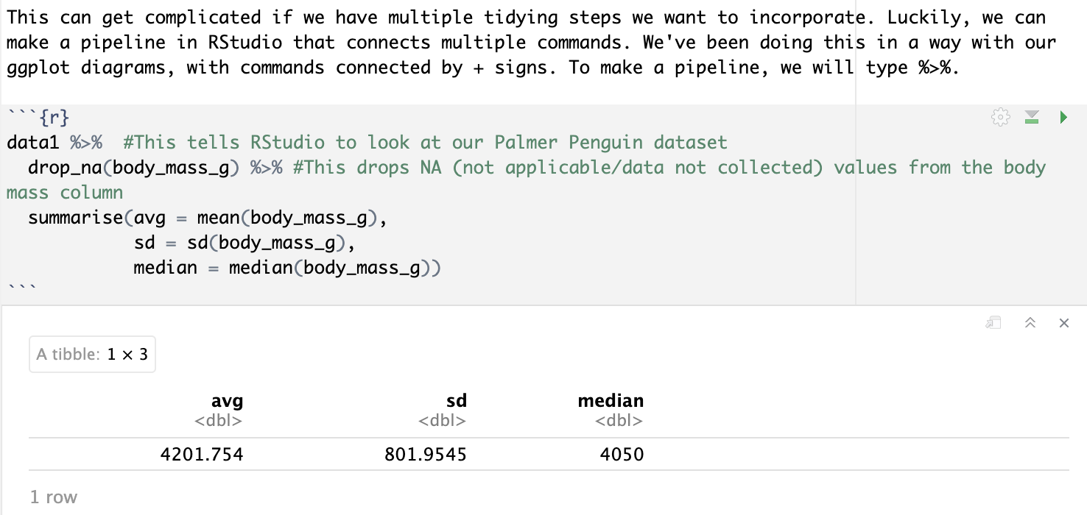

Slide 24
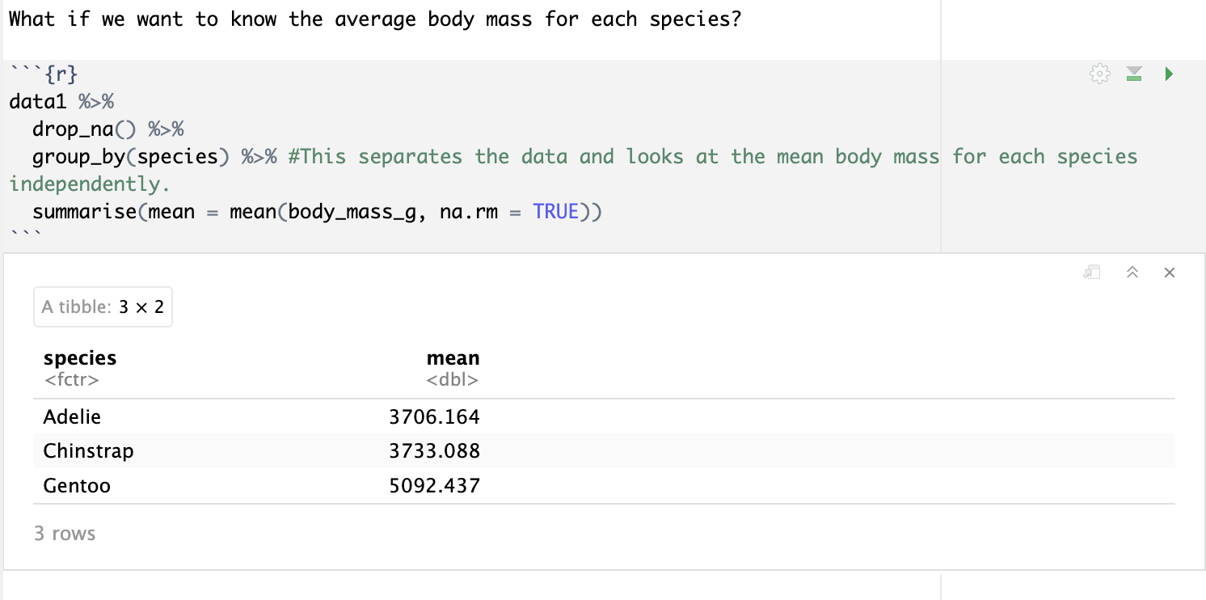

Slide 25
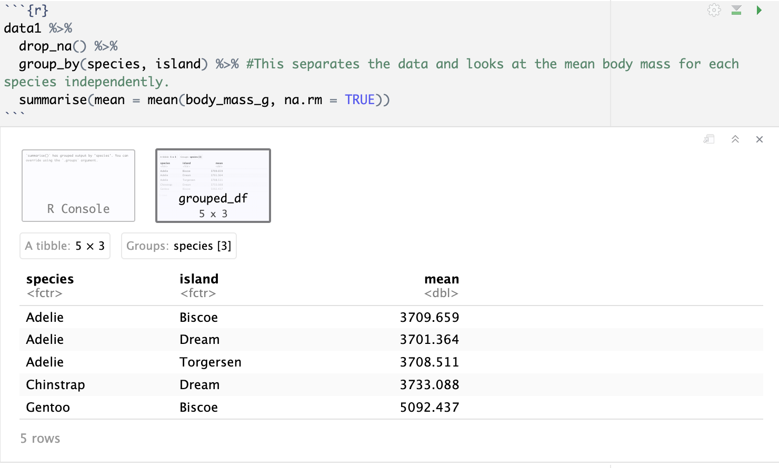

Slide 26
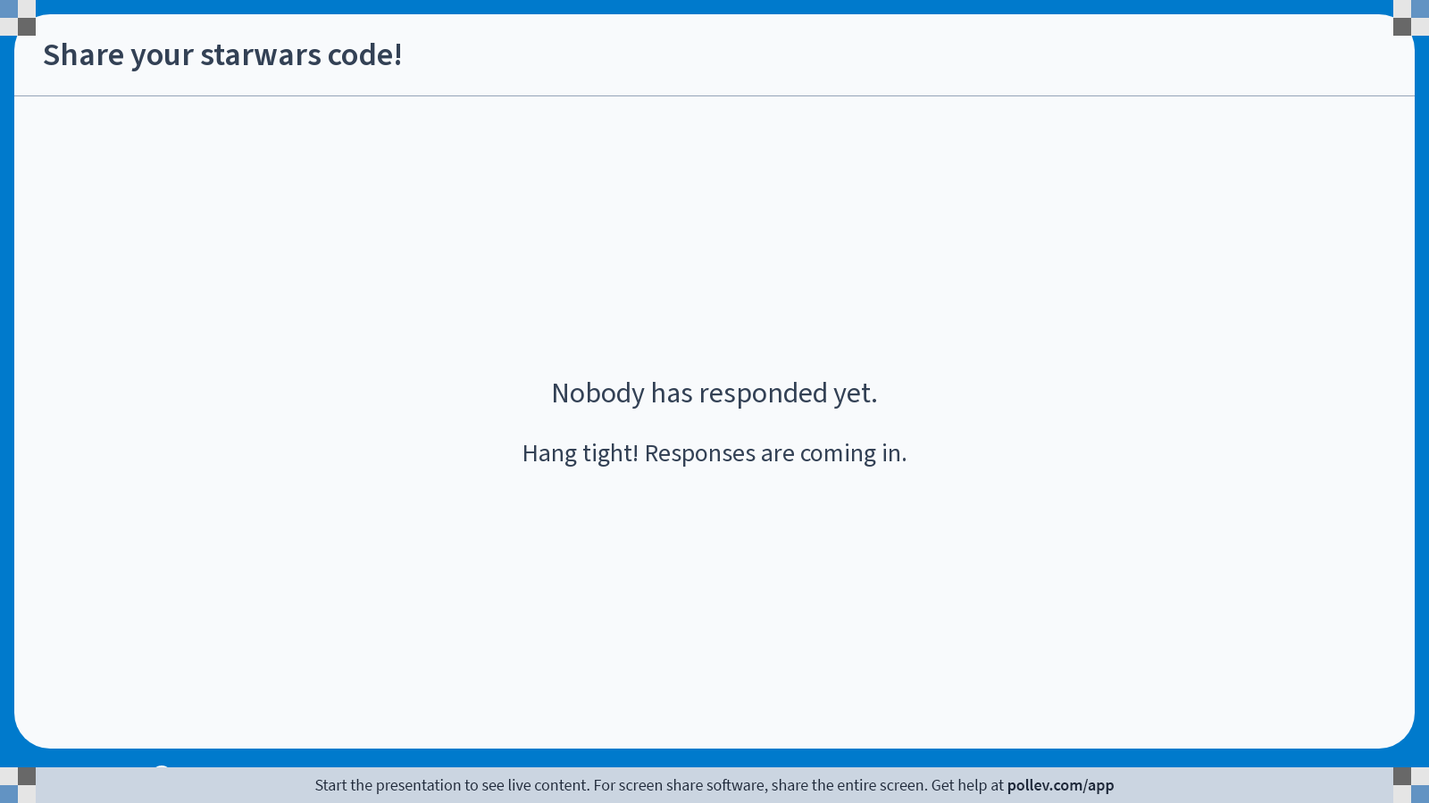
Notes:
Do not modify the notes in this section to avoid tampering with the Poll Everywhere activity. More info at polleverywhere.com/support Share your starwars code!
https://www.polleverywhere.com/free_text_polls/0AVbe8A82Zzs6HDK4kYxD

Slide 27
