Slide 1
Day 4: Null hypothesis and statistical tests

Slide 2
Who has heard of a null hypothesis?

Slide 3
Before you begin your experiment you should have two hypotheses:
Null hypothesis: There is not a significant relationship between the things you are comparing.
Alternative hypothesis: There is a significant relationship between the things you are comparing.

Slide 4
Example
Null hypothesis: There is no relationship between month and temperature.
Alternative hypothesis: Summer months (June, July, August) have higher average temperatures than winter months (December, January, February).

Slide 5
Types of statistical tests you may use
T-test: Compare means of two small sample sets.
Wilcoxon’s signed rank test: Alternative to t-test when data is not normally distributed.
Shapiro-Wilks test: Tests data for normal distribution.
F-test: Compare variances of sample sets.
Fisher’s Exact test: Analyze contingency tables with small sample size.
Chi-squared test: Analyze contingency tables with large sample size.
Pearson’s correlation: Normalized measure of covariance between variables.
ANOVA: Compare means of more than two groups.

Slide 6
These tests will give you a p-value
P-values < 0.05 are usually considered significant, meaning you can reject the null hypothesis, though some may argue p should be less than 0.01 or even 0.001.
What is a p-value?

Slide 7
Breakdown: If we get a significant effect (reject the null hypothesis, see a difference)… and the null hypothesis was actually true… what is the chance that we would see an effect equal to or bigger than what we saw when we ran this test if we run it again?
“If there were actually no effect (if the true difference between means were zero) then the probability of observing a value for the difference equal to, or greater than, that actually observed is called the p-value. In other words the p-value is the chance of seeing a difference at least as big as we have done, if, in fact, there were no real effect.”
Notes:
Colquhoun David. 2017. The reproducibility of research and the misinterpretation of p-values. R. Soc. Open Sci.4171085http://doi.org/10.1098/rsos.171085

Slide 8
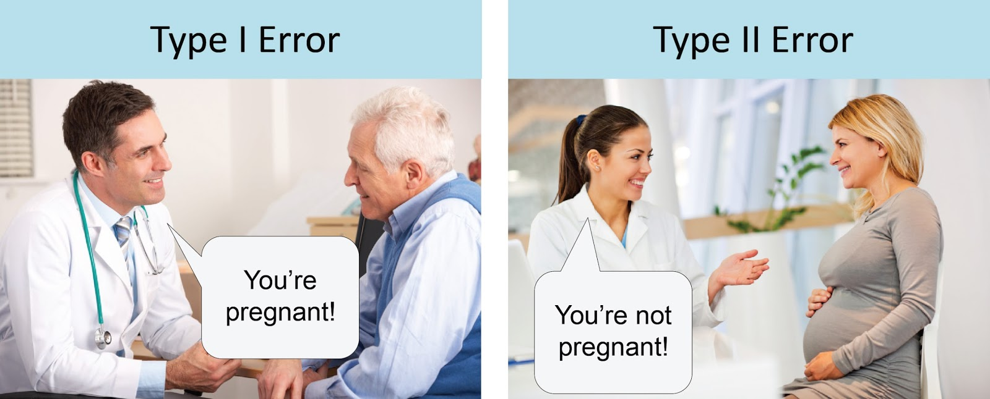
P-values can be complicated….
For one, you may have Type I or Type II errors
Type I: False positive, reject the null when it’s true
Type II: False negative, fail to reject the null when it is false

Slide 9
Today we are going to read papers illustrating data significance interpretation errors
Break out into groups of 4-5 students.
In each group, students will be assigned a different paper (in groups of 5, two students may have the same paper).
Answer the questions for your paper on your own.
Create new groups with people who had the same paper. Share your answers and discuss the paper.
Come back to your original group and explain your paper.

