Slide 1
AI and Machine Learning in the Classroom
Mauricio Codesso
Assistant Teaching Professor of Accounting
Northeastern University | D’Amore-McKim School of Business
m.codesso@northeastern.edu |

Slide 2
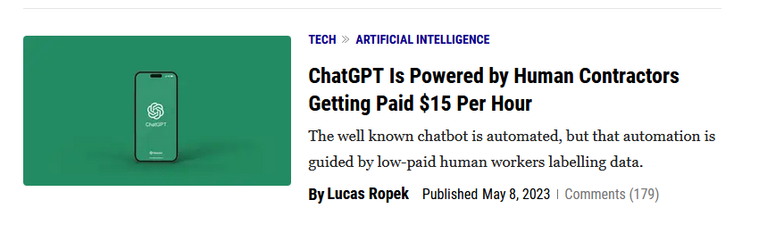
ChatGPT

Slide 3
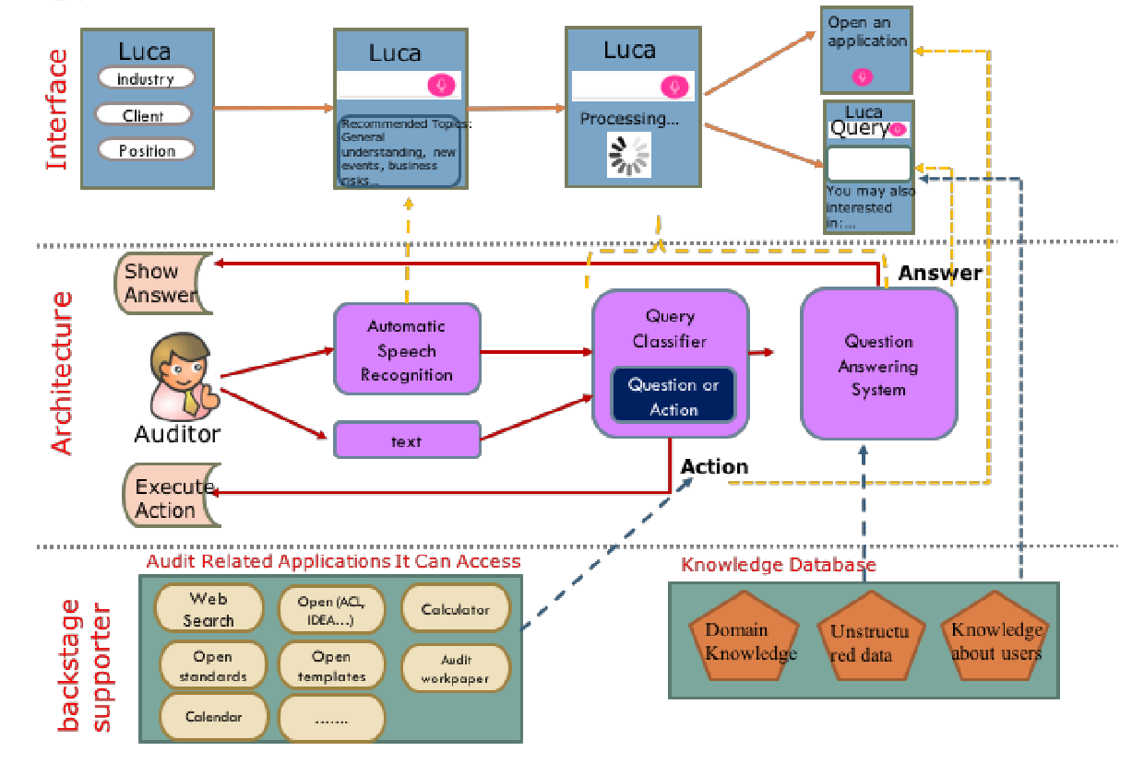
Luca
Li, Q., & Vasarhelyi, M. (2018). Developing a cognitive assistant for the audit plan brainstorming session. The International Journal of Digital Accounting Research, 18(January), 119-140.

Slide 4
Applications of ML
Healthcare
Vision
NLP
Speech recognition
Self-driving cars
Stock market analysis
Recommendations
Sentiment analysis
Human behavior
Quality of life
Business
Sports
Bots / chatbots
Science/engineering
Bioinformatics
Precision medicine
Unsupervised learning
Reinforcement learning

Slide 5
IA & ML Outline
What is machine learning?
The science of teaching machines how to learn.
Design predictive algorithms that learn from data
Replace humans in critical tasks.
Subset of Artificial Intelligence (AI)
Machine learning is very successful in:
Machine translation
Precision medicine
Recommendation systems
Self-driving cars
Why the hype?
Availability: data created/reproduced in 2010 reached 1,200 exabytes
Reduced cost of storage
Computational power (cloud, multi-core CPUs, GPUs)

Slide 6
IA & ML Outline
Introduction
Probability and linear algebra review
Linear regression and regularization
Classification
Linear classifiers: logistic regression, LDA,
Non-linear: k-nn, decision trees, SVM, Naïve Bayes
Ensembles: random forest, boosting
Model selection, regularization, cross-validation
Neural networks and deep learning
Backpropagation, gradient descent
NN architectures (feed-forward, convolutional, recurrent)
Ethics of AI

Slide 7
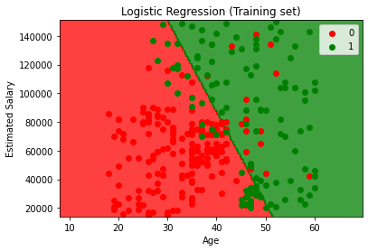
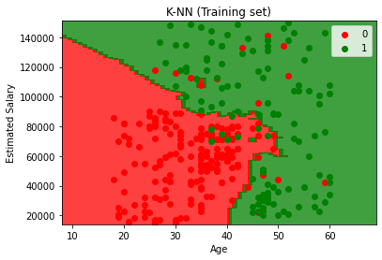
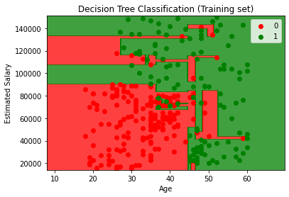
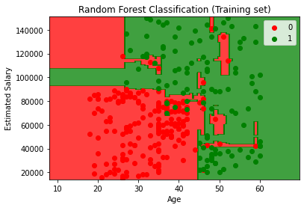
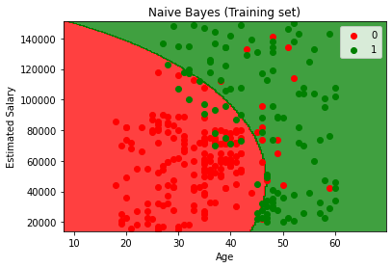
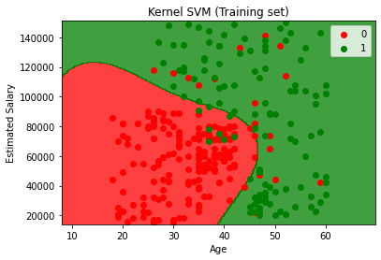
Comparing Different Models

Slide 8

AIS Bootcamp Repository
bit.ly/ais2023
or
github.com/mmcodesso/ais2023/

Slide 9
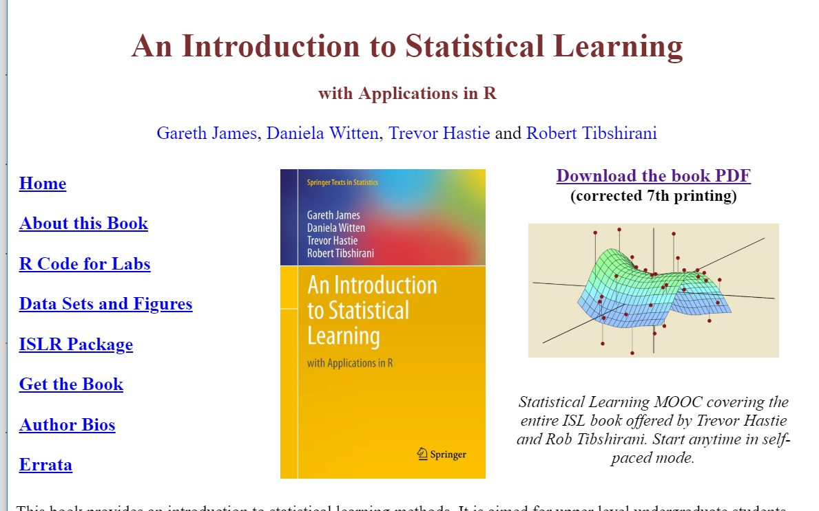
Textbook

Slide 10
Other resources
Trevor Hastie, Rob Tibshirani, and Jerry Friedman, Elements of Statistical Learning, Second Edition, Springer, 2009.
Christopher Bishop. Pattern Recognition and Machine Learning. Springer, 2006.
A. Zhang, Z. Lipton, and A. Smola. Dive into Deep Learning
Lecture notes by Andrew Ng from Stanford

Slide 11
Thank you!
Mauricio Codesso
Assistant Teaching Professor of Accounting
Northeastern University | D’Amore-McKim School of Business
m.codesso@northeastern.edu |

