Slide 1
Internship 2015
IT Mobility Specialist Intern Overview
Matthew Curtis

Slide 2
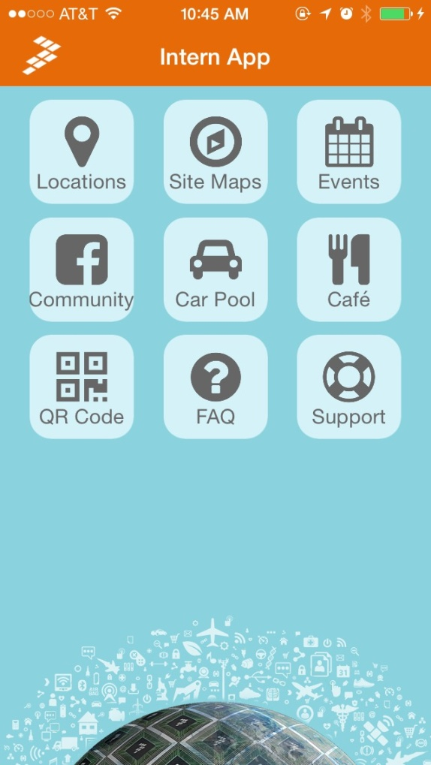
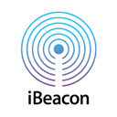

Summer Internship 2015
Learned Swift, XCode, Android Studio, Bash, Java
Became exposed to a multi-developer environment.
Intern App
  iBeacon research
  Eddystone research
  Site maps upgrade

Slide 3
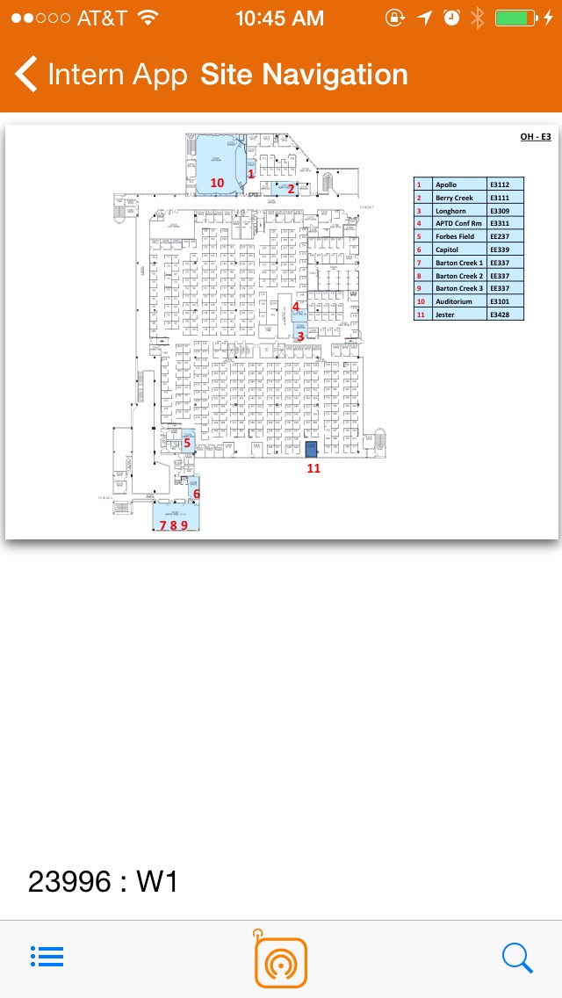
The Intern App
  The Intern App consists of subsections that offer different functionality.
    Site Maps
    Locations
    FAQ
    Café
    Events
    Support
    Community
    QR
    Car pool
  Created to help interns assimilate better and become comfortable with life at Freescale.
  Currently there are ~80 intern downloads out of ~110 interns.

Slide 4
The Intern App
  -App upgrades
    Locations
    Site maps
    Indoor location technology
      iBeacon
      EddyStone™
      Future capabilities
    QR code reader
    UI upgrades
  Future goals
    Deploy Bluetooth low energy beacons to provide indoor navigation.
    Use Intern App as template to create Employee app

Slide 5
Sitemaps
The Site Maps portion includes internal maps for ATMC, CHD, OHT, and Tempe.
Now integrated with iBeacon technology.
Soon to be integrated with Eddystone.
Program details

Slide 6
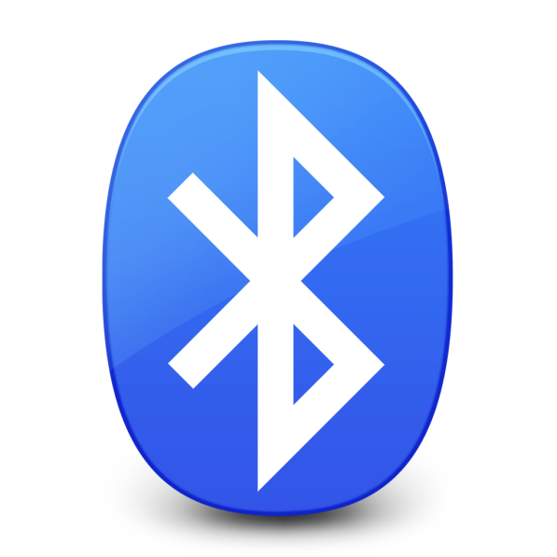
Bluetooth Low Energy
History
  Released in 2006 and given the name Bluetooth ultra-low-power technology in 2007.
  First integrated with smart phones by Apple in 2011.
Stats
  Max range of around 150m
  The ability to set strength.
  The ability to set packets.
  The ability to set data rate.
Program details

Slide 7

iBeacon
History
  Introduced by Apple during the 2013 WWDC.
  Created to be iOS only but there are Android libraries that allow android phones to listen for iBeacons.
What iBeacons do
  iBeacons broadcast a BLE signal
  Transmits UUID, Major and Minor Values
Program details

Slide 8

Eddystone™
History
  Introduced in summer 2015 by Google as their answer to Apple’s iBeacon.
  Open source project fully available in Github.
Beacons with support for Eddystone
  Eddystone’s broadcast a BLE signal
  Transmits Eddystone-UID, Eddystone-URL, and Eddystone-TLM.
  Eddystone-URL contains a URL address.
  Eddystone-TLM contains maintenance data. (Battery level, Beacon temperature …)
Program details

Slide 9

Possible Future Implementation
Indoor navigation with BLE beacons.
  Room to room navigation
  On-map location identifying.
  Searchable conference rooms
  Searchable cubicles
Movement analytics
  Time at location
  Movement around an area
  Flow of customers/visitors
Program details

