Slide 1
Internship 2015
Overview of summer projects

Slide 2

Wellness Incentive – Find Your Fit
Intern App
  Locations
  Site maps

Slide 3

Personalized Results
Onsite screenings – Individual health coaches
Personalized report – Mailed to your home within 3 weeks with easy to understand, actionable results
Summit > My HR > Benefits > Activity Center & Wellness Resources – everything you need to follow up on your results
Program details

Slide 4

Confidentiality – Protecting Your Data
Optum Health (formerly known as Wellness Inc.) provides the two-part wellness screenings and protects your confidential medical information
Freescale will NEVER see individual
results - only aggregate results to assist
in medical plan design
Extensive Legal and IT reviews ensure that personal data remains safe, secure
and confidential
Program details

Slide 5

How much is the 2016 wellness incentive?
Similar to the 2015 amount - $234/year
But, it’s too early to put a price tag on the health care costs for 2016
Complete details will be communicated during Annual Enrollment for 2016 (October 2015)
Program details

Slide 6
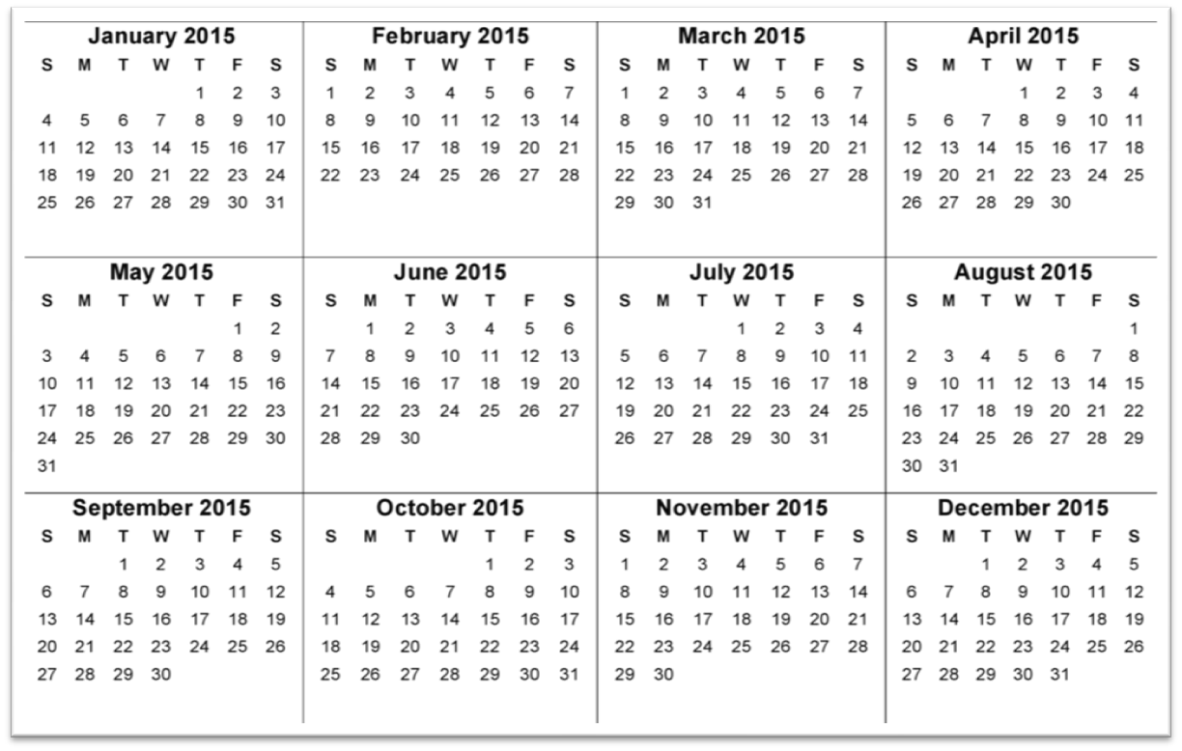






2015 Onsite Screening Schedule
March: AZ, 16-19
TX, 23-27
April: TX & AZ
13-16
May:
San Jose, 12
Detroit, 19
June:
TX, 8-12
AZ, 8-9
July: TX, 6-10
AZ, 8-9
Deadline: August 7th
Healthy snacks provided at all screenings!
Program details

