Slide 1
Robotics Course
به نام خدا
With MohammadReza Gholami

Slide 2
First Session
جلسه اول
آشنایی با رباتیک ، مهارت های لازم ، سرفصل های دوره

Slide 3
01
آشنایی با رباتیک

Slide 4
What is Robotics?
Electronics
Computer
Robotics
Mechanics

Slide 5
Why we make robots?

Slide 6
01
Electronics

Slide 7
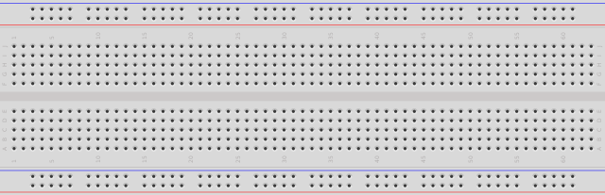
Bread Board

Slide 8

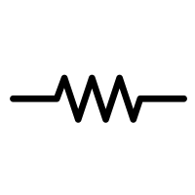
Resistor

Slide 9
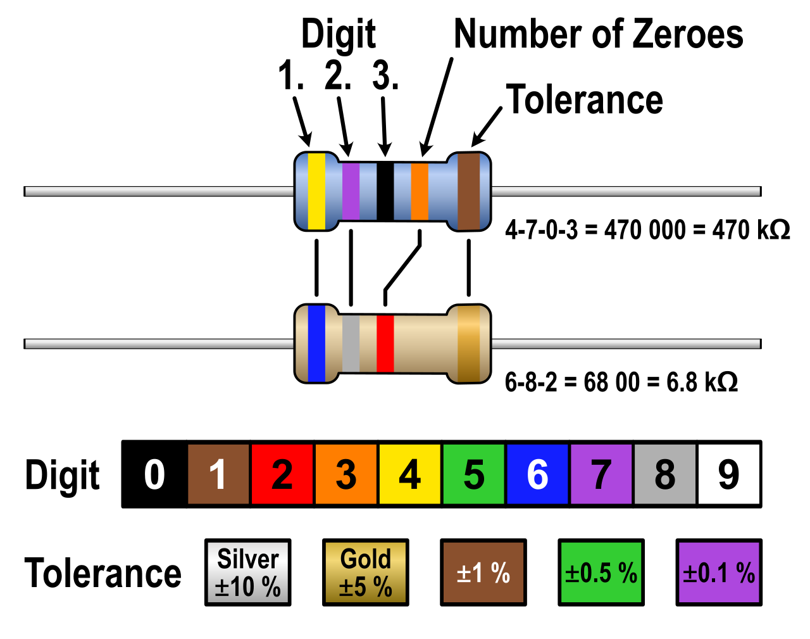

Slide 10
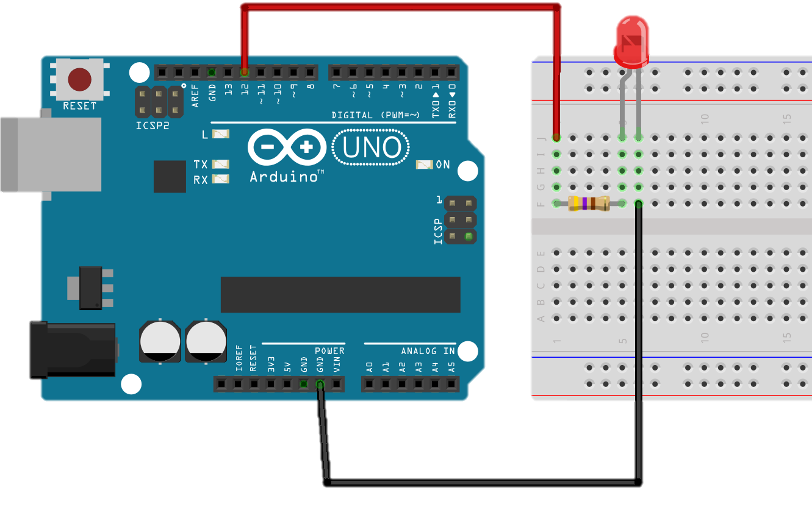
LED (Light-emitting diode)

Slide 11
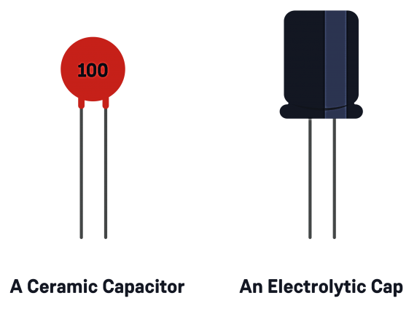
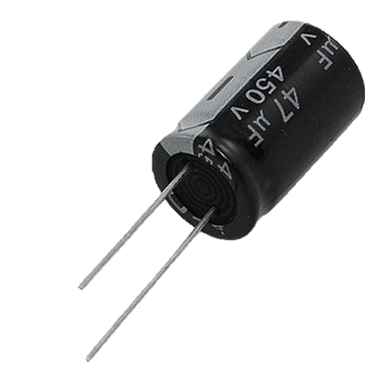
Capacitor

Slide 12
02
Control

Slide 13
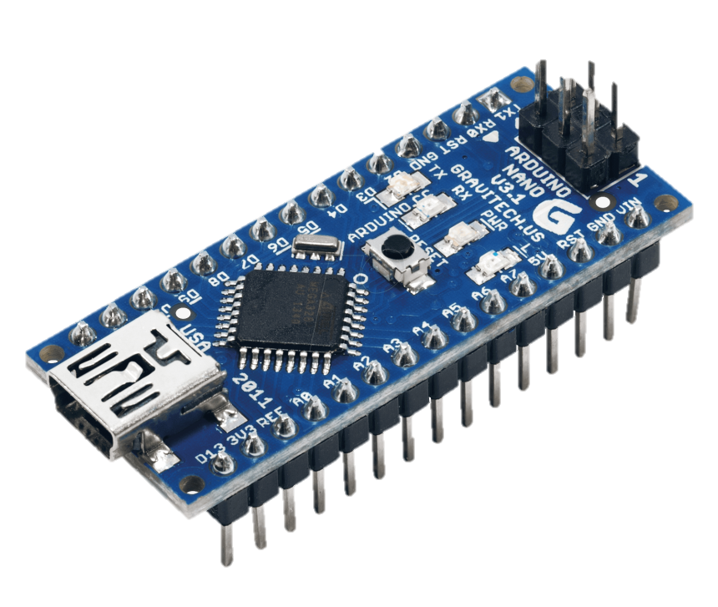
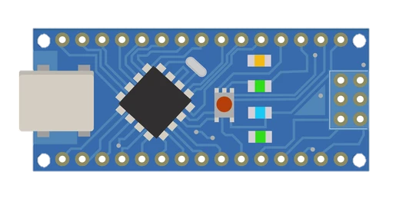
Arduino (Nano)

Slide 14

THANKS
Do you have any questions?
mmd.gh313@gmail.com
09939996370
https://github.com/mmd00Z

