Slide 1
Robotics Course
به نام خدا
With MohammadReza Gholami

Slide 2
3rd Session
جلسه سوم
ارتباط سریال، ارتباط سریال با پروتکل UART، سریال مانیتور و ارتباط کامپیتور با آردوینو، متد های کلاس سریال

Slide 3
03
Serial

Slide 4
ارتباط سریال

Slide 5
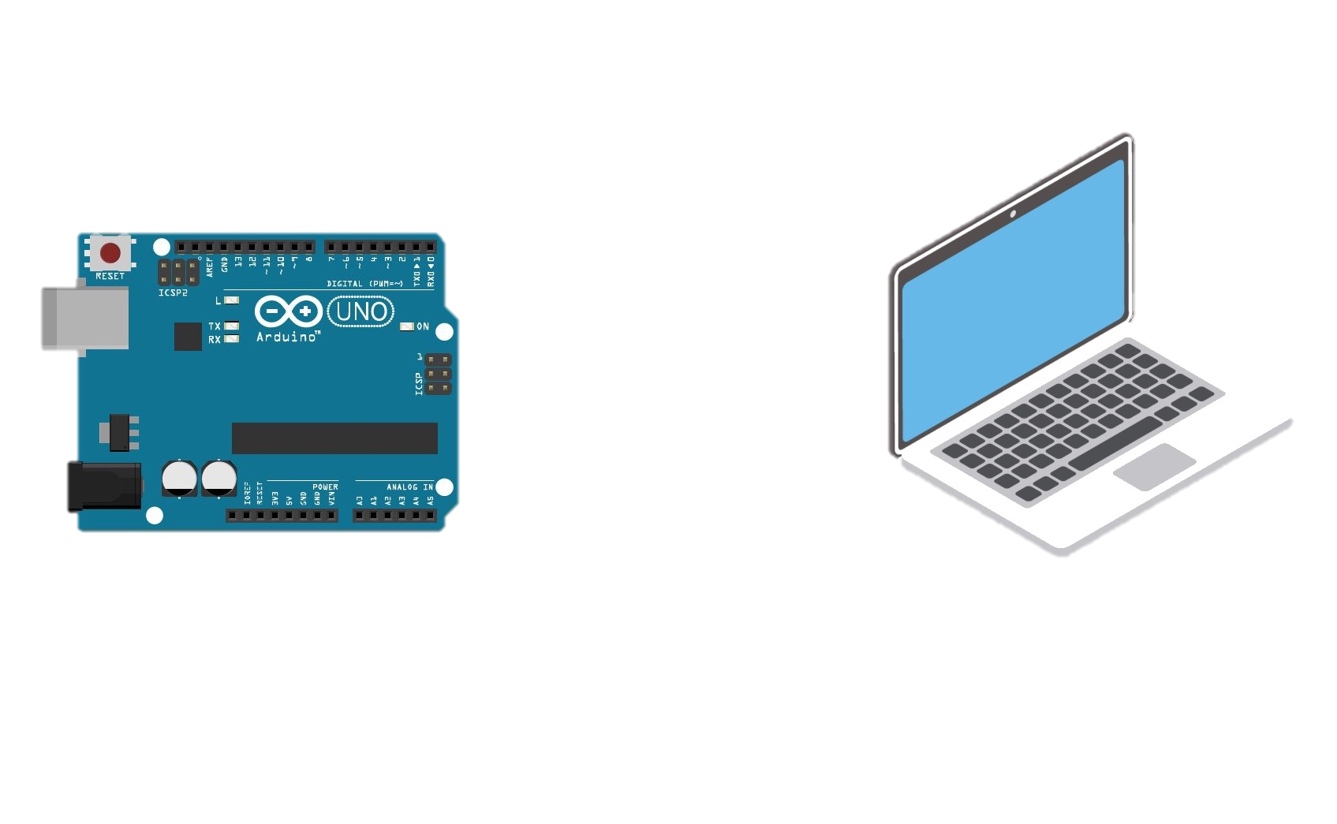
Serial
[Communication]
Description
Used for communication between the Arduino board and a computer or other devices. All Arduino boards have at least one serial port (also known as a UART or USART), and some have several.
Serial

Slide 6
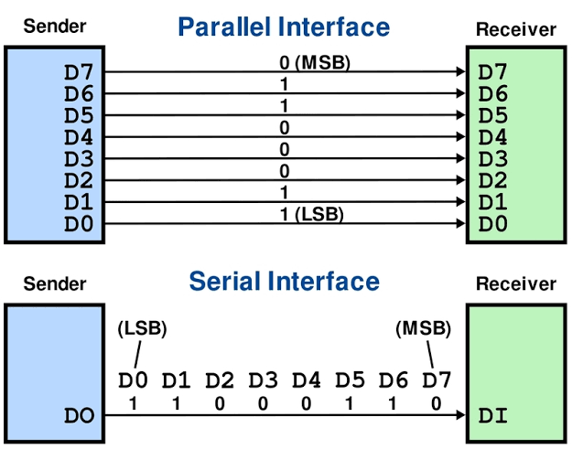

Slide 7
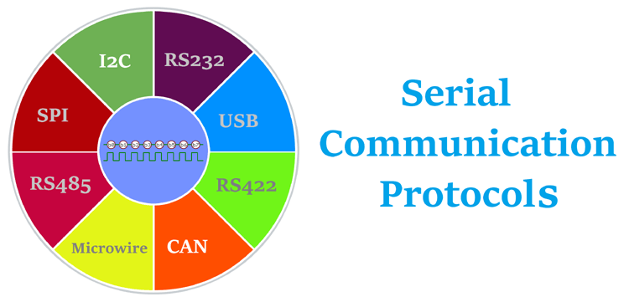

Slide 8
On Uno, Nano, Mini, and Mega, pins 0 and 1 are used for communication with the computer. Connecting anything to these pins can interfere with that communication, including causing failed uploads to the board.
You can use the Arduino environment’s built-in serial monitor to communicate with an Arduino board. Click the serial monitor button in the toolbar and select the same baud rate used in the call to begin().
Serial communication on pins TX/RX uses TTL logic levels (5V or 3.3V depending on the board). Don’t connect these pins directly to an RS232 serial port; they operate at +/- 12V and can damage your Arduino board.
To use these extra serial ports to communicate with your personal computer, you will need an additional USB-to-serial adaptor, as they are not connected to the Mega’s USB-to-serial adaptor. To use them to communicate with an external TTL serial device, connect the TX pin to your device’s RX pin, the RX to your device’s TX pin, and the ground of your Mega to your device’s ground.

Slide 9
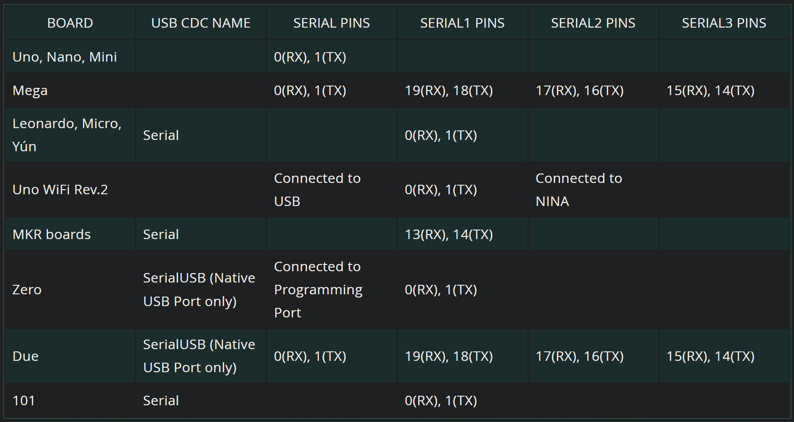

Slide 10
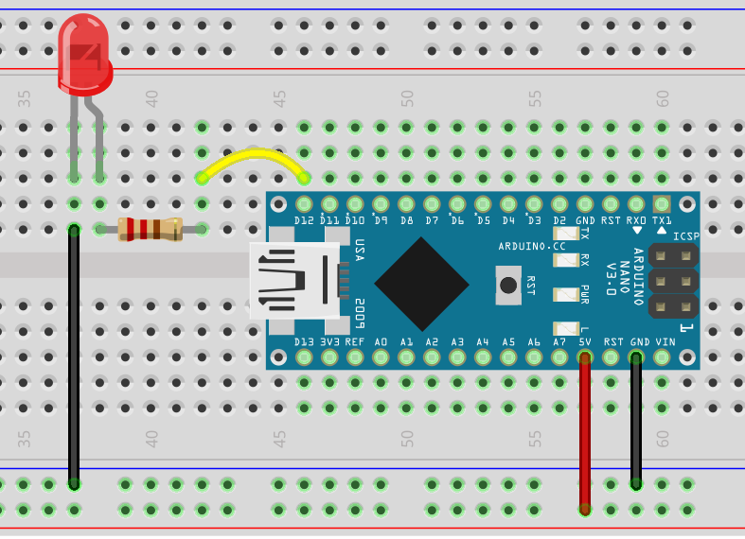
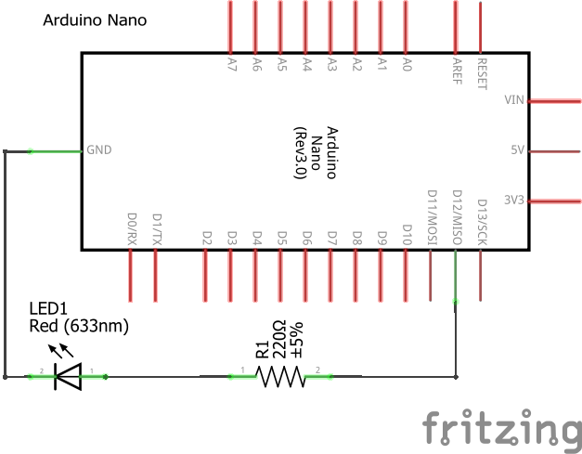

Slide 11
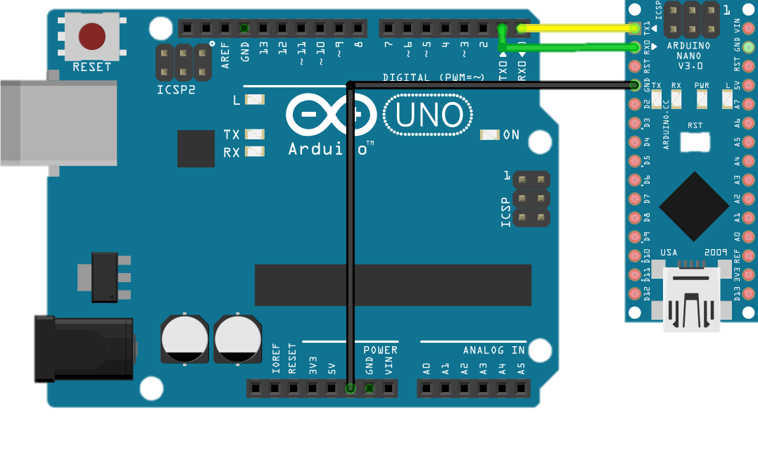

Slide 12
Serial Methods & References
Arduino Language Reference
Serial
Serial.begin()
if(Serial)
Serial.available()
Serial.write()
Serial.print()
Serial.println()
Serial.read()
Serial.readString()
Serial.parseInt()
Stream
ASCII Table

Slide 13

THANKS
Do you have any questions?
E-Mail me
09939996370
https://github.com/mmd00Z

