Slide 1
به نام خدا
تکنولوژی BLE و کاربردهای آن
Polwinno
سیدمحمدحسین حسینی
ارائه دهنده:

Slide 2
Contents
How BLE works
BLE layers
ibeacons

Slide 3
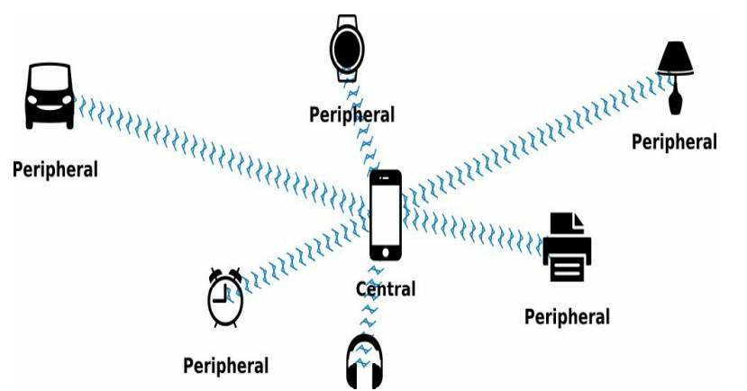
What is BLE?
How BLE Works
Bluetooth Low Energy (BLE) Digital Radio Protocol
Power consumption:
BLE 2 mw
wifi 80 mw
4G/LTE 1000 mw
Central and Peripheral
Hub-and-spoke

Slide 4
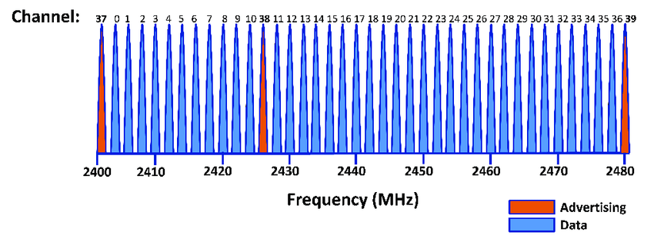
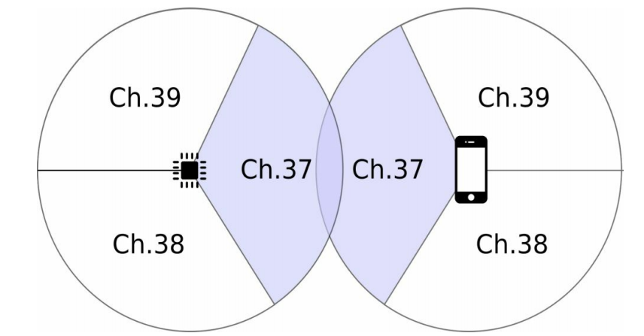
Advertising
Peripheral sends advertising packets
Scanning
central scans for advertising packets
Different Advertising and Scanning speed!
frequency hopping
Always start with Advertising

Slide 5
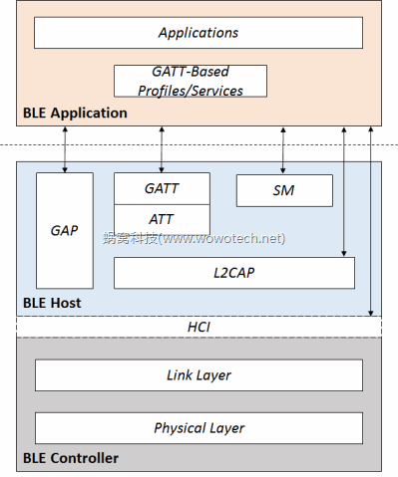
BLE Layers

Slide 6
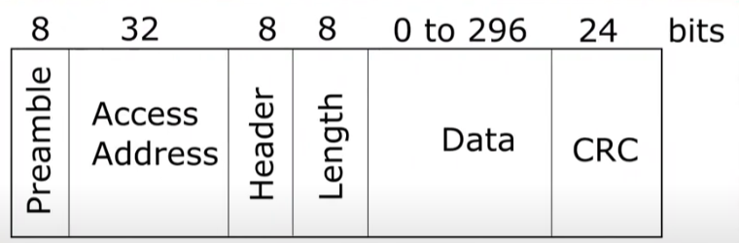
1- Controller Layer
Physical layer
40 channels 37 data 3 advertising
Longest possible packet 376 us 376 bit/s
Required sensitivity -70 dbm
Maximum transmit power 10 dbm (support 15 meters)
Link layer
Packets

Slide 7
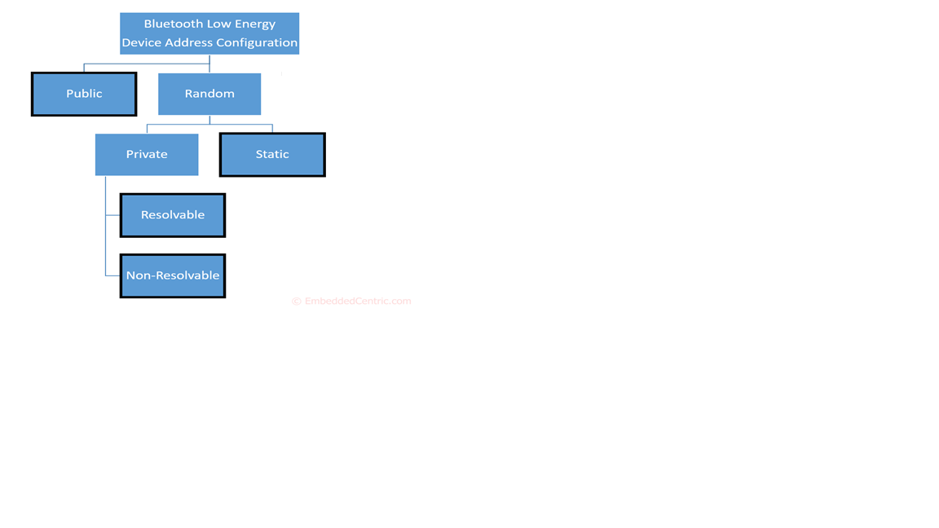
BLE Address types
Host Controller Interface (HCI)
receives back events to Host
Exchange Data
Sends commands to Controller
Channels (to start connection)
Packet formats ( Commands, Events, Data)
Flow controller

Slide 8
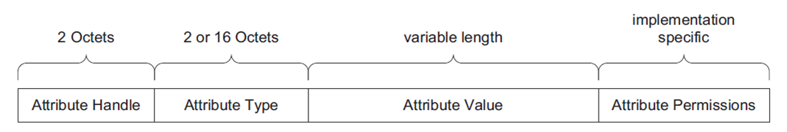
2- Host
Logical Link and Adaption Protocol (L2CAP)
Multiplexing layer (Three Channels) for different protocols
Attribute Protocol
Signaling channel
Security manager
Segmentation and Reassembling
Attribute Protocol
Attribute:

Slide 9
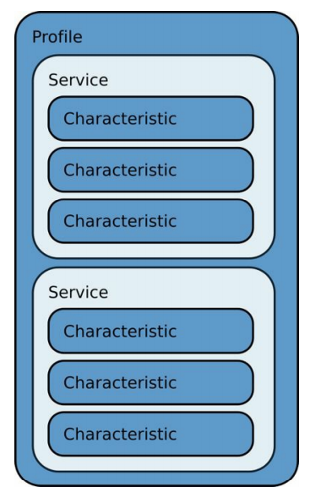
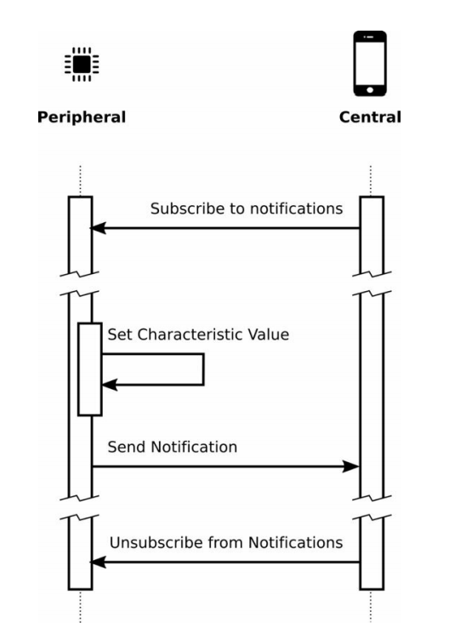
Attribute type:
Specifies with 128 bit Universally Unique Identifier (UUID)
Profile UUID
Service UUID
Characteristic UUID
Attribute permissions:
Read/Write/notify Operations
Encryption/Authorization
Generic Attribute Profile (GATT)
notify

Slide 10

Heart Rate Characteristics
Heart Rate Measurement Value
Body Sensor Location
Heart Rate Control Point
Generic Access Profile (GAP)
Heart Rate Service
Broadcaster
Observer
Peripheral
central
Security
Advance Encryption Standard (AES 128 bit)
Temporary Key
Short-term Key
Long Term Key
Identity Resolving Key
Connection signature Key

Slide 11
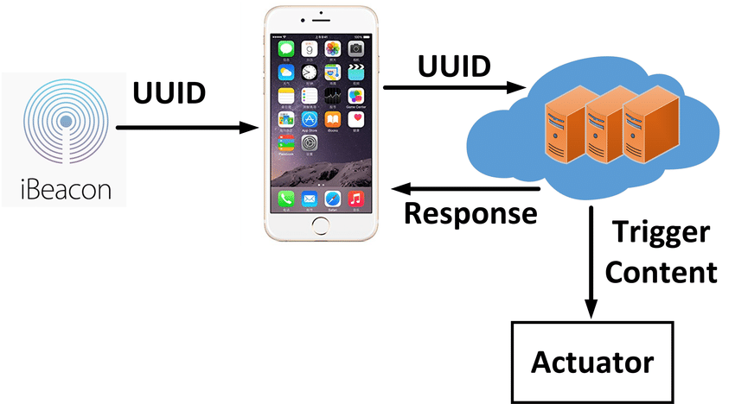
3- Application
Identify Project Objectives
Map Replacement
Transit Assistance
Indoor Direction Finding
Where is my car?
Museum Guides
Retail Store
Ticket Validation
Restaurant Table Pager
Application triggered by beacons :

Slide 12
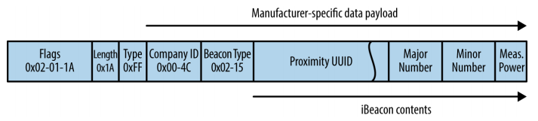
iBeacons
What is iBeacon?
a Bluetooth Low Energy proximity beacon
Apple
high-precision location information
iBeacon Protocol
advertising packet
Proximity UUID (16 bytes)
Major (2 bytes)
Minor (2 bytes)
Measured Power (1 byte)

Slide 13
ممنون از توجهتان!

