Slide 1
Three Kinds of Google Mashups – And More
Introduction
Mike Dolbow, Applications Unit Supervisor
MN Department of Agriculture

Slide 2
Introductions
Name
Organization
Experience with HTML/JS code?
Beginner
Intermediate
Advanced

Slide 3
Disclaimers
I am not a web designer
<html>the bare minimum</html>
<style type=“text/css”>the bare minimum</style>
I am not a Javascript expert
I am not a Google Maps API expert
More training is available for all of these!
Notes:
I am not a lawyer
However…I still want to share.

Slide 4
Why Google Maps?
Because your customer asked you for it:
All they need is a browser
They know how to interact with it
Peerless cartography & geocoding
Speed
Free (usually)
“don’t do plugin-based web development unless you bloody well have to.”
-- Tobin Bradley, Fuzzy Tolerance Blog
Notes:
You can even use an iPad – no plugins necessary!

Slide 5
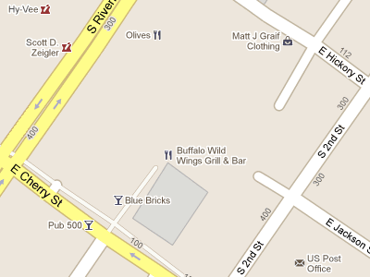
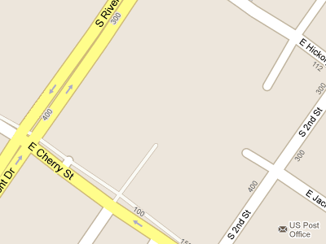

Know what you’re getting into
Sites must be publicly accessible
You need an API key to deploy
The default API is a moving target
Your site will never be as awesome as theirs
maps.google.com
your mashup (until v 3.6)
Notes:
Can’t separate functions from the map (exception: street view)
You might have to deal with ads, although I haven’t seen any yet
In v2 you needed an API key. In v3 at first you didn’t, and now you do. But you don’t need one to develop, only to deploy.
Moving Target: Versions (see below notes from Google)
As long as you’re doing basic stuff, you won’t have to worry too much about the versions, but you’ll want to subscribe to the Google Geo Developers Blog so you’ll know about releases.
They reserve the right to serve you up different tiles than they serve on their site. Right now (5/2013), it’s pretty consistent – but it doesn’t have to be.
*Changes to versioning* Previously, if you requested the API without the v parameter, or using v=3, you would receive the experimental version. Nowadays you will receive the release version. If your application requires features in the experimental version, just specify the version (e.g. v=3.10). Note that this will freeze your application to 3.10 (unless there is a newer “frozen” version). If you don’t currently request a specific version and you’d like to continue living on the bleeding edge, request the API with v=3.exp. This will always return the latest experimental version. *Reference documentation* The link to reference documentation now also defaults to the release version. If you’re working with the experimental version, please view the documentation here: https://developers.google.com/maps/documentation/javascript/3.exp/reference *Production applications* We previously recommended production applications specify a minor version (e.g. 3.5, 3.6). As the release version is now the default, this advice does not strictly necessary. If your application relies on new functionality in an experimental version, it’s still best practice to specify a minor version (such as v=3.10). You should avoid using v=3.exp in sensitive production applications.

Slide 6
Course Structure
Lecture 1: Static Locations
Exercise 1
Lecture 2: KML Overlays
Exercise 2
Lecture 3: ArcGIS Server Overlays
Exercise 3
Notes:
Make handout with specific times

