Slide 1
Lesson 1
Static Locations, Dynamic Content

Slide 2
Basic HTML page layout
<html>
</html>
Notes:
You’ll find more than this in the typical HTML page but this is how everything really starts.

Slide 3
Basic HTML page layout
<html>
<head>
</head>
<body onload="initialize()">
</body>
</html>
Notes:
You add a “header” section where you’re going to put a lot of stuff, like scripts. And you add the “body”, which is where all the stuff that is seen on screen goes. At the top of the body we ask the initialize Javascript function to fire after the body loads. Google recommends a slightly different approach now but this still works.

Slide 4
Basic HTML page layout
<html>
<head>
<script type="text/javascript”
src="http://maps.googleapis.com/maps..."></script>
<script type="text/javascript">
//all your functions here
</script>
</head>
<body onload="initialize()">
</body>
</html>
Notes:
Inside the header we put the bootstrap to the Google Maps API and our own script.

Slide 5
Basic HTML page layout
<html>
<head>…
</head>
<body onload="initialize()">
<div id="map_canvas" style=“height:80%…"></div>
<div id="details" style="width:100%"></div>
</body>
</html>
Notes:
In the body we just have two “divs”, a map_canvas and details where we’ll put everything else we might want.

Slide 6
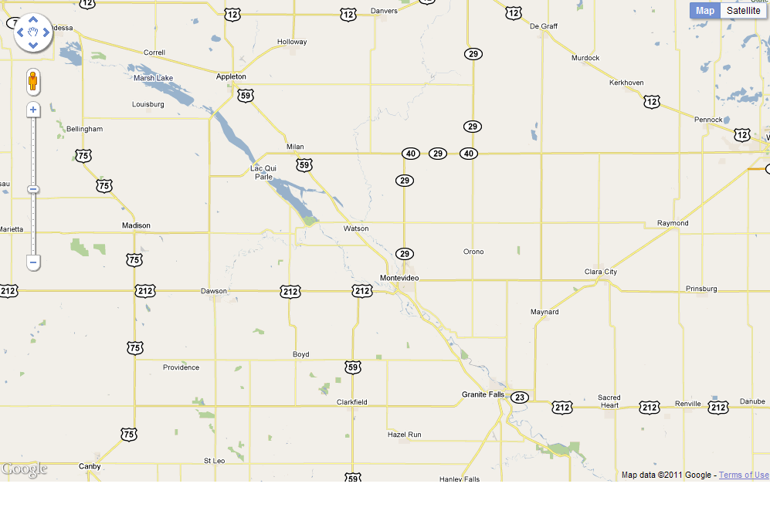
Basic HTML page layout
map_canvas
details

Slide 7
Javascript functions
function name(variables) {
var name = ‘some text’;
var options = {
option1: 10,
option2: latlng,
};
var map = map definition;
}
IMPORTANT!
Notes:
The curly braces are important! If I say “inside the function”, you have to be inside the braces. And it’s the converse if I say “before the function” or “after the function” – go OUTSIDE the braces in those cases.

Slide 8
Map Options
function initialize() {
var latlng = new google.maps.LatLng(45.00,-95.75);
var myOptions = {
zoom: 10,
center: latlng,
mapTypeId: google.maps.MapTypeId.ROADMAP
};
map = new google.maps.Map(document.getElementById("map_canvas"),myOptions);
}
Notes:
Here we show the very simple creation of a map, including the center point, the zoom level, and the type. You can get the “old” type choices if you really want but the latest have been very easy to work with.

Slide 9

Marker Overlays
function initialize() {
var marker = new google.maps.Marker({
position:<put latlng here>,
map: map
});
}
Notes:
This function places a marker on the map

Slide 10
InfoWindows
var infowindow = new
google.maps.InfoWindow({
position: marker.getPosition(),
content: myHtml
});
google.maps.event.addListener
(marker, 'click', function() { infowindow.open(map,marker);
});
Notes:
This shows a new variable and a new listener on a marker

Slide 11
HTML in InfoWindows
var contentString = '<div id="content">'+
'<h1 id="firstHeading" class="firstHeading">Awesomeness</h1>'+
'<div id="bodyContent">'+
'<p><b>Awesomeness</b>, also referred to as <b>Coolness</b>, is a solely ' +
'determined by the number of people you know who go by the name "Chuck". '+
'This can never be disputed.</p>'+
'</div>'+
'</div>';
Notes:
Here’s a whole bunch of HTML converted to Javascript

Slide 12
Stream Gage Markers – Base Vars
var imgHeight = 300;
var imgWidth = 500;
var today = new Date();
var weekAgo = new Date();
var yesterday = new Date();
weekAgo.setDate(weekAgo.getDate()-7);
yesterday.setDate(yesterday.getDate()-1);
var gEndFullDate = yesterday.getFullYear() + "-" + (yesterday.getMonth()+1) + "-" + yesterday.getDate();
var gStartFullDate = weekAgo.getFullYear() + "-" + (weekAgo.getMonth()+1) + "-" + weekAgo.getDate();
var baseGraphURL = ["http://maps1.dnr.state.mn.us/cgi-bin/csg/hydrograph_cgi.py?var1=232&show_legend=1&show_grid=1&site="];
var tailGraphURL = ["&start="+gStartFullDate+"&end="+gEndFullDate];
Notes:
Here’s a whole bunch of base variables you’re going to see in the first lesson

Slide 13
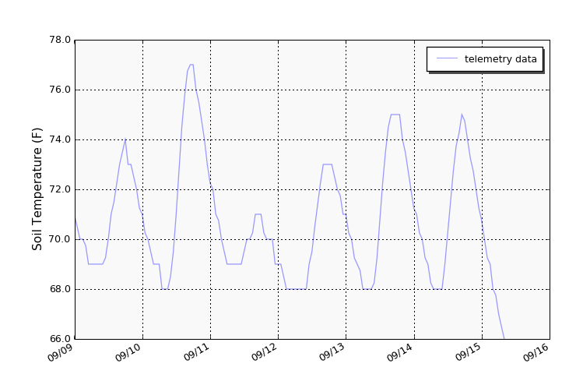
Stream Gage Markers – HTML
var myHtml = "<img src=\""+
baseGraphURL + ID + tailGraphURL +
"&height="+
imgHeight+
"&width="+
imgWidth+
"\" height=\""+
imgHeight+
"\" width=\""+
imgWidth+"\">";
Notes:
Put them all together into an HTML like this, and you’ll get a cool graph attached to your marker

Slide 14
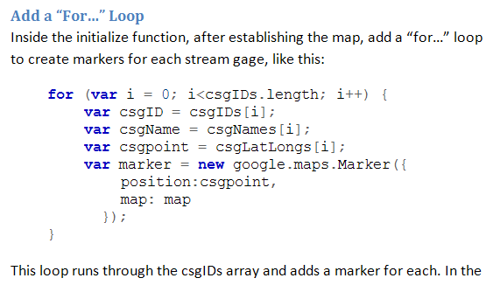
Exercise Instructions
Instructions
Code
WATCH OUT FOR LINE & PAGE BREAKS!
Notes:
When you are copying and pasting data from the Word docs, keep your eye out for line and page breaks. If too many get embedded in the code, you’re hosed.

Slide 15
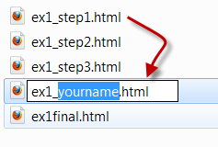
Training Data
Ex1 folder:
A “final” html: our goal
(w/ extra)
A“step1” html: copy & paste then rename as your own
Subsequent “step” htmls: use ONLY to re-set within exercise if there are problems
Notes:
This is how we step through the exercise.

Slide 16
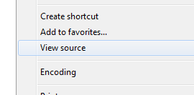
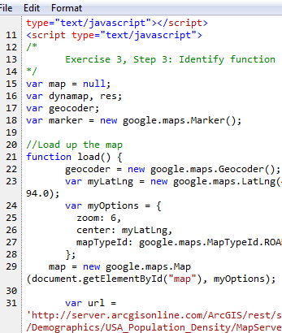
Navigating the Exercises
Each Exercise has 3 steps
Open files in Notepad, etc
After each step, Save
Preview in the browser
Right-click “Open with”…
Firefox is less picky with security
IE has better “View Source”

Slide 17
Stream Gage Data (Ex1, Step 2)
http://www.dnr.state.mn.us/waters/csg/index.html
Click map to find more details:
ID
Name/Description
Lat/Long in CSV file (find by ID)
Notes:
Use this web page to find the stream gage(s) you might be interested in

