Slide 1
Lesson 2
KML Overlays

Slide 2
KML: An open standard
Official OGC standard in 2008
Over a billion KML files on the web
Always WGS84
http://code.google.com/apis/kml/
Notes:
The KML API is separate from the Maps API. But understanding KML helps you know what you can – and can’t – do with it.

Slide 3
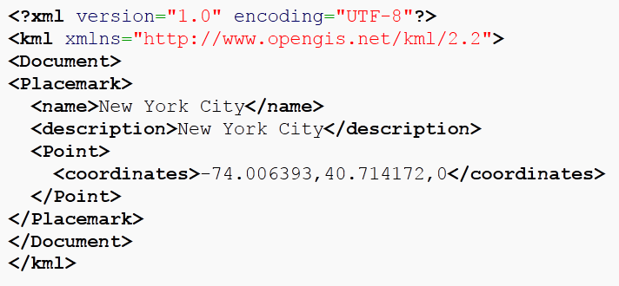
Example KML

Slide 4

Sweet Stuff inside good KMLs
Metadata: kml.getMetadata():
.name
.author
.description
.snippet
Image for TOC, for example: http://maps.google.com/mapfiles/kml/shapes/motorcycling.png
Notes:
Bring the KML into Google Earth or notepad to see the deep-linked image URL, and either re-use or download.

Slide 5
Compatibility with G Maps
Left-hand panel
Refresh
Links
Projection of polygons
Encoding requirements
Source:
https://developers.google.com/kml/documentation/kmlelementsinmaps

Slide 6
Limitations in Maps
“Fetched” File size: 3 MB (but you can use a KMZ)
“Uncompressed” file size: 10MB
Number of features: 1,000
Network links: 10
Total layers: 10-20
Number of vertices (polys and lines): ??
Source: https://developers.google.com/kml/documentation/mapsSupport
Notes:
Translation: Google Maps is a frying pan. It’s fast, it’s hot, and you can cook a lot of stuff on it. But you can’t cook a turkey.

Slide 7
KmlLayer object
new google.maps.KmlLayer
('http://linktomyKML.kml');
You must have a file hosted on a web server! (But it can be anyone’s)
Notes:
Assign this to a variable

Slide 8

setMap(map)
kmlLayer = new goo…
kmlLayer.setMap(map);
To remove:
kmlLayer.setMap(null);

Slide 9
Arrays are your friend
var arrayName = [];
arrayName[0] = variable definition…;
arrayName[1] = variable definition…; arrayName[2] = variable definition…;

Slide 10
Arrays are your friend
var kmlOverlays = [];
kmlOverlays[0] = new google.maps.KmlLayer(…
kmlOverlays[1] = new google.maps.KmlLayer(…
kmlOverlays[2] = new google.maps.KmlLayer(…
var kmlToggleStates = [];
kmlToggleStates[0] = true;

Slide 11
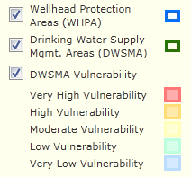
Set up a TOC/Legend
function toggLegend(index) {
if (kmlToggleStates[index]) {
kmlToggleStates[index]=false;
} else {
kmlToggleStates[index]=true;
}
loadKML();
}

Slide 12
loadKML function for legend
function loadKML() {
var i;
for (i = 0; i < kmlOverlays.length; i++) {
kmlOverlays[i].setMap(null);
}
for (i = 0; i < kmlOverlays.length; i++) {
if (kmlToggleStates[i]) {
kmlOverlays[i].setMap(map);
}
}
}
Notes:
There is probably a more graceful way to accomplish this with javascript. But we have to remove all of the overlays first, then add them back in order, if users are going to get what they expect when interacting with the TOC.

Slide 13
HTML for TOC/legend
<table id="tblTOC" width="150px">
<tr>
<td><input type="checkbox" id="chk2" checked="checked“ onclick="toggLegend(2);"></td>
<td>KML Name 2<td>
<td><img id="leg2" src=http://gis.mda.state.mn.us/images/iconHelp.gif alt="Legend 2"></td>
</tr>

Slide 14
Exercise
Similar to before
Some KMLs can be slow to load – be patient!
Go easy on the checkbox toggling!

