Slide 1
Lesson 1
Static Locations, Dynamic Content

Slide 2
Basic HTML page layout
<html>
</html>

Slide 3
Basic HTML page layout
<html>
<head>
</head>
<body onload="initialize()">
</body>
</html>

Slide 4
Basic HTML page layout
<html>
<head>
<script type="text/javascript”
src="http://maps.googleapis.com/maps..."></script>
<script type="text/javascript">
//all your functions here
</script>
</head>
<body onload="initialize()">
</body>
</html>

Slide 5
Basic HTML page layout
<html>
<head>…
</head>
<body onload="initialize()">
<div id="map_canvas" style=“height:80%…"></div>
<div id="details" style="width:100%"></div>
</body>
</html>

Slide 6
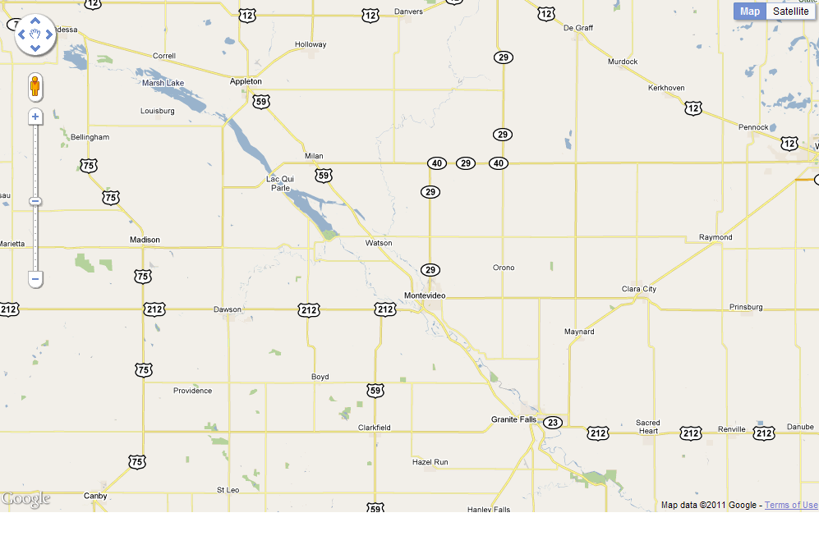
Basic HTML page layout
map_canvas
details

Slide 7
Javascript functions
function name(variables) {
var name = ‘some text’;
var options = {
option1: 10,
option2: latlng,
};
var map = map definition;
}
IMPORTANT!
Notes:
The curly braces are important! If I say “inside the function”, you have to be inside the braces. Same for if I say “before the function” or “after the function”.

Slide 8
Map Options
function initialize() {
var latlng = new google.maps.LatLng(45.00,-95.75);
var myOptions = {
zoom: 10,
center: latlng,
mapTypeId: google.maps.MapTypeId.ROADMAP
};
map = new google.maps.Map(document.getElementById("map_canvas"),myOptions);
}

Slide 9

Marker Overlays
function initialize() {
var marker = new google.maps.Marker({
position:<put latlng here>,
map: map
});
}

Slide 10
InfoWindows
var infowindow = new
google.maps.InfoWindow({
position: marker.getPosition(),
content: myHtml
});
google.maps.event.addListener
(marker, 'click', function() { infowindow.open(map,marker);
});

Slide 11
HTML in InfoWindows
var contentString = '<div id="content">'+
'<h1 id="firstHeading" class="firstHeading">Awesomeness</h1>'+
'<div id="bodyContent">'+
'<p><b>Awesomeness</b>, also referred to as <b>Coolness</b>, is a solely ' +
'determined by the number of people you know who go by the name "Chuck". '+
'This can never be disputed.</p>'+
'</div>'+
'</div>';

Slide 12
Stream Gage Markers – Base Vars
var imgHeight = 300;
var imgWidth = 500;
var today = new Date();
var weekAgo = new Date();
var yesterday = new Date();
weekAgo.setDate(weekAgo.getDate()-7);
yesterday.setDate(yesterday.getDate()-1);
var gEndFullDate = yesterday.getFullYear() + "-" + (yesterday.getMonth()+1) + "-" + yesterday.getDate();
var gStartFullDate = weekAgo.getFullYear() + "-" + (weekAgo.getMonth()+1) + "-" + weekAgo.getDate();
var baseGraphURL = ["http://maps1.dnr.state.mn.us/cgi-bin/csg/hydrograph_cgi.py?var1=232&show_legend=1&show_grid=1&site="];
var tailGraphURL = ["&start="+gStartFullDate+"&end="+gEndFullDate];

Slide 13
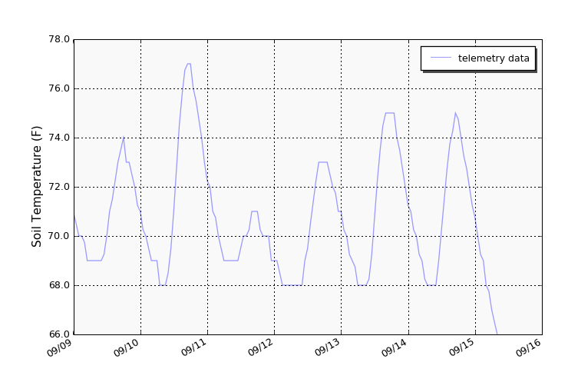
Stream Gage Markers – HTML
var myHtml = "<img src=\""+
baseGraphURL + ID + tailGraphURL +
"&height="+
imgHeight+
"&width="+
imgWidth+
"\" height=\""+
imgHeight+
"\" width=\""+
imgWidth+"\">";

Slide 14
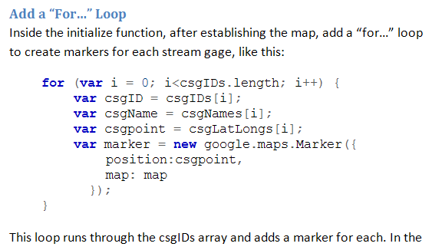
Exercise Instructions
Instructions
Code
WATCH OUT FOR LINE & PAGE BREAKS!

Slide 15
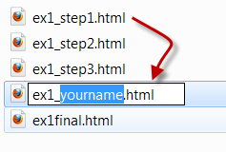
Training Data
Ex1 folder:
A “final” html: our goal
(w/ extra)
A“step1” html: copy & paste then rename as your own
Subsequent “step” htmls: use ONLY to re-set within exercise if there are problems

Slide 16
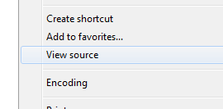
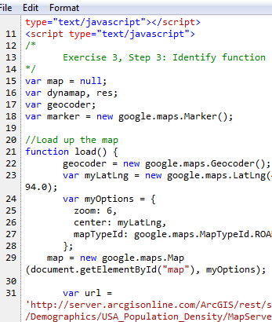
Navigating the Exercises
Each Exercise has 3 steps
After each step, Save
Preview in the browser
Right-click “Open with”…
Firefox is less picky with security
IE has better “View Source”

Slide 17
Stream Gage Data (Step 2)
http://www.dnr.state.mn.us/waters/csg/index.html
Click map to find more details:
ID
Name/Description
Lat/Long in CSV file (find by ID)

