Slide 1
Lesson 2
KML Overlays

Slide 2
KML: An open standard
Official OGC standard in 2008
Over a billion KML files on the web
Always WGS84
http://code.google.com/apis/kml/

Slide 3
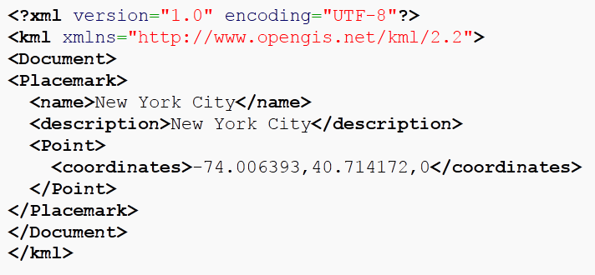
Example KML

Slide 4

Sweet Stuff inside good KMLs
Metadata: kml.getMetadata():
.name
.author
.description
.snippet
Image for TOC, for example: http://maps.google.com/mapfiles/kml/shapes/motorcycling.png
Notes:
Bring the KML into Google Earth or notepad to see the deep-linked image URL, and either re-use or download.

Slide 5
Compatibility with G Maps
Left-hand panel
Refresh
Links
Projection of polygons
Encoding requirements
Source: http://code.google.com/apis/kml/documentation/kmlelementsinmaps.html

Slide 6
Limitations in Maps
File size: 3 MB (but you can use a KMZ)
Number of features: 1,000
Number of vertices (polygons and polylines): ??
Source: http://code.google.com/apis/kml/documentation/mapsSupport.html
Notes:
Translation: Google Maps is a frying pan. It’s fast, it’s hot, and you can cook a lot of stuff on it. But you can’t cook a turkey.

Slide 7
KmlLayer object
new google.maps.KmlLayer
('http://linktomyKML.kml');
You must have a file hosted on a web server! (But it can be anyone’s)
Notes:
Assign this to a variable

Slide 8

setMap(map)
kmlLayer = new goo…
kmlLayer.setMap(map);
To remove:
kmlLayer.setMap(null);

Slide 9
Arrays are your friend
var arrayName = [];
arrayName[0] = variable definition…;
arrayName[1] = variable definition…; arrayName[2] = variable definition…;

Slide 10
Arrays are your friend
var kmlOverlays = [];
kmlOverlays[0] = new google.maps.KmlLayer(…
kmlOverlays[1] = new google.maps.KmlLayer(…
kmlOverlays[2] = new google.maps.KmlLayer(…
var kmlToggleStates = [];
kmlToggleStates[0] = true;

Slide 11
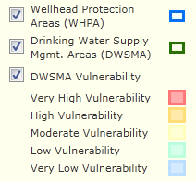
Set up a TOC/Legend
function toggLegend(index) {
if (kmlToggleStates[index]) {
kmlToggleStates[index]=false;
} else {
kmlToggleStates[index]=true;
}
loadKML();
}

Slide 12
loadKML function for legend
function loadKML() {
var i;
for (i = 0; i < kmlOverlays.length; i++) {
kmlOverlays[i].setMap(null);
}
for (i = 0; i < kmlOverlays.length; i++) {
if (kmlToggleStates[i]) {
kmlOverlays[i].setMap(map);
}
}
}

Slide 13
HTML for TOC/legend
<table id="tblTOC" width="150px">
<tr>
<td><input type="checkbox" id="chk2" checked="checked“ onclick="toggLegend(2);"></td>
<td>KML Name 2<td>
<td><img id="leg2" src=http://gis.mda.state.mn.us/images/iconHelp.gif alt="Legend 2"></td>
</tr>

Slide 14
Exercise
Similar to before
Some KMLs can be slow to load – be patient!
Go easy on the checkbox toggling!

