Slide 1
Lesson 3
ArcGIS Server Overlays

Slide 2
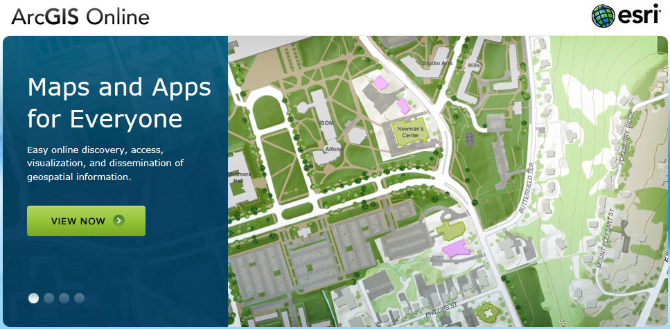
ArcGIS Server Prevalent
Notes:
Chances are you know of a government agency or private industry that uses it. ESRI’s services themselves are very valuable.

Slide 3
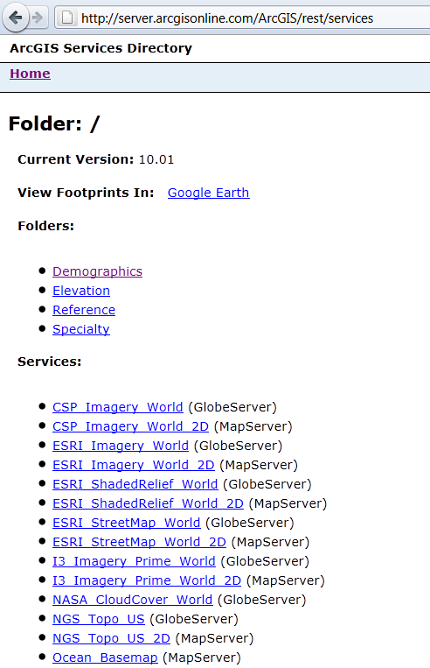
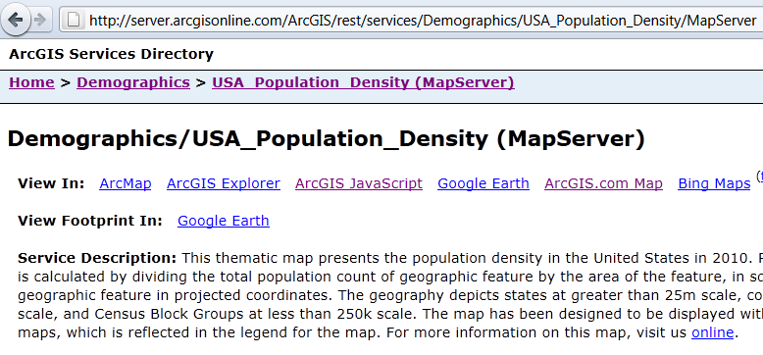
What to look for
The “REST” endpoint, v 9.3 or higher: …ArcGIS/rest/services
Notes:
Demo this location, the capabilities at the bottom, and the Help / Reference at the top

Slide 4
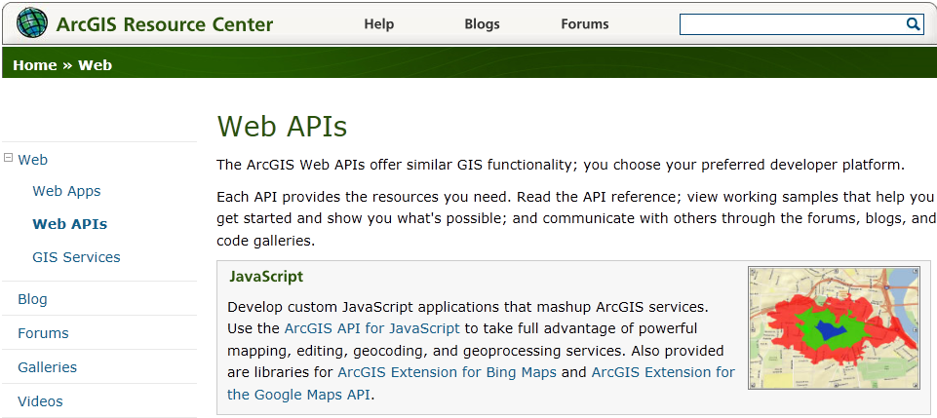
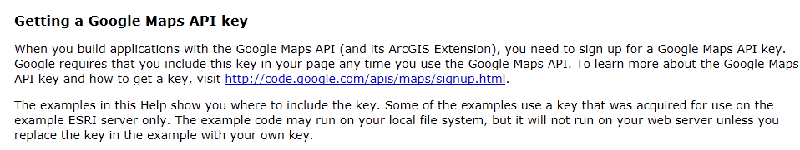
Warning! ESRI’s “Extension”…
Don’t Go Here
Notes:
ESRI has an “Extension” to use Google Maps with ArcGIS Server, but it’s built around version 1.6 of the Google Maps API, which is old, old old.

Slide 5
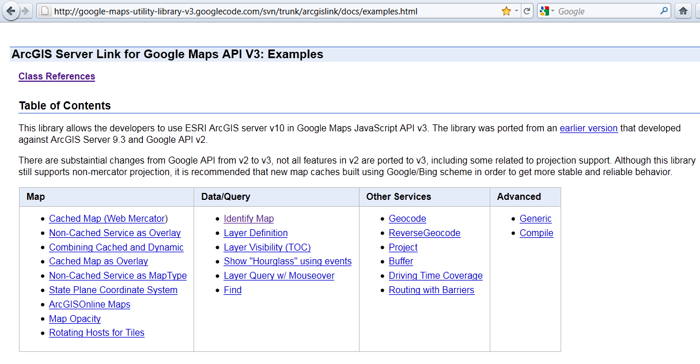

Lucky for us…

Slide 6
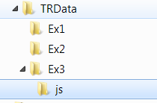

Add the .js reference
Link with <script> tag:
<script src="js/arcgislink.js" type="text/javascript"></script>
Notes:
I’ve downloaded the latest version and included it in the training data folder under /js

Slide 7
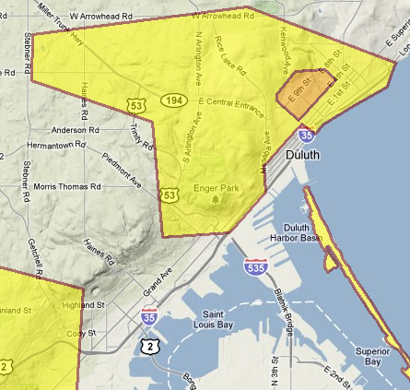
Add the map
Custom Overlay
var url = 'http://server….';
var agsType = new gmaps.ags.MapType(url,{name:'arcgis', opacity:0.5});
map.overlayMapTypes.insertAt(0, agsType);

Slide 8

Geocode
Why?
Google’s geocoder is superior
Users expect to “search” or “find”
Users have no idea what an “identify button” is or what it does
function load() {
geocoder = new google.maps.Geocoder();

Slide 9
Page Work Flow
Geocode Text Box
Send entry to geocode function, add marker
Identify Service
At the marker location, identify the service overlay
Parse Results
Take the results from the service and display them in text

Slide 10
Geocode function
function codeAddress(address) {
if (address) {
geocoder.geocode( { 'address': address}, function(results, status) {
if (status == google.maps.GeocoderStatus.OK) {
map.setCenter(results[0].geometry.location);
map.fitBounds(results[0].geometry.viewport);
marker.setMap(null);
marker.setMap(map);
marker.setPosition(results[0].geometry.location);
marker.setDraggable(true); …..

Slide 11
Identify Function
function identify(latLng){
if (res) res.length = 0;
dynamap.identify({
geometry : latLng,
tolerance : 3,
layerIds : [ 2 ],
layerOption : 'all',
bounds : map.getBounds(),
width: map.getDiv().offsetWidth,
height: map.getDiv().offsetHeight,
overlayOptions: [],
returnGeometry: false

Slide 12
Parse Results of Identify
function parseJSON(idresults) {
var demoN = "Tract Name: ";
var demoT = "Total Population: ";
var demoS = "Population Density: ";
res = idresults.results;
layersJSON = { "2": []};
for (var i = 0; i < res.length; i++) {
var thisrec = res[i];
layersJSON[thisrec.layerId].push(thisrec);
}
var lyr2 = layersJSON[2];
var attributes = lyr2[0].feature.attributes;
document.getElementById("demoName").innerHTML = demoN + attributes["Name"];
document.getElementById("demoTotalPop").innerHTML = demoT + attributes["2010 Total Population"];
document.getElementById("demoPopDens").innerHTML = demoS + attributes["2010 Population Density (Pop per sq mile)"];

