Slide 1
TIRTC Doctor Visit Analysis
Muhammad Samad Qureshi
STU6836ea3347cd01748429363

Slide 2
PROBLEM STATEMENT
Understanding doctor visit patterns from healthcare data
• Healthcare records contain demographic, income, illness, health and visit-related information.
• The project explores which patterns are visible in doctor visit behavior.
• The analysis uses Python to clean, validate, summarize and visualize the dataset.

Slide 3
Project Description
The project analyzes a healthcare dataset containing 5,190 records and 13 variables. Python and pandas were used to inspect the data, validate data quality and perform exploratory analysis. The notebook examines doctor visits along with age, income, illness, reduced activity, health and insurance-related variables. Visualizations and descriptive statistics are used to identify patterns and relationships.

Slide 4
WHO ARE THE END USERS?
• Healthcare analysts — to explore patient and visit patterns.
• Healthcare administrators — to understand demand and utilization patterns.
• Data/BI teams — as a starting point for deeper reporting or predictive analysis.
• Students and learners — to practice real-world exploratory data analysis with Python.

Slide 5
Technology Used
• Python — primary programming language
• Pandas — data loading, inspection, cleaning and analysis
• NumPy — numerical operations
• Matplotlib — data visualization
• Seaborn — statistical visualizations and heatmaps
• Jupyter Notebook — analysis environment

Slide 6
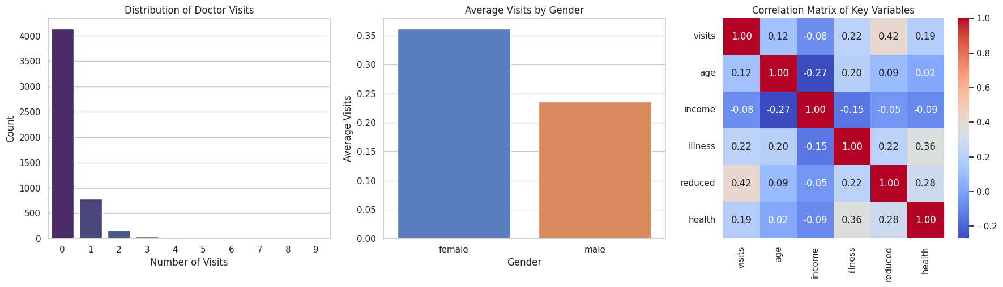
RESULTS
[Add screen shots of your code ]
4,141 records have 0 visits (79.8%)

Slide 7
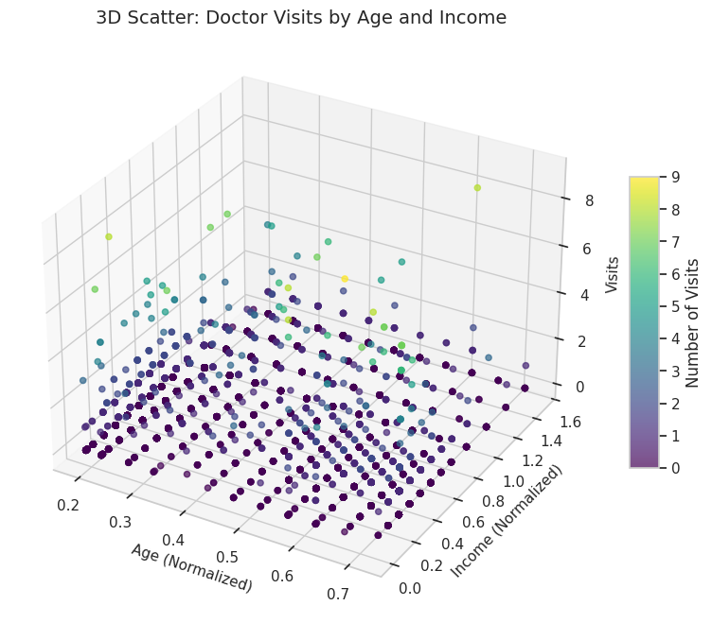
RESULTS
.
Age–income correlation: approximately −0.27

Slide 8
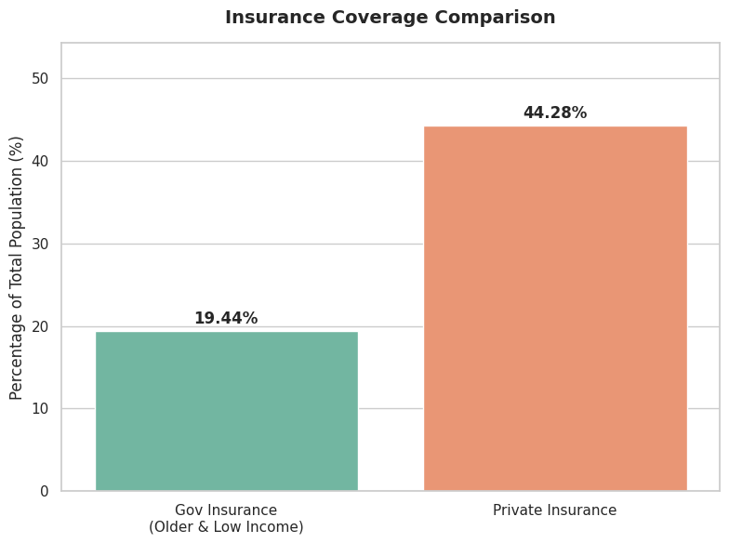
RESULTS
.
Data quality checks: 0 missing values and 0 duplicate rows

Slide 9
GITHUB LINK
https://github.com/mmdsamadqureshi/Doc_Visit_Analysis_using_Python
.

Slide 10
Thank you
.

