Slide 1
پروژه کرالر سایت خبری عربی
موضوع ارائه:
محمد ندیمی

Slide 2

Abstract
This project is for crawl news articles of Alsabah website with python and
Scrapy.
2/13
Alsabaah web crawler
محمد ندیمی

Slide 3
Web Crawler
A web crawler can serve two functions:
- Systematically browsing the web to index content for search engines. Web crawlers copy pages for processing by a search engine, which indexes the downloaded pages for easier retrieval so that users can get search results faster.
This was the original meaning of web crawler.
- Automatically retrieving content from any web page. This is more commonly called web scraping. This meaning of web crawler came about as companies other than search engines started using web scrapers to retrieve web information.
3/13
Alsabaah web crawler
محمد ندیمی

Slide 4
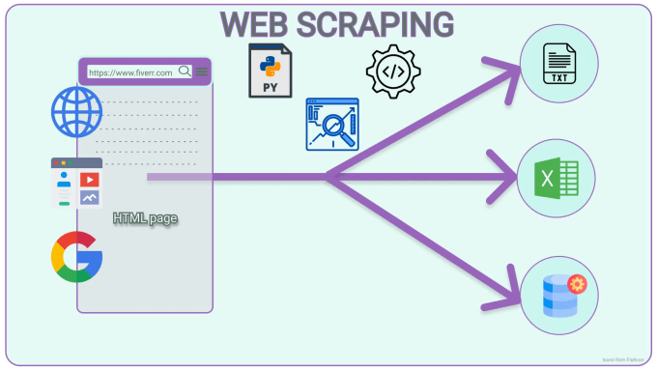
scrapy
Scrapy is a Python-based open-source web scraping framework used for extracting data from websites. It has built-in tools and libraries for handling common web scraping tasks and uses a modular architecture with a powerful selector system for parsing HTML and XML documents.
4/13
Alsabaah web crawler
محمد ندیمی

Slide 5
MongoDb
What is MongoDB?
MongoDB is an open-source NoSQL document-oriented database system designed for handling large amounts of unstructured data. It uses a document model and provides advanced features like dynamic queries and real-time data aggregation.
5/13
Alsabaah web crawler
محمد ندیمی

Slide 6
Features
- Crawl all posts of the website.
- Crawl any number of pages you want.
- Crawl new posts of website immediately and realtime.
- Crawl (title,img_url,publish_date,link,description,text_without_line_breaks,text_with_line_breaks,tag) from each post.
6/13
Alsabaah web crawler
محمد ندیمی

Slide 7
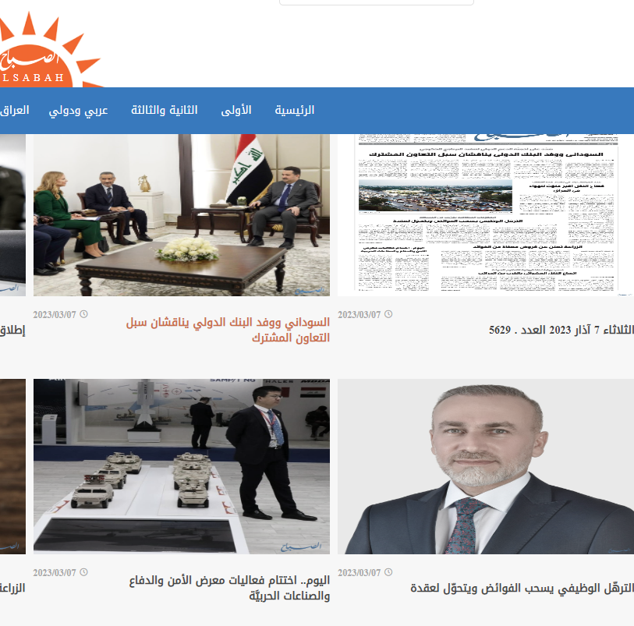
Lastnews Page
Link
Every posts has a link to details page and crawler gets the link of everyposts on the page.
7/13
Alsabaah web crawler
محمد ندیمی

Slide 8
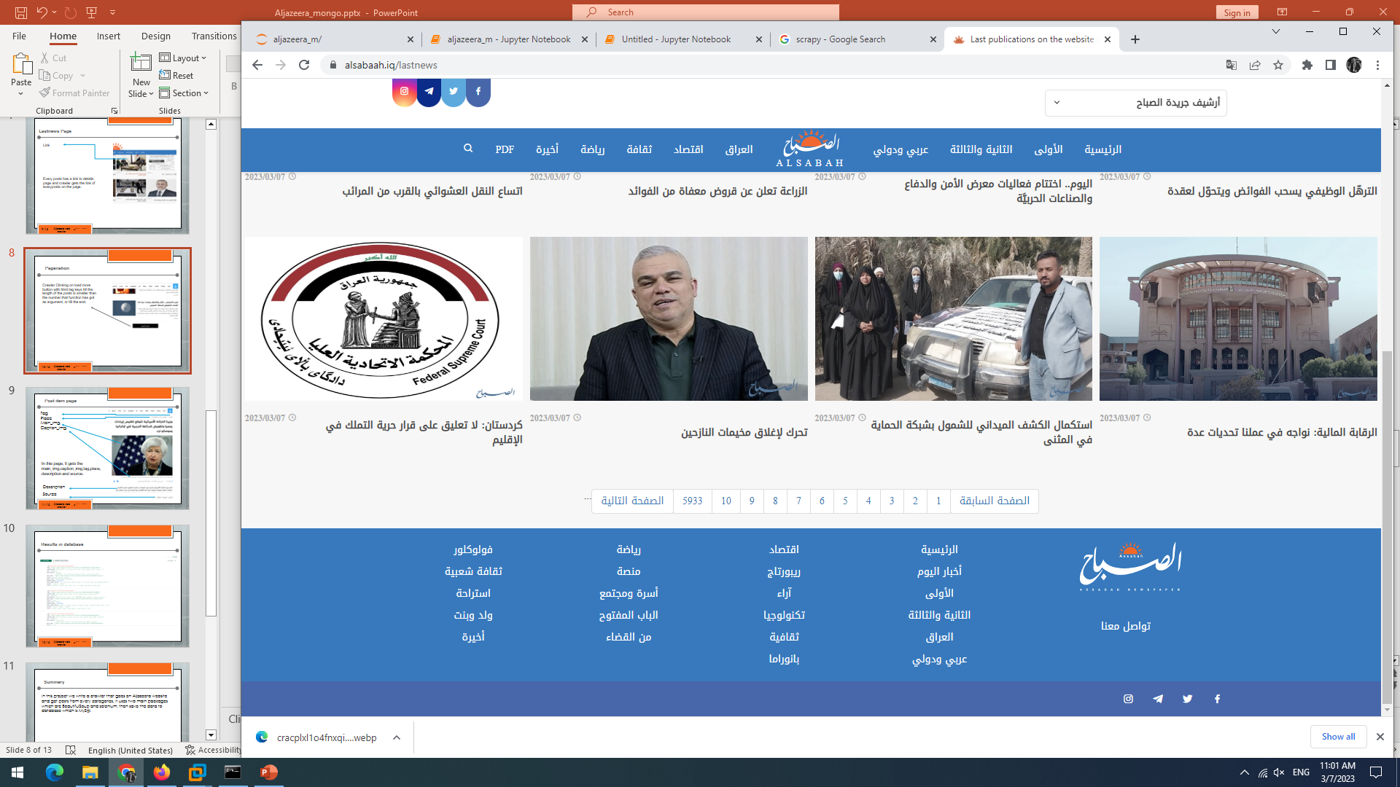
Pagenation
Crawler paginate the pages till the number of page we want to crawl.
8/13
Alsabaah web crawler
محمد ندیمی

Slide 9
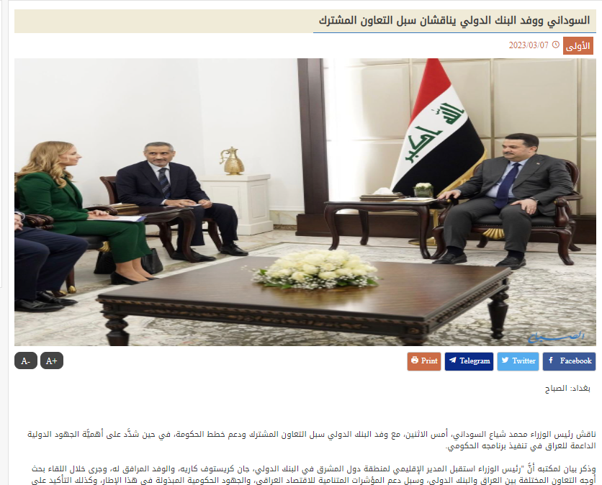
Post item page
Title
Tag
Main_img,
Publish_date
Text
In this page, It gets the title, tag, img_url, publish_date and text.
9/13
Alsabaah web crawler
محمد ندیمی

Slide 10
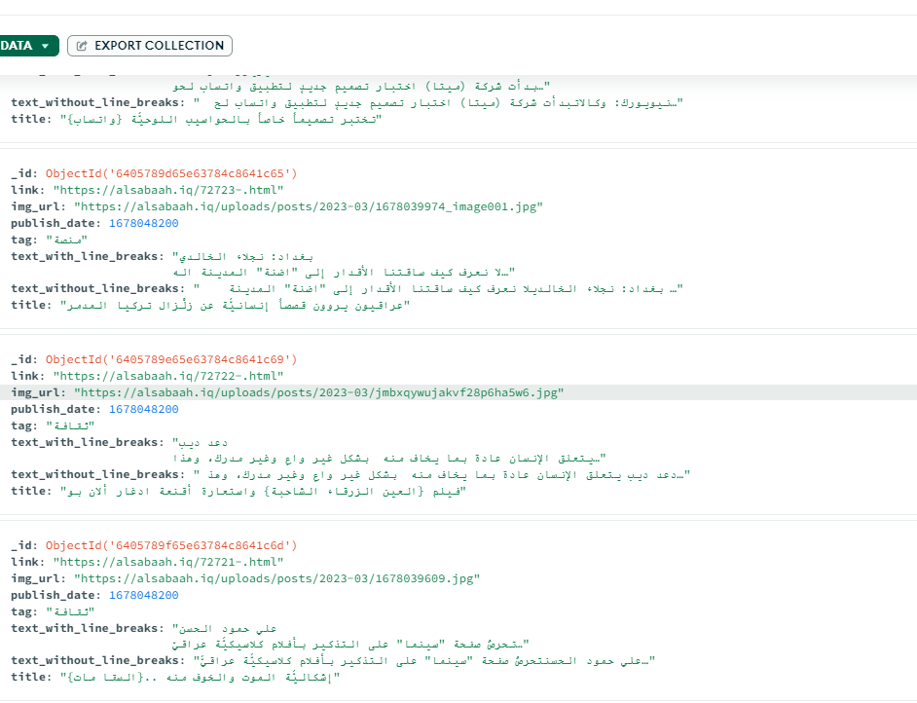
Results in database
10/13
Alsabaah web crawler
محمد ندیمی

Slide 11
Summery
The AlsabahmongoSpider is a web scraper built using the Python Scrapy library. It crawls the Alsabaah.iq website, a popular Iraqi news website, and extracts news articles' data. The data is then stored in a MongoDB database.
11/13
Alsabaah web crawler
محمد ندیمی

Slide 12
sources
www.alsabah.iq
12/13
Alsabaah web crawler
محمد ندیمی

Slide 13
Thank you for your attention
13/13
Alsabaah web crawler
محمد ندیمی

