Slide 1

Thapar Institute of Engineering and Technology
• UCS503: Software Engineering
PROJECT EVALUATION DETAILS (LAB EVAL I)
DREAMS2REALITY→A Minimalist Two-Electrode System for Real-Time Sleep-Stage and Dream-State Neural Decoding
Submitted by:
Meet(1024030343)
Harsh(1024030497)
Kanav Bhardwaj(1024030395)
Yukti Saklani(1024030392)
Academic Class: B.E. Third Year, Computer Engineering
Group No: 3C25
Submitted to: Dr. Stuti Chug
Academic Session: August – December 2026

Slide 2
Clinical Context & Problem Statement
The Clinical Problem in Sleep State
• Over 30% of adults suffer from chronic sleep disorders, parasomnias, and PTSD nightmares.
• Available Technology to evaluate: Today, doctors rely solely on patient memory after waking up, which suffers from severe memory loss and emotional bias.
• Lack of Objective Data: No hospital system tracks real-time dream distress spikes as they happen during the night.
Current Issues & Our Fix
• Hospital PSG is Invasive: Uses 32–128 wet electrodes, messy paste, takes 45 mins setup, and costs > $15,000.
• The 'First-Night Effect': Patients cannot sleep naturally with 64 wires on their head, ruining genuine dream cycles.
• Dreams2Reality Engineering Solution: Reduces 64 wet channels to just 2 dry temporal electrodes (T7–T8).
• Zero-gel, < 1 min setup, enabling natural sleep with real-time neural decoding.

Slide 3
Software Development Life Cycle (SDLC): Agile Scrumaf
AGILE->A methodology in which whole project is divided into in to short , flexible cycles to complete work piece by piece.SCRUM->A framework used here to implement agile methodology in which cycles or blocks are divided into cycles(2-3 weeks long).
Why Agile / Scrum for Dreams2Reality?
• Iterative Signal Tuning: Digital filter cutoffs (0.5–45 Hz) and neural attention weights require continuous experimental validation.
• Decoupled Component Sprints: Allows parallel development of the Telemetry Streamer, Preprocessor, ML Engine, and Web UI.
• Course Schedule Alignment: 2-week sprint cycles directly match the TIET UCS503 15-week academic calendar milestones.
Sprint Breakdown & Laboratory Roadmap
• Sprint 1 (Weeks 1–3): Problem definition, domain research on PSG bottlenecks, toolchain setup.
• Sprint 2 (Weeks 4–5): IEEE SRS formalization, PhysioNet Sleep-EDFx ingestion, Butterworth IIR filter.
• Sprint 3 (Weeks 6–7): UML Object-Oriented Modeling, Euclidean Alignment, and Lab Eval 1 Documentation.(CURRENTLY COMPLETED).
• Sprint 4 (Weeks 8–12): Attention network refinement, Hall-Van de Castle narrative generation.
• Sprint 5 (Weeks 13–17): Final dashboard integration, stress testing, and seminar presentation.

Slide 4
High-Level Software Architecture & Flow Pipeline
1. Ingestion
Simulates 128 Hz dual-channel (T7-T8) telemetry channel(act as a conductor which loads data,supervise it and export report pdf in morning) from PhysioNet Sleep-EDFx records.
Technology Stack:
FastAPI & WebSockets
2. Preprocessing
4th-order zero-phase Butterworth bandpass filter: (0.5-45 Hz) + notch filter:50 Hz notch; artifact rejection (> 250uV).
Technology Stack:
SciPy & NumPy
3. ML Engine
Extracts Differential Entropy (DE), DASM/RASM; Euclidean Alignment (EA); DC-CTA Net inference.
Technology Stack:
PyTorch & MNE
4. Clinical UI
Displays 60 FPS live waves, real-time hypnogram, bedside nightmare alerts, and morning PDF.
Technology Stack:
React & Canvas

Slide 5
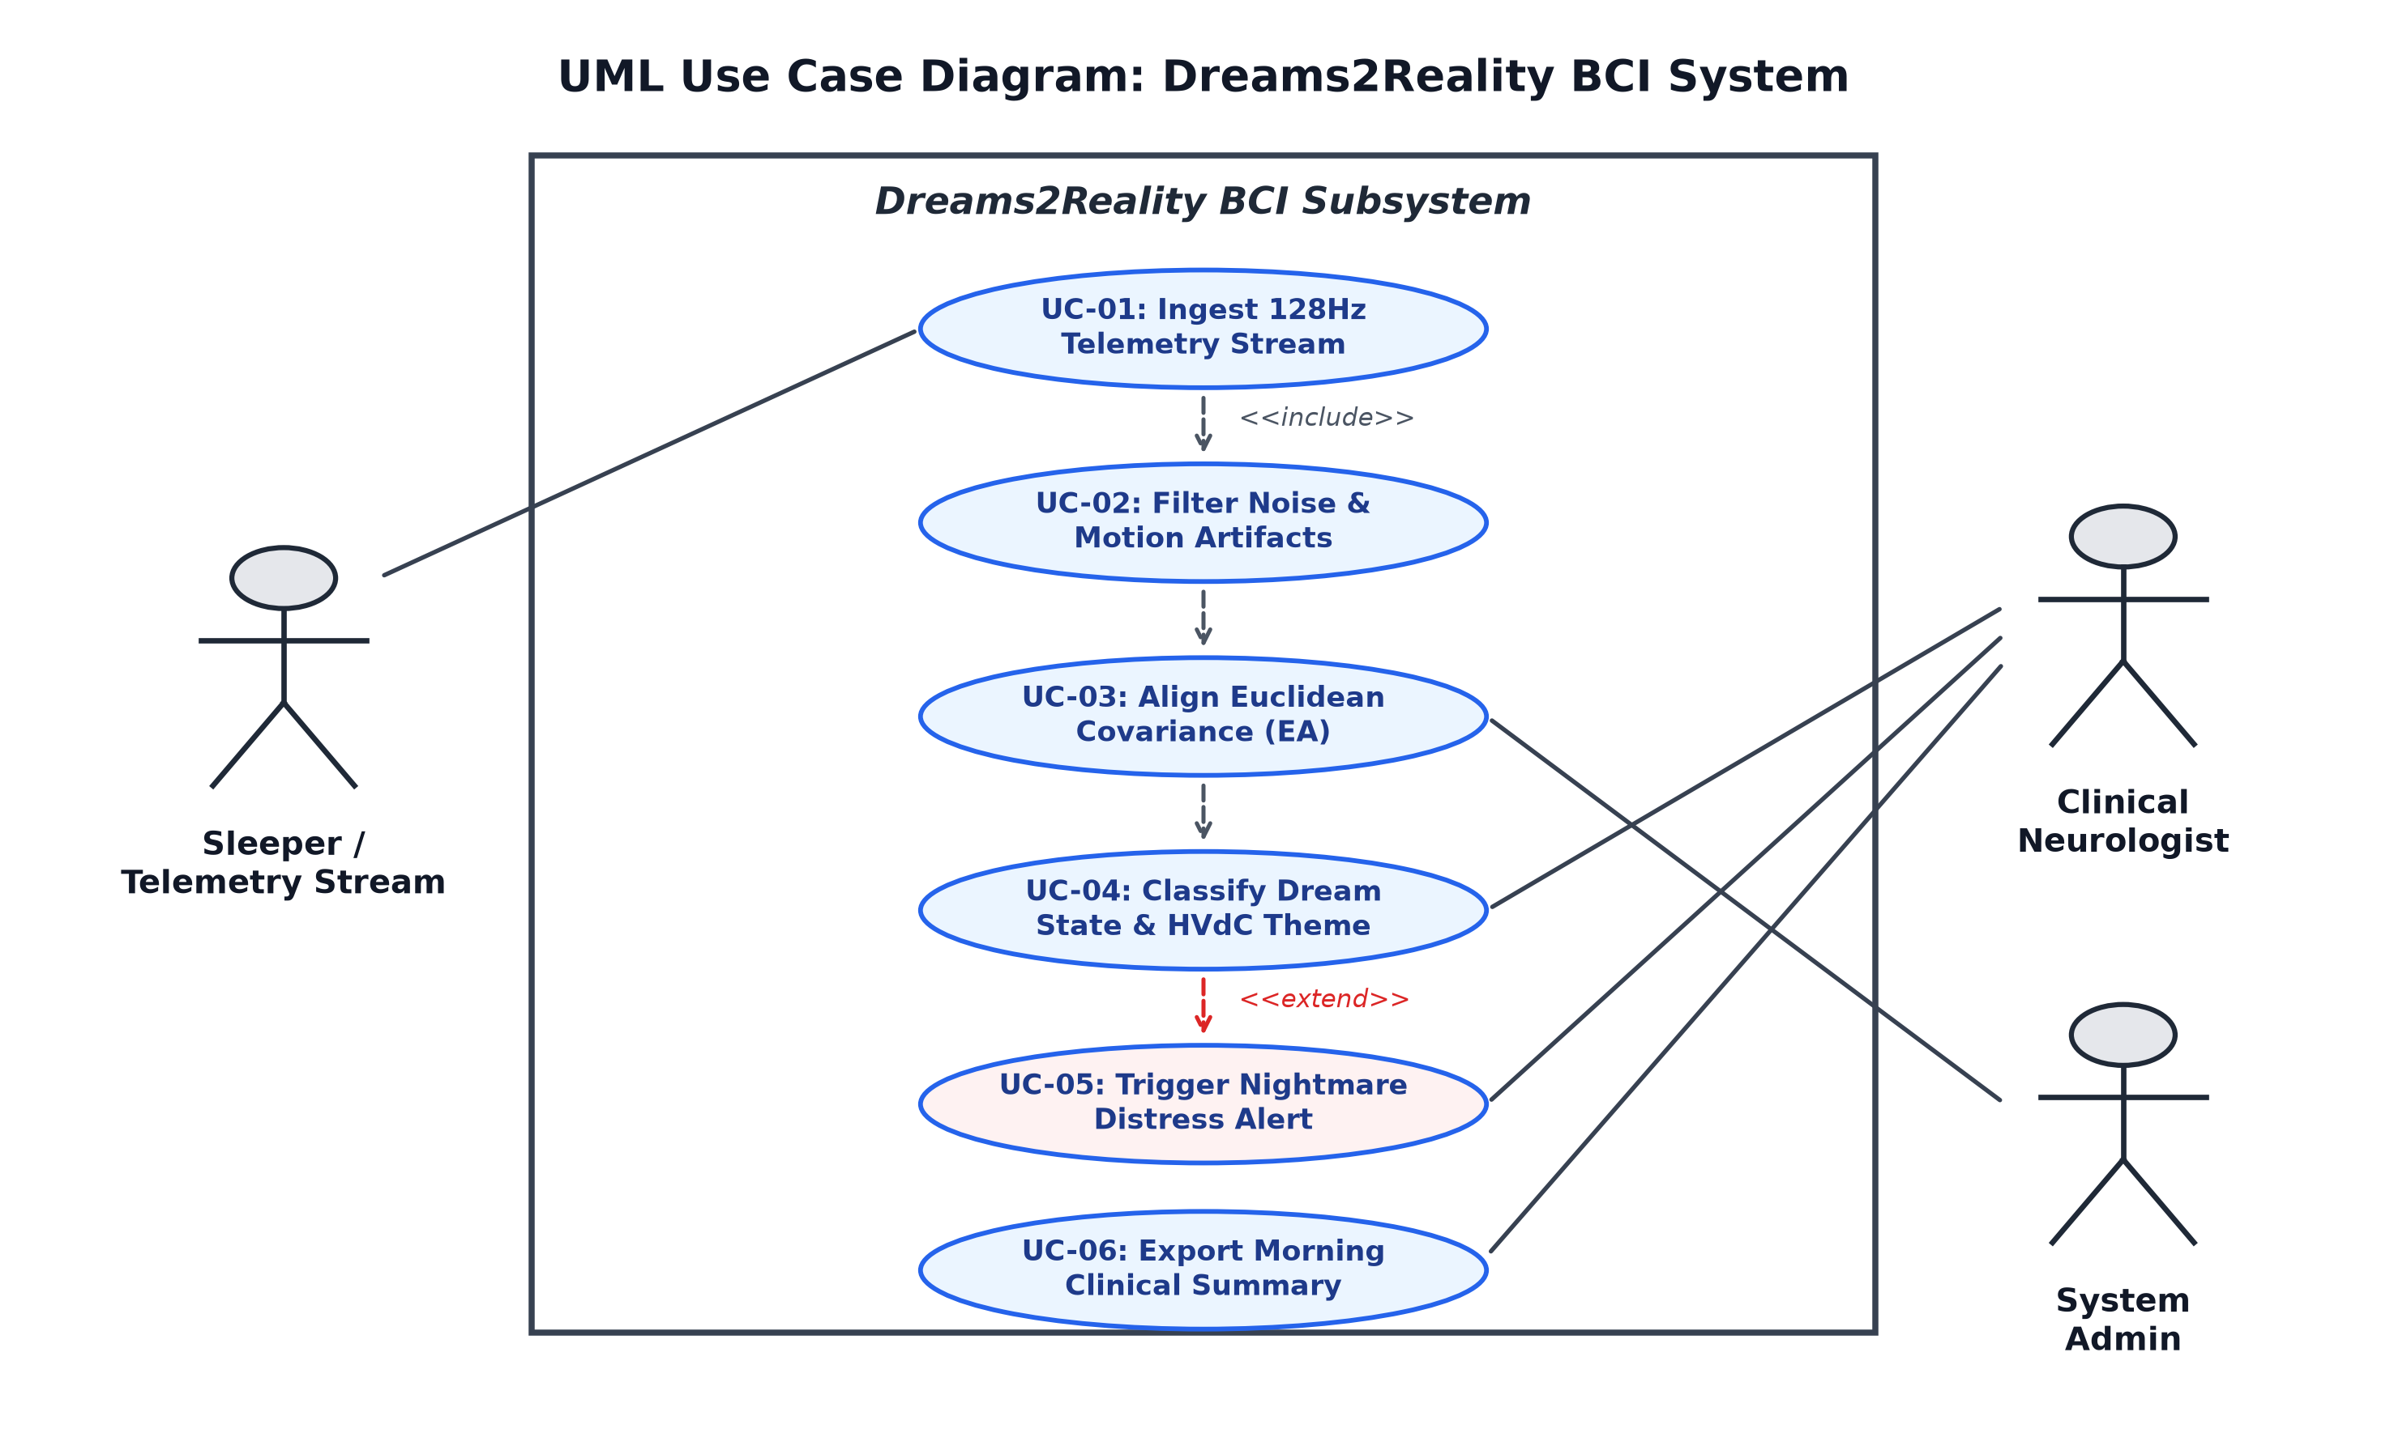
UML Use Case Diagram & Actor-System Analysis
Key Architectural Elements
• Primary Actors:
• - Sleeper / Telemetry Stream: Ingests 128 Hz data.
• - Clinical Neurologist: Monitors live hypnograms, handles alerts, exports morning summaries.
• - System Admin: Calibrates baseline filters.
• Core Relationships:
• - UC-01 <<include>> UC-02 (Noise filtering is mandatory for ingestion).
• - UC-04 <<extend>> UC-05 (Nightmare alert triggers only when distress threshold is breached).

Slide 6
UML Activity Diagram: 4
Key Architectural Elements
• Lane 1: Dataset Streamer - Reads calibrated Sleep-EDFx EDF files; streams packets over WebSockets.
• Lane 2: Signal Preprocessor
• - Bandpass (0.5-45 Hz) & 50 Hz notch; discards motion artifacts (> 250uV).
• Lane 3: ML Brain Engine
• - Calculates Differential Entropy; Euclidean Alignment; DC-CTA Net classification.
• Lane 4: Clinical Web UI
• - Real-time hypnogram; trauma alarm evaluation; morning PDF generation.
\

Slide 7
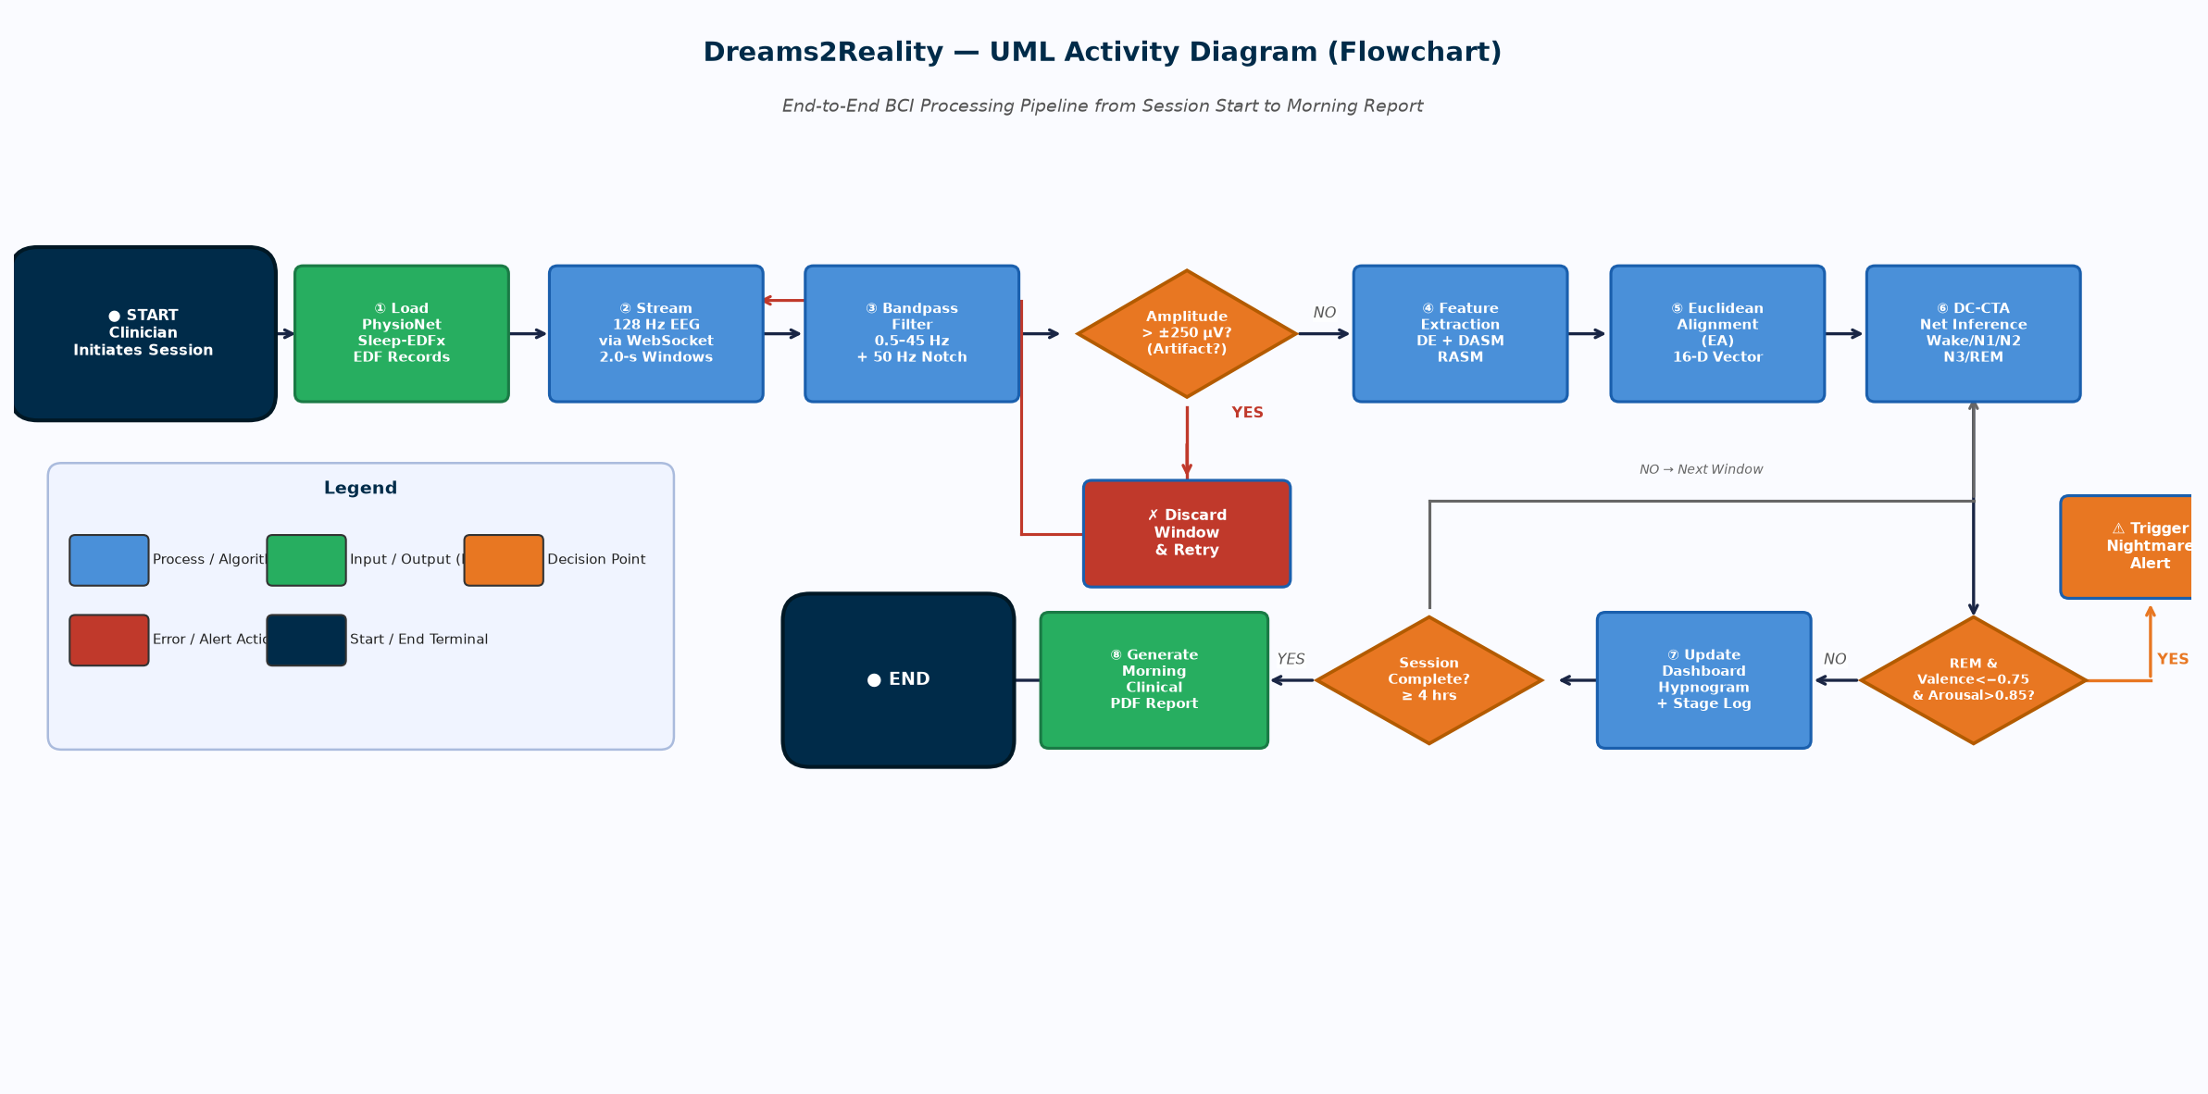
UML Activity Diagram: 4

Slide 8
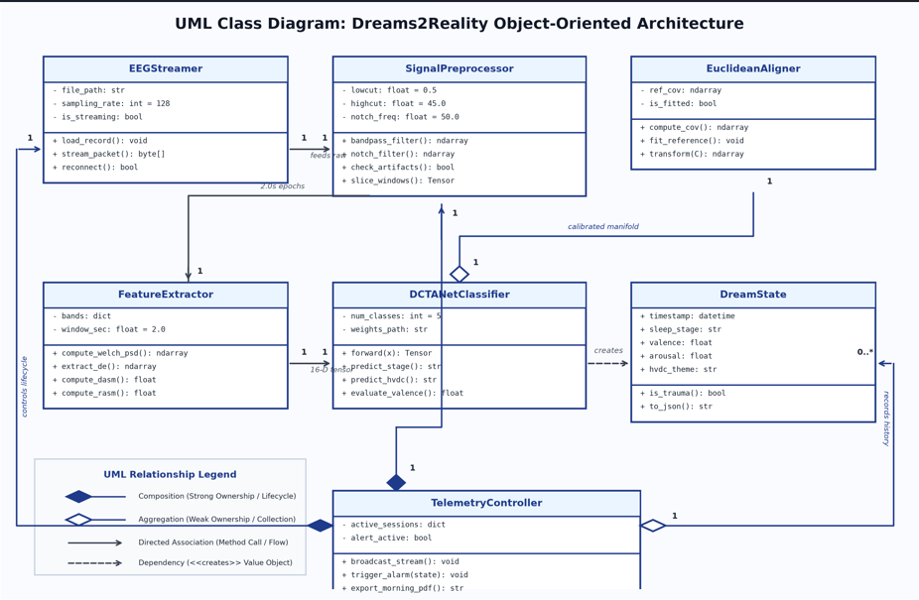
UML Object-Oriented Class Diagram
Key Architectural Elements
• Core Software Entities:
• EEGStreamer: Telemetry packet assembly & socket control.
• SignalPreprocessor: Digital IIR filtering and sliding windowing.
• FeatureExtractor: Computes Welch PSD, DE, and DASM/RASM.
• EuclideanAligner: Standardizes spatial covariance across skulls.
• DCTANetClassifier: PyTorch Cross-Temporal Attention Network.
• DreamState: Value object storing stage, valence, and HVdC theme.
• TelemetryController: Manages clinical sessions & alerts.

Slide 9
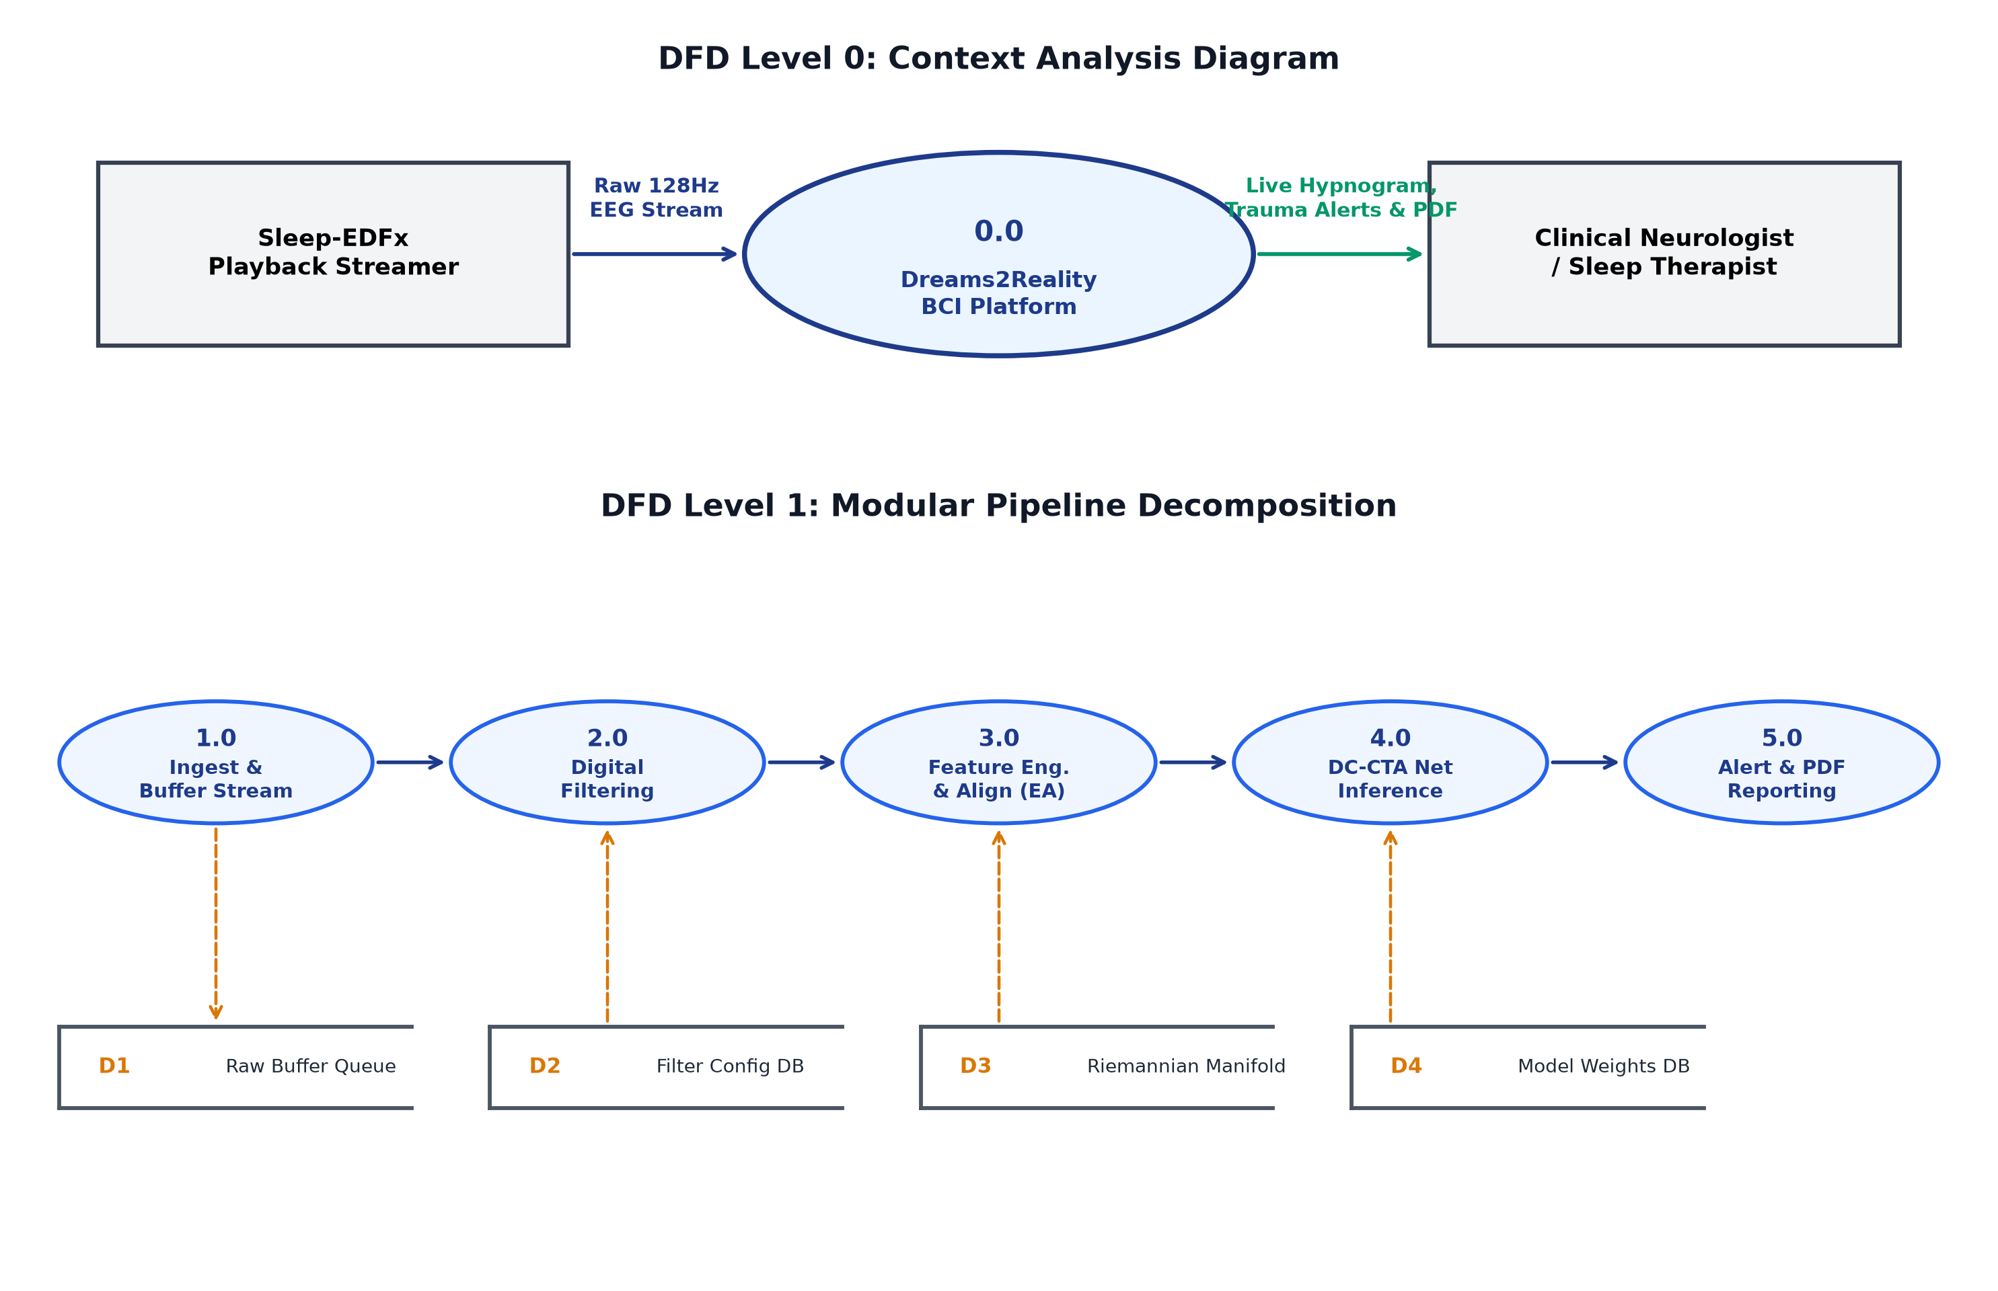
Data Flow Diagrams: Level 0 (Context) & Level 1 (Modular)
Key Architectural Elements
• DFD Level 0 (Context):
• Data Source: Sleep-E DFx Playback Streamer feeds raw 128 Hz EEG.
• Central Process: 0.0 Dreams2Reality BCI Platform.
• Data Sinks: Clinical Neurologist (live telemetry & alerts) and EHR Database.
• DFD Level 1 (Modular):
• Decomposes into 5 functional processes (1.0 to 5.0).
•Data Stores: D1 Raw Buffer, D2 Filter Configs, D3 Riemannian Manifold, D4 Model Weights.

Slide 10
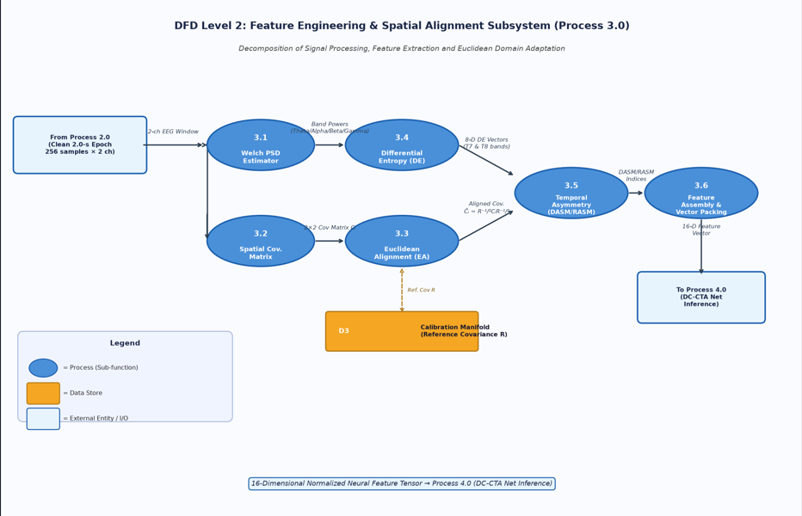
Data Flow Diagrams: Level 2

Slide 11
Algorithmic Formulation: Channel Selection & Covariance Alignment
ANOVA F-Score Channel Reduction
• Statistical Feature Ranking: Applied SelectKBest across all 64 standard 10-20 scalp electrode positions.
• Bilateral Temporal Optimality: Proved that temporal channels T7 and T8 achieve the highest F-statistic score for separating REM dream mentation from delta slow waves.
• Scientific Validation: Empirically justifies eliminating 62 wet channels down to a comfortable 2-electrode dry setup.
Euclidean Covariance Alignment (EA)
• Solving Skull Impedance Drift: Inter-subject skull bone thickness causes signal drift across different patients.
• Riemannian Covariance Projection: Standardizes spatial covariance matrix Ci using reference geometric mean R: Ci_norm = R^(-1/2) * Ci * R^(-1/2).
• Zero-Shot Generalization: Delivers > 70% classification accuracy on unseen subjects without per-user retraining.

