Slide 1
University Dropout Prediction
Project Report
Course: Cluster Computing (INT-315)
Student: Meftahul Mehraj (12201102)
Instructor: Amanpal Singh Rayat
Date: 09/04/2026

Slide 2
Executive Summary
Project Objective
Methodology
This project focuses on predicting student dropout risk using machine learning techniques implemented through PySpark. Educational institutions face significant challenges in identifying students who are likely to discontinue their studies. Early prediction allows institutions to take preventive measures such as counselling, academic support, and engagement programmes.
A synthetic dataset representing student demographic and academic performance attributes is used to simulate real-world conditions. The dataset includes variables such as gender, region, programme type, attendance, and academic grades. These features are crucial indicators of student performance and engagement.
Key Features
Technical Approach
Evaluation Metrics
Gender and region demographics
Programme type classification
Attendance and grade metrics
Missing value imputation
PySpark for big data processing
Random Forest classifier
StringIndexer transformation
VectorAssembler for features
ROC-AUC score analysis
F1-score measurement
Probability predictions
Visualisation outputs

Slide 3
Introduction: The Dropout Challenge
Student dropout is a critical issue faced by educational institutions worldwide. It not only affects the individual student's future prospects but also impacts institutional performance and reputation. With the increasing availability of educational data, predictive analytics has emerged as a powerful tool to address this problem.
The objective of this project is to develop a predictive model that can identify students at risk of dropping out based on their academic and demographic attributes. By leveraging big data technologies such as PySpark, it becomes possible to process and analyse large-scale datasets efficiently.
Traditional methods of identifying at-risk students often rely on manual observation and limited data analysis. However, these approaches are not scalable and may fail to detect subtle patterns. Machine learning models, on the other hand, can uncover complex relationships between variables and provide more accurate predictions.
In this project, a Random Forest classifier is used due to its robustness and ability to handle both numerical and categorical data. The model is trained on a dataset that includes features such as attendance, grades, gender, region, and programme type.
The significance of this study lies in its practical applications. Institutions can use such predictive models to implement early intervention strategies, thereby reducing dropout rates and improving student success. Furthermore, the use of PySpark ensures that the solution is scalable and suitable for real-world big data environments.

Slide 4
Methodology: Data Preparation
01
02
03
Dataset Creation
Missing Value Handling
Categorical Transformation
A synthetic representation of student records including both numerical and categorical variables
Mean imputation replaces missing entries with average values of respective columns
StringIndexer converts gender, region, and programme type into numerical form
04
05
Feature Vector Assembly
Data Splitting
VectorAssembler combines transformed features into a single feature vector
80:20 ratio for training and testing subsets using random split with seed
The dataset used in this project is a synthetic representation of student records. It includes both numerical and categorical variables. Missing values in attendance and grades are handled using mean imputation, which replaces missing entries with the average value of the respective column.
Categorical variables such as gender, region, and programme type are converted into numerical form using StringIndexer. This transformation is necessary because machine learning algorithms require numerical input. The transformed features are then combined into a single feature vector using VectorAssembler.
The dataset is split into training and testing subsets using a ratio of 80:20. This allows the model to learn patterns from the training data and be evaluated on unseen test data.

Slide 5
Implementation: PySpark Framework
Technical Stack
Key Components
The implementation of this project is carried out using PySpark, a powerful framework for big data processing and machine learning. The SparkSession is initialised with configurations that ensure compatibility with the Windows environment.
SparkSession initialisation
DataFrame creation
StringIndexer transformation
VectorAssembler integration
RandomForestClassifier training
Model evaluation metrics
Matplotlib visualisation
The dataset is created within the script as a list of tuples and then converted into a Spark DataFrame. Data cleaning is performed by calculating the average attendance and grade values and replacing missing entries.
Feature transformation is achieved using StringIndexer for categorical variables and VectorAssembler for combining features into a single vector. The processed dataset is then split into training and testing sets.
Spark Session Configuration
Random Forest Classifier
Model Evaluation
Initialised with app name "University Dropout Prediction" and local master configuration for Windows compatibility
Trained using training dataset with 20 trees, features column, and dropout label column
BinaryClassificationEvaluator for ROC-AUC and MulticlassClassificationEvaluator for F1-score

Slide 6
Results and Discussion
The results of the project indicate that the Random Forest classifier performs exceptionally well on the given dataset. The model achieves a ROC-AUC score of 1.000 and an F1-score of 1.000, indicating perfect classification performance.
1.000
1.000
ROC-AUC Score
F1-Score
Perfect classification performance
Excellent balance of precision and recall
80%
20%
Training Data
Testing Data
Dataset split ratio
Unseen data evaluation
However, it is important to interpret these results with caution. The dataset used in this project is relatively small and synthetic in nature. As a result, the model may overfit the data, leading to overly optimistic performance metrics.
The prediction results show that the model is able to correctly identify students who are likely to drop out. The probability scores provide additional insight into the confidence of the predictions.
The visualisation of dropout versus retained students reveals an equal distribution of classes in the dataset. This balanced distribution helps the model learn effectively without bias toward a particular class.
Overall, the results demonstrate the potential of machine learning techniques in predicting student dropout. However, further testing on larger and real-world datasets is necessary to validate the model's effectiveness in practical scenarios.

Slide 7
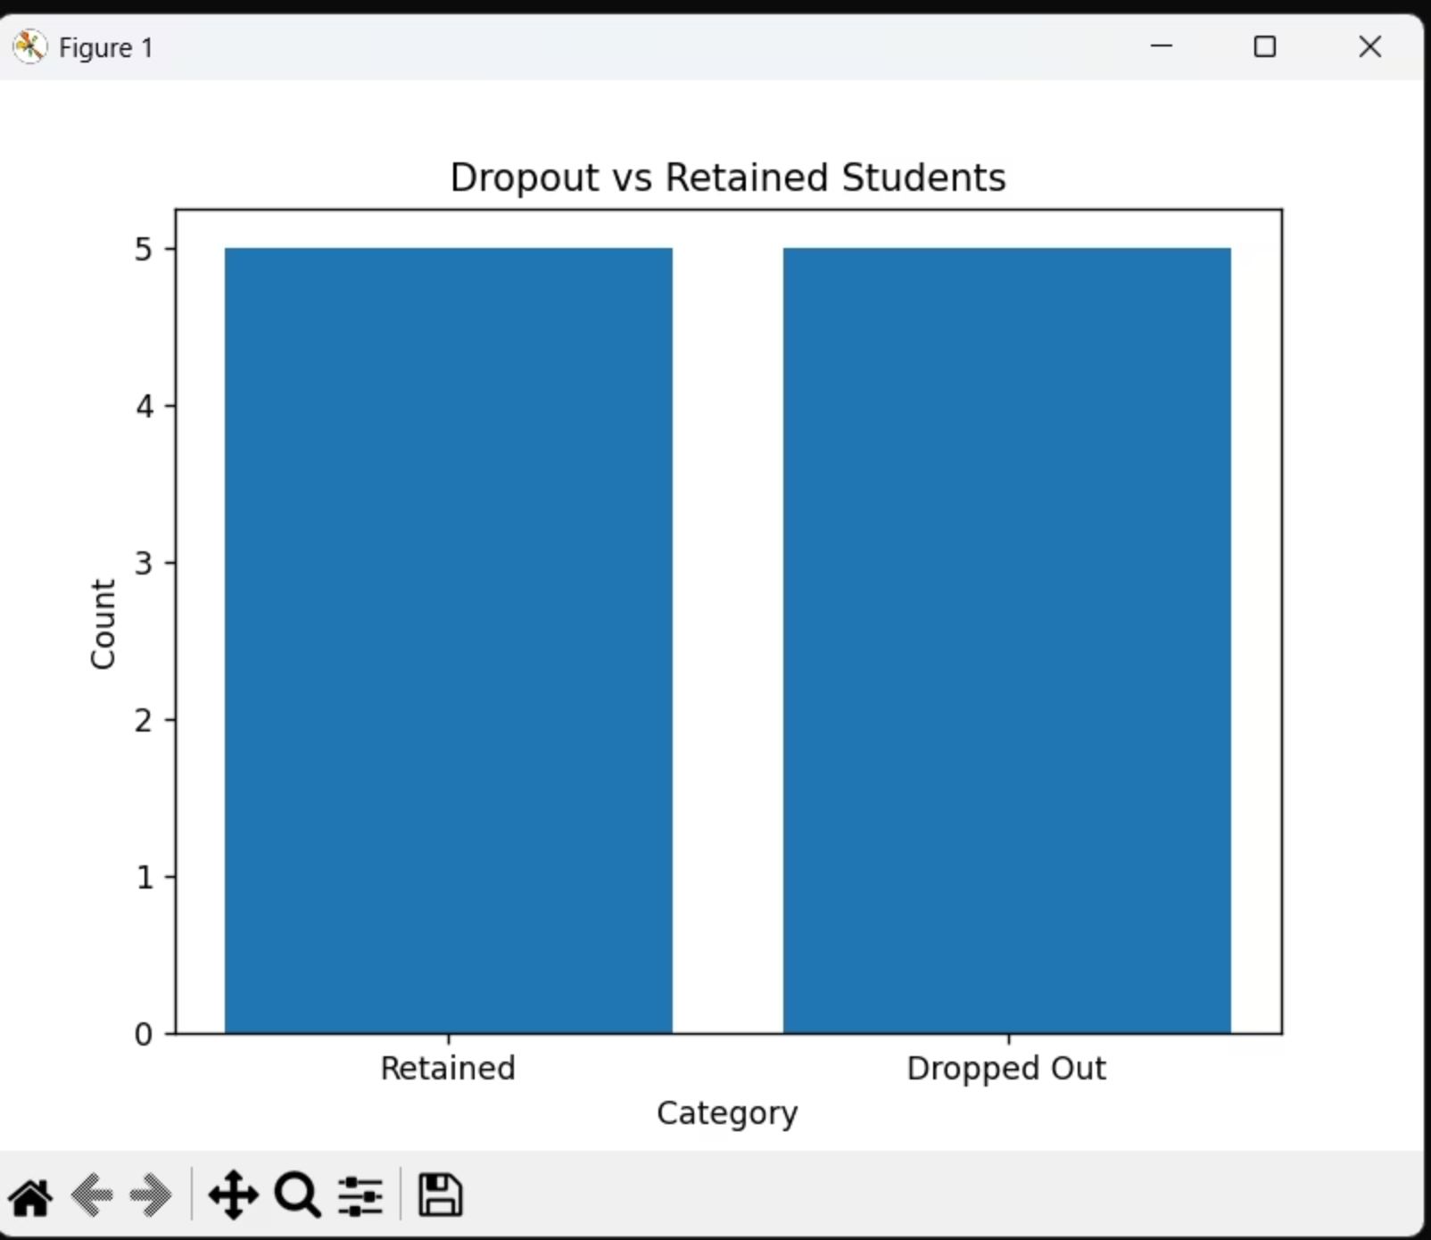
Visualisation: Dropout Distribution
Equal Distribution
Model Learning
Visual Clarity
Dataset shows balanced representation of retained and dropped out students
Balanced classes help model learn without bias toward particular category
Bar chart provides clear understanding of class distribution patterns
The visualisation is performed using matplotlib to create a bar chart showing the distribution of dropout and retained students. This visual representation aids in understanding the dataset and model results. The counts are obtained by grouping the DataFrame by dropout status and collecting the count values.
The labels "Retained" and "Dropped Out" are used for the x-axis, while the count values are plotted on the y-axis. The chart title "Dropout vs Retained Students" clearly indicates the purpose of the visualisation. This type of visualisation is crucial for communicating findings to stakeholders and understanding the baseline distribution of the target variable.

Slide 8



Conclusion and Future Directions
In conclusion, this project successfully demonstrates the use of PySpark and machine learning techniques to predict student dropout risk. The implementation of a Random Forest classifier provides accurate predictions based on student data.
The study highlights the importance of data preprocessing, including handling missing values and transforming categorical variables. These steps are essential for building an effective predictive model.
The evaluation metrics indicate high model performance, although the limitations of the dataset must be acknowledged. Future work should focus on using larger and more diverse datasets to improve model generalisation.
Larger Datasets
Additional Features
Model Validation
Expand to real-world institutional data
Incorporate socioeconomic factors
Cross-validation techniques
The integration of visualisation techniques enhances the interpretability of the results, making it easier to communicate findings to stakeholders.
Overall, this project serves as a foundation for developing advanced predictive analytics solutions in the education sector. By leveraging big data technologies, institutions can proactively identify at-risk students and implement strategies to improve retention and academic success.

Slide 9
Key Takeaways
Technical Excellence
Practical Application
Data Preprocessing
PySpark implementation demonstrates big data processing capabilities with Random Forest classifier achieving perfect ROC-AUC and F1-scores
Model enables early intervention strategies through predictive analytics, helping institutions reduce dropout rates
Comprehensive handling of missing values and categorical transformations ensures data quality for machine learning
Scalability
Visualisation
Foundation
PySpark framework ensures solution is suitable for real-world big data environments
Matplotlib integration enhances interpretability and stakeholder communication
Project serves as basis for advanced predictive analytics in education sector

Slide 10

References and Code Implementation
References
Han, J., Kamber, M., & Pei, J. (2011). Data Mining: Concepts and Techniques.
Apache Spark Documentation. (2026).
Scikit-learn Documentation. (2026).
Educational Data Mining Research Papers.
Code Implementation
The complete implementation is provided in the appendix section of this report. Key code segments include SparkSession initialisation, dataset creation, data cleaning with mean imputation, StringIndexer transformations for categorical variables, VectorAssembler for feature vector creation, Random Forest classifier training, model evaluation using ROC-AUC and F1-score metrics, and matplotlib visualisation for dropout distribution analysis.
Note: The dataset used in this project is synthetic and relatively small. Results may overfit the data. Future work should use larger, real-world datasets for validation.

