Slide 1

MEDICAL OFFICE MNAGEMENT
AMERYAHIA Mélissa
Hamdi sarah
secB
Notes:
Photo by rawpixel on Unsplash

Slide 2

OVERVIEW
Our project is a Medical Appointment Management System designed to modernize and streamline the process of managing appointments in medical practices.
managing appointments using paper and pen is an outdated method that leads to inefficiencies and disorganization.
Similarly, doctors manually writing patient observations can result in time wastage and unorganized records.
before

Slide 3


To address these issues, we developed a personalized application tailored to the needs of each clinic, offering:
Efficient appointment scheduling to save time and reduce workload.
Enhanced organization of patient files and appointments, making it easier for doctors and nurses to manage their daily tasks effectively.
Automated patient notifications via SMS, sent one day before the appointment, which helps decrease the number of patients waiting in the clinic, unlike other traditional methods.
This system is designed to facilitate the management of appointments and improve the overall workflow, ensuring a better experience for both patients and staff.

Slide 4

In today's healthcare environment, efficient management of patient information and appointment scheduling is crucial for providing high-quality care. Our Medical Office Management System aims to streamline these processes by offering tailored functionalities for nurses and doctors. This system ensures seamless coordination between staff, enhances patient data accuracy, and improves overall workflow within the clinic.
With distinct roles for nurses and doctors, the system allows for secure login, easy access to patient information, and efficient appointment management. Below is a detailed overview of the system's features and how each user role contributes to the smooth operation of the medical office:
Notes:
Photo by Samuel Zeller on Unsplash

Slide 5
User Roles and Permissions
At, first lets see the different user roles (Doctor, Nurse) and their permissions.
Doctor:
Permissions:
View patient records.
Add observations and prescriptions.
Generate medical certificates.
Primary Interface: Observation and Prescription management.
Key Features:
Adding detailed medical notes.
Reviewing patient history.
Nurse:
Permissions:
Manage appointment schedules.
Collect initial patient details (name, birth date, etc.).
Primary Interface: Appointment management.
Key Features:
Viewing upcoming appointments.
Entering new patient data into the system.
before

Slide 6
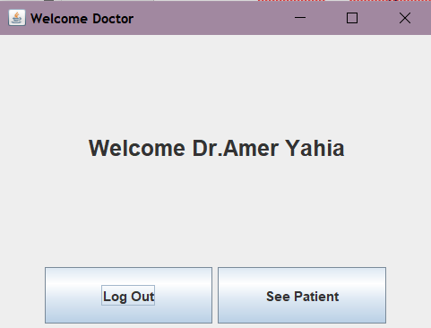
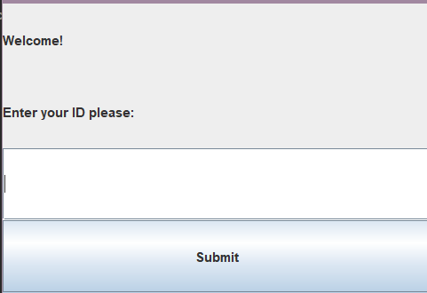
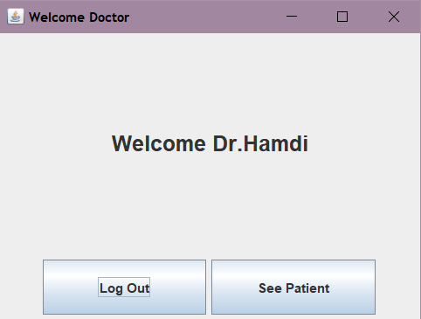
Login System
Nurse: Assigned ID 3333
Doctor 1: Assigned ID 1111
Doctor 2: Assigned ID 2222
Upon login, users are prompted to enter their ID. Based on the ID entered, the system determines whether the user is a nurse or a doctor, granting access to role-specific features.
1- Doctor login
before
Doctor 1: ID 1111
Doctor 2: ID 2222

Slide 7
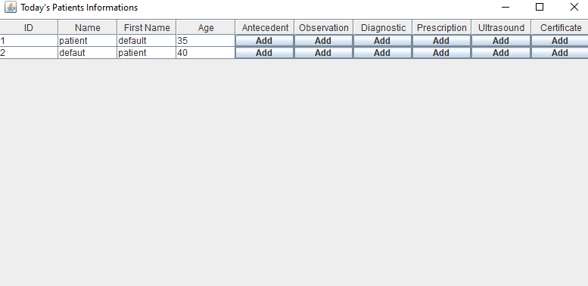
Doctor Features:
Patient Information Access:
Doctors have access to patient details collected by nurses.
They can review and update patient records as necessary.
Observation and Prescription:
Doctors can add observations, prescribe medications, and optionally issue certificates
This interface allows for detailed input, including medication dosage and additional notes.

Slide 8
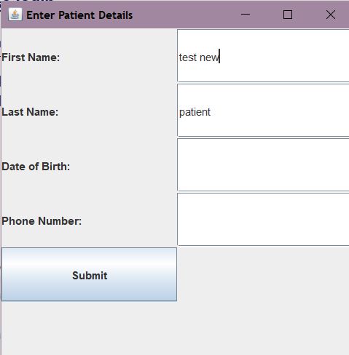
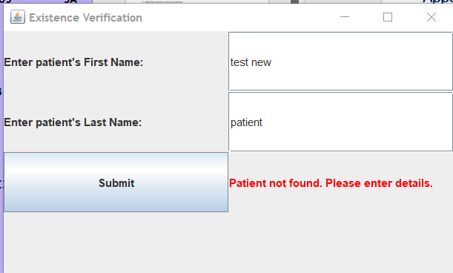
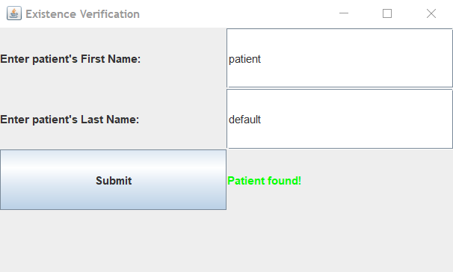
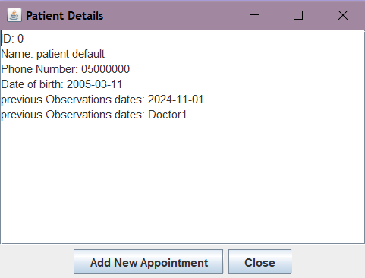
2- Nurse login
Appointment Scheduling:
The nurse can schedule appointments for patients.
Patient details are collected, including name,
last name, and birthdate.
Example : new patient
If the patient is a returning visitor, their existing details are displayed for confirmation.
Example : patient default :

Slide 9
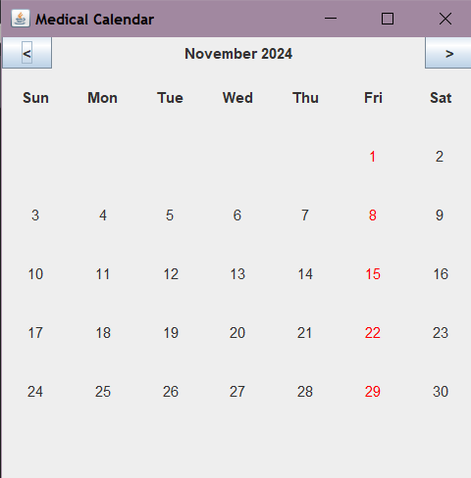
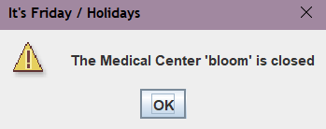
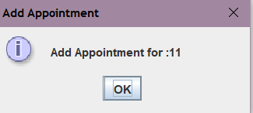
Doctor Selection:
After logging in as a nurse, the nurse will be prompted to choose a doctor from a list (doctor 1 or doctor 2
Appointment Creation: After selecting the doctor:
Calendar View:
The calendar should display available days and a botton to add an appointment there, unless :
Booked Days: These days should be marked as unavailable for appointments.
Non-Working Days: These should be automatically blocked out to prevent scheduling on days when the cabinet is closed (e.g., holidays or office hours).
Weekends
Day Selection: When a day is selected, the nurse will be shown the
available time slots. If a day is full, it will be clearly marked to avoid
confusion.
Confirmation: After selecting the appropriate day and time, a confirmation
screen can display the appointment details before final submission.

Slide 10
- THANK YOU -
Notes:
Photo by rawpixel on Unsplash

